Slide 1
Microsoft 365 Business Central Introduction
(ERP=Microsoft Dynamics 365 Business Central)
Ing.J.Skorkovský,CSc.
Department of Business Management
Faculty of Business and Administration
Masaryk University Brno
Czech Republic

Slide 2
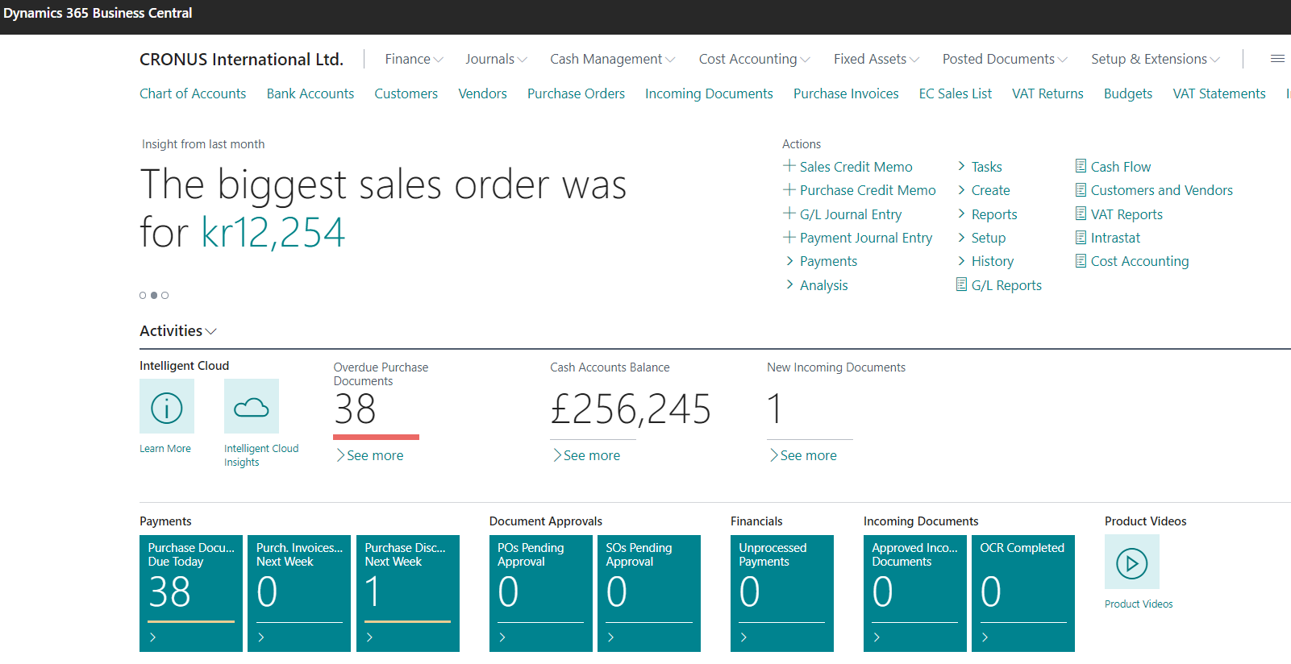
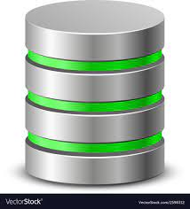
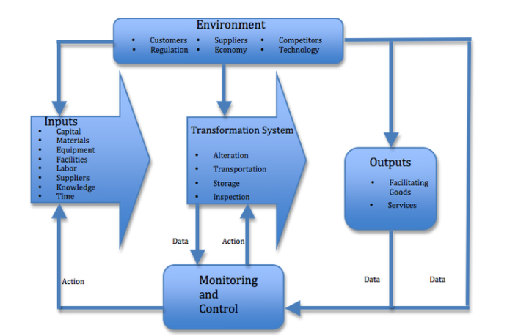
Principles
Data
Management philosophy
Information technology
Feedback

Slide 3
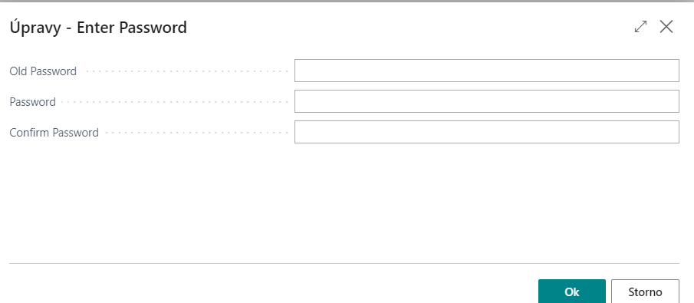
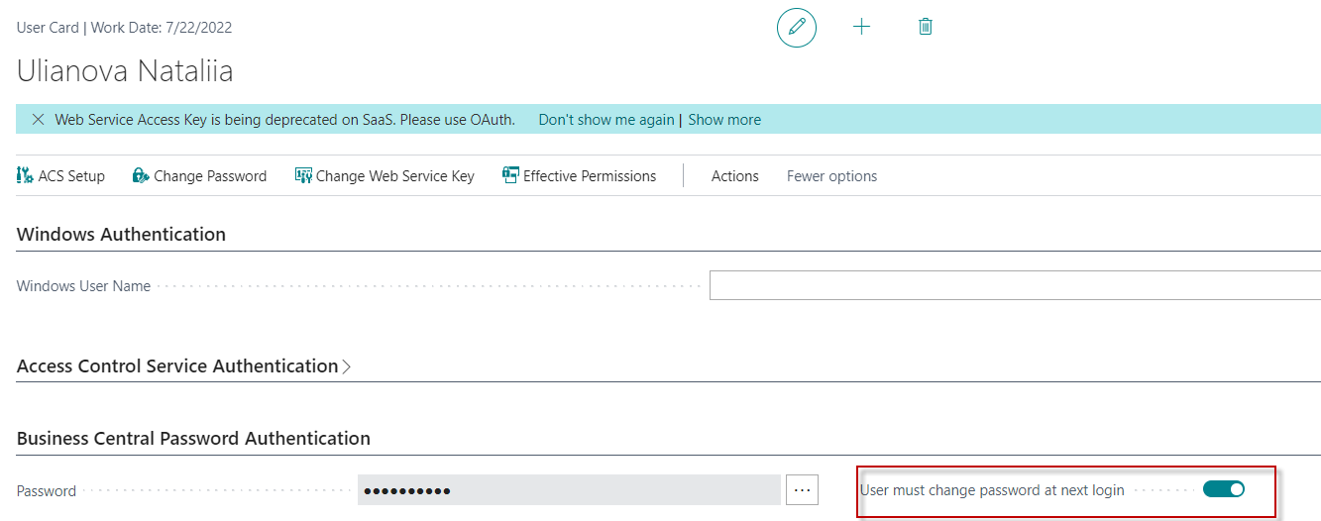
Access to BC
Your real UČO
Password1
secondary password
secondary password
https://dynamics-esf.ucn.muni.cz/514441
User name = UČO and 1st Password=Password1
The prime password for everyone (students only) is Password1 and then after login you need to enter a new password created by you. Use for instance your secondary password. Or, for sake of simplicity and speed of access, use the simplest alternative, which I recommend. 8 positions, one capital letter, one number and one special character easily found on a Czech keyboard such as * or + or %. It's faster.
Due to the user setting, you must have to enter a new password the first time you enter your ID and preset prime password=Password1.
After 1st login you will be asked to change this prime password to your unique password , in our course it will be secondary password.
Next logins will be always : ID= UČO and PSW= Student Secondary Password or your new created password (as simple as possible pls)

Slide 4
Remote Access from your PC at home
If you are connected to the faculty network, then you only use one of these this links
  https://dynamics-esf.ucn.muni.cz/514441
If you are connected to a different network, then you must install the MUNI VPN on your computers (see instructions at the link provided below and a brief description of the procedure in this presentation ) and then access Business Central using either the same link as the one used if connected to ESF net or by use of eduVPN.
Access to the server is now possible only from the MU network. Access from other networks (from home or abroad) will now only be possible when using MUNI VPN.
Installation on Winows

Slide 5
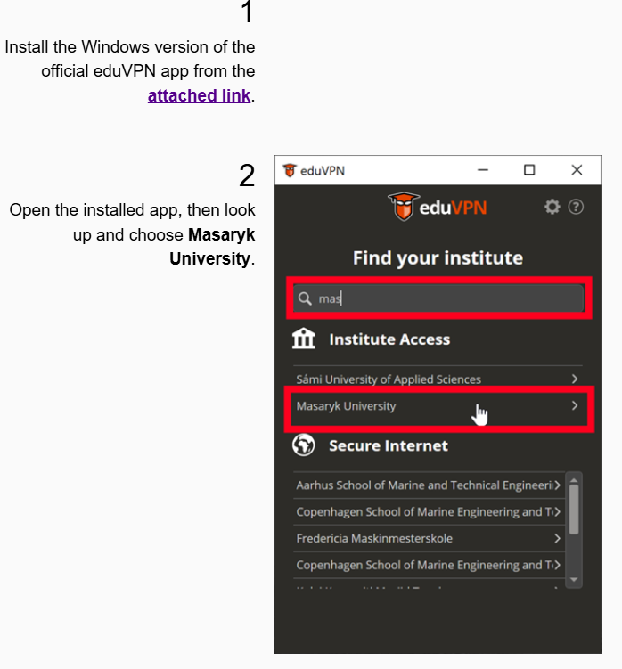

Slide 6


