Slide 1
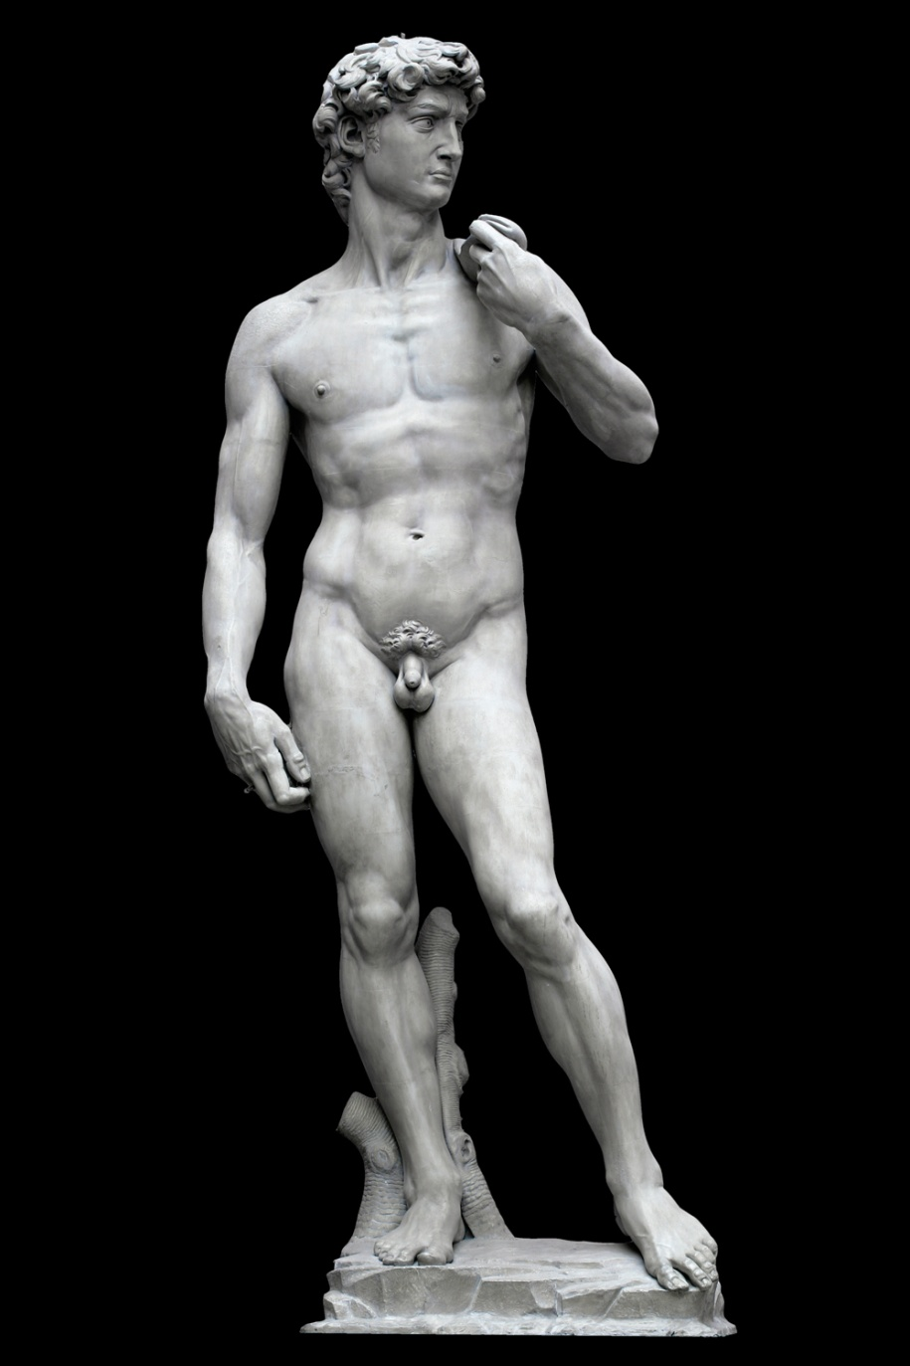
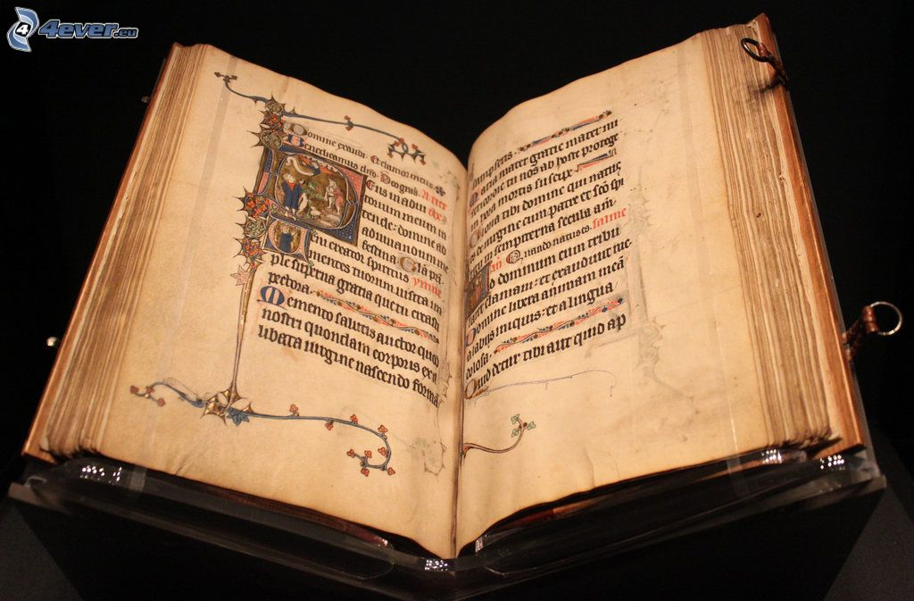
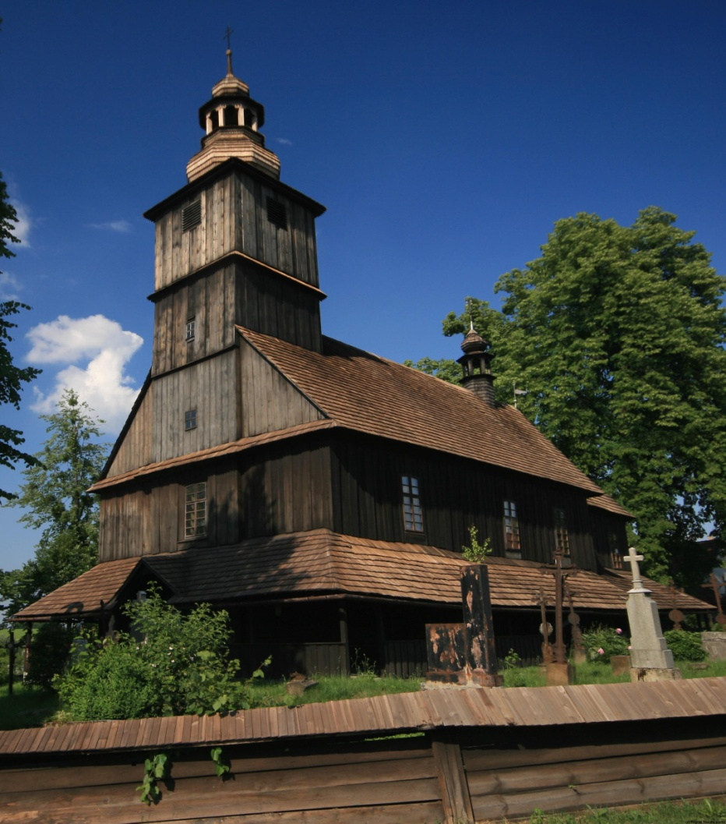
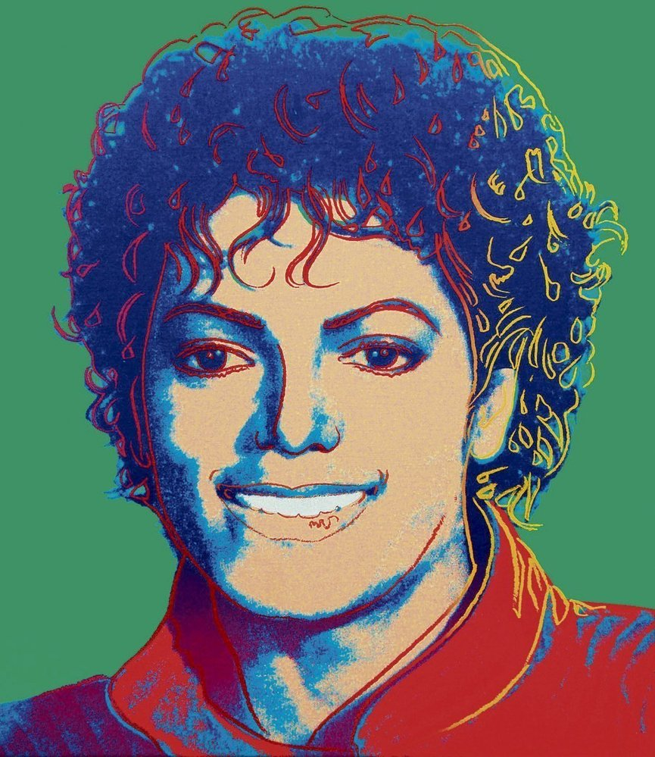
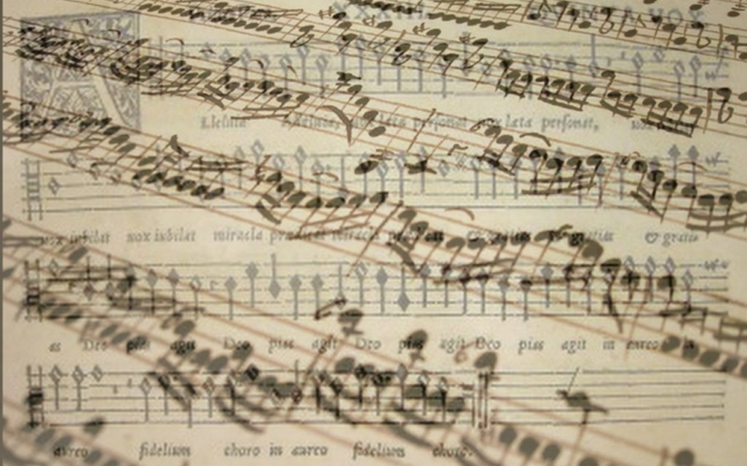
Economy of culture

Slide 2
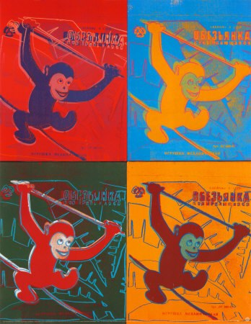
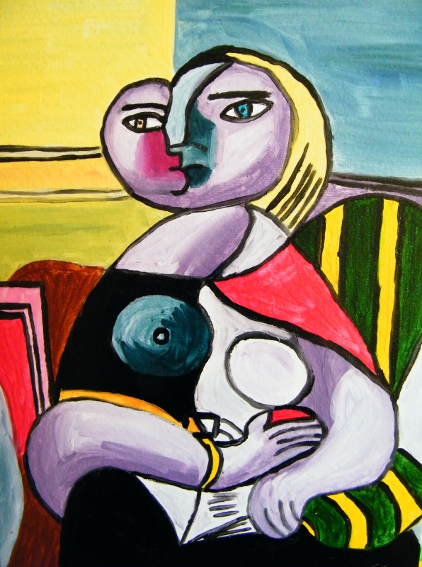
1.Find definition of culture

Slide 3
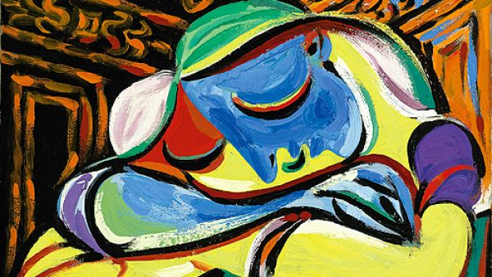
Definition of culture
„the arts and other manifestations of human intellectual achievement regarded collectively“ (Oxford dictionary)
"[Culture] is that complex whole which includes knowledge, beliefs, arts, morals, laws, customs, and any other capabilities and habits acquired by [a human] as a member of society.„ (UNESCO)
An international debate centered in UNESCO (United Nations Educational, Scientific, and Cultural Organization) since 1960s
Term cultural heritage

Slide 4
2. International cultural differences

Slide 5
Cultural differences
Dress up
Food
Music
Housing
Habits
…..

Slide 6
Roots of cultural differences
Historical
Geographic
Religious
Politicals
…..

Slide 7
3. What is a cultural good and cultural service?

Slide 8
cultural goods and cultural services
Ballet
Opera
Orchestras
Heritage
Museums
Publishing
Cinema
Television
Broadcasting
Music
Visual arts(architecture, design, crafts, etc.)
Festivals
…

Slide 9
How could we sort cultural goods and services?
Cultural heritage (goods and services)
Tangible x Intangible
Tangible cultural heritage:
movable cultural heritage (paintings, sculptures, coins, manuscripts)
immovable cultural heritage (monuments, archaeological sites, and so on)
underwater cultural heritage (shipwrecks, underwater ruins and cities)
Intangible cultural heritage: oral traditions, performing arts, rituals
Natural heritage: natural sites with cultural aspects such as cultural landscapes, physical, biological or geological formations
Durable vs. Exist in particular time (castle vs. concert)

Slide 10
4. WHAT DOES TERM HIGH CULTURE MEAN?

Slide 11
High culture
High culture:
„ This is the culture of the elite and usually refers to artistic endeavors such as music, dance, theater, certain writing, architecture, etc.“[CCSU]
The artistic entertainment and material artifacts associated with a society's aristocracy or most learned members, usually requiring significant education to be appreciated or highly skilled labor to be produced. [Your dictionary]

Slide 12
High culture
Motivation:
Achievement of catharsis
mental cleansing, mystical purification of the soul from all sensual,
Uplifting of the spirit
To show social status
Escape from the real world

Slide 13
5. WHAT DOES TERM POPULAR CULTURE MEAN?

Slide 14
Popular culture
Popular culture (also „pop culture“)
Culture based on the tastes of ordinary people rather than an educated elite. [oxford dictionary]
music, TV, cinema, books, etc. That are popular and enjoyed by ordinary people, rather than experts or very educated people [Cambridge dictionary]

Slide 15
Popular culture
Motivation:
Possibility of social interaction
Escape from the real world
Have a fun

Slide 16
How wage affect attendance in events

Slide 17
6. What is Baumol's cost disease?

Slide 18
Baumol´s cost disease
Phenomenon described by Bauml and Bowen in the 1960s
Rise of salaries of musicians without productivity changes
Rise of wages in automobile factory X in opera

Slide 19
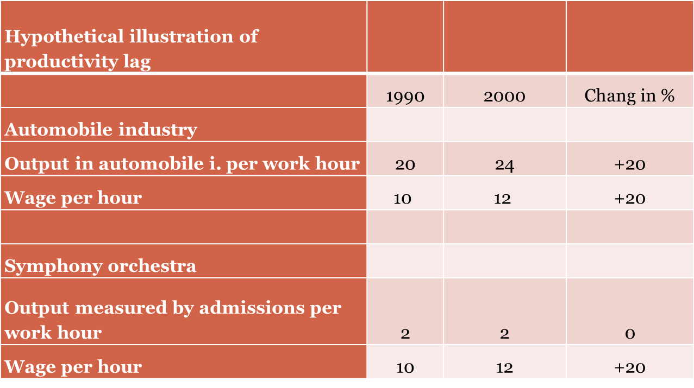
Baumol´s cost disease

Slide 20
Baumol´s cost disease
Weakness of theory:
Modern technology influence the productivity of culture
Past: composers wrote score by hand
Now: composers use PC programs to wrote a score
Past: painters mixed colors by themselves
Now: painters can buy any color shade
Delivery of cultural products
More people are able to consume cultural products and services because of modern technologies
Records
Pictures of paintings
Virtual visit of galleries etc.

Slide 21
How could we measure productivity in culture?
It doesn't exist single index for all culture branches
What is used
Number of (play, paintings, songs, etc.) per month?
Problem: How to measure quality of product?
Profit
Problem: Popular vs. Traditional art
Film industry vs. Opera->film industry is in general self-sufficient. Opera cannot exist without state support

Slide 22
How could we increase production in culture?
Motivate artist (How?)
According Baumol´s cost disease increasing of wages doesn't mean increasing of productivity
Have more artist? (what about quality)

Slide 23
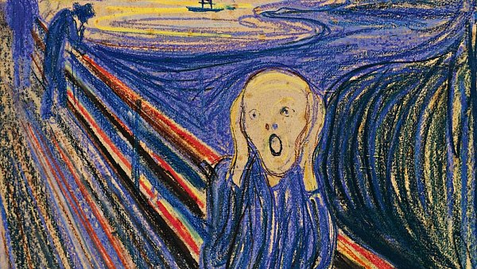
7. International organizations which focused on culture

Slide 24
International organizations which focused on culture
UNESCO – United Nations Educational, Scientific and Cultural Organization
https://en.unesco.org/
ITI –International Theatre Institution
https://www.iti-worldwide.org/iti.html
ASEMUS – Asia Europe Museum Network
http://asemus.museum/

Slide 25
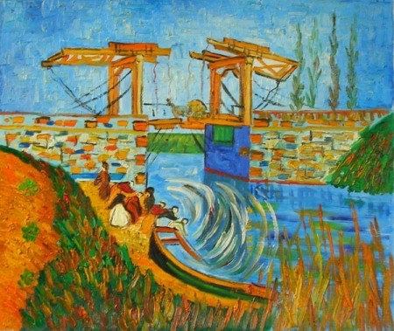
8. What is the EU's role in the culture area?

Slide 26
EU's role in the culture area
Article 167 of Treaty on the functioning of the European union
„The Union shall contribute to the flowering of the cultures of the Member States, while respecting their national and regional diversity and at the same time bringing the common cultural heritage to the fore.“

Slide 27
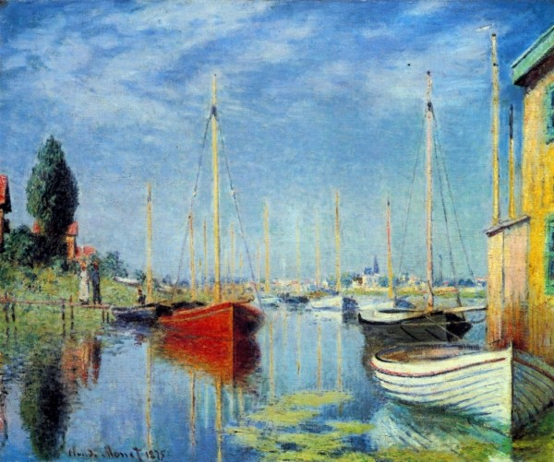
9. Find three examples of European union’s activities, which are connecting with culture

Slide 28
Examples of cultural activities of EU
The European Capitals of Culture initiative is designed to:
Highlight the richness and diversity of cultures in Europe
Celebrate the cultural features Europeans share
Increase European citizens' sense of belonging to a common cultural area
Foster the contribution of culture to the development of cities

Slide 29
Examples of cultural activities of EU
Voices of Culture ‒ Structured Dialogue between the European Commission and the cultural sector
„provides a framework for discussions between EU civil society stakeholders and the European Commission“

Slide 30
Examples of cultural activities of EU
The European Culture Forum
„The European Culture Forum is a biennial flagship event organized by the European Commission, aimed at raising the profile of European cultural cooperation, uniting the sector's key players, taking stock the European Agenda for Culture's implementation, and sparking debate on EU culture policy and initiatives“

Slide 31
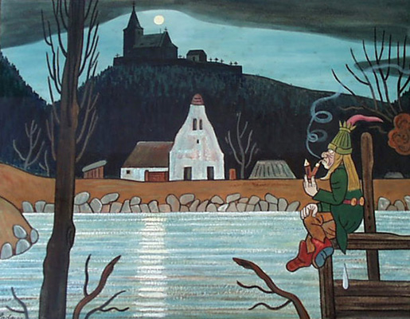
Conclusion

Slide 32
Conclusion
Culture
„manifestations of human intellectual achievement“
„product of human creativity“
Roots of cultural difference comes from
History
Geography
Religion
Product of culture is good, service, knowledge or identity
According economic theory has culture positive externality
Productivity in culture is highly limited and in long term condition is constant, but the wages are increasing (according Baumol's cost disease)
Role of EU in field of culture is „ flowering of the cultures of the Member States“

Slide 33
Use full links
http://www.unesco.org/new/en/social-and-human-sciences/themes/international-migration/glossary/cultural-diversity/
http://ec.europa.eu/eurostat/statistics-explained/index.php/Quality_of_life_in_Europe_-_facts_and_views_-_leisure_and_social_relations
http://eur-lex.europa.eu/legal-content/EN/TXT/PDF/?uri=CELEX:12012E/TXT&from=en#page=75&zoom=100&view=FitB
http://www.lisbon-treaty.org/wcm/the-lisbon-treaty/treaty-on-the-functioning-of-the-european-union-and-comments/part-3-union-policies-and-internal-actions/title-xiii-culture/455-article-167.html
https://ec.europa.eu/programmes/creative-europe/actions/capitals-culture_en
http://www.voiceofculture.eu/
http://ec.europa.eu/culture/forum/index_en.htm

