Slide 1
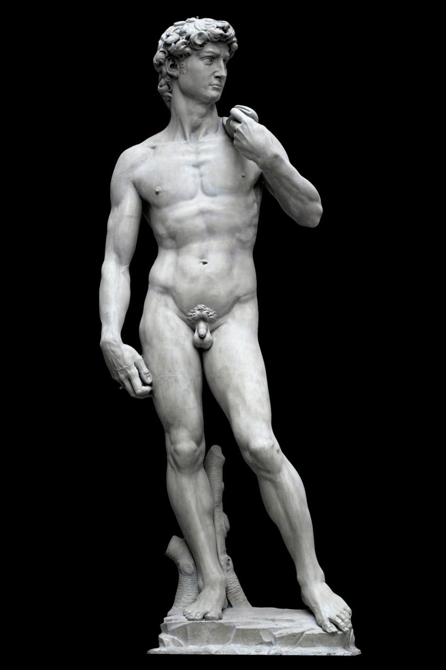
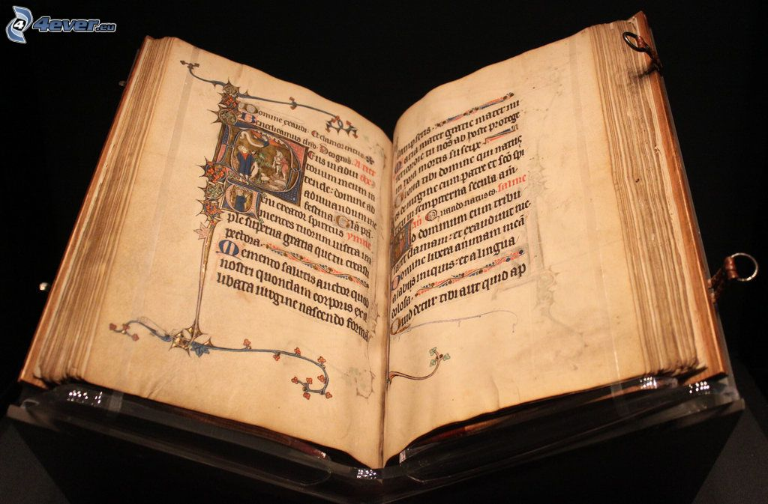



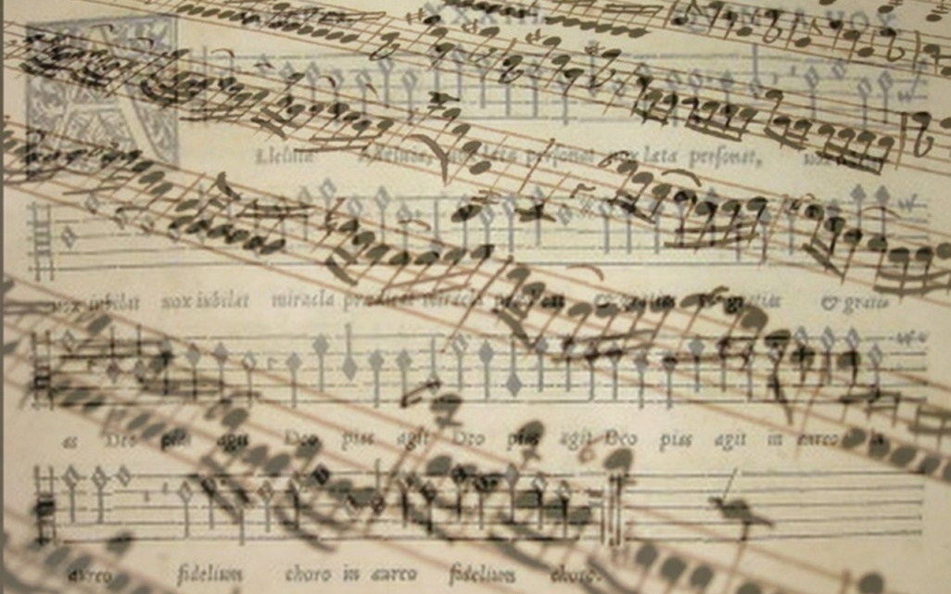
Investment in culture

Slide 2

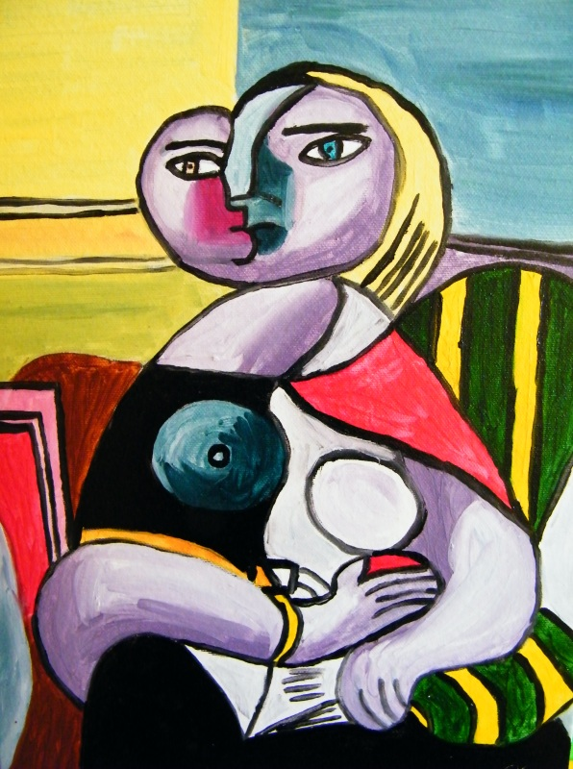

1. investment

Slide 3
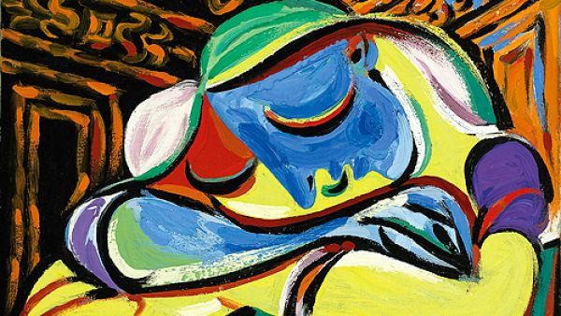

Investment
Term investment
Definitions:
  „the action or process of investing money for profit “(Oxford dictionary)
  „the act of putting money, effort, time, etc. into something to make a profit or get an advantage, or the money, effort, time, etc.“ (Cambridge dictionary)

Slide 4
2. Liquidity

Slide 5
Liquidity
Term liquidity
Definitions:
  „Liquidity refers to the ease with which an asset, or security, can be converted into ready cash without affecting its market price“(Investopedia)
  „the fact of being available in the form of money, rather than investments or property, or of being able to be changed into money easily“ (Cambridge dictionary)

Slide 6
Liquidity
Liquidity of culture goods
In general the culture goods has low liquidity
  The time between the decision of capitalization the culture good and real sell can be affected by:
    Physical characteristics of culture good (size, weight, material…)
    Specific market (specific group of buyers)
    Time to care about the culture good and its valuation by professionals

Slide 7
3. SALES METHODS

Slide 8
Sales methods of culture goods and services
Direct sale
Commission sale
Auction
….

Slide 9
Sales methods of culture goods and services
Primary market
      Culture goods are sold by artists
        Production for potential buyers
        Culture goods and services are created on the basis of current demand
  Secondary market
      Culture goods are sold by owners
        Market with culture goods that have been produced in past and are sold again

Slide 10
4. AUCTIONS

Slide 11
English auction
Most common form of auction
Price starts low and increases as buyers bid for the item
  Until one buyer is left willing to pay a certain amount and a higher bid isn't received during the given time period
The auction is overseen by an auctioneer who announces prices and makes sure all bidders have the opportunity to increase the price

Slide 12
Dutch auction
An auction process where the auctioneer or seller starts with a high asking price
Type of auction in which the price of an item is lowered until it gets a bid
  First bit win
Relict of auction of tulip in Dutch
  In general perishable goods

Slide 13
Envelopment auction
Bids are submit in envelopments
Bids aren't known for others buyers
  Motivation for giving higher bids
Highest bid win

Slide 14
Vickrey auction
Bidders submit written bids without knowing the bid of the other people in the auction
The highest bidder wins
The price paid is the second-highest bid
  Motivation for giving higher bids

Slide 15
5. FINAL AUCTION PRICE

Slide 16
Final auction price
Hammer price
  The winning bid for a lot at auction. It is the price upon which the auctioneer’s hammer falls, determining the sale price, but does not include the buyer's premium
Buyers premium
  The amount above the hammer price that is paid as part of the total purchase price
  Often between 5 % -25 % of hammer price
Sale price
  Total price which consist hammer price and buyers premium
Sellers commission
  A commission paid by the consignor to the auction house, which is deducted from the hammer price

Slide 17
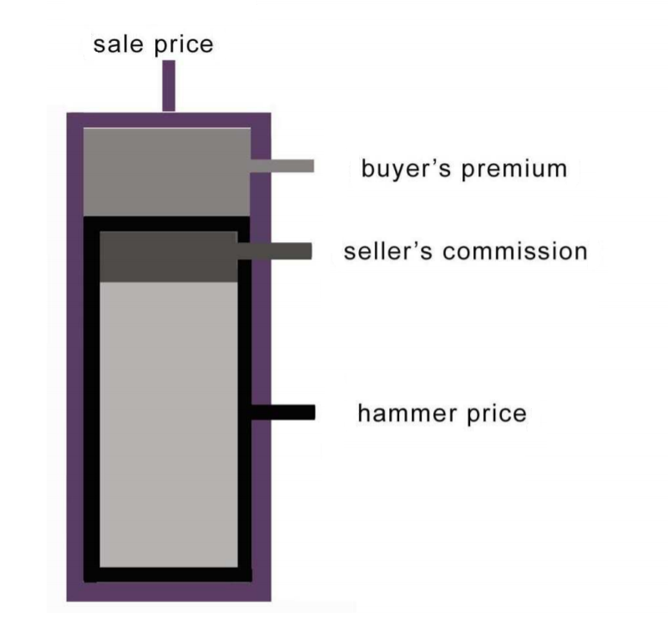
Final auction price
source: Hasoňová, S.,2010.

Slide 18
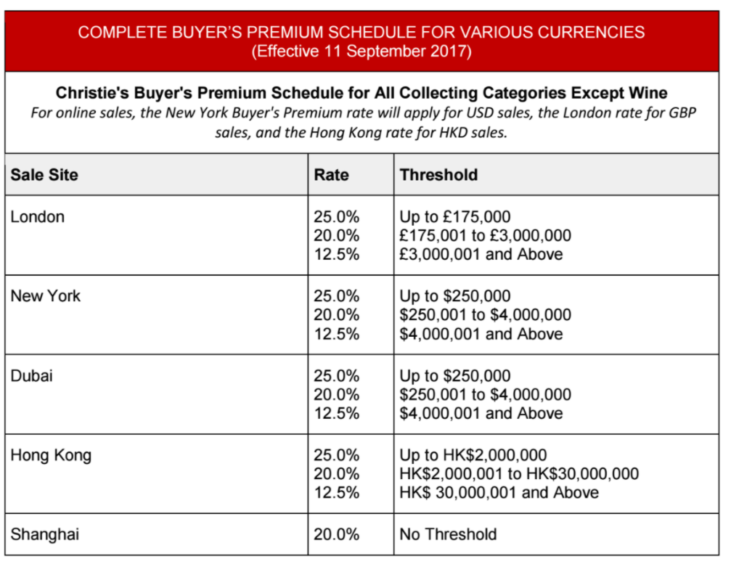
Final auction price

Slide 19
6. AUCTION IN THE WORLD

Slide 20
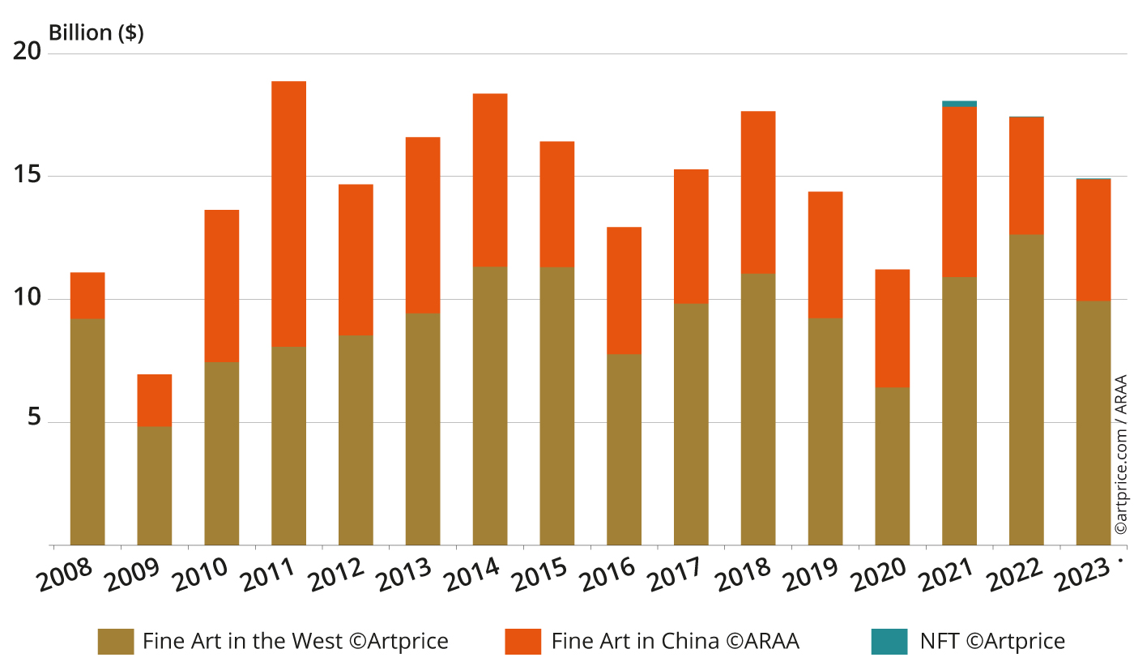
Turnover and sales (in billion $)

Slide 21
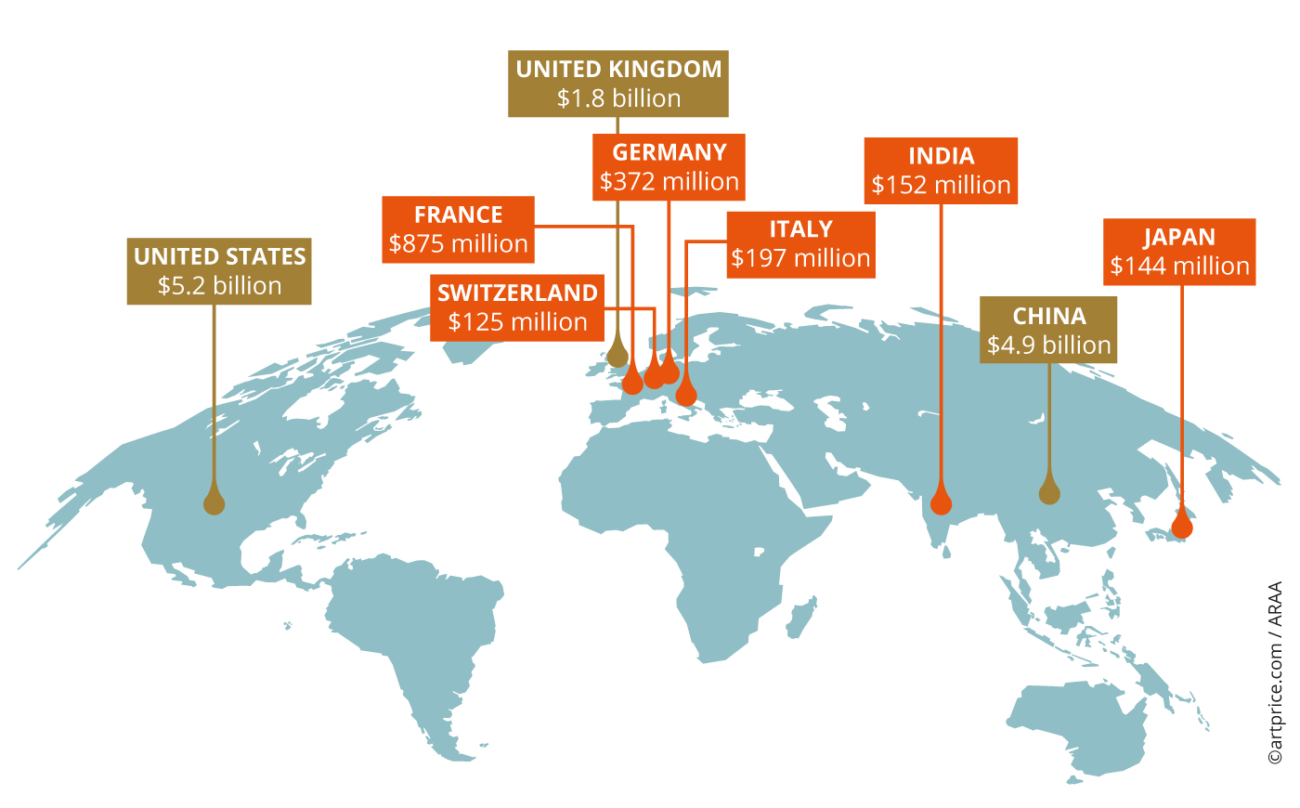
Turnover and market share in auctions

Slide 22
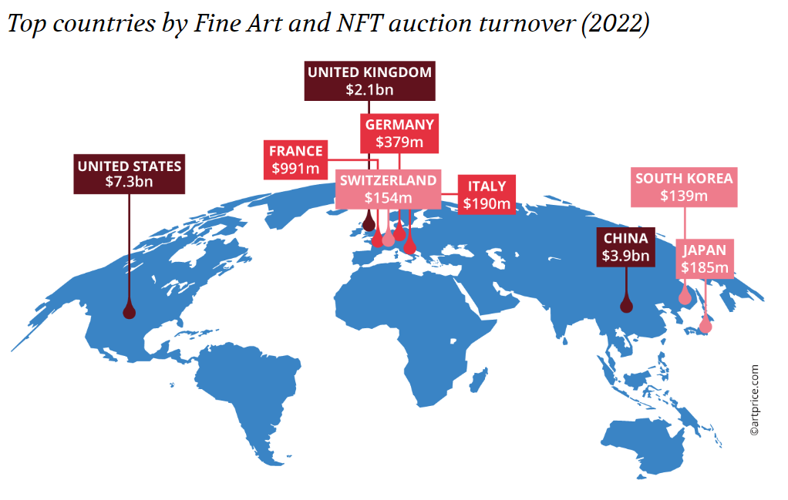
Turnover and market share in auctions

Slide 23
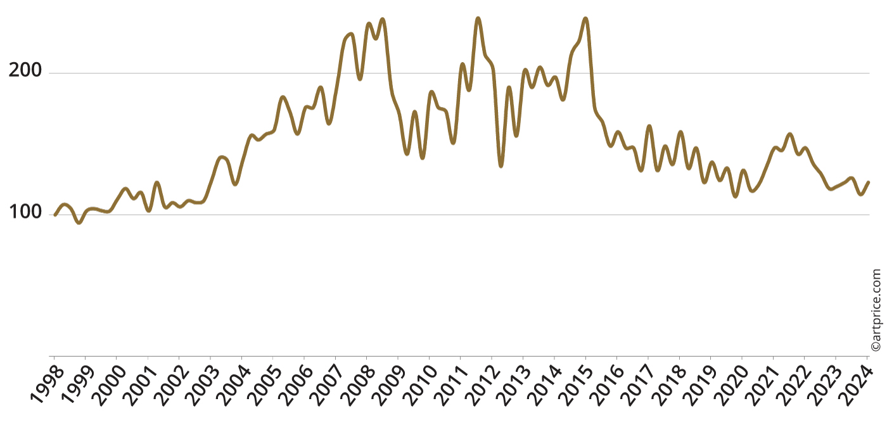
Quarterly evolution of the overall auction price index (TA)

Slide 24
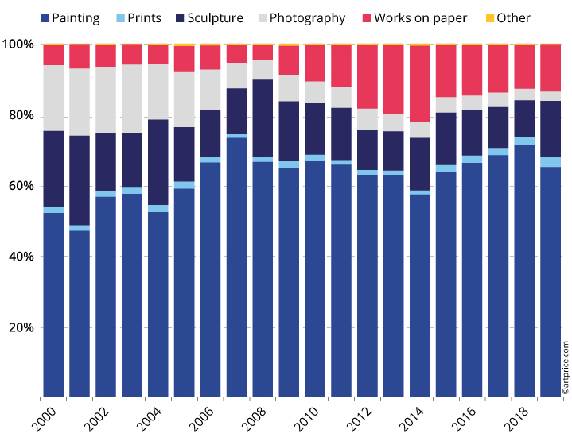
Goods sold in auction according categories

Slide 25
7. Investment in culture

Slide 26
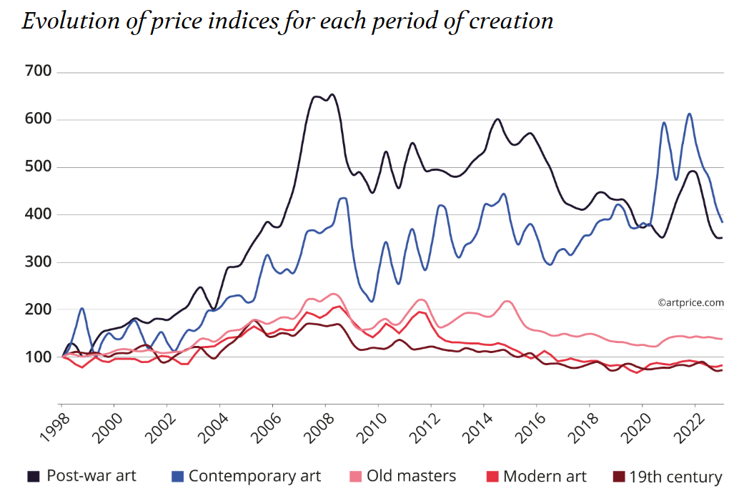
Investment in culture goods in USA

Slide 27
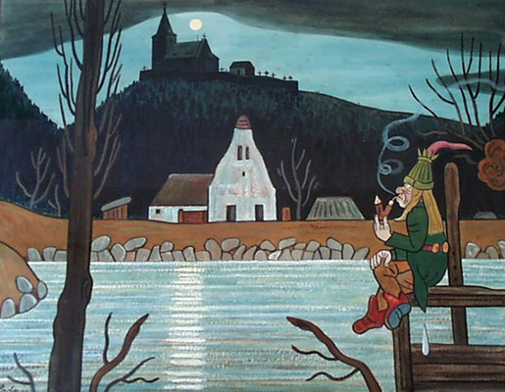
Conclusion

Slide 28
Conclusion
Investment in culture goods is specific kind of investment
  In general it is long term investment
Profitability of investment depend on the characteristics of culture good
  Durability of culture goods (material, age, condition,…)
Culture goods has low liquidity
  Because of
    Specific of objects
    Specifics of market
    Specific of sales method
Auction is popular kind of sales method of culture goods
  It exists several types of auctions
  In auction is not the hammer price the final price for buyers and sellers

Slide 29

Use full links
  https://www.artprice.com/

