Slide 1
MPV_COMA Communication and Managerial Skills Training
Lecture 1: Basic Communication Skills
Jan Řezáč

Slide 2
Agenda
Information about the course
Course requirements
Introduction
Communication process
Asking the right question
How to be a better listener
How to give feedback
All presentations and teaching materials are uploaded in IS
https://is.muni.cz/auth/el/econ/jaro2022/MPV_COMA/um/seminars/
MPV_COMA Communication and Managerial Skills Training

Slide 3
Course objectives
To provide you with basic knowledge of effective communication in management and, by using training methods, to develop your communication and managerial skills
No prior knowledge required
Topics of all six lectures and seminars:
  Basic skills
  Non-verbal communication + Assertiveness
  Presentation skills
  Teamwork
  YOUR Presentations
  Negotiation
Skills of a good manager
Coma topics
Coma topics
Coma topics
Coma topics
MPV_COMA Communication and Managerial Skills Training

Slide 4
Lectures and seminars, timing and calendar
3 lectures (other dates in reserve), 3 hours each (theoretically split in 2)
12:00 – 13:30 Lecture 1, 13:30 – 15:00 Lecture 2
6 seminars, 3 hours each
Seminars are mandatory
For seminars, make sure you can actively participate
All communication by email
MPV_COMA Communication and Managerial Skills Training

Slide 5
In case of COVID
You need to follow the standard guidelines
In case in-person teaching is not possible:
  All classes move to online mode
  At the exactly same time
  Keep your camera on
  You still need to actively participate
  Everything is recorded
  Exams
MPV_COMA Communication and Managerial Skills Training

Slide 6
Schedule
Lectures: 24.2., 10.3., 24.3., 12:00--15:50, room S309
Lectures not mandatory
Seminars: 25.2., 11.3., 25.3., 8.4., 25.4., 6.5., 12:00--15:50, room S309
Seminars mandatory
Changes are possible, and will be announced by email
Other lecture and seminar days in reserve
MPV_COMA Communication and Managerial Skills Training

Slide 7
Course requirements – how do you pass this class
1) Attendance at seminars (85%)
Maximum - missing only two seminars (out of six)
One more reminder – seminars work only with your active participation.
Do not worry about getting the answers wrong, or not having perfect English. Your work in the class helps both you and your classmates.
MPV_COMA Communication and Managerial Skills Training

Slide 8
Course requirements – how do you pass this class
2) Presentation at the seminar
  A professional presentation with a clear aim to give information or to persuade
  Three steps
  23rd of March – deadline to choose topic in IS - There will be an IS option provided where you mark down your topic and goal before the presentation
  8th of April – short verbal description of your presentation goal and sources at the seminar
  6th of May – The actual presentation
MPV_COMA Communication and Managerial Skills Training

Slide 9
Course requirements
3) Test (minimum level of knowledge 60%)
theoretical knowledge
assessing practical communication skills (via practical examples, correcting wrong statements, etc.)
Abc and open ended questions
Assessment criteria:
  quantity and quality of theoretical knowledge
  understanding theory
  ability to apply gained knowledge
  extent of the development of relevant skills
MPV_COMA Communication and Managerial Skills Training

Slide 10
Study materials
Materials provided on lectures (presentations)
Seminars (presentations and exercises)
Learning texts:
Communication process
Effective verbal communication
Basic communication skills
https://is.muni.cz/auth/el/econ/jaro2022/MPV_COMA/um/68157015/?lang=en
MPV_COMA Communication and Managerial Skills Training

Slide 11
Further readings in pdf
E-book_I_Effective-Communication-Skills
E-book_II_Business-Communication
E-book_III_Assertiveness
E-book_IV_Dealing_with_conflict_ and_complaints
https://is.muni.cz/auth/el/econ/jaro2022/MPV_COMA/um/68157015/?lang=en
MPV_COMA Communication and Managerial Skills Training

Slide 12
How do you improve your communication skills?
Learning is hard. Learning soft skills (like presentation skills and negotiation) is even more hard.
What are some common good ways to learn new skills? Music, math, language?
How is it different when learning soft skills and difficult conversations? Salary negotiation, handling of criticism, asking for a promotion?
MPV_COMA Communication and Managerial Skills Training

Slide 13
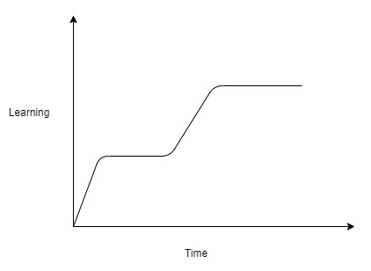

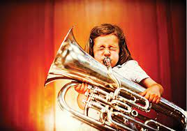

How do you improve your communication skills?
Plateau
Practice is hard to get by for soft skills.
Passive reading of materials does not provide many benefits.
MPV_COMA Communication and Managerial Skills Training

Slide 14
How do you improve your communication skills?
Extremely important part of learning is having somebody teaching you, who gives good feedback, meaning:
      Closely observes you;
      Identifies areas of improvement;
      Breaks big tasks into smaller pieces;
      Suggests changes;
      Monitors progress.
  All this is for soft skills extremely rare in the world outside of seminars.
MPV_COMA Communication and Managerial Skills Training

Slide 15
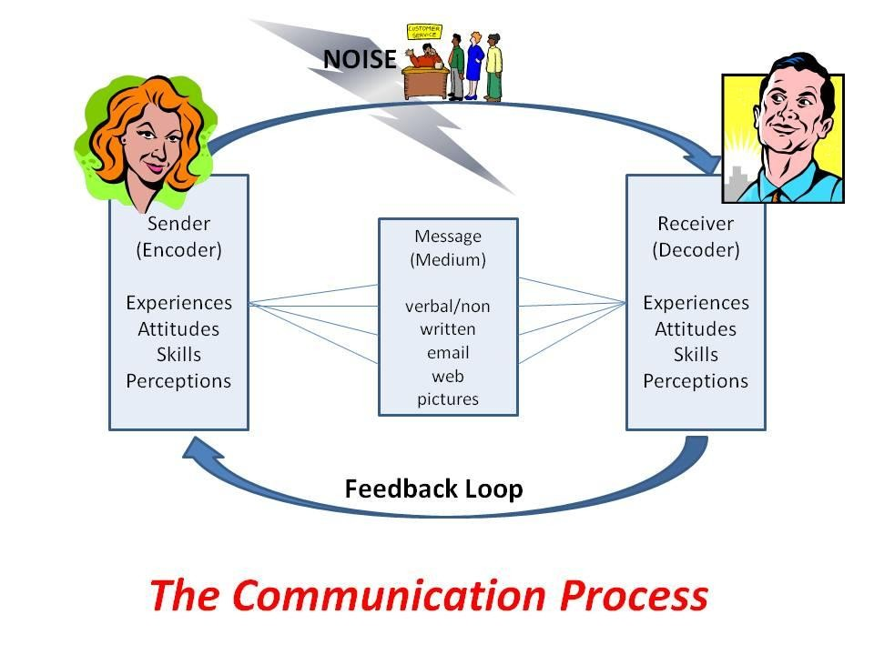
Communication process
To understand something, you have to go into bigger detail (granularity).
To improve your ideas with others, you need to share the same vocabulary.
By seeing communication as steps, it is easier to spot errors.
MPV_COMA Communication and Managerial Skills Training

Slide 16


Communication process – encoding and decoding
There are multiple names about the actual actions behind encoding and decoding
Mental models, belief system, framework of your mind, set of experiences…
My favourite is the operating system of your mind – balanced importance, variation and changeability
MPV_COMA Communication and Managerial Skills Training

Slide 17
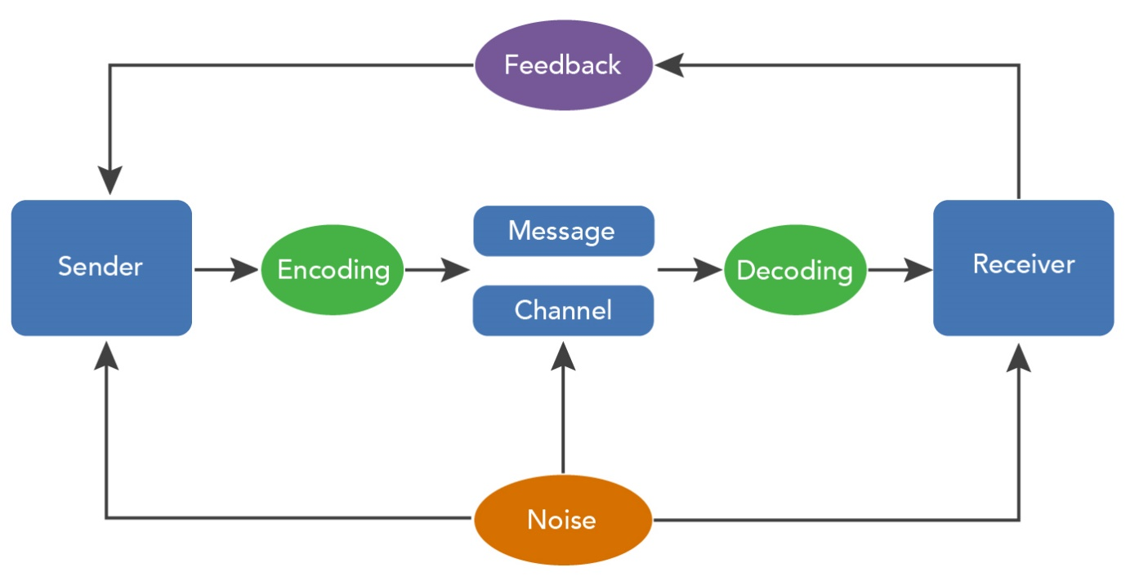
Communication process – example. Cultural differences?
Sender wants to apologize, and believes that words are important (saying “Sorry”). Receiver wants to accept an apology, and believes gestures and tone of voice are important.
Sender encodes the apology as “Sorry”, in a flat tone of voice. This “Sorry” is decoded as insincere by Receiver, because it lacks emotion.
MPV_COMA Communication and Managerial Skills Training

Slide 18
Communication process – cultural differences?
Culture (just like gender, age or wealth) differences exist, but they are much less significant than people expect.
We have a tendency to see gaps and split our world into two separate groups. But differences of people within the groups are bigger than differences between the group averages, proven by both observations, surveys and brain scans.
Donot treat people differently because you think they belong in a certain group. Rather be explicit (use clear words) in the way you communicate.
MPV_COMA Communication and Managerial Skills Training

Slide 19

Communication process – how to solve differences
As a manager, you have to be able to listen before making judgements
You will meet people from very diverse background.
Being persistent in questions and getting a full picture are valuable skills.
MPV_COMA Communication and Managerial Skills Training

Slide 20
What is involved in verbal communication?
Only words?
MPV_COMA Communication and Managerial Skills Training

Slide 21
What is involved in verbal communication?
Only words?
Intonation
Dialect/jargon
Mistakes
Pauses
Quality of speech
Accent
What other forms of communication do you know?
MPV_COMA Communication and Managerial Skills Training

Slide 22
What is involved in verbal communication?
Only words?
Intonation
Dialect/jargon
Mistakes
Pauses
Quality of speech
Accent
What other forms of communication do you know? Non verbal, signals (morse code), traffic sign, mafia symbols
MPV_COMA Communication and Managerial Skills Training

Slide 23
Pillars of effective communication - context
Communication is influenced by:
  Time
  Space
  The importance of the topic for both communicators
  Presence of emotions
  Relationship between communicators
  Situational frame
  Continuity
MPV_COMA Communication and Managerial Skills Training

Slide 24
Outcome of communication
Level: pure exchange of information, matter of fact.
Level: relationship status
  their attitude to the agenda they are talking about;
  attitude towards the person they are talking to;
  attitude towards themselves;
  current feelings.
MPV_COMA Communication and Managerial Skills Training

Slide 25
Pillars of effective communication - Listening
To be heard, you need to hear others.
Good listening skills are invaluable for many leadership positions.
Listening can be considered a skill to be mastered.
MPV_COMA Communication and Managerial Skills Training

Slide 26

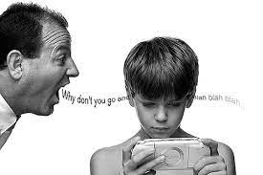
The art of listening
Listening means effort towards understanding, not only hearing
Passive listening – just accepting the voice signals without any effort to understand them ad decode them, does not involve the context and situation
Active listening - sensitive perception of the partner, connected with empathy, sympathy, the context and nonverbal behaviour is taken into account
MPV_COMA Communication and Managerial Skills Training

Slide 27
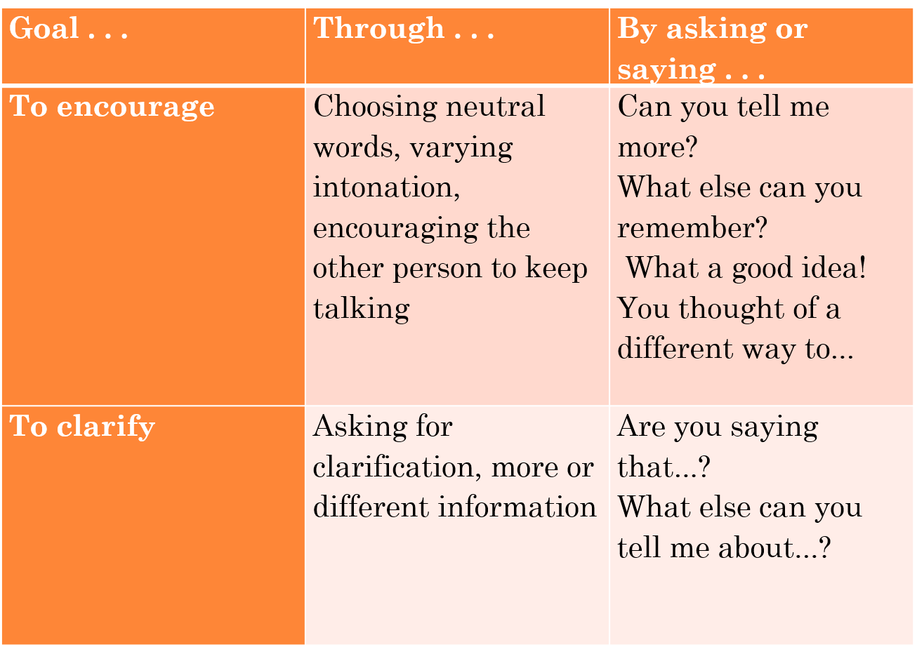
The art of listening
MPV_COMA Communication and Managerial Skills Training

Slide 28
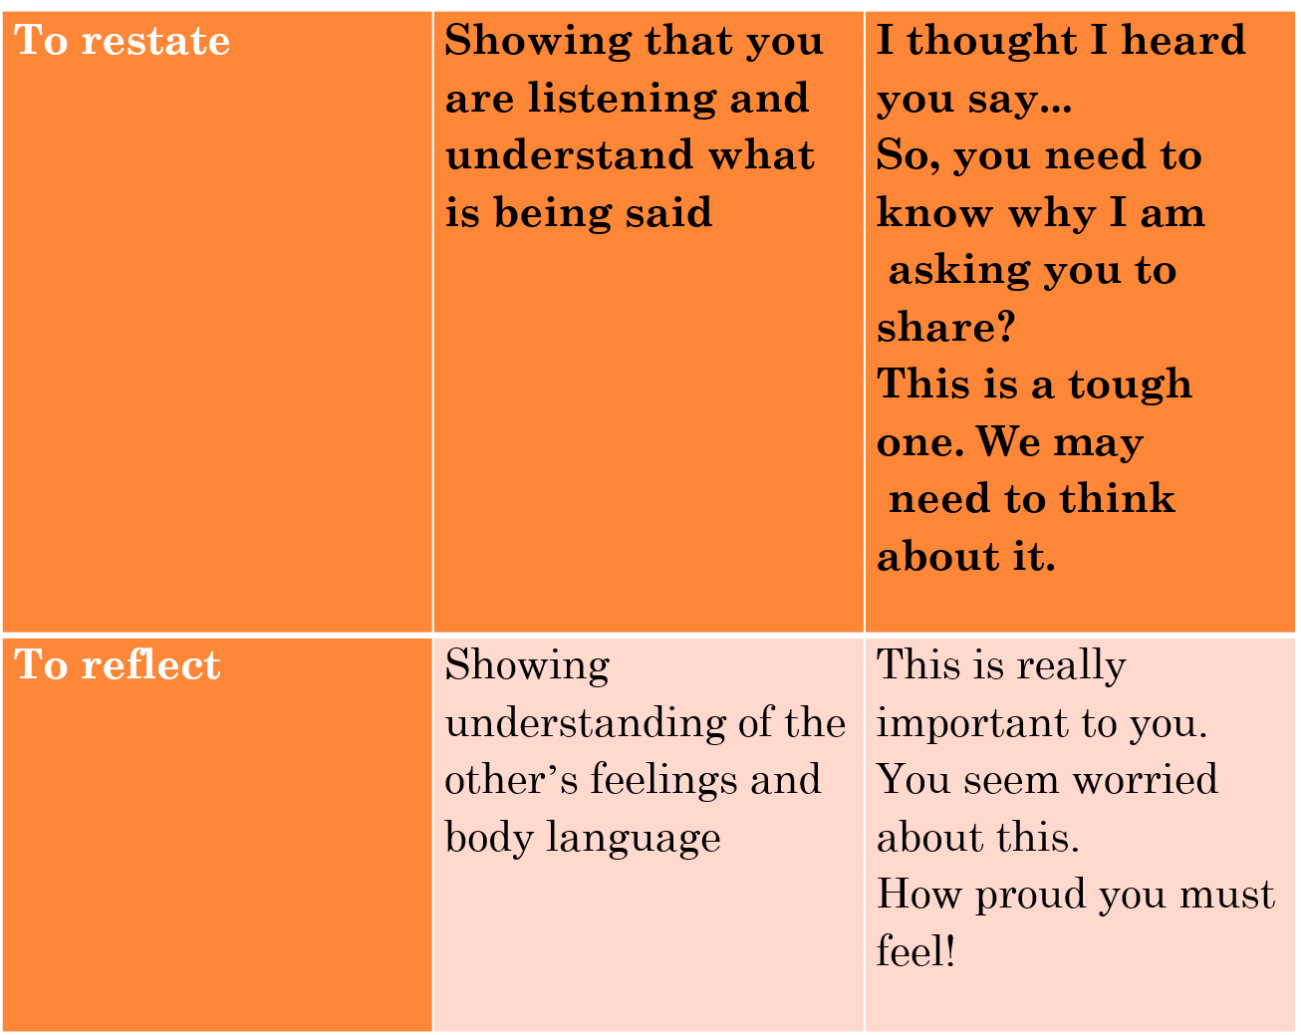
MPV_COMA Communication and Managerial Skills Training

Slide 29
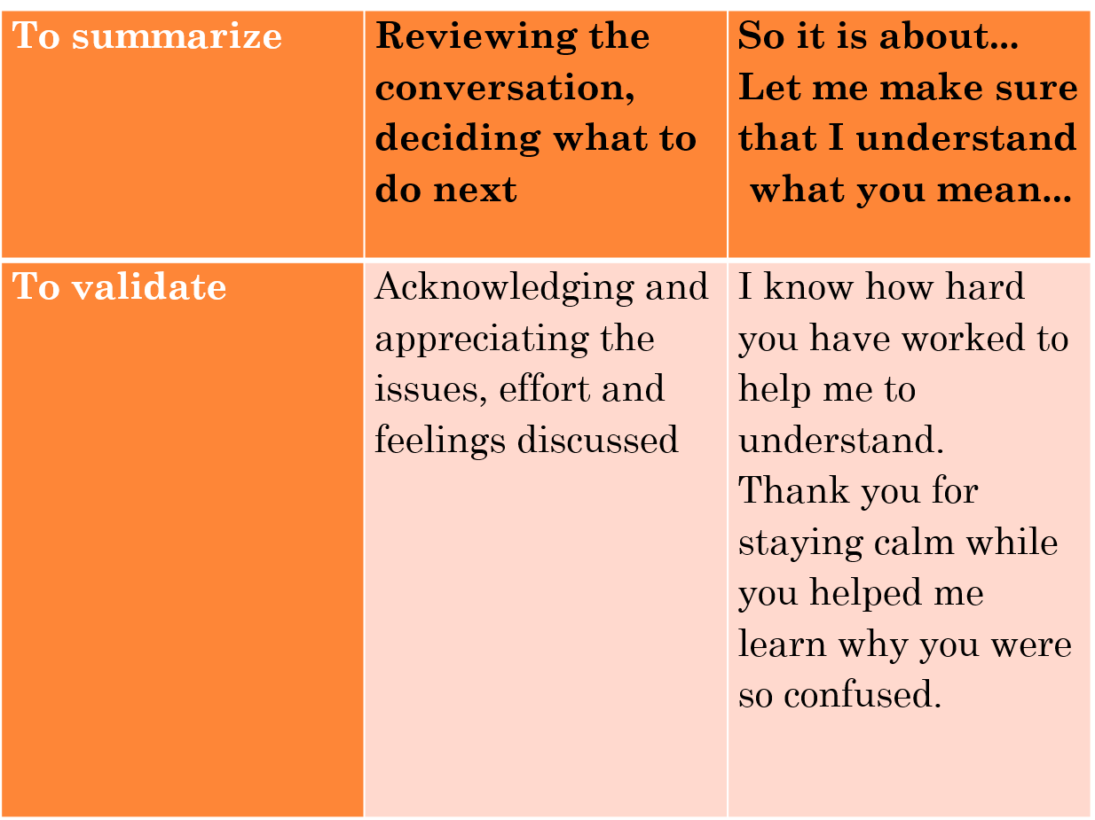
MPV_COMA Communication and Managerial Skills Training

Slide 30
Open-ended and close-ended questions
Closed-ended questions can be answered with “Yes” or “No,” or they have a limited set of possible answers
Open-ended questions are questions that allow someone to give a free-form answer.
MPV_COMA Communication and Managerial Skills Training

Slide 31
Discussion
Which are easier?
Which are more effective to gain information?
MPV_COMA Communication and Managerial Skills Training

Slide 32
Open ended and close-ended questions
  Open-ended questions: "what", "how", "why“.
  Open-ended questions are very useful when:
    you need to gain maximum information, especially about a conversation subject you are not much familiar with;
    you need to create a good atmosphere and build rapport;
    you do not know your communication partner and for a successful negotiation you need to learn about their character as much as possible.
  Generally, open-ended questions are mainly suitable at the beginning of a meeting.
MPV_COMA Communication and Managerial Skills Training

Slide 33
Pillars of effective communication - feedback
Observe the reaction of the listener
Pay attention to the level of interest/no interest of the audience
Request specific feedback from people with insight
Adjust the content and form to your audience
MPV_COMA Communication and Managerial Skills Training

Slide 34
Ideal feedback
Looking in the mirror in an unbiased way

Slide 35
Self
awareness
Why do we give and
receive feedback
Development
Learning
Breaking
a
pattern

Slide 36
Feedback structure
1.Observation
2. Effect
3. Reaction
  Behaviour?
  Specific and detailed description of what was observed
  How did it come across?
  Which effect did it have?
  What feeling did it give you?
  Were you aware?
  What is your opinion?
  Future?

Slide 37
Feedback rules
Giving feedback:
Stay subjective! What you think is an opinion, not a fact. „I think that...“
Stay specific! Say what happened and when, so the person can learn.
Stay positive! Helps best to say, what can be improved instead of what went wrong.
Show respect. Like a mirror, more than an advisor
Getting feedback:
Let people finish talking
Try to understand
There is no need to defend yourself

Slide 38
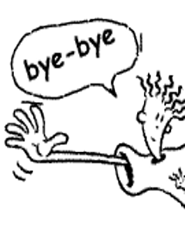
Thank you for your attention
MPV_COMA Communication and Managerial Skills Training

