Slide 1
MPV_COMA Communication and Managerial Skills Training
Seminar 1: Basic Communication Skills
Jan Řezáč

Slide 2
Agenda for today
Information about the course
Course requirements
Introduction
Communication process
Asking the right question
How to be a better listener
All presentations and teaching materials are uploaded in IS
https://is.muni.cz/auth/el/econ/jaro2025/MPV_COMA/um/seminars/
MPV_COMA Communication and Managerial Skills Training

Slide 3
Course objectives
How to have difficult conversations better.
To provide you with a basic knowledge of effective communication in management and, by using training methods, to develop your communication and managerial skills
No prior knowledge required. Only basic English level needed.
Expect to both learn the sophisticated vocabulary of managers and how to structure your words in an extremely clear way for better understanding.
MPV_COMA Communication and Managerial Skills Training

Slide 4
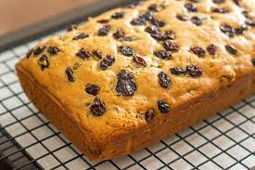
Course topics of the six lectures and seminars:
  Only limited number of topics with high focus and a lot of allocated time for each topic (like raisins in a raisin cake)
  Seminars:
  Intro + Basic communication skills
  Non-verbal communication + Assertiveness
  Presentation skills
  Teamwork
  YOUR Presentations
  Negotiation
All the skills of a good manager
Coma topic
Coma topic
Coma topic
Coma topic
MPV_COMA Communication and Managerial Skills Training

Slide 5
English level & Asking questions
  The one skill which helps you most and is covered here only implicitly is your English language ability.
  You are not directly benefiting here. But it is recommended you keep improving, even enroll in additional classes.
  It helps to know the management jargon:
  "By deploying agile methods and fostering interdisciplinary collaboration, we strive to boost efficiency and adaptability in response to market dynamics.”
  In this class if you hear a word you do not understand, ask.
  There is no other way. Ask any time, simply raise your hand. You are probably not alone in not knowing.
MPV_COMA Communication and Managerial Skills Training

Slide 6
Lectures and seminars timing
3 lectures (other dates in reserve), 3 hours each (theoretically split in 2)
6 seminars, 3 hours each
Seminars are mandatory
For seminars, make sure you can actively participate
All additional communication by email
MPV_COMA Communication and Managerial Skills Training

Slide 7
Schedule
Lectures not mandatory
Seminars mandatory
Changes are possible, and will be announced by email
Other lecture and seminar days in reserve
Usually shorter break and shorter overall seminar, based on teachers assessment
MPV_COMA Communication and Managerial Skills Training

Slide 8
Schedule – why you should attend lectures
  Reasonably short and hopefully enjoyable,
  Lectures give clarity and depth for your seminar work
  It might also incline your teacher to give you a helping hand in case you might need it
MPV_COMA Communication and Managerial Skills Training

Slide 9
In the case of COVID or other emergencies
You need to follow the standard guidelines and requirements to finish the course
In case in-person teaching is not possible:
  All classes move to online mode (MS Teams)
  At the exactly same time as in-person classes
  Keep your camera on
  You still need to actively participate
  Everything is recorded
  Exams online
MPV_COMA Communication and Managerial Skills Training

Slide 10
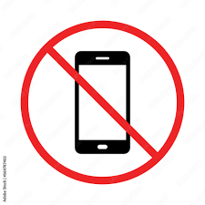

Course requirements – how do you pass this class
1) Attendance at seminars (85%) = Missing only one seminar out of the six
Missing more than two seminars makes it not possible to finish the class!
The seminars work only with your active participation. Be on time, use electronics only to make notes, be present mentally.
MPV_COMA Communication and Managerial Skills Training

Slide 11
Course requirements – how do you pass this class
2) Presentation at the seminar
  A presentation on a management related topic
  Brief on theory, heavy on examples and real world applications
  There will be an IS option provided at the end of this week, where you mark down your topic and goal before the presentation. An email will be sent to you.
  Three steps:
  Before Seminar 2: deadline to choose topic in IS.
  Seminar 3 – short verbal description of your presentation outline and sources at the seminar
  Seminar 5 – your actual presentation
MPV_COMA Communication and Managerial Skills Training

Slide 12
Course requirements
3) Test (minimum level of knowledge 60%)
theoretical knowledge
assessing practical communication skills (via practical examples, correcting wrong statements, etc.)
ABC and open ended questions
Assessment criteria:
  quantity and quality of theoretical knowledge
  understanding theory
  ability to apply gained knowledge
  extent of the development of relevant skills
  NOT presentation, class participation or attendance
MPV_COMA Communication and Managerial Skills Training

Slide 13
Presentation work progress
  https://is.muni.cz/auth/rozpis/tema?fakulta=1456;obdobi=9105;kod=MPV_COMA;predmet=1566953;balikto=511942;balik=511942
  Take a small amount of time to find a topic you like.
  Start browsing relevant sources – the attached material is a good start.
  Describe something useful you learned from the topic, not the topic
  Specific example & case studies are better than theoretical concepts
  Before you present, you can test the water with your outline at the seminar 3
MPV_COMA Communication and Managerial Skills Training

Slide 14
How should your presentation look like
  Based on good literature
  Clear aim and structure
  Do not try to cover the whole topic, it is designed for two people
  Included feedback from the class preparation session
  Easy to understand
  Only a short introduction: Most of the topics are known to the class already
  Cca 6 minutes in total - Be done with theory and your motivation within 5 sentences
  Your goal is to improve the lives of those who listened to you. There will be a whole COMA class to help you do the presentation properly.
MPV_COMA Communication and Managerial Skills Training

Slide 15
Study materials
Materials provided on lectures (presentations)
Seminars (presentations and exercises)
Learning texts:
Communication process
Effective verbal communication
Basic communication skills
https://is.muni.cz/auth/el/econ/jaro2022/MPV_COMA/um/68157015/?lang=en
MPV_COMA Communication and Managerial Skills Training

Slide 16
Further readings in pdf
E-book_I_Effective-Communication-Skills
E-book_II_Business-Communication
E-book_III_Assertiveness
E-book_IV_Dealing_with_conflict_ and_complaints
All these materials are in the IS
Do you have any questions?
MPV_COMA Communication and Managerial Skills Training

Slide 17
Introduce yourself
Your name and age
Where are you from
Your motivation for the course
Any previous similar courses
MPV_COMA Communication and Managerial Skills Training

Slide 18
How do you improve your communication skills?
Learning is hard. Learning soft skills (like presentation skills and negotiation) is even more hard.
What are some common good ways to learn new skills? Music, math, language?
How is it different when learning soft skills?
MPV_COMA Communication and Managerial Skills Training

Slide 19
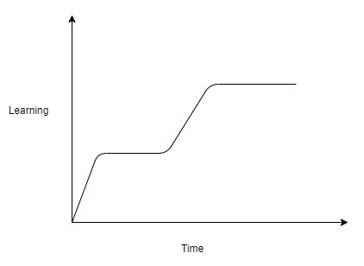

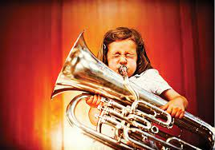

How do you improve your communication skills?
Plateau
Practice is hard to get by for soft skills.
Passive reading of materials does not provide many benefits.
MPV_COMA Communication and Managerial Skills Training

Slide 20
How do you improve your communication skills?
Extremely important part of learning is having somebody teaching you, who gives good feedback, meaning:
      Closely observes you;
      Identifies areas of improvement;
      Breaks big tasks into smaller pieces;
      Suggests changes;
      Monitors progress.
  All this is for soft skills extremely rare in the world outside seminars.
MPV_COMA Communication and Managerial Skills Training

Slide 21
General rules of effective verbal communication
Be clear and brief, listen carefully;
Give information in a logical order;
Do not forget the essential;
Adjust yourself to your partner(s).
Common knowledge, right?
But to improve, it is necessary to split the process into several steps, and study it.
MPV_COMA Communication and Managerial Skills Training

Slide 22
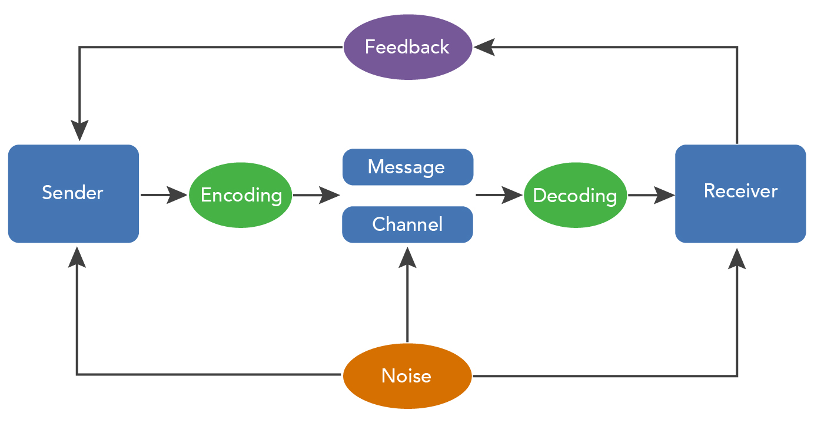
Communication process - Graph
MPV_COMA Communication and Managerial Skills Training

Slide 23
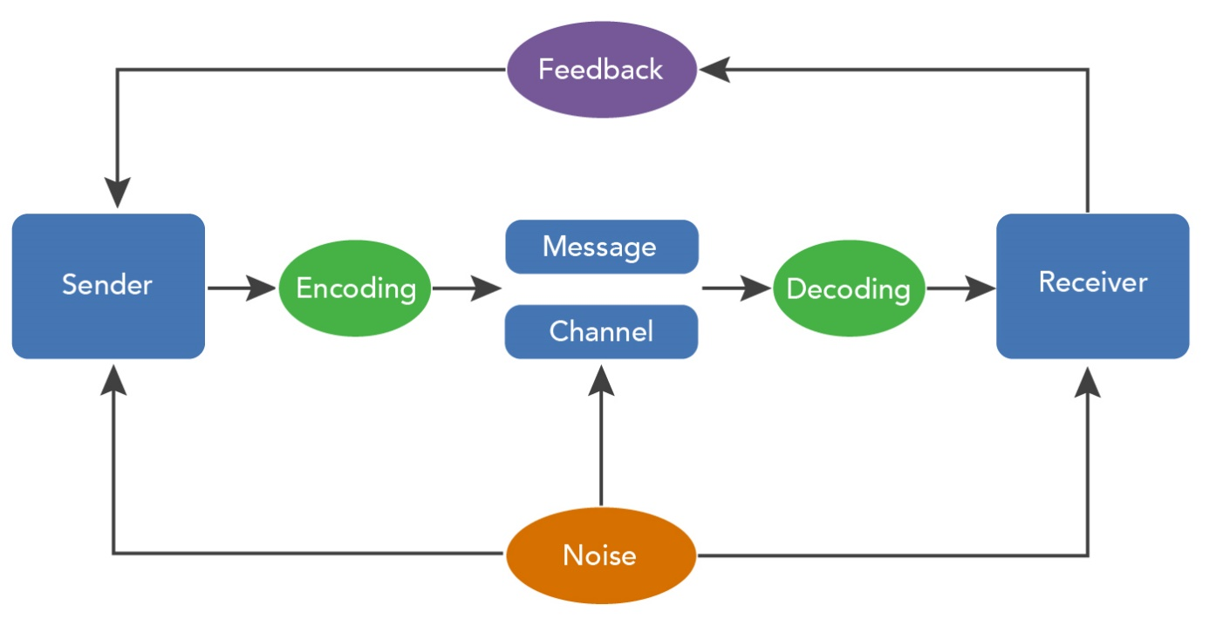
Communication process
To understand something, you have to go into bigger detail (granularity).
To improve your ideas with others, you need to share the same vocabulary.
By seeing communication as steps, it is easier to spot errors.
MPV_COMA Communication and Managerial Skills Training

Slide 24
Communication process - example
Sender wants to apologize, and believes that words are important (saying “Sorry”). Receiver wants to accept an apology, and believes gestures and tone of voice are important.
Sender encodes the apology as “Sorry”, in a flat tone of voice. This “Sorry” is decoded as insincere by Receiver, because it lacks emotion.
MPV_COMA Communication and Managerial Skills Training

Slide 25
Communication process – What happens next?
Consider the following feedback after previous conversation:
    R: “Hey Sender, I am not sure if your apology is sincere, it lacked emotions due to the flat tone of voice.”
    S: “Oh no Receiver, in my understanding the word “Sorry” is what matters. My apology is fully sincere and I am ready to prove it further.”
    R: “Glad to hear Sender! Today I learned something new. Let us move on to something more productive.”
MPV_COMA Communication and Managerial Skills Training

Slide 26
Communication process – more realistic feedback
Receiver will criticize the sender for not being sincere. Sender will feel rejected unfairly, because they gave a proper apology.
Humans do not often communicate about communication, and we are rarely prepared for others to have different standards.
We let our learned patterns guide us, which leads to more conflict.
MPV_COMA Communication and Managerial Skills Training

Slide 27
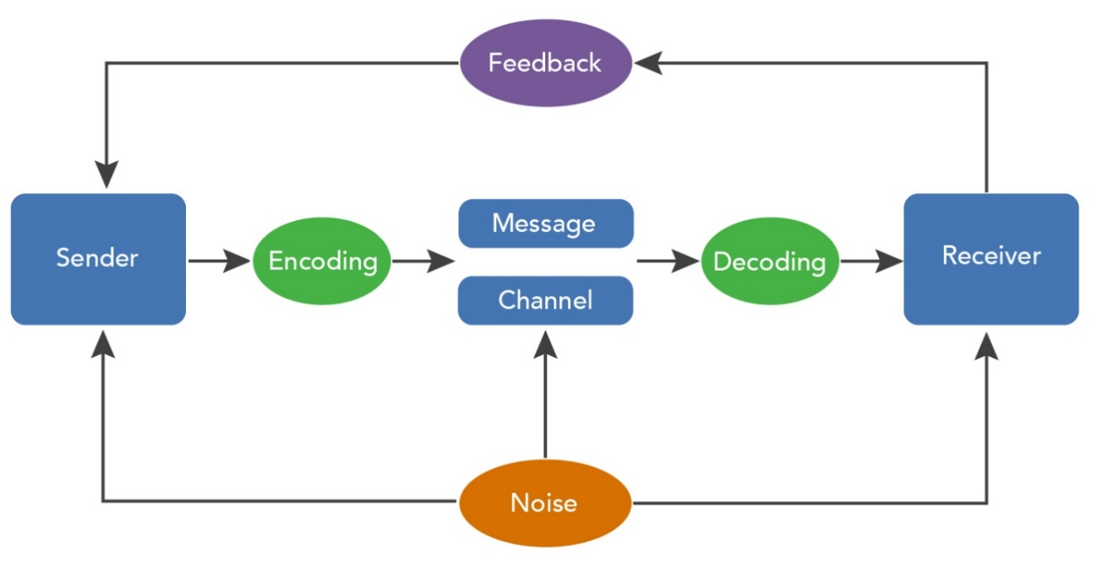
Communication process – describe steps
Manager: Hey, I need the report on the sales projections as soon as possible.
Employee: Okay, I'll get to it as soon as I can.
Later that day...
Manager: It's almost the end of the day. Where's the report?
Employee: You knew I had another deadline. I thought the end of the week is acceptable.
MPV_COMA Communication and Managerial Skills Training

Slide 28
Communication process – describe steps
Manager: Please, keep the budget for this project under control.
Employee: Sure, we will stay within company limits.
Later that day...
Manager: I haven't seen any updates on the budget. What's the status?
Employee: You knew I had another deadline. I thought the end of the week is acceptable.
MPV_COMA Communication and Managerial Skills Training

Slide 29
Exercise: Drawing picture
(One student will be drawing, and should not see the picture on the next slide.)
MPV_COMA Communication and Managerial Skills Training

Slide 30
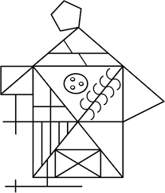

Slide 31
Exercise: Drawing picture
What was important from Sender’s viewpoint to make communication process successful?
What was important from Receiver’s viewpoint to make communication process successful?
MPV_COMA Communication and Managerial Skills Training

Slide 32
Exercise: Drawing picture
What were the difficulties in communication from the viewpoint of the speaker?
What were the difficulties in communication from the viewpoint of the listener?
MPV_COMA Communication and Managerial Skills Training

Slide 33
Exercise: From closed to open questions
Closed questions vs. Open questions
MPV_COMA Communication and Managerial Skills Training

Slide 34
Discussion
Which are easier?
Which are more effective to gain information?
MPV_COMA Communication and Managerial Skills Training

Slide 35
Exercise: Change the questions – Think about the idea/need of the sender.
Do you know the answer?
Is everything OK?
Does that work for you?
Have you done this before?
Did it act as you expected?
Do you think you would use this product?
MPV_COMA Communication and Managerial Skills Training

Slide 36
Exercise: Change the questions – Think about the idea/need of the sender.
Do you think they are capable?
Have you read the manual?
Are they only visiting?
Should I consider this proposal?
Were you taking notes?
Do you think I should start this project?
Would you use this procedure?
Can we finish without delays?
MPV_COMA Communication and Managerial Skills Training

Slide 37
Exercise: The name game
The well-known game „Who am I?“ One person thinks about someone, others in the group are guessing who.
First time: only closed-ended questions
Second time: only open-ended questions
Third time: all allowed
MPV_COMA Communication and Managerial Skills Training

Slide 38
The art of listening – stay active
Listening means to understand, not only to hear
Passive listening
Active listening
MPV_COMA Communication and Managerial Skills Training

Slide 39


The art of listening
Listening means effort towards understanding, not only hearing
Passive listening – just accepting the voice signals without any effort to understand them ad decode them, does not involve the context and situation
Active listening - sensitive perception of the partner, connected with empathy, sympathy, the context and nonverbal behaviour is taken into account
MPV_COMA Communication and Managerial Skills Training

Slide 40
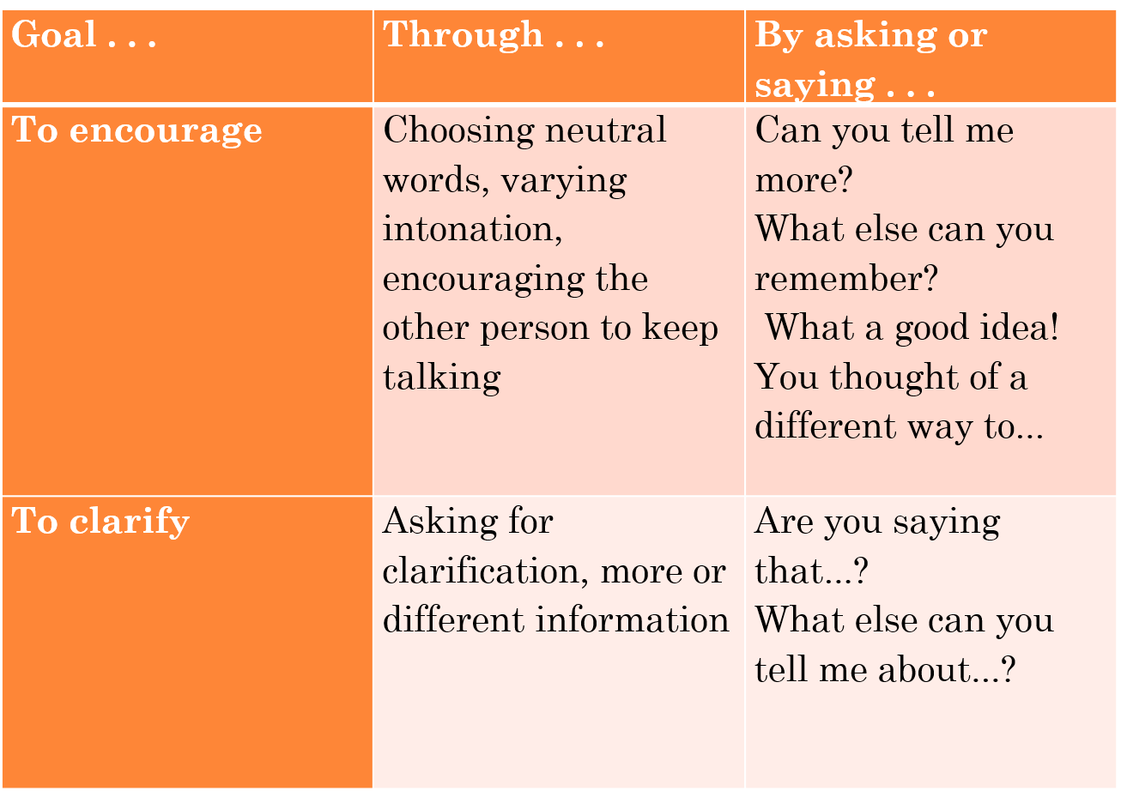
The art of listening
MPV_COMA Communication and Managerial Skills Training

Slide 41
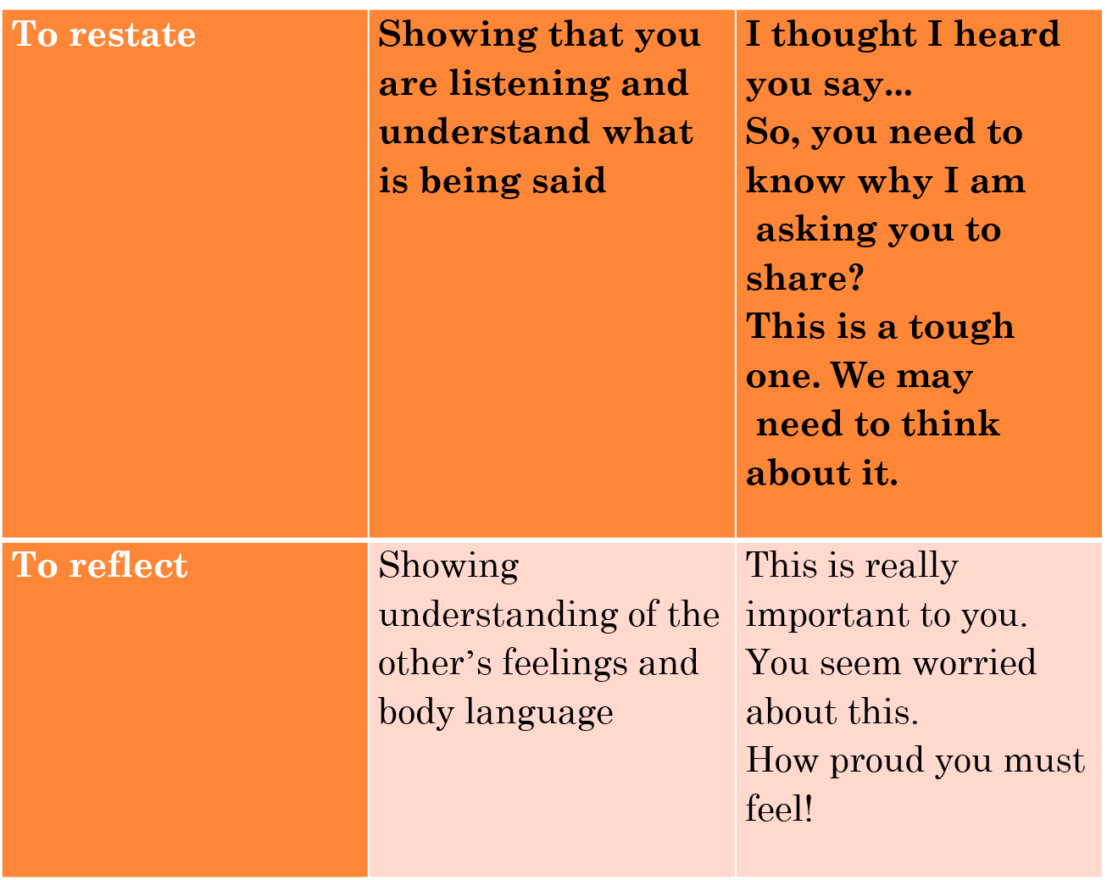
MPV_COMA Communication and Managerial Skills Training

Slide 42
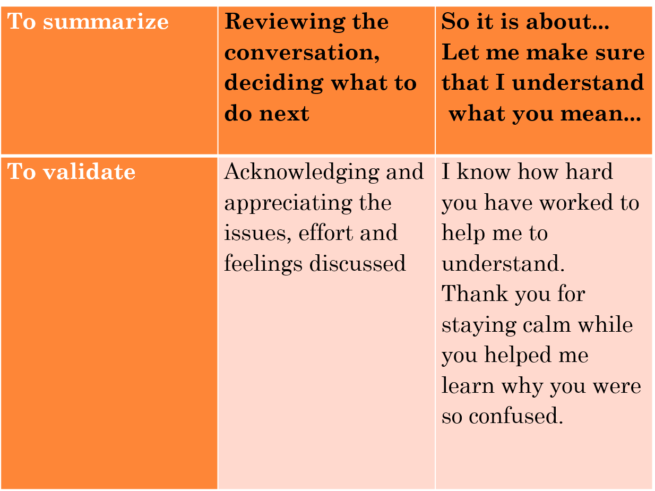
MPV_COMA Communication and Managerial Skills Training

Slide 43
Communication exercise - Just Listen
In pairs: One person is the speaker, one is the listener
STEP 1
Speaker talks for two minutes on any topic of their choosing. The listener stays completely quiet and motionless while the speaker talks, just listening instead of speaking. No questions, no nods, no „mhm“.
Switch within the pair and do the same.
After that, STEP 2:
Speaker talks for two minutes on any topic of their choosing. The listener stays tries the techniques of active listening. Switch within the pair and do the same.
MPV_COMA Communication and Managerial Skills Training

Slide 44
Communication exercise – Radical empathy
Groups of three: One person is the speaker, one is the listener, one is for support
STEP 1
Speaker talks for cca two minutes about a situation where they faced difficulty. Their partners listen.
I was unfairly attacked by my manager and…
STEP 2:
One of the previous listeners re-tells the story in the I-form as similarly as possible. Same words, same gestures, same emotions
I was unfairly attacked by my manager and…, NOT they were unfairly attacked
MPV_COMA Communication and Managerial Skills Training

Slide 45
Final exercise: The interview
Groups of three. Speaker, interviewer, feedback-giver.
Speaker: Think of scenario where it was difficult to you to communicate or when you had a conflict with someone, but you are still comfortable talking about. Talk for cca 3 minutes.
Interviewer: Help the speaker by interviewing them and get as much information as you can. Use all the small tricks we learned today – active listening, adequate questions, focus on the process etc.
Feedback giver: Observe the interaction, do not interrupt. Afterwards, try to give meaningful feedback to both.
MPV_COMA Communication and Managerial Skills Training

Slide 46
Final check:
How easy was this seminar to follow? Indicate with your hand:
Raise hand to your eye level: Everything alright.
Keep your hand down: Too easy, I am bored.
Put your hand up: Too difficult, I am drowning.
Close your eyes and show me.
MPV_COMA Communication and Managerial Skills Training

Slide 47
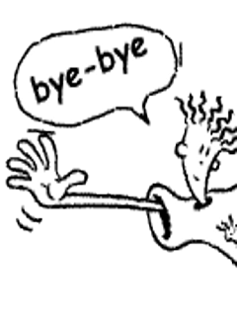
Thank you for your attention
MPV_COMA Communication and Managerial Skills Training

