Slide 1
MPV_COMA Communication and Managerial Skills Training Lecture 2: Non-verbal Communication and Assertiveness
Jan Řezáč

Slide 2
NONVERBAL COMMUNICATION
- WORDLESS SIGNALS
Skills that are intuitive – how to improve?
Goal: Making subconscious observations explicit
What are some examples of nonverbal communication?

Slide 3
NONVERBAL COMMUNICATION
- WORDLESS SIGNALS
Goal: Making subconscious observations explicit
Distance
Eye contact
Facial expressions
Tone of voice
Gestures
Posture
Physical contact
Motion & Intensity
Dress/dress code

Slide 4
DISTANCE
I. zone – private, 0 - 45 cm
Intimate communication (partners, parents and children, close friends)
II. zone – personal, 45 - 100 cm
Greetings, shaking hands, family dinner, friends at
lunch)
III. zone – social, 100 - 360 cm
Meetings in the store, shop, post office, bank, meetings, offices etc.
IV. zone – public, 360 cm and more
Lectures, theatre etc.

Slide 5
EVALUATING NONVERBAL SIGNALS
Eye contact
Is eye contact being made? If so, is it overly intense or
just right?
Facial expression
What is their face showing? Is it masklike and unexpressive, or emotionally present and filled with interest?
Tone of voice
Does their voice project warmth, confidence, and interest, or is it strained and blocked?
Posture and gesture
Are their bodies relaxed or stiff and immobile? Are
shoulders tense and raised, or slightly sloped?

Slide 6
EVALUATING NONVERBAL SIGNALS
Physical contact
Is there any physical contact? Is it appropriate to the situation? Does it make you feel uncomfortable?
Motion & Intensity
Do they seem flat, cool, and disinterested, or over-the-
top and melodramatic?
Timing and pace
Is there an easy flow of information back and forth? Do nonverbal responses come too quickly or too slowly?
Sounds
Do you hear sounds that indicate caring or concern?

Slide 7
(video - 3 Ways to Improve Your Communication Skills, Brian Tracy)
https://www.youtube.com/watch?v=D5hMN_XkPQA

Slide 8
Assertiveness (healthy way of communicating)

Slide 9
Overview
What is assertiveness?
Differences from other types of behaviour.
Practice of assertive communication.
Playing scenarios.

Slide 10
Energizer!
Split into pairs.
One of you is person B, and looks away. Person A will read the instructions.
The exercise starts when lecturer says „start“.

Slide 11
Exercise – The Fist, person A
Person B will make a fist. You MUST get that fist open.
Now look away for B to read her instructions.

Slide 12
Exercise – The Fist, person B
Make a fist. Person A is going to attempt to get you to open your fist. You must NOT open your fist unless he/she asks you politely and assertively.

Slide 13
What is your definition of Assertiveness?

Slide 14
What is your definition of Assertiveness?
Forthright, positive, insistence on the recognition of everyone's rights
Assertiveness means standing up for your personal rights - expressing thoughts, feelings and beliefs in direct, honest and appropriate ways.
By being assertive we should always respect the thoughts, feelings and beliefs of other people.
Can be contrasted with other modes of behavior – Aggressive (non-cooperative, selfish) and Passive (non-assertive, submissive)

Slide 15
Assertiveness and other modes of behavior

Slide 16
Examples
Aggressive
“I don’t know how you’ve got the nerve to give me this sort of stuff for signing. It’s full of mistakes.”
Non-Assertive
 “I know it’s probably my fault in not writing very clearly, but is there, any chance at all you could find a spare minute to just change one or two small things on this letter for me?”
Or finding an excuse to avoid talking about changes in the document.
Assertive
 “Jane, I’d like you to re-do this document as there are several mistakes in it.”

Slide 17
Assertiveness and Rights
Assertiveness can be described as a way to balance the rights of the parties involved.
A G G R E S S
Your rights more important
A S S E
N O N
I VE
R T I VE
- A S S E R T I V E
Their rights more important

Slide 18
Who should benefit in communication?
http://www.alchemyformanagers.co.uk/topics/U7FcjfSSxK3jHuCS.html

Slide 19
Exercise: Aggressive, Passive or Assertive?
Threats and intimidation
Aggressive
Never sharing your ideas
Passive
Accepting compliments comfortably
Assertive
Manipulating
Aggressive
Not saying no (when you should)
Passive
Not saying yes (when you want to)
Passive

Slide 20
Exercise : Aggressive, Passive or Assertive?
Sarcasm
Aggressive
Using “I need, I want, I feel” statements to express your needs, wants, feelings, or concerns
Assertive
Over apologizing
Passive
Respecting the opinions and needs of others
Assertive
Withdrawal
Passive
Blaming
Aggressive

Slide 21
Exercise: Aggressive, Passive or Assertive?
Believing in own opinion and right to be heard
Assertive
Easily intimidated by others
Passive
Violating others’ rights and boundaries in an effort to get what she wants
Aggressive
Using “I” statements to get the message across
Assertive
Worrying about others getting angry
Passive

Slide 22
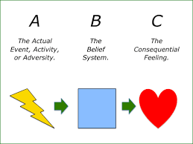
Changing our behavior: It is ABC, DEAR MAN
https://positivepsychology.com/albert-ellis-abc-model-rebt-cbt/

Slide 23
Changing our behavior: It is ABC, DEAR MAN
ABC (Albert Ellis) describes our inner thought process
Actions/Adversities (A) do not cause our emotions (C). It is beliefs (B) that form our reaction+responses and, in particular, irrational beliefs
One more time: our emotions and behaviors (C: Consequences) are not directly determined by life events (A: Activating Events), but rather by the way these events are cognitively processed and evaluated (B: Beliefs)
The type of belief matters, and we have the power to change our beliefs.

Slide 24
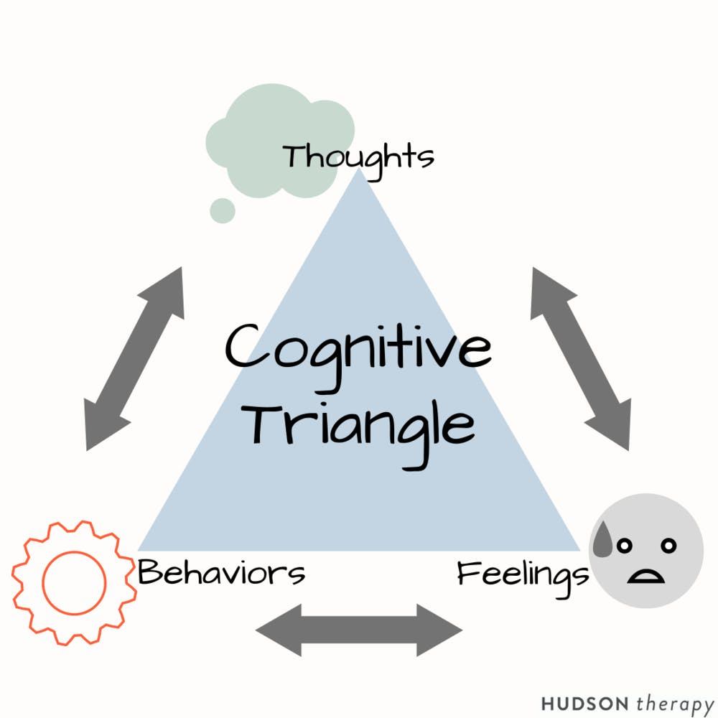
Changing our behavior: It is ABC, DEAR MAN - example
Activating event – when Ellis arrives at work one day, her co-worker walks past her desk without saying a word
Beliefs about the event – Ellis takes the perceived indiscretion personally and she is immediately reminded of a minor disagreement the pair had over a month previous.
Consequences of the event – Ellis feels disrespected, angry, and resentful
Disputation of the event – why else may co-worker have ignored me that morning? Perhaps he had been in a fight and was distracted
Effect - For the rest of the day, I will not waste any more time expelling energy on an issue that does not concern me

Slide 25
Changing our behavior: It is ABC, DEAR MAN – specific work
A popular notion in most forms of therapy:
- One does not necessarily have to change their environment to become happier and healthier,
they simply have to recognize and change their reactions to their environment.
This takes a little self-awareness, but that’s something we are all able to do with a bit of effort.

Slide 26
Changing our behavior: It is ABC, DEAR MAN
DEAR MAN (Marsha Linehan) describes how to communicate differentiated ABCs with others
Describe: Describe to the other person what is the current situation, explaining yourself through language as clearly and objectively as possible.
Express: Express your emotions, using facial expressions, tone of voice, or gestures that capture the content and importance of your request.
Assert: What do you want? Others need to know
Reinforce: Positive outcome and rewards for your partner
Stay Mindful, Appear Confident, Negotiate

Slide 27
Changing our behavior: It is ABC, DEAR MAN - exercise
Provide examples of healthy and unhealthy explanations (belief systems) for the situations below. Add Dear Man explanations of your feelings:
Your boss did not notice you while talking to a new colleague
You were not introduced at a large meeting
Only your colleague was allowed to go to an interesting seminar
Your colleague took your car
Your mentor gave you a wrong advice
HR cannot find time for your scheduled appointment

Slide 28
WHAT DRIVES BEHAVIOUR
Inner Dialogues can affect the way we respond, for example:
Aggressive: “If people produce rubbish, I have every right to tell them so”. “She obviously doesn’t care. That’s typical of young people today.” “This reflects badly on me, and I won’t stand for it.”
Assertive: “This may be uncomfortable for us both, but we can handle it.” “She has the right to make mistakes, but the responsibility to correct them.” “I want her to know the effect her errors have on other people.”
Non-Assertive: “I don’t want to make a scene or upset our working relationship.” “I’m sure these are unintentional errors – I’ll let it go this time.” “I know she’s very busy, so I expect that’s why these mistakes happened.”
Being aware of these Inner Dialogues can help us consider our response and adjust behaviour to be assertive!

Slide 29
ASSERTIVE PEOPLE
Feel free to express their feelings, thoughts, and desires;
Are also able to initiate and maintain comfortable relationships with other people;
Know their rights;
Have control over their anger. This does not mean that they repress this feeling; it means that they control anger and talk about it in a reasoning manner;
Are willing to compromise with others, rather than always wanting their own way ... and tend to have good self-esteem;
Enter friendships from a position ‚I say my needs. I see your needs'.

Slide 30
Assertive techniques
Fogging
Stuck Record
Positive enquiry
Negative Enquiry

Slide 31
Stuck Record
It involves repeating what you want, time and time again, without raising the tone of your voice, becoming angry, irritated, or involved in side issues.
Continually repeating a request will ensure the discussion does not become side-tracked and involved in irrelevant argument. The key is to stay calm, be very clear in what you want, stick to the point and not give up.
Accept a compromise only if you are happy with the outcome.

Slide 32
THE STUCK RECORD TECHNIQUE
Example Situation
Imagine that you are returning something that is faulty to
a store. The conversation may go as follows.
“I bought these shoes last week and the heels have fallen off. I would like a refund please.”
“It looks like they've been worn a lot and these shoes were only designed for occasional wear.”
Stuck Record technique response:
“I have only had them a week and they are faulty. I would like a refund please.”
“You cannot expect me to give you your money back after
you've worn them out.”
Stuck Record technique response:
“The heels have fallen off after only a week and I would like a refund please.”
○

Slide 33
Positive Enquiry
Positive enquiry is a simple technique for handling positive comments such as praise and compliments.
People often struggle with responding to praise and compliments, especially those with lower self-esteem as they may feel inadequate or that the positive comments are not justified. It is important to give positive feedback to others when appropriate but also to react appropriately to positive feedback that you receive.
Positive enquiry is to find out more details about the compliment or praise given, and agree with it.

Slide 34
Negative enquiry
is used to find out more about critical comments and is a good alternative to more aggressive or angry responses to criticism.
You ask for clarification of the things about yourself or your behaviour that might be negative.
It is important to get specific, eliciting information in an unemotional low key manner,

Slide 35
POSITIVE ENQUIRY
Example Situation
Sender:
“You made an excellent meal tonight, it was delicious!”
Receiver:
“Thanks. Yes, it was good. What did you like about it in particular?”
This is different from a passive response that may
have been:
"It was no effort" or "It was just a standard recipe"

Slide 36
NEGATIVE ENQUIRY
Example Situation - Negative Enquiry
Sender:
“That meal was practically inedible, I can't remember the last time I ate something so awful”
Receiver:
“It wasn't the best, exactly what didn’t you like
about it?”
This is different from an aggressive response that
may have been:
"How dare you, I spent all afternoon preparing that meal" or "Well that's the last time I cook for you"

Slide 37
Fogging
In challenging situations – uneven fight, such as criticism by your boss.
Rather than arguing back, fogging aims to give a minimal, calm response using terms that are de-escalating, while at the same time not agreeing to meet demands.
Fogging involves agreeing with any truth that may be contained within statements, even if critical. By not responding in the expected way, in other words by being defensive or argumentative, the other person will cease confrontation as the desired effect is not being achieved. When the atmosphere is less heated, it will be possible to discuss the issues more reasonably.
Fogging is so termed because the individual acts like a 'wall of fog' into which arguments are thrown, but not returned. Other name – greyrock.

Slide 38
Fogging example

Slide 39
Why is it difficult to say NO?
If I say no, they may feel hurt or injected.
If I say no, they may not like me anymore.
They would say ‘yes’ to me (and so I will feel guilty if I refuse them)

Slide 40
How to say NO assertively
Feel that you have a right to say no.
Start your reply with a clear, firm, audible ‘NO’.
Do not justify or make excuses. Giving a reason is not over-apologizing.
Remember you are saying ‘no’ to that particular request, not rejecting them.
After ‘NO’ , do not stay around waiting to be persuaded. Closure - change the subject or even walk away
Take responsibility for saying no, do not blame the other person for asking you.
You can always say, ‘I will let you know’ in order to give yourself time.

Slide 41
Final exercise
One person tries assertive behavior, one person opposes, one person gives feedback. Then switch!
You bring your car to a garage for service. You ask the mechanic to call and let you know how much it will cost before doing the work. He doesn't call and when you call him he tells you he already put a part in a car, and your bill is 5000 EUR. It is too much.
At a daily briefing with the team, Your manager comes up with an idea, which you yourself had mentioned to her only 3 days ago. The problem was that she indicated that it was her idea. You are annoyed about this, and want to tackle her after the briefing.
You want to go to the department meeting. Your manager says to you: “As everyone can’t go the meeting, would you mind staying and answering the phone.” You do mind.
Your own scenario.
Remember to use the technics mentioned! Fogging, Stuck Record, Positive Enquiry, Negative enquiry

Slide 42
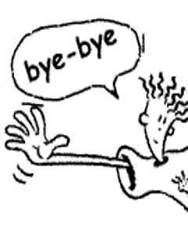
Thank you for your attention

