Slide 1
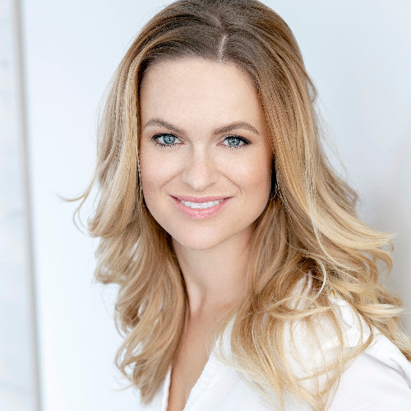
Who is Veronika?
Veronika works as a Senior HR Consultant at Oracle Czech Republic. With 16 years compex experience across HR areas, she is currently specialized as a general HR Business Partner with a strong focus on learning and development, performance and talent management, dismissals, grievances, employee relations, continuous improvement of HR processes and psychological assessments (DISC certified), supporting teams in growth and achieving results.
She has held various internal or exteranl HR roles at international companies like Oracle, NetSuite, as well as in local companies like CatCut, Vykupto or Promoteri.eu.
With a master’s degree in psychology and a focus on work-life balance strategies, she combines practical HR knowledge with psychological insights to support employees and leadership effectively.
Veronika Dvorakova

