Slide 1
Building Nonprofit Capacity: Fundraising
Julie Pietroburgo, Ph.D.
Visiting Fulbright Professor
to Masaryk University
Associate Professor
Department of Public Administration and Policy Analysis
Southern Illinois University Edwardsville
Edwardsville, Illinois U.S.A.

Slide 2
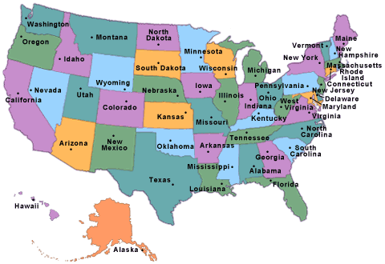
Where I’m From:
Edwardsville, Illinois

Slide 3
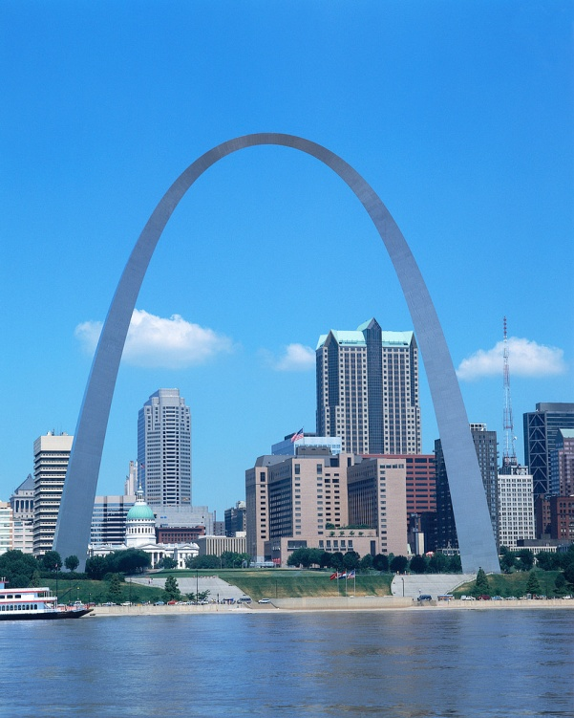
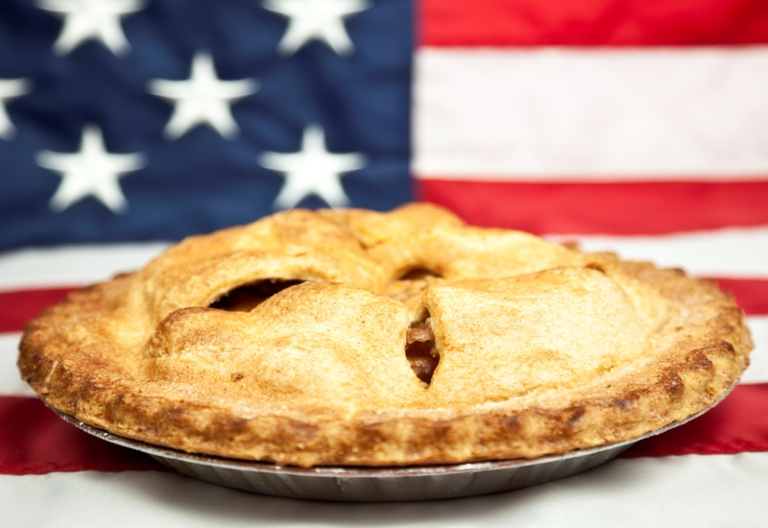
Where I’m From:
The Midwest Region

Slide 4
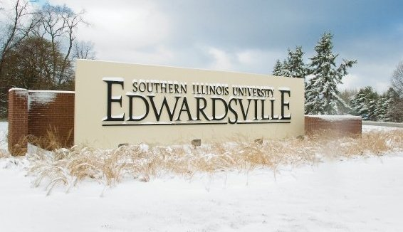
Where I’m From:

Slide 5
Southern Illinois University Edwardsville
Southern Illinois University Edwardsville is a public comprehensive university dedicated to the communication, expansion and integration of knowledge through excellent undergraduate education as its first priority and complementary excellent graduate and professional academic programs; through the scholarly, creative and research activity of its faculty, staff and students; and through public service and cultural and arts programming in its region
Established in 1957
One of top 15 public universities in U.S.News’ Midwest-Master’s category

Slide 6
Southern Illinois University Edwardsville
Student Body: Fall 2011
Total Students: 14,235
Undergraduate Students: 11,428
Graduate Students: 2,289
SIUE has over 90,000 alumni.
SIUE is one of the largest employers in Southwestern Illinois with more than 2,500 full-time employees.
Location: Edwardsville, Illinois - just 20 miles from St. Louis.
Affiliation: Part of the Southern Illinois University System
Emphasis: SIUE is a fully accredited public university offering a broad choice of degrees and programs ranging from liberal arts to professional studies.

Slide 7
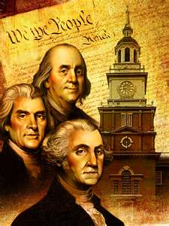
Department of
Public Administration and Policy Analysis
140 Graduate Students
Six Full-time Faculty (Ph.D. level professors); 8 adjunct professors
Specializations: Local Government and Nonprofit Administration
Applied Program: Internships, service learning projects, practitioner study body
Masters of Public Administration

Slide 8
Personal Areas of Concentration and Research
Courses taught: Organization Theory, Public Budgeting, Fundraising, Board Leadership, Marketing and Public Relations, Grantwriting and Health Care Administration, Communications
Research Focus: Organizational Restructuring in Nonprofit Organizations (Mergers, Public Private Partnerships, Privatization, Hospice organizations)

Slide 9
Scholarship: Articles
“Navigation Notes: A Case Study in Hospice Strategic Planning” , J. Pietroburgo. To be submitted to American Journal of Hospice and Palliative Care. December, 2012.
“Investigation of Association Mergers. – Phase III” J. Pietroburgo and S. Wernet in conjunction with William E. Smith Institute for Association Research. To be published as technical report in 2007.
“Saving Fido: A Case Study in the Inter-Sectoral Privatization of Local Animal Control Services”, J. Pietroburgo. Public Sector Innovation Journal. August, 2012.
“Merging Missions and Methods: Restructuring and Adaptation in Nonprofit Hospices”, J. Pietroburgo. Journal of Healthcare Leadership. Spring, 2010.
“Nonprofit Mergers: Assessing the Motivation and the Means”, J. Pietroburgo. Journal of Leadership Studies. March, 2010 .
“Coming to Terms: A Case Study of Hospice Collaboration Challenges”, J. Pietroburgo and R. Bush. American Journal of Hospice and Palliative Care. January, 2008.
“Police Response to Domestic Violence: The Role of an Intervention Counselor.” J. Pietroburgo and T.R. Carr. Forum: Illinois Law Enforcement Executive Institute . September, 2008.
“Bowling Together: Anatomy of a Successful Association Merger.” J. Pietroburgo and S. Wernet. Baruch College, City University of New York Nonprofit Working Paper. September, 2008 .
“Investigation of Association Mergers.” J. Pietroburgo and S. Wernet in conjunction with William E. Smith Institute for Association Research. Published as technical report in 2007.
“Charity at the Deathbed: The Impact of Public Funding Changes on End-of-Life Care.” J. Pietroburgo. American Journal of Hospice and Palliative Care; December, 2004 .
“Meeting in the Middle: The Challenges of Public/Private Partnerships in Domestic Violence Intervention.” J. Pietroburgo and T.R. Carr. Forum: Illinois Law Enforcement Executive Institute Journal; January, 2005 .
“Joining Forces, Fortunes and Futures: Restructuring and Adaptation in Nonprofit Hospice Organizations.” J. Pietroburgo and S. Wernet. Nonprofit Management and Leadership; September, 2004 .
“Joining Forces, Joining Futures: Hospices at the Crossroads.”J. Pietroburgo. Published in the American Journal of Hospice and Palliative Care; May, 2004.

Slide 10
Getting to Know You
Why did you want to take this course?
What do you want to learn specifically in this course?
How do you plan to use what you learn in this course?

Slide 11
Week One

Slide 12

Introduction
Syllabus Review
Defining terms
Understanding
capacity building
Reviewing course expectations

Slide 13
Defining the Terms
Nonprofit:
  In U.S.:
    Corporations organized and operated exclusively for religious, charitable, scientific, testing for the public safety, literacy, or educational purposes.
    501(c)(3) Status
    Tax Exemption
    Limited Liability

Slide 14
Defining the Terms
Nonprofit:
  In Czech Republic:
    Organizations not affiliated with the state with efforts aimed at helping aspects of humanity.
    Four types of nonprofits: Citizen-action associations, foundations and charities, legal entities established by the church, generally beneficial associations

Slide 15
Nonprofit vs. For-Profit

Slide 16
Differences
Nonprofit Corporation
For-profit Corporation
Cannot distribute its profits to members or “owners” of the corporation
The profits must be spent to further the organization’s charitable goals.
Profits are distributed privately to the owners of the corporation (i.e. usually the owners of the corporation’s stock receive the profits in the form of dividends).
A “for-profit” generates profits for its owners.

Slide 17
Similarities
Nonprofit Corporation
For-profit Corporation
Legal Incorporation
Board of Directors & Officers
Pay Salaries
Face Expenses
Able to Receive Profit
Legal Incorporation
Board of Directors & Officers
Pay Salaries
Face Expenses
Able to Receive Profit

Slide 18
Defining the Terms
Capacity Building:
  refers to strengthening the skills, competencies, abilities and resources of people and communities so they can overcome the causes of their exclusion and suffering.

Slide 19
Defining the Terms
Capacity Building (continued):
  refers to intentional, coordinated and mission-driven efforts aimed at strengthening the management and governance of nonprofits to improve their performance and impact. Includes:
    leadership development
    strategic planning
    program design and evaluation
    board development
    financial planning and management: FUNDRAISING!

Slide 20
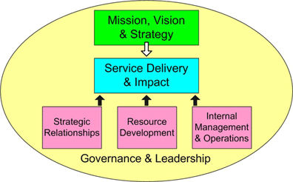
Capacity Building Framework

Slide 21
Defining the Terms
Philanthropy:
  The effort or inclination to increase the well-being of humankind, as by charitable aid or donations.
  Love of humankind in general.
  Something, such as an activity or institution, intended to promote human welfare.

Slide 22
Defining the Terms
Development:
  Philanthropy is made possible by development
  Involves building a supporting constituency around a worthwhile cause or organization.
Fundraising:
  Fundraising is one (very important) element of development
  Involves the process of soliciting and gathering voluntary contributions including money and other resources by requesting donations from individuals, businesses, charitable foundations, or governmental agencies

Slide 23
More Fundraising Terminology
Donation/Pledge
Grant
Campaign
Appeal
Annual Gifts/Annual Fund
Major Gifts
Planned Giving
Etc., etc., etc.

Slide 24
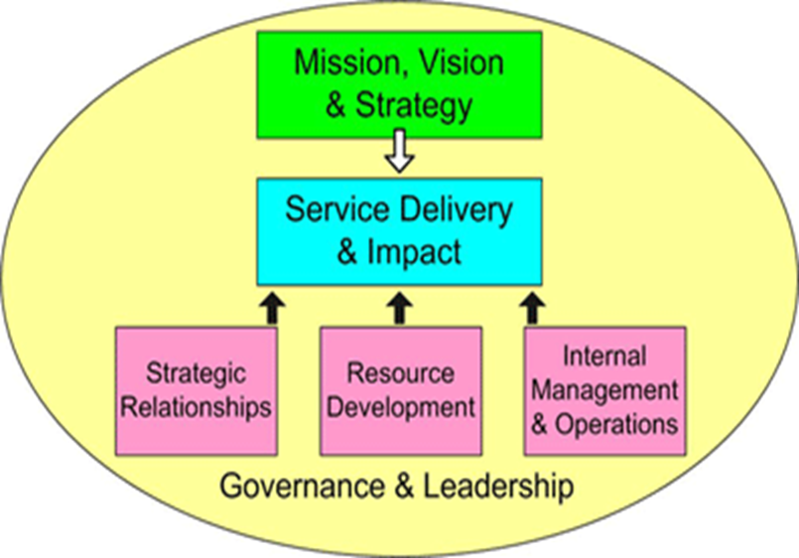
Where Do We Start?
The mission, need, objectives and goals of the nonprofit organization!

Slide 25
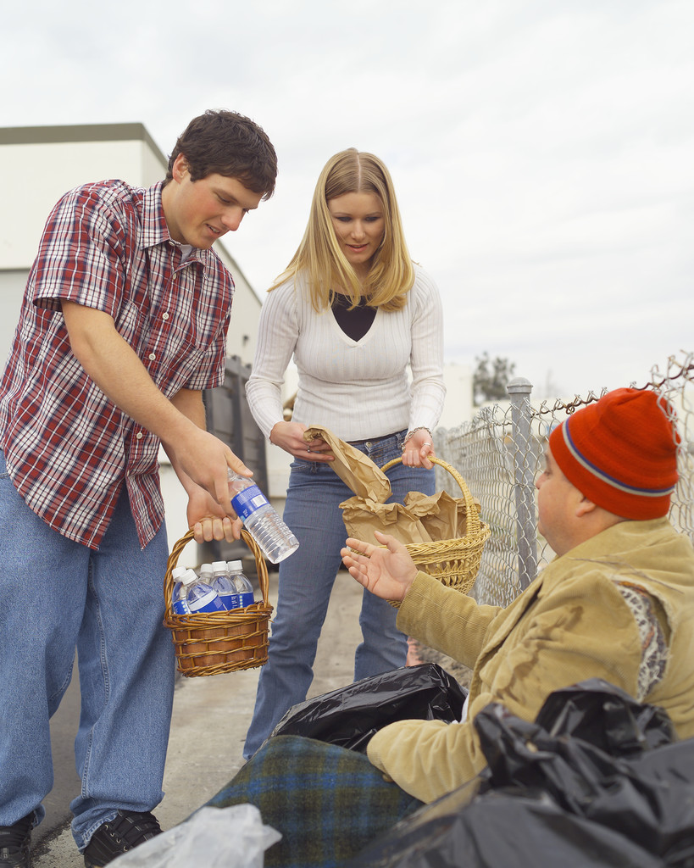
Nonprofits: The Mission
The cornerstone of the organization that answers two questions:
  Why does your organization exist?
  Who were you created to help?

Slide 26
Some mission statements:
To improve cardiovascular health of patients through education and clinical research.
To strengthen and expand philanthropy among nonprofit organizations .
To provide high-quality, compassionate and comprehensive legal services to as many low-income persons as possible.
To protect the lands and waters that define the communities and enrich the quality of life for citizens in the state of Illinois.

Slide 27
Mission Statement
A Mission Statement is a broad, usually brief description of:
  Ends: What problems, concerns, or opportunities you seek to address. What you want to achieve in the long run.
  Means: What ways you will use to try to achieve those ends.
  Target population/geography: What people and places you seek to serve.

Slide 28
Mission Statement (cont.)
Your mission statement should:
  Provide the definitive purpose of your organization to the rest of the world.
  Be the point of reference around which your board, staff, members, and volunteers develop common understanding of the organization’s reason for being.
  Be the touchstone from which all planning proceeds.

Slide 29
Example of a Mission Statement
The Carpathian Eco-region Initiative: to work through collaborative eco-regional planning in order to conserve the Carpathian ecosystem and secure sustainable economic and cultural benefits for the peoples of the region.
Is it compelling? Can people get behind it?
Is it your true reason for existence?

Slide 30
NEEDS STATEMENT
A Needs Statement describes the situation that the organization intends to address with its programs.
What is the problem that you are addressing?
Note: Do not assume everyone knows the problem. Be sure to make a convincing case.

Slide 31
Example of a Needs Statement:
Conservation of the unique Carpathian biodiversity is threatened by economic and industrial development with 10% of the unique species threatened with extinction by 2050.

Slide 32
GOAL
A goal is a broad-based statement of the desired ultimate result of the change being undertaken (a result that is sometimes unreachable in the short term).
Note: Don’t confuse a goal with an objective. In general, a goal is conceptual and more abstract.

Slide 33
Examples of Goals:
Build a Carpathian Biodiversity Information System to track the extinction threats and growth initiatives related to endangered species in the region.
Offer education and skill-building training to community leaders on bio-diversity protection initiatives.

Slide 34
What is an Objective?

Slide 35
OBJECTIVE
S
pecific
M
easurable
A
chievable
R
ealistic
T
ime-bound

Slide 36
OBJECTIVE (cont.)
It is much more narrowly defined than a goal. Like the goal, the objective is tied to the need statement.

Slide 37
Examples of Objectives:
Implement the Biodiversity Information System with the tracking of 20 unique species by 2015.
Provide speeches to 20 groups each year about bio-diversity endangerment.
Prepare a new study of bio-diversity threats to the region by June 30, 2013.

Slide 38
Program Plan Chart
Mission
Needs Statement
Goal #1
Goal #2
Objective #1a
Objective #1c
Objective #2a
Objective #2b
Objective #1b

Slide 39
What is a Method?

Slide 40
METHOD
A method is a detailed description of the activities to be implemented to achieve the ends specified in the objectives.
Methods should be reasonable and should be able to be accomplished within the timeframe of the program and with appropriate resources.
Note: Methods are frequently referred to as activities or strategies

Slide 41
Examples of Methods:
Conduct training on the Biodiversity Information System with all project personnel.
Recruit 12 community leaders to sit on the Carpathian Bio-diversity task force.
Convene an annual Bio-diversity Conference of 250 community leaders, elected officials, and citizens to discuss barriers to ecological protection.

Slide 42
Program Plan Chart Sample
ABC after-school program inspires children in South Los Angeles elementary schools with a passion for learning through one-on-one mentoring and tutoring.
Mission
Neighborhood School has an Academic Performance Index (API) of 550, a Statewide Rank of 2, and a Similar School Rank of 3.
Needs
Statement
Our after-school program will help children read better.
Goal #1
Goal #2
Objective #1a
Objective #1c
Objective #2a
Objective #2b
Our after-school remedial education program will assist 50 children in improving their reading scores by one grade level as demonstrated on standardized reading tests administered after participating in the program for six months.
Objective #1b
Method→ We will recruit volunteer undergraduate tutors from USC and UCLA to tutor children. For ten weeks they will tutor 50 children every Thursday for two hours.

Slide 43
Hope4Africa
What are the organization’s
  Mission/Vision
  Statement of Need
  Goals/Objectives
  Methods
http://www.youtube.com/watch?v=nxudc_5Ydpk

Slide 44
Review
Nonprofit Definitions
Capacity building in Context
Where it all starts: Mission, Need Statement, Goals, Objectives, Methods

