Slide 1
Week Seven: Fundraising

Slide 2

Special Events
Personal Solicitation
Telephone Solicitation
Internet Solicitation

Slide 3
Special Events
The process of using sports, arts, entertainment, festivals, fairs, auctions, and other gatherings of people to generate revenue.
Functions of special events:
  Generate revenue
  Enhance reputation
  Generate interest
  Educate individuals
  Generate publicity
  Gain donors who normally wouldn’t contribute
  Foster social unity
Notes:
Another common type of fundraising tactic that many organization use is the special event. In fact, when most organizations decide they want to fundraise, this is what they generally will do first. The problem is that many organizations never move beyond this very basic form of fundraising.
What are special events – they involve the process of using sports, arts, entertainment, festivals, fairs, auctions and other gatherings of people to generate revenue.
Special events attract consumers during their leisure time. This appeals to sophisticated consumers who want their participation, whether as spectators or participants, to have some value beyond their personal enjoyment.
What functions are we serving through special events:
Hopefully we are generating some revenue (however, it is amazing to see how many organizations host special events and find that after they tally their results, they have barely if even covered their costs.)
They can enhance the reputation and awareness of the mission of the organization
They generate interest and enthusiasm for the organization among those working on and attending the function.
They can educate individuals about the organization’s purpose and objectives
They can generate publicity about the organization in a way that the daily activities of the organization will not
They help gain some donors for the organization that you normally wouldn’t find supporting the organization
And they foster social unity (within the organization among board, staff, volunteers) and within the broader community.
Having said that, they don’t do all of these things equally well. They are good for increasing visibility, social unity, generating interest and some of those other p.r. functions, but unless the organization has hit upon a particularly lucrative special event, they generally are not moneymakers.

Slide 4
Special Event Planning
Consider
  Fit with organization image
  Timing
  Energy required
  Front money
  Repeatability
  Revenue potential (Break even analysis)
Notes:
Most of the time, organizations are hosting their own events. The time and effort to do so can be immense. Again, you don’t want to think of the event as an end in and of itself. It is a means to an end – raising money. So, you want to always be mindful of whether or not the event is serving the true purpose of raising money well and back away from those events that aren’t going to produce adequate revenues.
When you are thinking about the kinds of special events to have, consider these things:
The appropriateness of the event – does it fit with the organization’s image to host this kind of event. Consider the impression of your organization that will be left with people who knew nothing about your organization other than what is conveyed by the event itself. Is it too flashy, ostentatious, young/old, etc.)
Think about the timing of the event – does it work well with your other fundraising plans and the timeline of the organization in general. Will it compete with other major events in your area, or other priorities/challenges of your prospective attendees; holidays, etc.
What kind of energy is required to pull it off? What are the opportunity costs – if you didn’t do this special event, would there be another more productive way to use your volunteer and staff resources to raise money.
What kind of front money does it require? You have to be able to say that you can afford to lose that money …..of better yet, can you assure that can get a sponsorship that will cover most front end costs so that the event itself becomes profit.
What is the potential for repeating the event. Ideally you want a special event that can be repeated (costs to hold special events will decline if you can do it more than once and if it’s successful, additional events tend to grow in popularity/success if repeated – up to a certain point.
What is the revenue potential – in the end, you must consider how much you are likely to make off the special event. Often nonprofits engage in many special events and pay off is not really significant. Another problem tends to be with organizations that set unrealistic goals about a special event. It is hard to find special events that are huge moneymakers.
If you are not driven by a financial goal, what are some other goals and how will you measure – number of new supporters, volunteer involvement, visibility, education, etc.

Slide 5
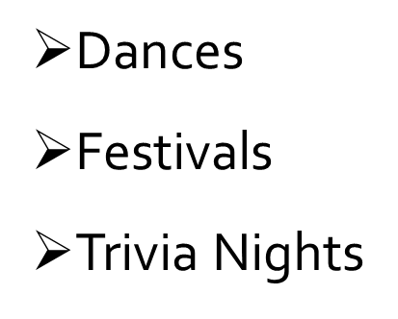
Types of Special Events
EVENTS
Examples: http://www.worldmsday.org/wordpress/2010/06/15/raising-money-for-ms-a-concert-and-a-cake-in-the-czech-republic/
Luncheons/dinners/auctions
Musical or Theatrical Performances
Sports tournaments
Notes:
Here are some common examples. Other?

Slide 6
Special Event Planning
It’s all in the details!
  Date and site
  Budget
  Timeline
  Event leadership
  Management structure
  Sponsorships
  Invitation lists
  Printed materials
  Public relations
  Financial oversight
  Record-keeping
  Holding the event
  Post-event activities
  Murphy’s law
Notes:
If you decide special event fundraising is for you, there are myriad of details to attend to:
Select the date and site – may have to book best sites six or more months in advance. Keep in mind holidays, competing events and other activities of organization itself.
Prepare a budget early – determine what the break even point is – how many people will you have to bring in to cover all your fixed and variable costs. Always seek sponsors and then promote them prominently in ads/signage/publicity. Seek in-kind gifts.
Lay out a detailed timeline for every element of the event (from planning stages through the actual night of the event and the work to wrap up budget/acknowledgments afterward).
Designate event leaders – designate chair people and hold them responsible for overseeing that every thing gets done. Assign each task to someone. Consider role of honorary chairpeople (name only) and operating chair.
Have a management structure – have committee structure, reporting intervals, etc. Special events are not a one-person job.
Always seek sponsorships.
Develop good invitation lists- build list from board directors, staff, volunteers, past donors/attendees, clients, etc. General lists of wealthy in community.
Produce quality printed materials – invitations, flyers, posters, programs. Graphically consistent, interesting, inviting….Give sponsors prominent billing in all printed materials.
Seek all public relations opportunities. Promote the event – radio, tv, internet, interviews, features,etc. Press releases well ahead of the event and then follow-up to get coverage. Find a hook to make your event stand out – human interest story. Free publicity through public service announcements.
Financial oversight – put someone in charge of continually assessing how the event is proceeding financially. Follow budget. Track all expenses. Track all revenues. Also helps to determine where you may need to cut corners as you go along or do follow-up work to increase participation rate/attendance.
Keep records of what worked and what didn’t. Have a post-mortem immediately after event to document what you learned so that you can improve next time (if there is a next time).
As you hold the event – checklists, volunteer descriptions, walk throughs, communications. Have back up plans for everything – what if your av doesn’t work, what if your emcee gets sick, what if your programs contain errors or don’t get delivered, what if it rains on the day of the golf tournaments, what if you run out of food, etc…….) Operate by Murphy’s law – if it can go wrong, it will.
After the event, you’re not done; thank yous to sponsors, volunteers, emcees, etc. Collection of any pledges of outstanding revenues. Assessment of the event – meet with key players to do exhaustive critique of what worked and what didn’t. Making assessment of whether should do it again. Cultivation – how do you build on relationship with those who are first time participants so that they will continue to support organization in bigger way in future. Close out records and make financial accounting of event.

Slide 7
Personal Solicitation
Most effective way (and perhaps only way) to generate large gifts
Close relationships are critical
Who should solicit?
  Represent organization
  Known to prospect
  Status equivalent
Notes:
Continuing with our discussion of fundraising tactics, one of the most important, but perhaps also the most feared among fundraisers is the personal solicitation.
By far the most effective way to generate large gifts is to talk to donors in person. Studies support what fundraisers know from experience – the closer the relationship between the person asking for the gift and the prospect, the greater the change that a contribution will be made and the larger the contribution is likely to be. Relationships are the foundation of giving – and often times that means meeting with someone on a very personal level to solicit a gift. Having said this, it is amazing to see how many organizations think they can just send a letter to a potential donor and receive a large check in return. It simply does not happen like this unless you have done the up front work to meet with people personally and get to know them.
So, how do we do it? Who should solicit these types of gifts through personal solicitation?
First, the person must represnet th organization and should be known to the prospect. The relationship with the asker and the prospect is key. The ideal asker also has status in the organization and a recognized role in the nonprofit. The board should be heavily involved in making these kinds of personal solicitations when you are talking about major gifts – also the key leadership of the organization. It must be enculturated with the organization that personal solicitation is a key piece of board responsibility. Solicitors should be trained, given the materials they need to do a good job of soliciting.
The best solicitor is going to be known to the person being solicited – a relationship already exists.
In addition, equivalency in status is important – CEO to CEO or middle manager to middle manager.

Slide 8
Question for Discussion
Why Do Some People Like To Ask/
While Most People Hate To Ask?
Notes:
Having said all this, not many individuals feel comfortable with soliciting their friends, family, acquaintances and business associates for gifts? Why not?
Money is a taboo subject; if they give to me, I have to give to their cause; fear of rejection; fear of damaging relationship; don’t know what to say……

Slide 9

What are you afraid of?
Failure
Embarrassment
Alienation
Obligation
REJECTION
Notes:
We’re afraid of failure, embarrassment,alienation of a colleague or friend, afraid of the obligation (if the goal or the expectation for you as a solicitor seems unattainable), but most of REJECTION! (Awkward if they say no and seems like a personal rejection).

Slide 10
How can it be fun?
Passion for the mission
Positive interactions
Joy of victory
Peer recognition
Notes:
But is there a way that it can be fun.
First, we have to realize that this kind of interaction happens every day and chances are you are not the first person in a while to ask your prospect for money to support a cause.
Beyond that, it all starts with being equipped with the information, ammunition and compelling story that you want to convey.
But it is also about attitude.
If you’re going to be an effective solicitor, you have to start with a passion for the mission. This will either shine through or not….how committed are you? Why is this so critically important? Why do I think we are the best at serving this need.
You also have to have the attitude going in that it will be a positive interaction – if you think you will be successful, you probably will.
Also, it can be fun to experience the joy of victory – walking away with a pledge of a substantial gift can be very rewarding and make you feel good about yourself and good for your cause.
Finally, if this is something you are expected to do, and you do it well, others will recognize you for your skill in this area – peer recognition should be a benefit of doing this well.

Slide 11
Keys to Successful
Personal Solicitation
Attainable goal
Solicitor makes gift first
Solicitor is familiar with prospect and his interests
Solicitation in person
Teams used to strengthen the visit
Case materials are used
Solicitor listens and responds to questions
Specific amount asked for
Follow-up
Notes:
As we go out to make these kinds of personal visits, what are some things to keep in mind:
First assure that your goal is attainable – don’t get saddled with a goal or a number of visits that you don’t truly feel you can attain. Start small and work up.
Make sure that as a solicitor, you have made your gift first. The personal commitment empowers you to ask for “stretch” gifts from others. How can you ask others to give, when you yourself have not.
As a solicitor, you should be familiar with the prospect and the prospect’s primary interest in the agency.
Of course, you go in person to see your prospect.
You also use a team if necessary to strengthen the visit (board/staff leaders).
You bring also case materials that may help explain the cause. But don’t overdo the paper.
You express appreciation for prior contributions and indicate the importance of prior support to the organization. What was accomplished with previous gifts?
You lay out the problem, the need.
You listen and respond to the prospect’s questions and interests.
You go armed with a specific amount to be asked for. And you know specifically how you would like to use this money.
If an immediate decision is not forthcoming, you hold on to the pledge card.
You follow-up with a phone call or visit to get the answer. You let them know when you will be following-up.
The acknowledgement of the gift is immediate, personal and heartfelt.

Slide 12
Make the Case
Introduce the cause/need
Explain your interest and commitment
Describe the organization and how it meets the need
Explain need for and use of funds
Notes:
The setting for personal solicitations usually involves two persons, the prospect and asker, although when a major gift is expected a second asker may be present and the prospect’s spouse or trusted advisor may sit in. The prospect knows either directly or indirectly that a request for funds will be made (don’t go under other pretenses). The message is conveyed in the appointment or in mailings sent in advance. The amount of the request is not announced but is left to be introduced and discussed during the presentation.
So what is the flow of such a contact.
First make the case:
Introduce the cause or need – giving any brief background (stats, history, evidence of need) that will be compelling.
Explain your personal interest and commitment – tell your story as to why this is important –why have you put your heart and soul and wallet behind the cause.
Describe the organization specifically and why and how it is capably meeting the need.
Explain why they need additional funds and how these funds will specifically be used.

Slide 13
Make the Ask
Ask them to join you in support
Ask for a specific amount
Deal with (and be prepared for) “no”/delay in “no”
Negotiate appropriate amount
Accept and express appreciation
Notes:
Then you transition to Making the Ask.
You are direct, forthright in this phase.
Ask them if they will join you in supporting this worthwhile cause.
Ask them for a specific amount – what is it that you want for them (you have researched this amount in advance and you know what you need and what they are capable and perhaps willing to give – stretch amounts are good).
You come prepared to deal with the no or delay responses you might get.
You negotiate an appropriate amount.
You accept this and thank them profusely.

Slide 14
Practicing the ask
Break into teams of two
Each team drafts and role plays both:
  30 second conversation to engage a
  co-worker
  A formal “ask” meeting requesting a $15,000 gift from a fictitious (or real) donor/prospect who you know has the financial resources to give!
Notes:
Let’s try it!

Slide 15
Asking for A Gift
Levels of effectiveness (Best to worst)
  Peer asking peer face to face
  Non-peer/staff asking face to face
  Peer asking peer via telephone
  Non-peer/staff asking via telephone
  Personalized customized letter
  Personalized customized email
  Bulk Mailing
Notes:
Thinking about this a bit further – there is a hierarchy of effectiveness in asking for major gifts. From best to worst in actually obtaining the desired gift are the following:

Slide 16

Attitudes Needed for Successful Fundraising
Unshakable conviction in the value of your organization
Belief that people are willing to give
Belief that, even in bad times,
wealth exists in your community
Willingness to step outside
your comfort zone
Resistance to tin-cup mentality
Notes:
Again, much of it rests on having the right mentality going in to a solicitation meeting.
You have to have an unshakeable conviction in the value of your organizaiton.
You have to believe that people are willing to give – and most are.
You have to believe that people also have the capacity to give – and many do even in bad times.
You have to be willing to step out of your comfort zone.
Finally, if you are going to get the large gifts, you have to get beyond the tin-cup mentality of we’ll take anything we’re so poor.

Slide 17
Know what you are asking for and why
Mission and goals
Organization’s values
Use of funds
Results of gift
Track record of organization
Notes:
Go armed with the facts:
What the mission and goals of the organization are.
What the organization stands for – what are its guiding values.
How it will use donated funds.
Results of use of past gifts.
How the organization can be trusted – what has been the track record of the organization; what is the organization’s reputation, image and history.

Slide 18
Important Rules of Thumb
The best gifts are win-win propositions
  Have donors thank YOU
People tend to repeat pleasurable experiences and avoid painful ones
  Help donors to enjoy their gift
How you acknowledge the last gift determines whether you get the next
Never beg – create partnerships
Good planning precedes good fund-raising
  The $10,000 question – what are they able to give?
Notes:
Other important rules……

Slide 19
Telephone Solicitation
Fit with image/goals
Expense and yield
Timing
Details
  Volunteer or paid support
  Phonathons
  Arming reps with facts
  How to overcome objections
Notes:
Telemarketing continues to be a vital part of annual fund programs. Even though some individuals are not comfortable giving over the phone, telemarketing can be very successful.
Telemarketing can be more expensive than direct mail – if use long distance and utilize a bank of phones. Phone programs, however, can yield as much as 5 to 10 percent pledge rate and allow the donor continued interaction with a live individual.
Proper planning, training and execution are all necessities for a successful phone program. Must be sure that your telemarketing is not overlapping other types of solicitation (direct mail, personal) which could have negative overall effect.
Must consider whether the particular cause and fundraising program is appropriate for telemarketing. Programs that cannot be easily explained over the telephone might be better left to personal or direct mail solicitation.
Consider the expense and yield. Need to consider whether will use volunteers or paid callers or hire an outside vendor to call, prepare scripts and information packets. Also must plan for follow-up mailings for fulfillment of pledges.
Many organizations choose to conduct in-house “phonathons” using either hired or volunteer callers. Requires constant recruitment of callers, training and on-site supervision – all can devour a lot of time. Can hire outside vendors to make calls for organization – allows more control over script-handling but can be expensive and loses personal/local touch. In-house – you can tell your story best; outsource – easier, trained and control over content.
Place –real estate offices, travel agencies, law firms –connected room with lots of phones.
If outsource – callers on hourly rate, not commission, invisible to donor, funds collected sent directly to vendor; respect caller’s wishes, custom designed.
Ideal telemarketing rep is enthusiastic, articulate and knowledgeable about mission and goals of organization; thick skin.
Must arm telemarketing reps with: facts and info about the organization and the annual fund drive, scripts or outlines of a proper call, ways to deal with objections they might hear (i.e. suggested responses) samples of mailing sent by organization recently. Trained how to overcome objections, how to ask for specific dollar amounts, how to remain polite, accurate record-keeping, use of follow-up pledge cards to facilitate fulfillment.
Works best – crisis situations and to renew lapsed donors.

Slide 20
Fundraising on the Internet
Reach
Passive vs. active involvement
Types
  Membership fundraising
  E-mail fundraising
  Large gifts on-line
  Pledging on-line
  Merchandise sales
  Auctions
Notes:
Consider impact of internet –took over 20 years for radio to reach 50 million households in North America (50 million being a benchmark indicating some form of mass communications) . !2 years for television to reach same saturation level and four years for internet to do it.
In the early days, on-line fundraising was largely passive. Nonprofits were content to build giving forms, hope donors found their way to the form and then counted the unsolicited gifts that trickled in.
Over time, nonprofits have become more proactive; new trends emphasize proactive approaches – e-mail fundraising (blast e-mails), use of application service providers, using better planning, testing and tracking of internet tactics.
All nonprofits should be on-line with their fundraising efforts. There are too many people on the Internet to ignore.
Donor-on-line behavior – studies show that on-line donors tend to be more generous. Average gift of $48. 71 vs. $29 in direct mail and $24 in person. 35 to 50 % larger gifts. Also tend to subscribe more to monthly giving programs than those giving through mail or personal solicitation. On-line works well with automoatic deductions from a credit card.
Types of on-line fundraising:
Membership fundraising – Example is World Wildlife Fund – has created an on-line membership opportunity for visitors. In bottom on right-hand corner of the home page, the text “join” takes visitors to a membership form that gives them chance to make membership donation of $15 and then be entitled to bi-monthly newsletter, t-shirt and annual Travel Magazine. Realized 70 new memberships per month – 27- percent growth in membership donations.
E-mail fundraising – direct messages to potential donors lists promoting cause, offering gift in exchange for donations. Getting e-mail addresses is key. Relatively low cost.
Large gifts on-line – electronic transactions where the prospective donor enters information on-line, sends it to the agency and then the agency processes the gift. Particularly in disaster situations, these kinds of immediately accessiable ways to donate have been well-accepted (red cross) have to publicize this on-line option as a way for people to donate. Security concerns. Still have to cultivate donors in other ways.
Pledging on-line – If you are conducting any kind of campaign – give donors an opportunity to pledge via the internet – fulfillment through mail or in-person
Merchandise sales – Use your web-site as place to sell merchandise associated with your cause.
Auctions – more risky. Must find an appropriate auction site on which to sell the organization’s item, contact the owner/manager of site, determine commission/listing fees. Prepare back-up materials, determine the rules, establish starting price, follow through (mailing, fulfillment)
Charity portals – websites fun by for-profits and nonprofit groups that list a variety of charities on site, with description and how to donate – becomes a “shopping” site for charitable people looking for good causes to give their donations to.
Important aspects of internet fundraising – you must drive traffic to your side – put your website address on everything, register with key search engines to make sure others link to you. Use portals, use affiliates (sponsoring organizations) to link to you.

Slide 21
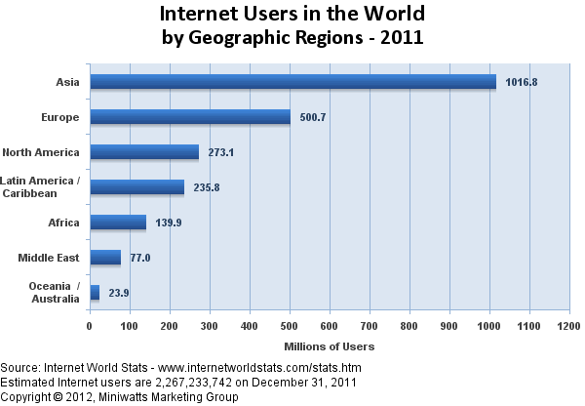
Internet Usage 2011
Notes:
This reflects the massive potential for fundraising on the internet……everybody is on!

Slide 22






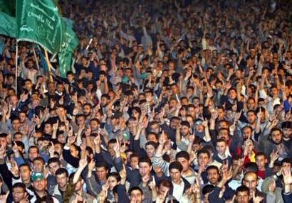
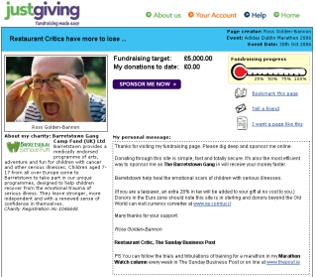
Planning: Ingredients…
  Website/Email
  + Online Donation Processing Vendor
  + Supporter List
  + Donation Pages
  + Calendar of Appeals...
Notes:
You have to have a number of important key ingredients to do internet fundraising well:
First, obviously, you need an effective, well-constructed, compelling website and appropriate e-mail capabilities. (You will want to be able to do some website data tracking – know how many are responding and to what).(Also, specifically, you will want to have the capability to do broadcast e-mails to your subscriber list).
On your internet sige, you will want to have an effective, well-constructed and compelling donation page (think easy)
If you are going to take donations over the internet – you will want an online donation processing vendor – these are important ones in the U.S.
Very important – a large and up-to-date list of supporter e-mail addresses.
And you will want to have a calendar of appeals that incorporates internet fundraising activity.

Slide 23
Planning: Donation Pages
Customized for your campaign
Ask for lots of information
  Require only what’s necessary
  Pre-populate fields, if possible
Keep copy short and sweet
Notes:
Specifically, thinking about your donation page – take the time to do this right.
Make sure that if you are using website in conjunction with a specific fundraising campaign, that you customize your website for your campaign – make it all work together.
Your donation should give a good amount of information, but it should also ask for necessary info too. Require only what is necessary and pre-populate fields if possible.
Keep the copy short and sweet – again, keep in mind that users attention span on these things is very short.

Slide 24
Planning: Donation Processor
Vendors process donations for you, take cut of amount processed (2%-5%)
Many options:
  Paypal
  Google Checkout
  eTapestry
  Groundspring
Notes:
When we talk about donation processors – these are the vendors that take the donation, handle the transaction and then take a cut of the amount processed – saves you the ongoing hassle of fulfillment, monitoring and gives donors the comfort of dealing with what they know is a secure site in making their donations.

Slide 25
Planning: Know Your Supporters
Have an active, engaged list of supporters
Know who they are
Know what they are interested in
Know why they signed up - that issue is what they’ll give $$ to
Notes:
Data, data, data. If you can, track what they do on your website, which emails they open, and use that to segment your list and target your asks.

Slide 26
Planning: Calendar of Appeals
Notes:
Coordinate your fundraising campaigns by mapping out which messages you're sending when and to whom

Slide 27
Online Fundraising Math
  If you want to generate 10 gifts...
1,000 people must receive your email
250 must read it (‘open’)
50 must click donate (‘click-thru’)
  Average response rate to fundraising
  messaging [for NPOs] = 3%
Notes:
This slide indicates that in internet fundraising, it is all about the number of e-mail addresses you are sending to

Slide 28
Preparing for Success: The Website
  Is it up to date? (programs, events, services)
  Do you tell people what you want them to DO? Over and over again?
  Good, clean writing?
  Easy to navigate?
  Does everything actually work?
  Opportunities for dialogue, engagement?
  Quick and easy email signup?
  Is it compelling
  $Transparency?
  (how is $ spent? privacy policy?)
Notes:
In general, you must make sure that your website is top notch…..these are some important questions to ask about your site.

Slide 29
Preparing for Success: The List
A good list is key to successful online fundraising.
A good list:
  is large and responsive
  receives steady stream of trusted and relevant communications
  has opportunities for meaningful online engagement -- other than giving $$
Notes:
Again, the list is the key. A good list is large and responsive (i.e. these are largely recipients that have shown they will respond to yours or similar causes), A good list is populated by people with whom you have been communicating regularly (i.e. before you ask for money this way), and a good list is populated by people who have had opportunities for meaningful online engagement, other than just giving money.

Slide 30
Size Matters: List Building
Bring your off-line donors on-line: Collect e-mail addresses vigorously!
Conduct engagement campaigns (issues, advocacy, etc.)
Do fun stuff to create interest (Flash, quizzes, e-cards, contests, etc.)
Buy names and internet addresses (carefully!)
Notes:
How do you build your list?
First, make sure that any donors you have who are not currently on your on-line list, get on your internet list.
You can further build your list by getting their interest in other things you are doing on line – advocacy efforts, issue updates, auctions, etc.
Do fun stuff on your site – quizzes, contests, e-cards, etc.
You can also buy names and internet addresses – but do so carefully

Slide 31
Preparing for Success: The Copy
Keep it short
Make it engaging
Get right to the point
Be specific
Be relevant
  Timing (send it after a big disaster)
  Topic (target email to portions of your list who you know are interested in saving the banana slug)
Have a good ask (the best writing won’t save a bad idea)
Notes:
What should you say on your site about your fundraising activities? As you right your copy for your site, keep in mind that you want to:
Keep it short, make it engaging, get to the point, be specific, be relevant/timely, and incorporate a good ask – many of the same elements that we talked about with respect to preparing a direct mail piece……
The difference is that your internet piece should be much more visual, interactive and even shorter!!!!!

Slide 32
Successful on-line fundraising campaigns
  It gets opened
  Think subject lines & timing
  It gets noticed
Think creative & design
  It’s concise
Think scan-ability, length, and getting to the point
  It converts
Think specificity, transparency
It minds its manners
Think thank you pages and follow-up
Notes:
What does all this mean?

Slide 33
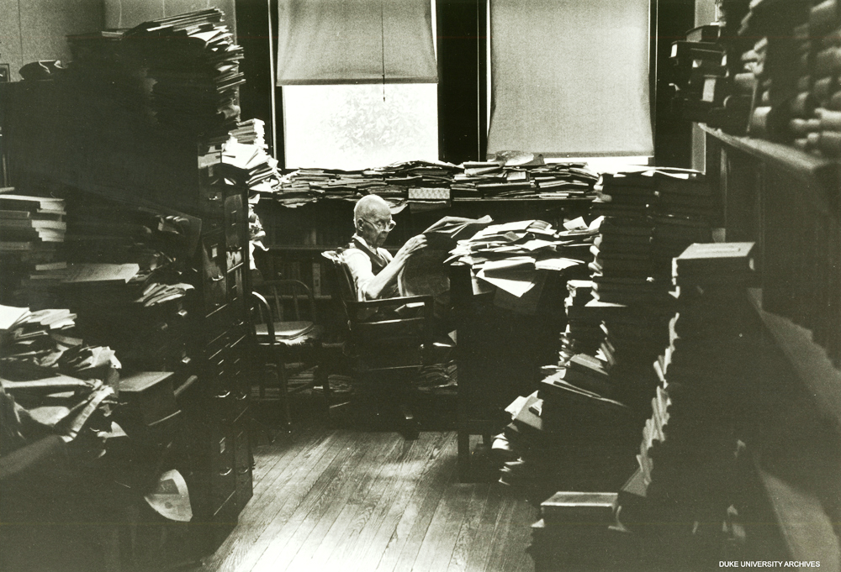
Why it must be Creative….. Your Donor’s Inbox
Notes:
These things are important because we all get inundated!!!!!

Slide 35
Review
Special Events
Personal solicitation
Telephone solicitation
Internet solicitation

