Slide 1
Market Failures
Ing. Marek Vyskočil

Slide 2
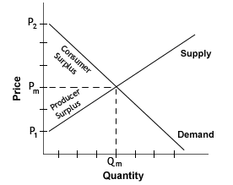
Market efficiency
Revision:
The invisible hand
of competitive
markets
Price mechanism
Pareto efficiency
Individual´s welfare
Perfect competition
„If private markets are efficient, why should there be an economic role for government?“

Slide 3
Market failures
Conditions under which markets are not efficient
Reasons for government interventions
Causes of market failures:
1)Public goods
2)Failure of competition
3)Information asymmetry/failures
4)Externalities
5)Incomplete markets or Missing markets
6)Unemployment, inflation,
disequilibrium
7)Property rights
8)Distribution of wealth
9)Public benefit

Slide 4
Public goods
Goods that either will not be supplied by market or, if supplied, will be supplied in insufficient quantity
Example: national defense, navigational aids (light house)
These are called pure public goods
Non-rival consumption – it’s not desirable to exclude anyone from the benefits (MC of providing to an additional person = 0). Private provision -> underconsumption or undersupply
Non-excludability – it’s not feasible to exclude anyone from the benefits of the good (cost of exclusion is too high) -> free rider problem
Free-rider problem
Public goods x Publicly provided goods

Slide 5
Failure of competition
For markets to result in pareto efficiency, there must be perfet competition
Large number of firms
That has no effect on prices
Homogeneous product
No barriers to enter the market
In some industries, conditions are not valid – imperfect markets
Monopoly – singl firm
Oligopoly – few firms
Monopolistic competition – many firms with slightly different goods

Slide 6
Monopoly
Types of the monopoly
Geographic monopoly
Natural monopoly
Technological monopoly
Government granted monopoly
Monopoly exists on the markets, where:
Exists only one company on the market
There are no substitutes of the goods
There are very high barriers to enter the market
Monopoly solutions
Supporting competition
Regulations
Public ownership
Simply doing nothing
… pros and cons?

Slide 7
Monopoly
MC
$
Dead weight loss
P_{M}
P_{M} = monopoly price
P_{eff} = efficient price
Q_{M} = monopoly quantity
Q_{eff} = efficient quantity
P_{eff}
D
0
Q_{M}
Q_{eff}
Q
MR

Slide 8
Information asymmetry
Imperfect information – situation when one party of the trade doesn´t have all information needed to make proper decision
Content of products, used car markets, medicine
Solution: government interventions, NGOs iniciatives, regulations(labelling content) and certificates (of quality or education).
Moral hazard - if a party that is insulated from risk has more information about its actions than the party paying for the negative consequences of the risk.
Adverse selection - market process in which undesired results occur when the "bad" products or services are more likely to be selected.

Slide 9
The Market for Lemons:
Market of used cars
There are good used cars ("cherries") and defective used cars ("lemons")
Many important mechanical parts and other elements are hidden from view and not easily accessible for inspection, the buyer of a car does not know beforehand whether it is a cherry or a lemon
Buyer will be willing to pay for it only the price of a car of known average quality (average price between lemon and cheery).
This means that the owners of cherries will be unable to get a high enough price to make selling that car worthwhile.
Therefore, owners of cherries will not place their cars on the used car market. The withdrawal of cherries reduces the average quality of cars on the market, causing buyers to revise downward their expectations for any given car.

Slide 10
Externalities and markets
Whenever an individual or firm undertakes an action that has an effect on another individual or firm, for which the latter doesn’t pay or is not paid
Types:
Positive and negative externalities
In production and in consumption
Undersupply of goods - positive externalities
Overproduction of goods - negative externalities

Slide 11
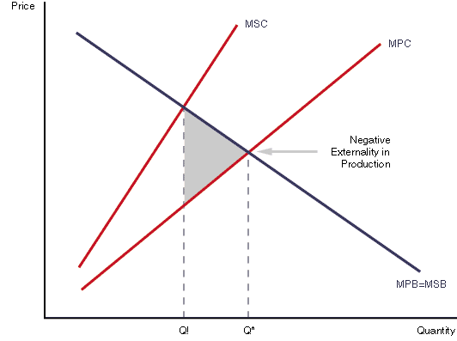
Negative externality in production
Source: thestudentroom.co.uk

Slide 12
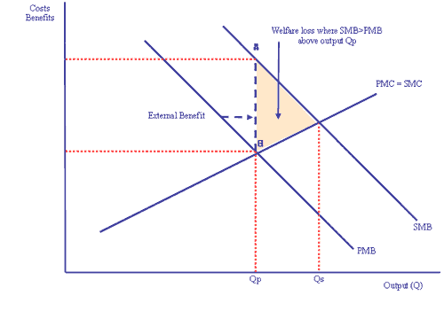
Positive externality in consumption
Source: tutor2u.net

Slide 13
Externality solutions
Public solutions
Fines and taxes – corrective tax (Pigouvian tax)
Subsidies
Regulations
Marketable permits
Private solutions
Internalizations (joinning two companies in one (where one of the companies is producer of the externality and the other one is accepter of the externality))
Coase Theorem (assign property rights)

Slide 14
Pigouvian tax
A Pigouvian tax is a tax applied to a market activity that is generating negative externalities. The tax is intended to correct an inefficient market outcome, and does so by being set equal to the negative externalities
Problem: determination of the tax, measurement of social cost is almost impossible

Slide 15
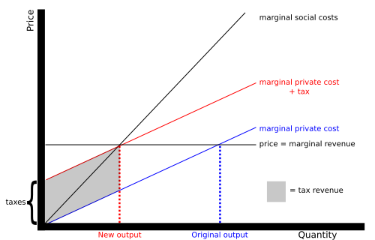

Slide 16
Coase Theorem
If trade in an externality is possible and there are no transaction costs, bargaining will lead to an efficient outcome regardless of the initial allocation of property rights
There is an assumption of
Zero transaction costs
Clearly defined property rights
Examples in lecture (loud party next door, doctor and barber)

Slide 17
Incomplete markets
Are markets that fail to provide adequately good or service even thought the cost of providing it is less than what individuals are willing to pay.
Some economist believe that private markets have done a poor job of providing insurance and loans
Private market does not provide insurance for many important risks that individuals face
Causes: transactions costs , asymetries of information, enforcement costs
Solution: government undertake a number of initiatives, insurance programs, loans and guarantees

Slide 18
Unemployment, inflation, disequilibrium
Widely recognized symptoms of market failure
Periodic episodes of high unemployement or hight inflation
Periods of recessions and depressions
For most economists -> evidence that something is not working well.
Economic cycles (growth, recession of GDP)
Stabilization policy (solution and even possible cause)

Slide 19
Property rights
Problem of Open-access property, property that is not owned by anyone.
Open-access property may exist because ownership has never been established, because the state has legislated it, or because no effective controls are in place, or feasible.
Ocean fisheries, atmosphere (over consumption)
Example: Cows x Elephants, unowned land and sheeps
Solution: convert types of property, gov.regulations
proposed by Ronald Coase that clearly defining property rights would resolve environmental problems by internalizing externalities

Slide 20
Two other reasons for government intervetion..

Slide 21
Distribution of wealth
Not market failure per se
The fact that eonomy is pareto efficient says nothing about the distribution of income
Competitive markets may give rise to a very unequal distribution, may leave individuals with insufficient resources
Solution: government redistribution of wealth
Solution as part of problem – inefficiency of redistribution

Slide 22
Public benefit
Argument for government intervention
Even in pareto efficient economy individuals may not act in their own best interest, even full informed cnsumers may make „bad“ decisions.
Examples: smokers, seat belts
Solution: regulations (seat belts), taxes (cigarettes)
Paternalism: government know best interest of individuals better than they do themselves
May be connected with externalities (smokers)

Slide 23
Interrelationships of market failures
Market failures are not mutually exclusive
Information problems – missing markets (inexisting supply)
Property rights- missing markets (market with fishing rights)
Public benefit – externalities (smoking)

Slide 24
Literature
Recommended:
STIGLITZ, Joseph E. Economics of the public sector. 3rd ed. New York: W. W. Norton, c2000, xxiii, 823 p. ISBN 03-939-6651-8.
Chapters 4 and 9 (market failures and externalities)

Slide 25
Thank you for your attention!

