Slide 1
Hurwitz score related decision making methods
Skorkovský
Department of business economy

Slide 2
Uncertainty-Risk
Although the possible returns of the investment are beyond the control of the decision maker, the decision maker might or might not be able or willing to assign probabilities to them.
If no probabilities are assigned to the possible consequences, then the decision situation is called "decision under uncertainty".
If probabilities are assigned then the situation is called "decision under risk".
This is a basic distinction in decision theory, and different analyses are in order.

Slide 3
First approach
Alternative 1
10000000 USD
Decision
(what to do ?)
Alternative 2
500000 EUR
Outcomes
Shares in diamond mines
Alternative i
8000000 EUR
Bonds
A/O | O1 | O2 | O3 | O4 | O5
A1 | po11 | po12 | po13 | po14 | po15
A2 | po21 | po22 | po23 | po24 | po25
A3 | po31 | po32 | po33 | po34 | po35
A4 | po41 | po42 | po43 | po44 | po45
Decision
Table
(payoff table)
Antiquities
Where : A=alternative(action); O=Outcome, po=payoff (benefits), (přínosy, prospěch)
A=(A1,A2,…Ai) = inventory of viable options=vector, O=(O1,O2,…Ok)= outcome vector

Slide 4
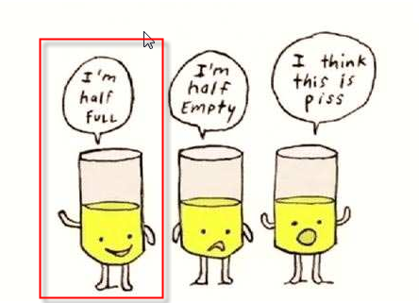

Chosen criteria I
MaxiMax
  MaxiMax is the rule for the optimist. A slogan for MaxiMax might be "best of the best" - a decision maker considers the best possible outcome for each course of action, and chooses the course of action that corresponds to the best of the best possible outcomes
Example of the decision table I (best of the vector {800,400,200,100} is 800 !!
Choices | Profit
 | Strong market | Fair market | Poor market
invest $8000 | $800 | $200 | -$400
invest $4000 | $400 | $100 | -$200
invest $2000 | $200 | $50 | -$100
invest $1000 | $100 | $25 | -$50
Example II

Slide 5

MaxiMax Payoff
Select the alternative which results in the maximum of maximum payoffs; an optimistic criterion
Payoff Table
 | Outcomes
Alternatives | O1 | O2 | O3
A | $1,000 | $1,000 | $1,000
B | $10,000 | -$7,000 | $500
C | $5,000 | $0 | $800
D | $8,000 | -$2,000 | $700
Maximum Payoff
$1,000
$10,000
$5,000
$8,000
B > D > C > A
Alternatives (invested amount, expectant spouse inheritance, type of the car,..)

Slide 6
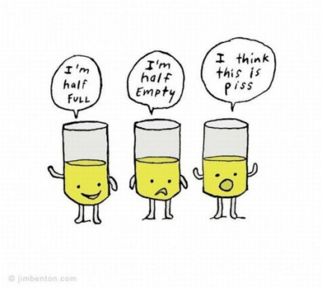
Chosen criteria II
MaxiMin
  The MaxiMin decision rule is used by a pessimistic decision maker who wants to make a conservative decision. Basically, the decision rule is to consider the worst consequence of each possible course of action and chooses the one that has the least worst consequence (in our case= -50). So it is better to invest nothing !!!!
Choices | Profit
 | Strong market | Fair market | Poor market
invest $8000 | $800 | $200 | -$400
invest $4000 | $400 | $100 | -$200
invest $2000 | $200 | $50 | -$100
invest $1000 | $100 | $25 | -$50
Example II

Slide 7
MaxiMin Payoff
Select the alternative which results in the maximum of minimum payoffs; a pessimistic criterion
Payoff Table
 | Outcomes
Alternatives | O1 | O2 | O3
A | $1,000 | $1,000 | $1,000
B | $10,000 | -$7,000 | $500
C | $5,000 | $0 | $800
D | $8,000 | -$2,000 | $700
Minimum Payoff
$1,000
-$7,000
$0
-$2,000
A > C > D > B

Slide 8
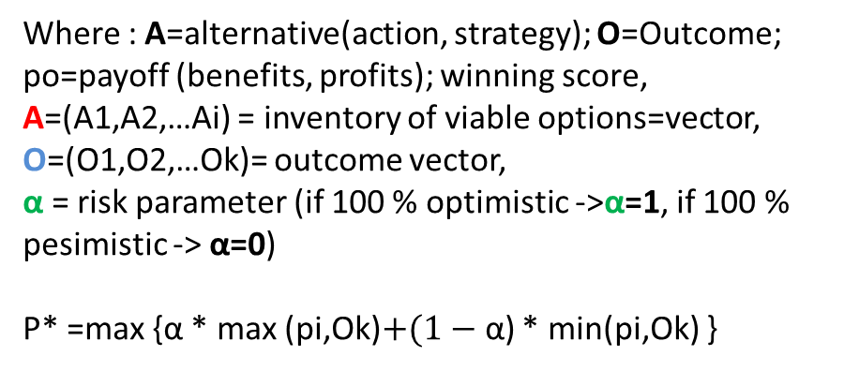
Decision Strategy I
(Hurwitz criterion allows to choose strategies depending on propensity (inclination, tendency) to risk,
A/O | O1 | O2 | O3 | O4 | O5
A1 | po11 | po12 | po13 | po14 | po15
A2 | po21 | po22 | po23 | po24 | po25
A3 | po31 | po32 | po33 | po34 | po35
A4 | po41 | po42 | po43 | po44 | po45
Where : A=alternative(action, strategy); O=Outcome; po=payoff (benefits, profits); winning score, A=(A1,A2,…Ai) = inventory of viable options=vector,
O=(O1,O2,…Ok)= outcome vector,
α = risk parameter (if 100 % optimistic ->α=1, if 100 % pesimistic -> α=0)
P* =max {α * max (pi,Ok)$+(1−\text{α}$) * min(pi,Ok) }
Example on the next slide

Slide 9
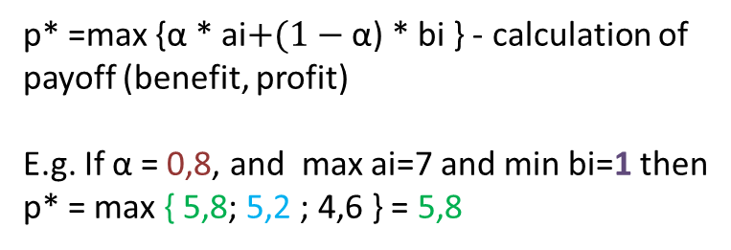
Decision Strategy II
A/O | O1 | O2 | O3 | a=max | b=min
A1 | 1 | 5 | 7 | 7 | 1
A2 | 3 | 2 | 6 | 6 | 2
A3 | 5 | 4 | 3 | 5 | 3
Where ai = max (pi,Ok) and bi=
min(pi,Ok)
p* =max {α * ai$+(1−\text{α}$) * bi } - calculation of payoff (benefit, profit)
E.g. If α = 0,8, and max ai=7 and min bi=1 then
p* = max { 5,8; 5,2 ; 4,6 } = 5,8
Where 5,8=7*0,8+(1-0,8)*1=5,6+0,2; 5,2=6*0,8+(1-0,8)*2,…….
First line
Second line

Slide 10

Thanks for Your attention

