Slide 1


MS Dynamics – nothing simpler
Jaromír Skorkovský
Training Manager
Anytime

Slide 2
Agenda – concise screening of MS Dynamics NAV
MS Dynamics – nothing simpler
Short Live introduction–sales-replenishment-purchase-general ledger(International world wide demo database -WW)
PWP Nothing simpler – form sequences and basic logic
Live system (WW database – Financial Management)
  Chart of accounts – structure – entries->Navigation
  Budget
  Setup – Posting Group ->main setup in order to ensure proper and simple booking in the background of NAV
Reporting – standard
Accounting Schedules – reason, type of reports,…
MS Dynamics Role Tailored Client live show - principles
Discussion

Slide 3

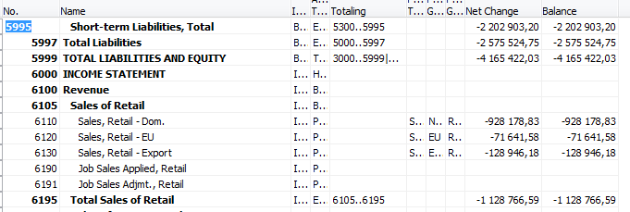
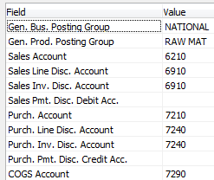



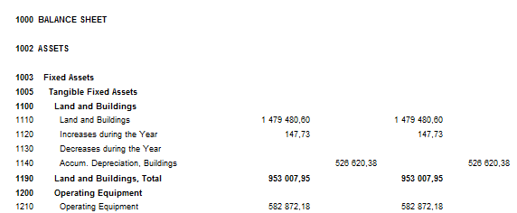
Accounting in NAV in one perspective I
Main principles of reporting
Customer|Vendor
Chart of accounts
Business posting group code
Customer|Vendor
Order
Posting
G/L Entries
Reporting
Business posting group code ,VAT,..
Item,Resource, Account,..
Item,Resource, Account,..
Stock value
G/L Entries
Item,Resource, Account,..
Item,Resource, Account,..
Item ledger Entries

Slide 4
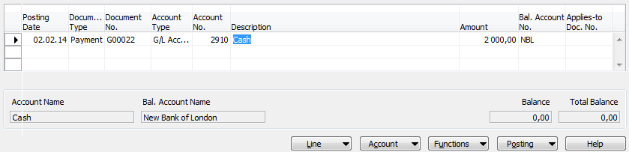

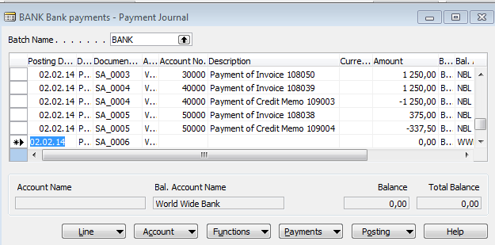
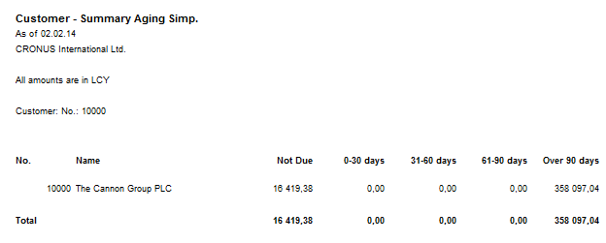
Accounting in NAV main tool = General Journals
Chart of accounts
Cash account
G/L Entries
Bank account
Reporting
Reporting
G/L Entries

Slide 5
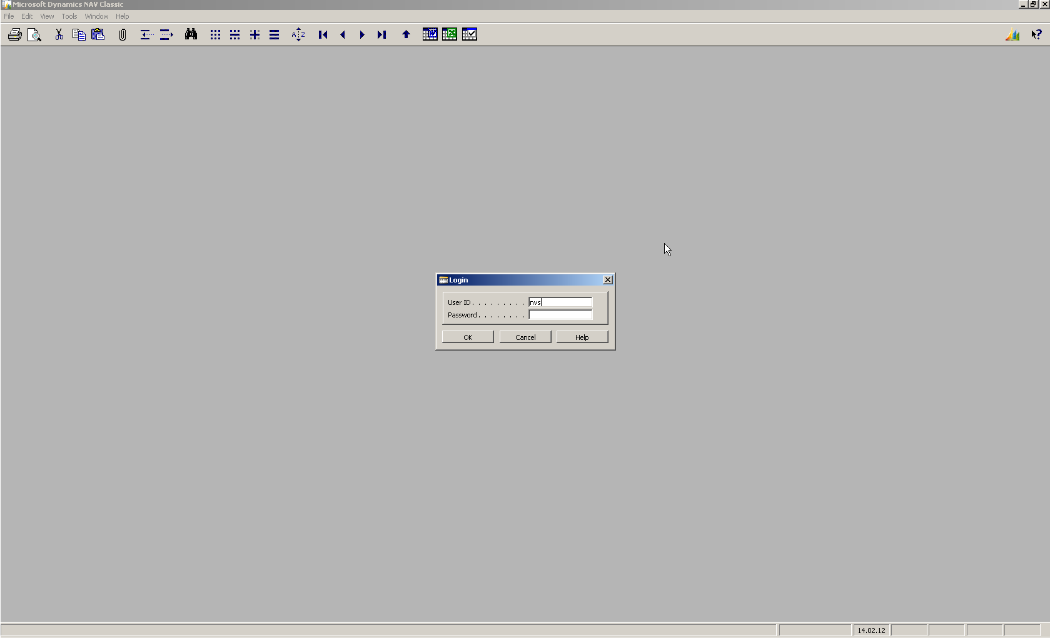
MS Dynamics – nothing simpler
Notes:
Protected Access to the system (ID and passwords).

Slide 6
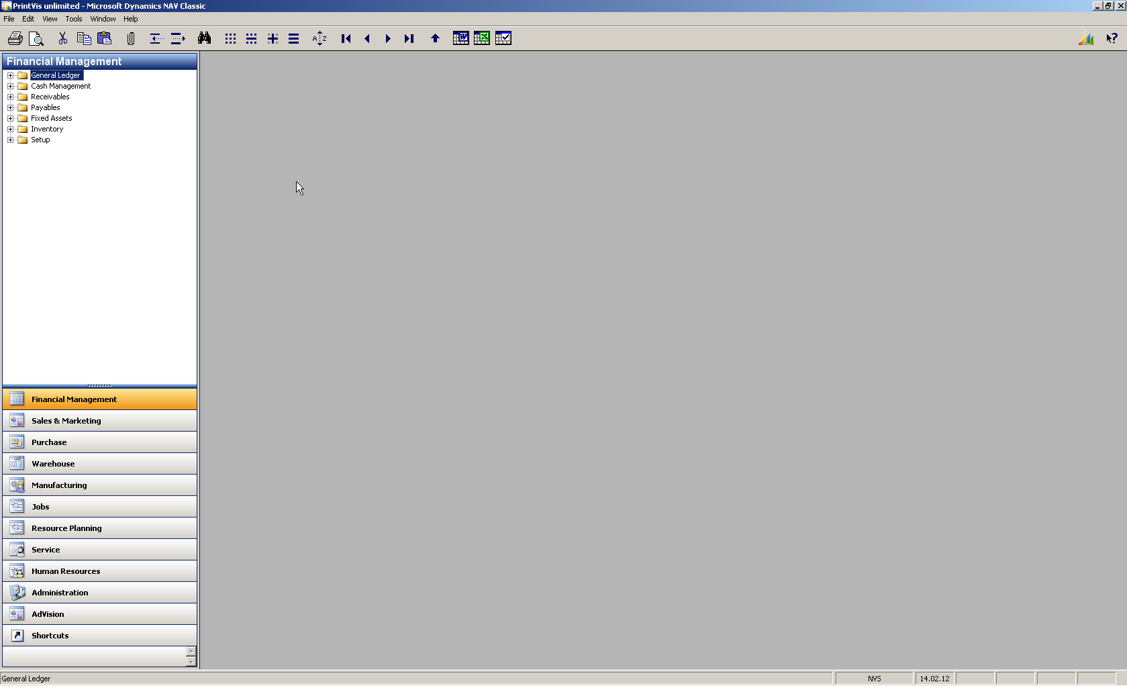
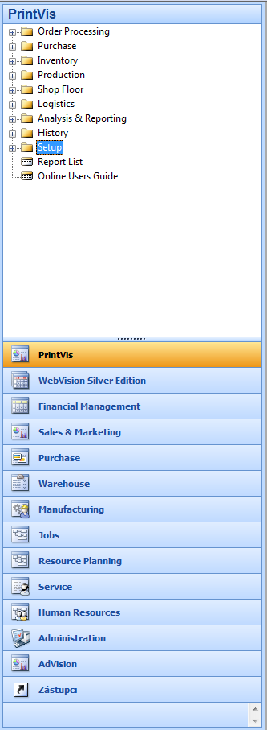
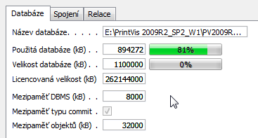
MS Dynamics – nothing simpler
Info for presenter : Database open from
Working area
Notes:
Modularity- similarity to MS Office (such as Outlook)- Setup of the ERP functionality (modules) based on user requirement

Slide 7
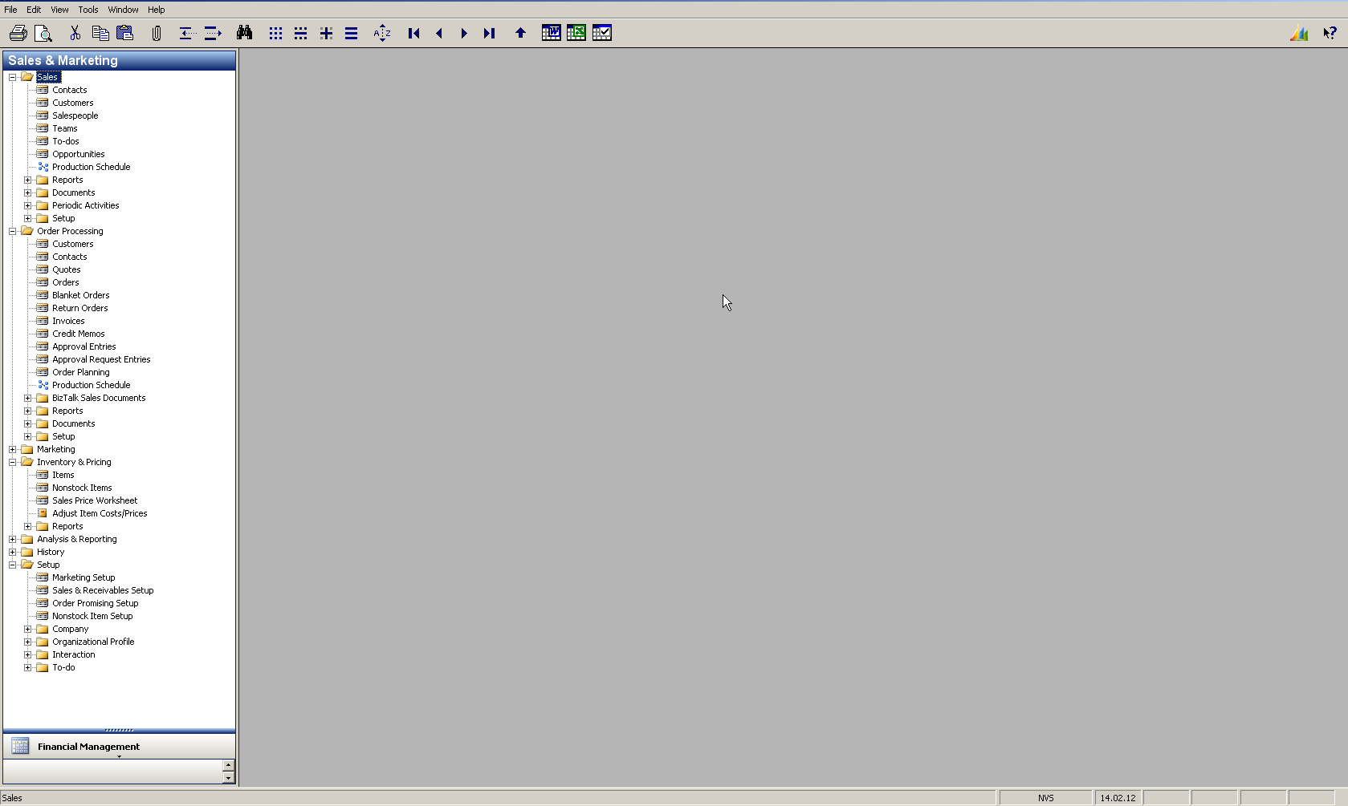
MS Dynamics – nothing simpler
Working area
Notes:
One of the chosen menu module expanded. Every partial menu structure is similar, so finding the right functionality is very easy

Slide 8
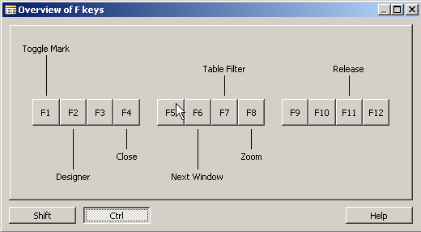
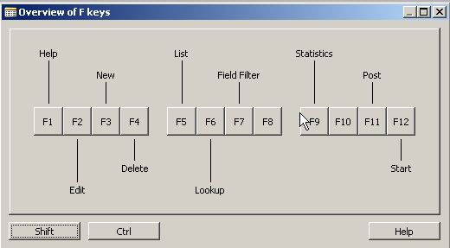
MS Dynamics – nothing simpler
Notes:
For control of your steps (processes) a mouse or key combination can be used. These combinations are same for every window type

Slide 9
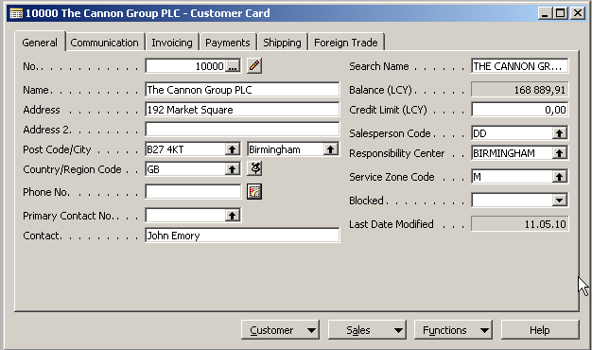
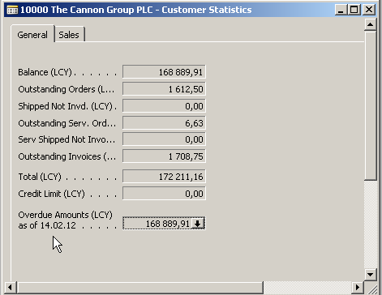
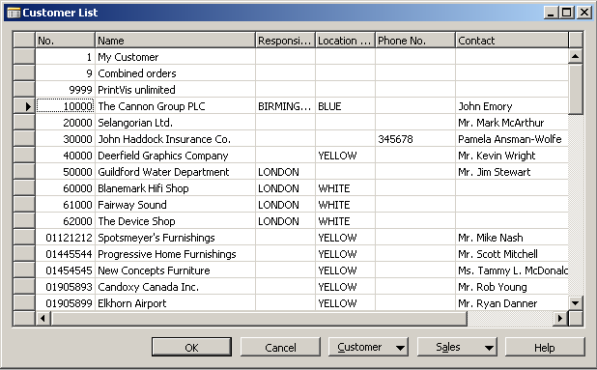
MS Dynamics – nothing simpler
Notes:
Data can be displayed by use of windows of the different types (card, list, form and sub-form->header and lines). You can have in the working area any quantity of the open windows. Anyhow , only one window is active at any moment. This is one example, where you can see a customer card, basic statistics for chosen customer and list of all customers in our database (one of many examples)

Slide 10
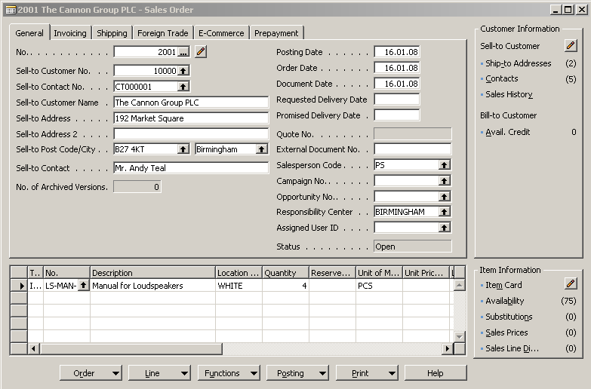
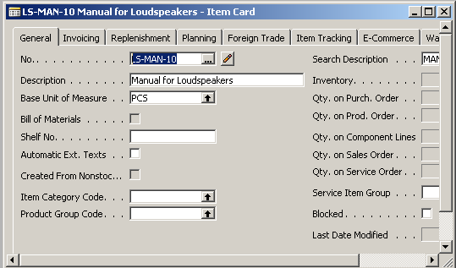
MS Dynamics – nothing simpler
Notes:
Another example : customer card, item card and combination of two single records (windows, cards) in the shape of form and sub-form windows, which represent a most common MS Dynamics NAV structure composed of header and lines , in the other words, a type of document such as quote, order, credit notes, invoice delivery list , production order and so on.

Slide 11
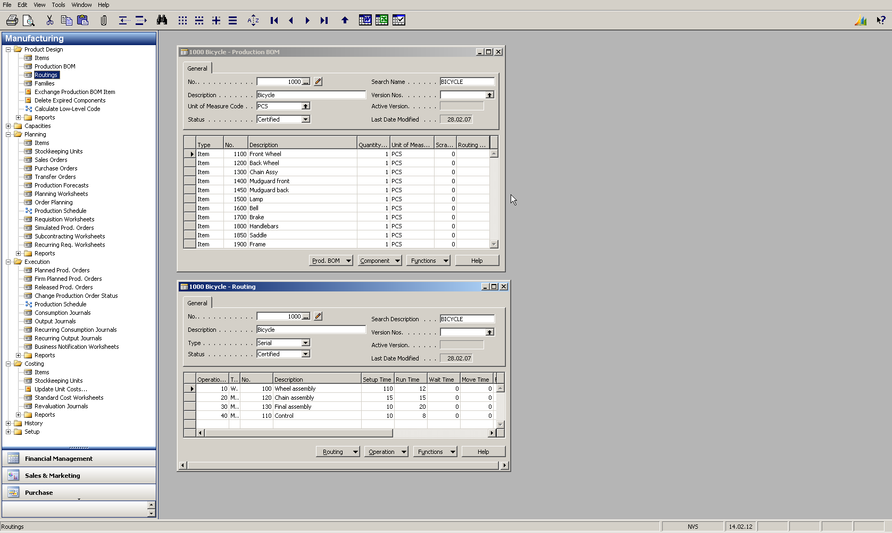
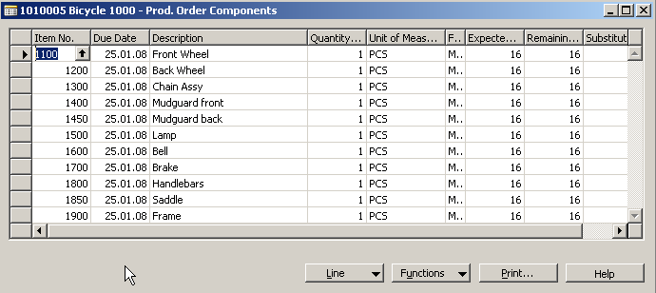
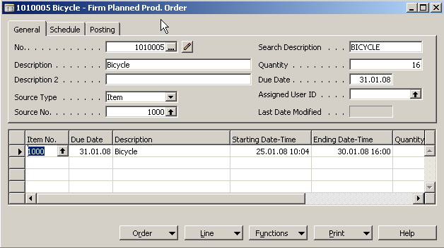
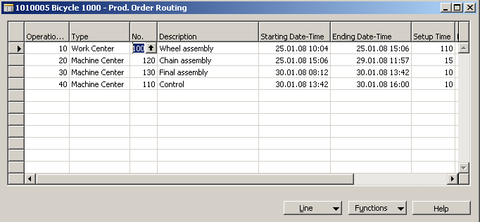
MS Dynamics – nothing simpler
Notes:
Another example of data representation from manufacturing application : Form representing structure of the final product (Bill-of -Material), another form (window) (bellow BOM) representing a routing (how to produce a final product) and then you see production order and its components and calculated job lines based of predefined routings.

Slide 12
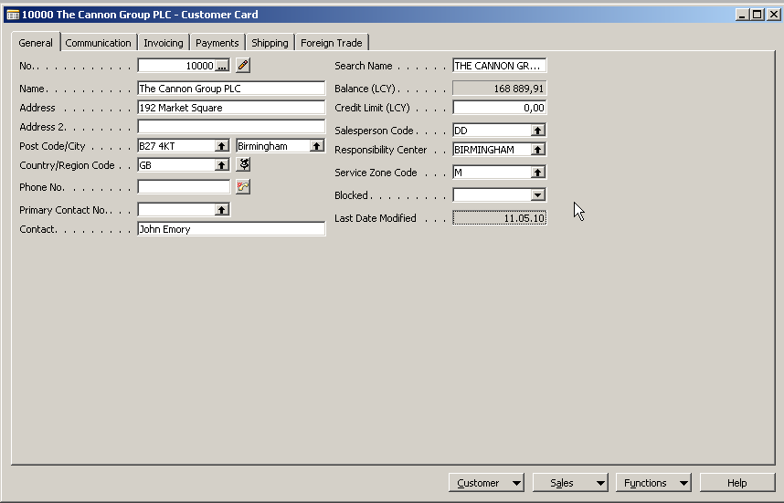
MS Dynamics – nothing simpler
Notes:
Calculated fields (flow fields) : a technical wizardry to show at any time when chosen window is open a current calculated value such a balance, inventory quantity and so on. Be aware : these values are never saved in the database. It is a virtual value !!!

Slide 13
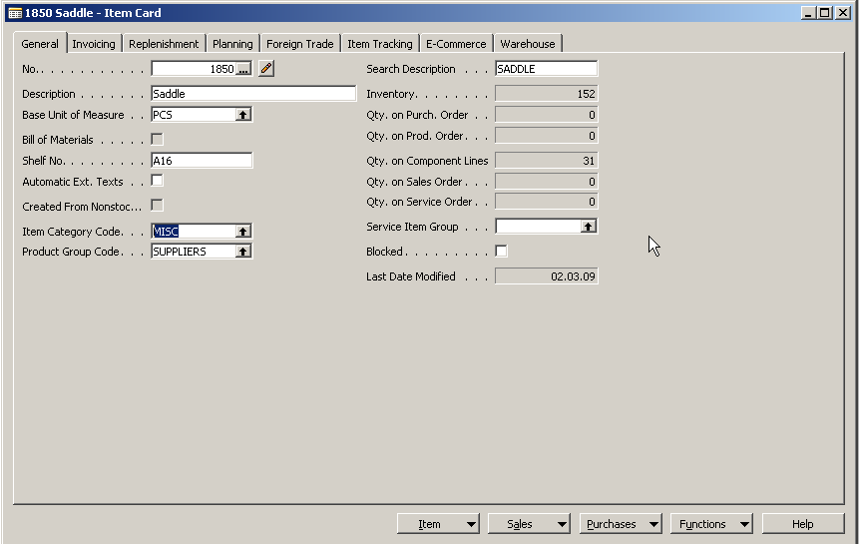
MS Dynamics – nothing simpler
Notes:
Calculated fields (flow fields) : a technical wizardry to show at any time when chosen window is open a current calculated value such a balance, inventory quantity and so on. On the above example you can see item card with calculated field inventory and quantity on all production orders component lines.

Slide 14
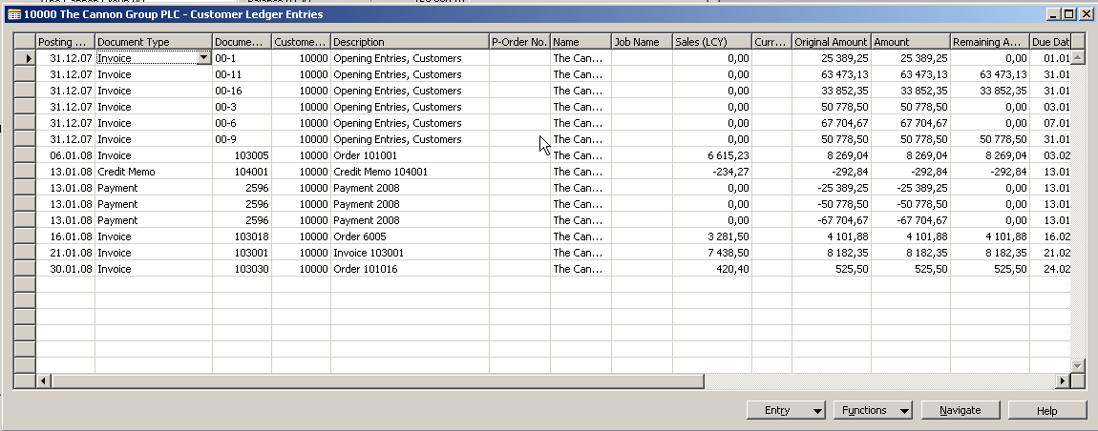
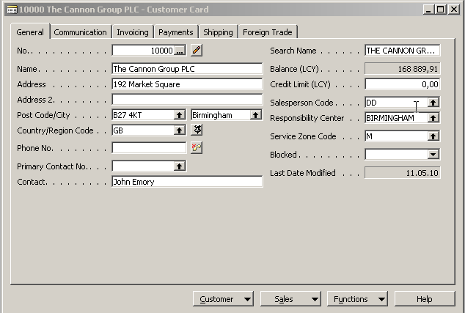
MS Dynamics – nothing simpler
Notes:
Calculation principles related to calculated fields (flow fields) : To every basic table (customer, vendor, item, account) a records called entries are related (connected). These entries have a common causes of its appearance in registration (booking, posting) of documents such as orders, invoices, production orders or credit notes. In our example we can see entries of the type invoice and some entries of the type payment. Payment entries apply invoice entries. If all invoice entries are applied , the calculated balance is zero

Slide 15
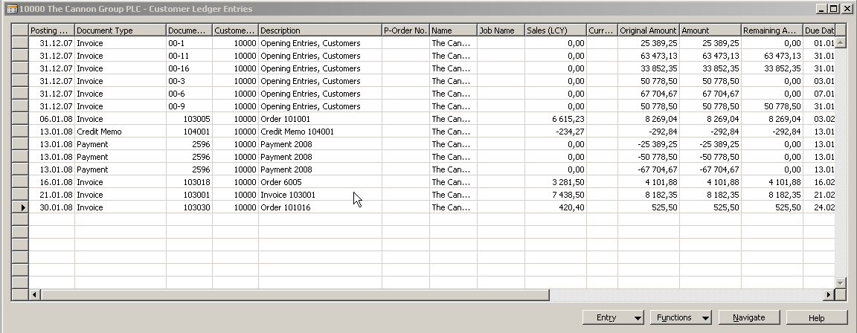
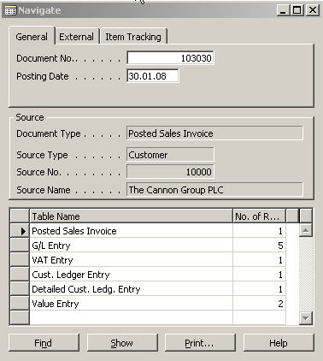
MS Dynamics – nothing simpler
Notes:
Navigate request panel to setup what you want to see

Slide 16
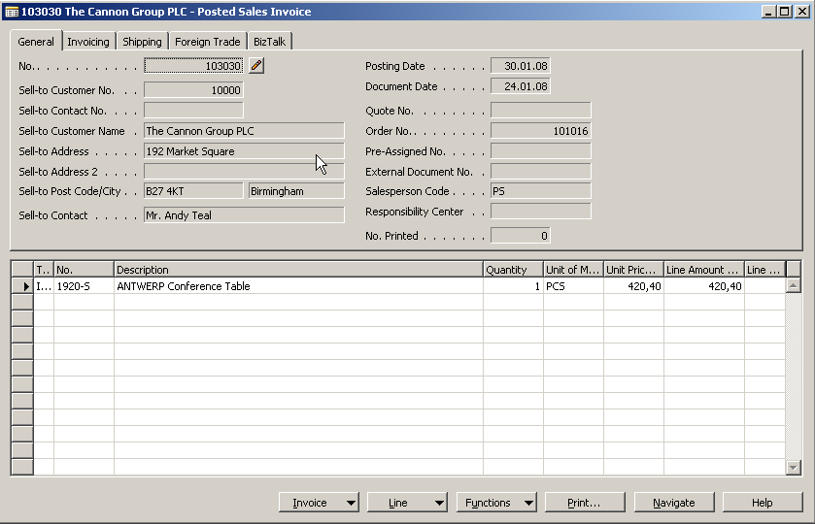
MS Dynamics – nothing simpler
Notes:
Navigated (found) document related to previously chosen entry

Slide 17
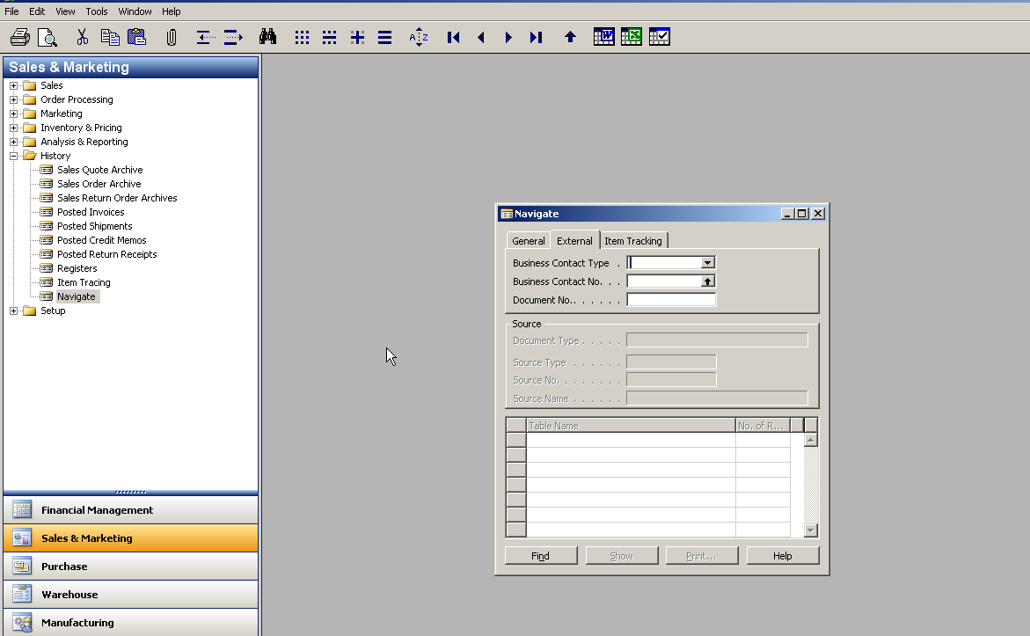
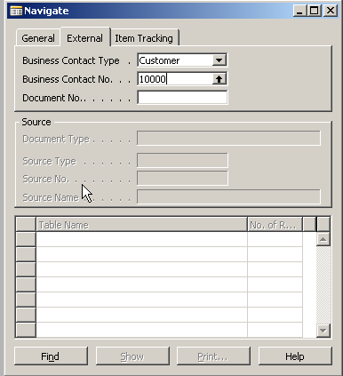
MS Dynamics – nothing simpler
Notes:
Navigation tool started from Menu item History, which can be found in most of the modules. The benefit of using is to find immediately any document of you know its specification (e.g. Number) or you can see all document related to chosen business partner (Vendor, Customer).

Slide 18
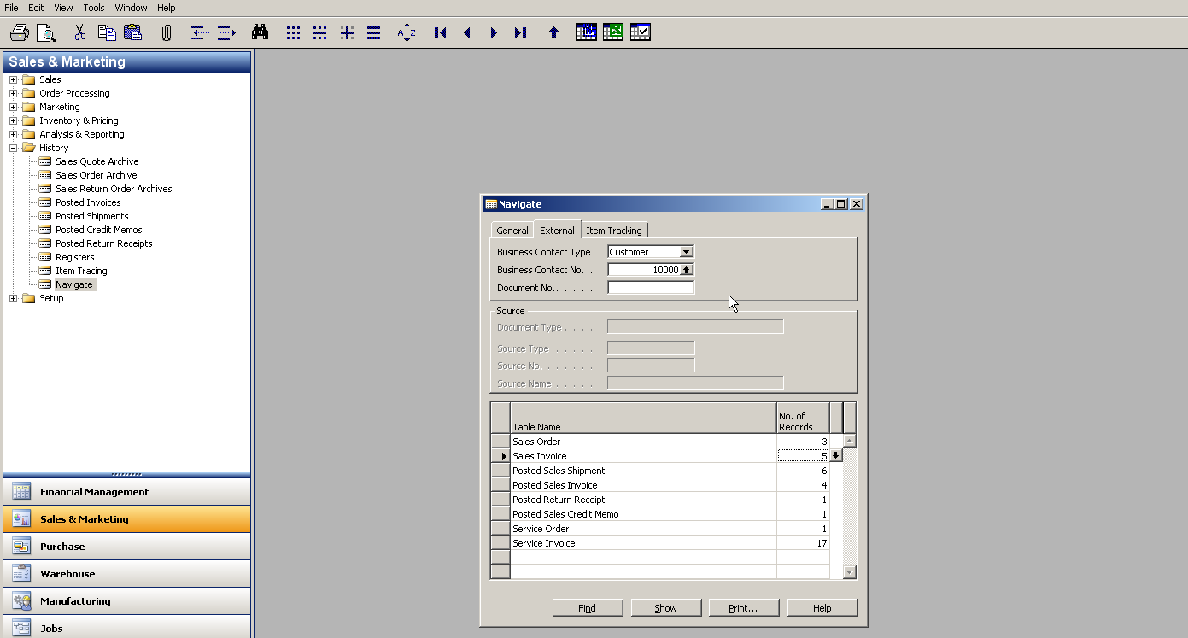
MS Dynamics – nothing simpler
Notes:
Navigate window with entered parameters (type of the partner =Customer and its number). You can see from here 3 already created Sales Orders, 5 Sales Invoices, 6 Posted Sales Shipment and so on. Kindly see next slide

Slide 19
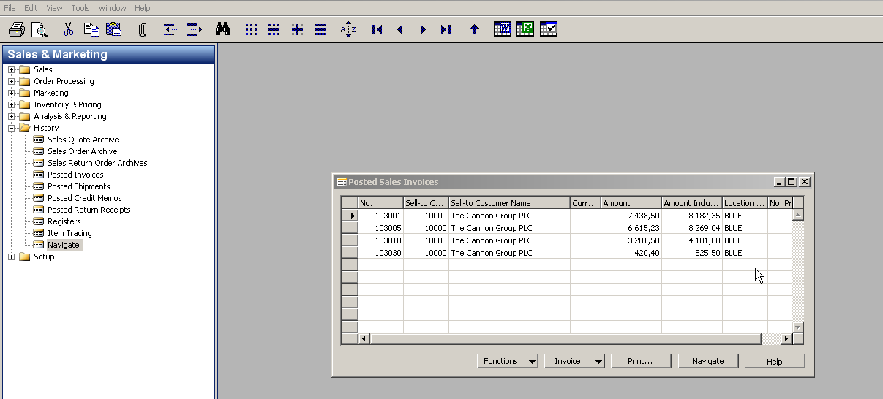
MS Dynamics – nothing simpler
Notes:
List of Posted Sales Invoices of one chosen customer. From here you can preview a document in question (required one)

Slide 20
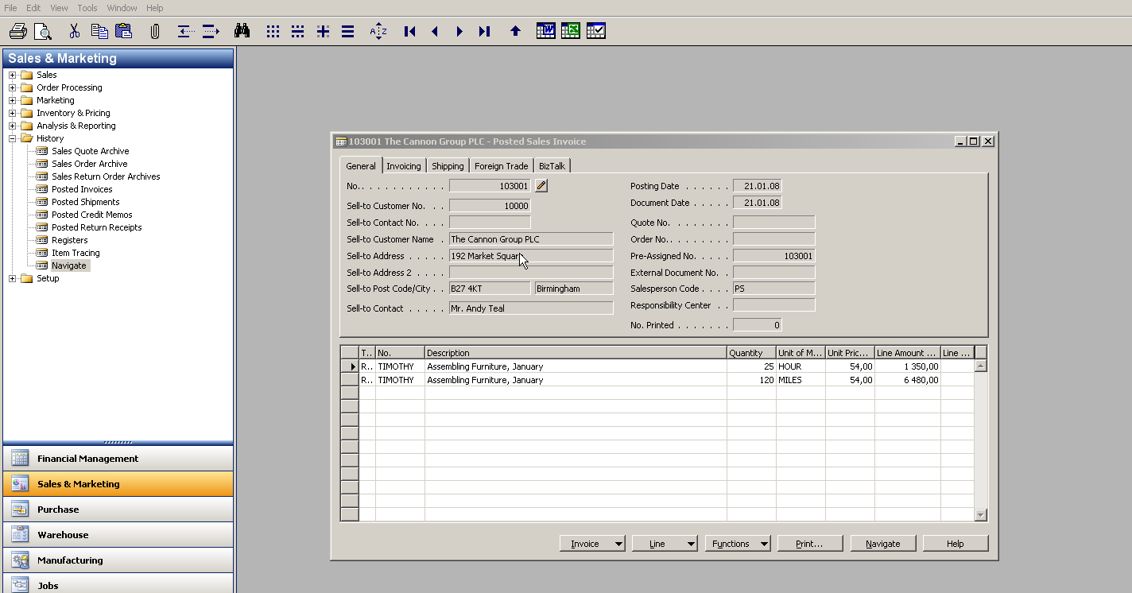
MS Dynamics – nothing simpler
Notes:
Found document related to chosen business partner and other parameters.
Navigation benefits: quick access to required information and better decision making based on such a information

Slide 21
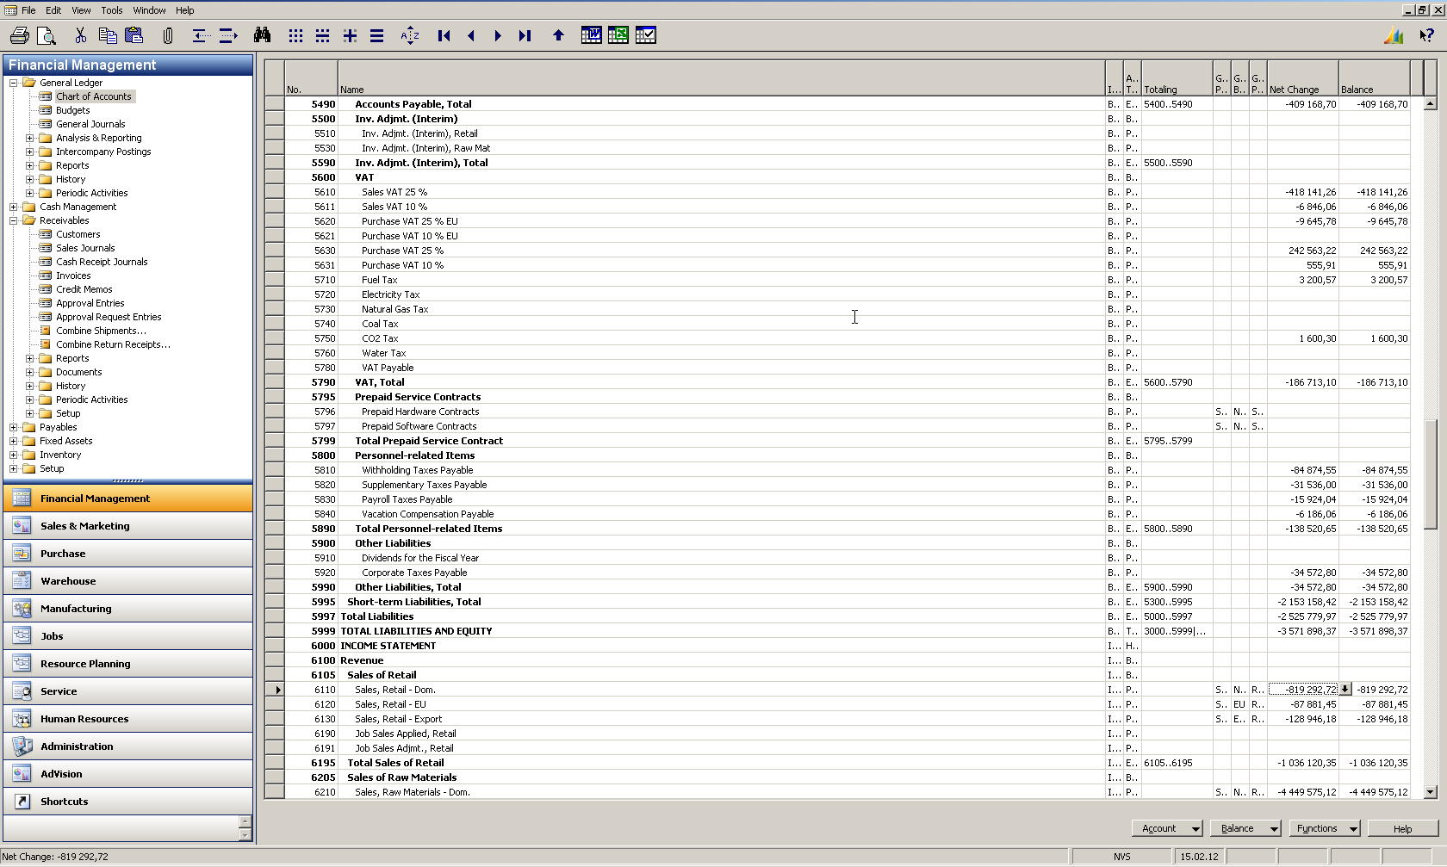
MS Dynamics – nothing simpler
Notes:
Principles connected with sweet point called Easily from Anywhere to Wheresoever. The example can be started e.g. from Chart of account. Chosen account will be chosen for the group of turnover ones. The field where a chosen amount is displayed is calculated field (flow field). You can see drill down arrow in order to display immediately related general ledger entries from where the final amount is calculated (total amount called here Net Change)

Slide 22
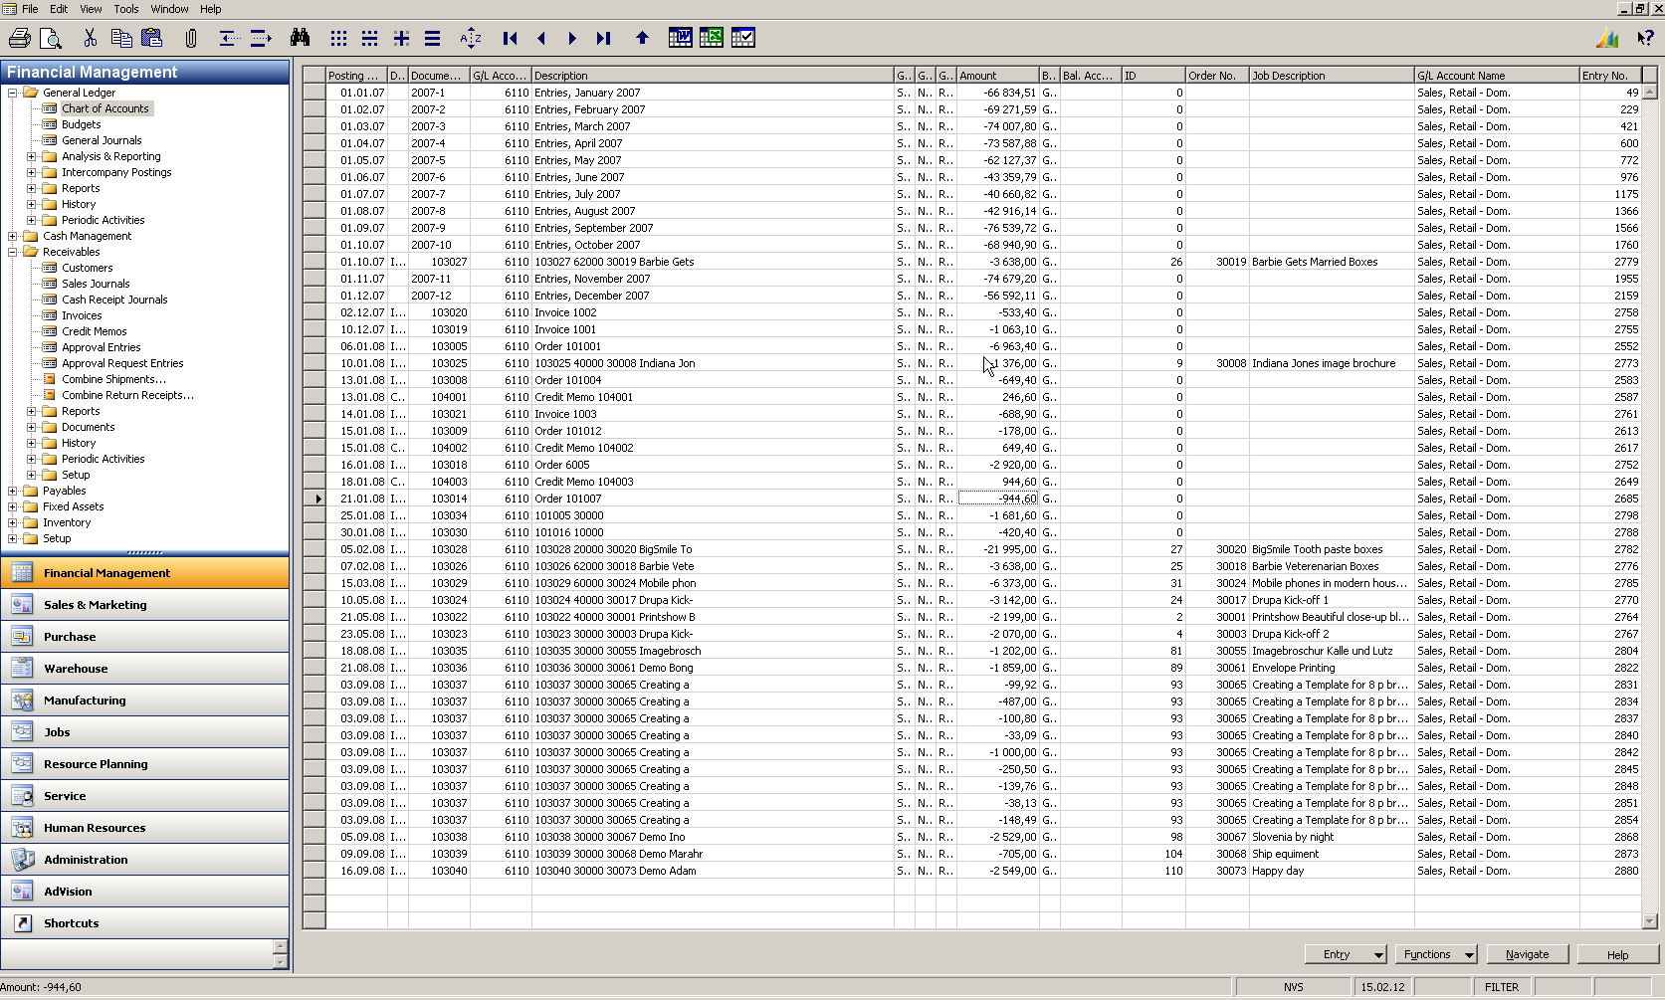
MS Dynamics – nothing simpler
Notes:
All general ledger entries having origin in booked documents (e.g .invoices). Mind you, that these entries are only entries related to one and only one sales account (filtering). From chosen entry we will go to document by use of Navigate tool (navigate functionality was already presented) in this power point show.

Slide 23
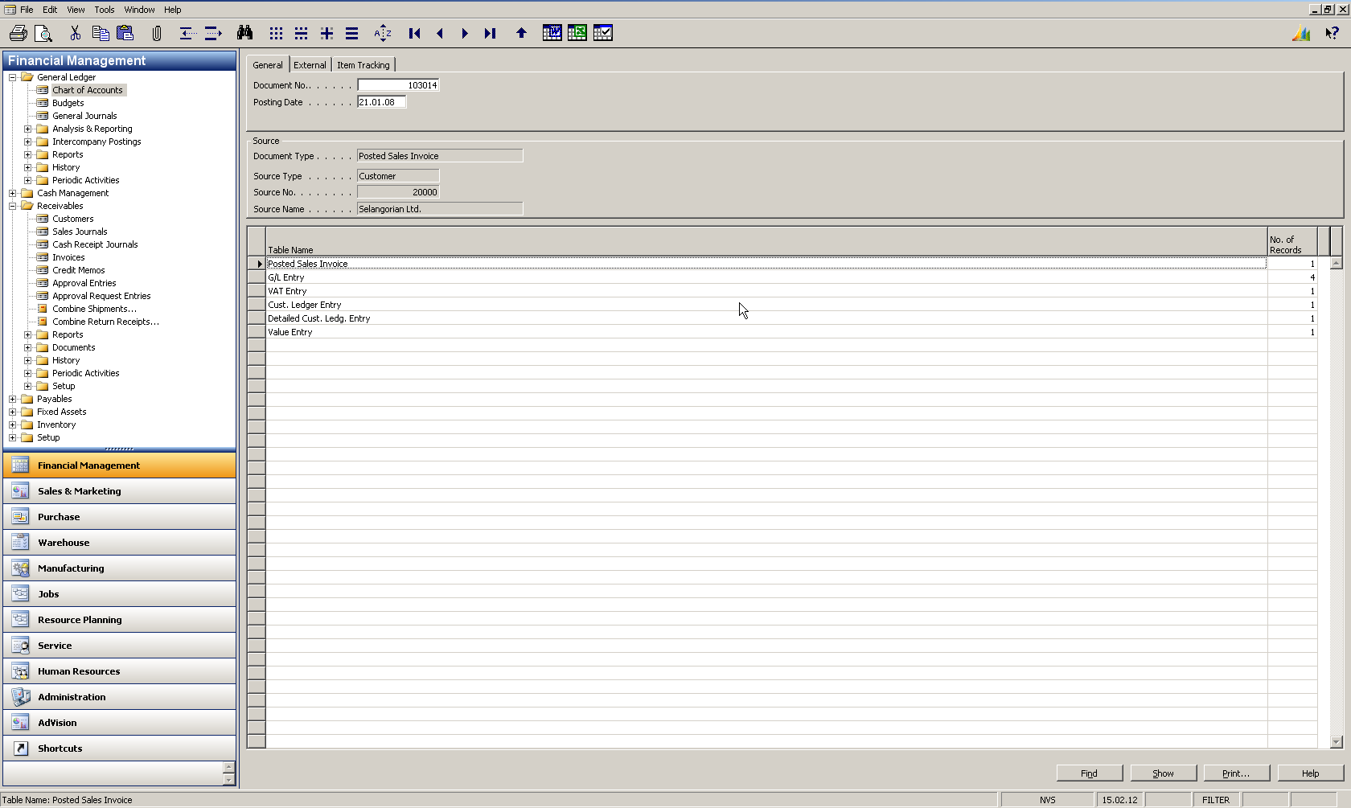
MS Dynamics – nothing simpler
Notes:
The result of the use of Navigation tool. From here we will go (by use of Show button) to Posted Sales Invoice

Slide 24
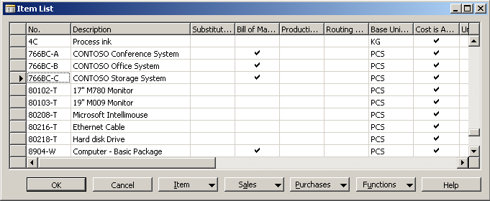
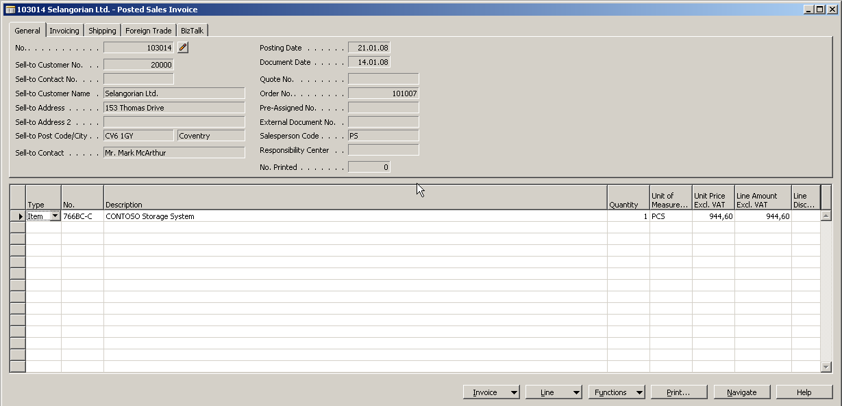
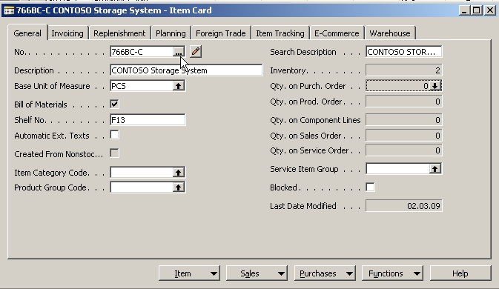
Notes:
From the displayed Posted Sales Invoice we will go directly to the inventory by use of Look-up function from the field No. of the Item in invoice line. So the next window is List of all items in our inventory and the next window is a item card which was sold .

Slide 25
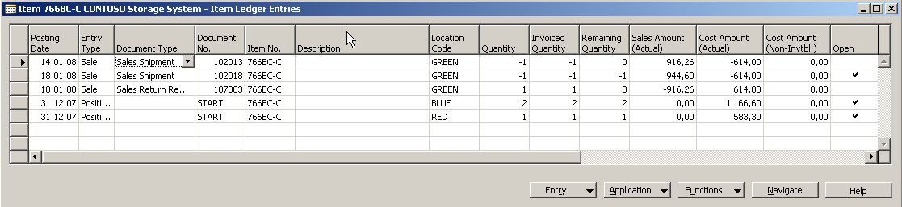
MS Dynamics NAV
Drill down function
Notes:
In order to see next step we went from Item Card to Item Ledger Entries, which are entries connected with item movements such as Sales, Purchase, Production , Transfer and so on.

Slide 26
MS Dynamics NAV
Chart of Accounts
Production Order
General Ledger Entries
Components (BOM)
Posted Sales Invoice
Item Ledger Entries
List of Items
Purchase Order
Item Card
Vendor Card
Item Ledger Entries
Vendor Statistics
WHAT WAS PRESENTED SO FAR
WHAT CAN BE ALSO SHOWN
Notes:
Presented sequence which can be far much complicated (from the Item ledger entries you go to production order (if sold Item was a final product), than from production order to component stored on inventory and from here again by use of Item Ledger Entries window to Purchase Order and form here e.g. to Vendor card …….in the other words never ending story !!!!

Slide 27

Reporting (NAV tools or JETs)
Reporting

Slide 28
Main principles (source tables and their entries)
Main principles of reporting
Control parameters
(time, type of products,
Costs, Revenue, Area,..)
Customer
Vendor
Item
Account
Dimension

Slide 29
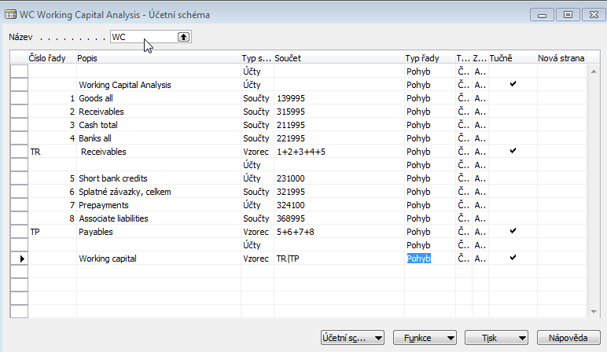
Some chosen analysis asked by CFO EUROM Czech Republic
Analysis
Working capital – setup of the accounting schedule from NAV

Slide 30
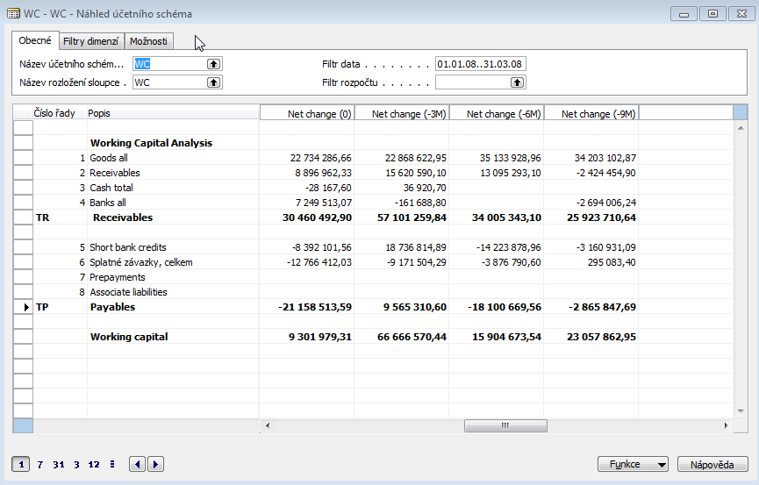
Analysis
Some chosen analysis asked by CFO EUROM Czech Republic
Working capital – Show of the results from NAV

Slide 31
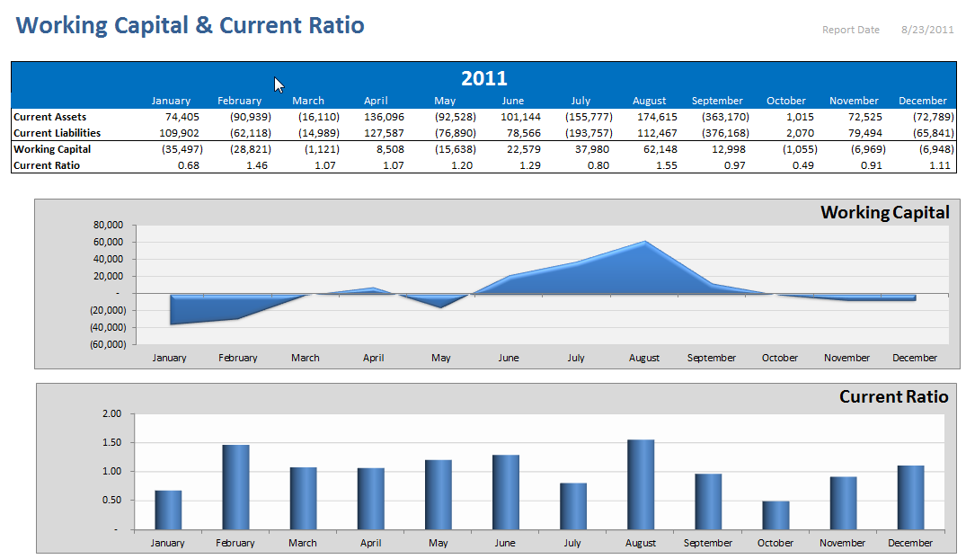
Some chosen analysis asked by CFO EUROM Czech Republic
Working Capital JETs
Working capital – Show of the results from JETs

Slide 32
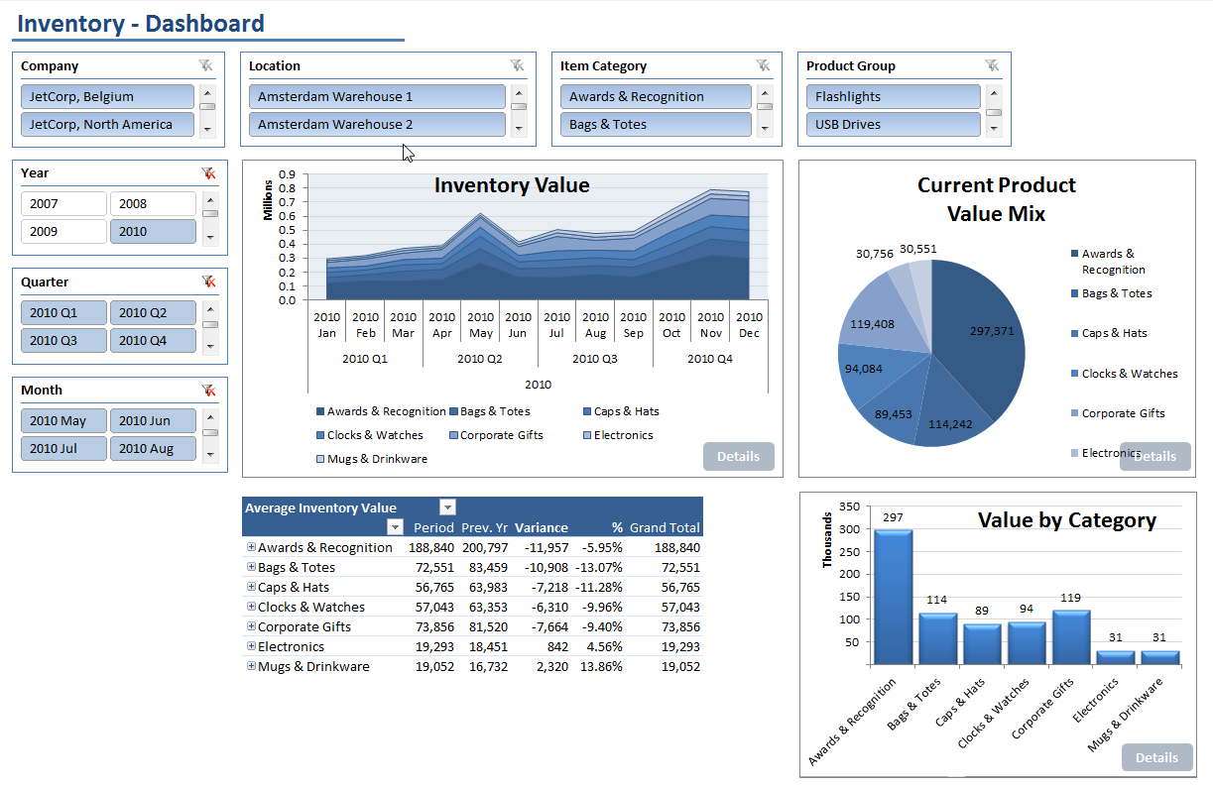
Some chosen analysis asked by CFO EUROM Czech Republic
Inventory Dashboard

Slide 33
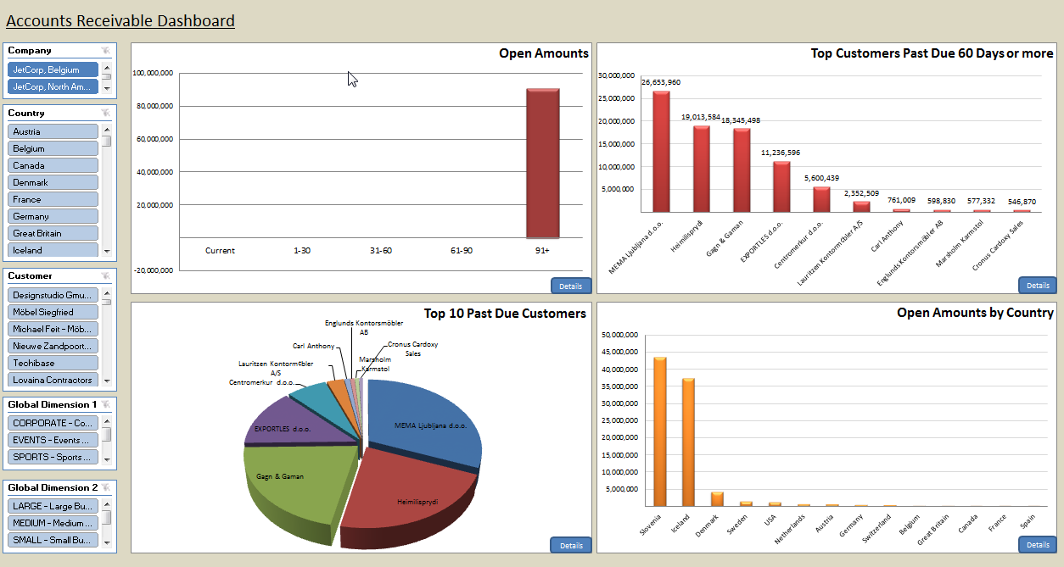
Some chosen analysis examples (JETs)
Analysis examples

Slide 34
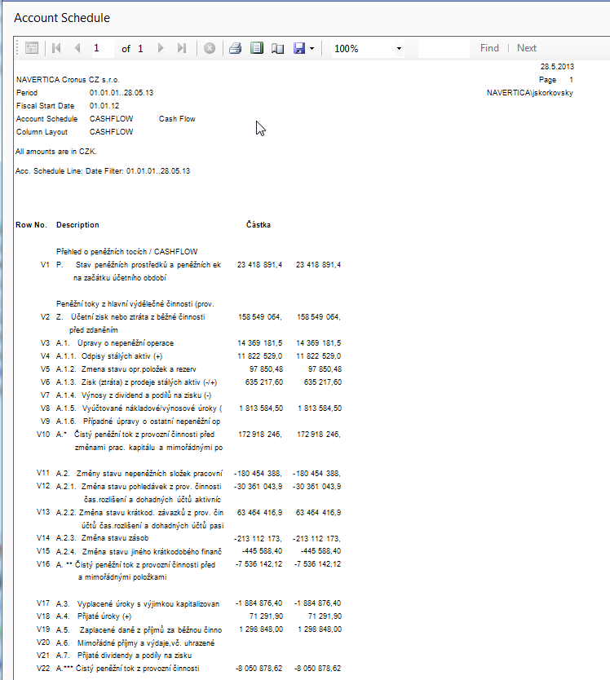
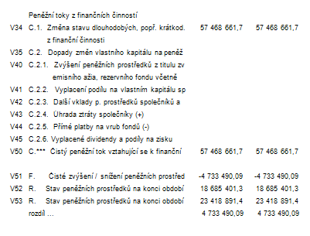
Some chosen analysis examples (directly from NAV)
Cash Flow
Cash flow page 1
Cash flow page 2

Slide 35
On line analysis example generated over database by JETS
Account receivables
Account Receivables with Details

Slide 36
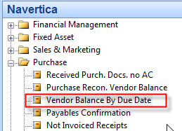
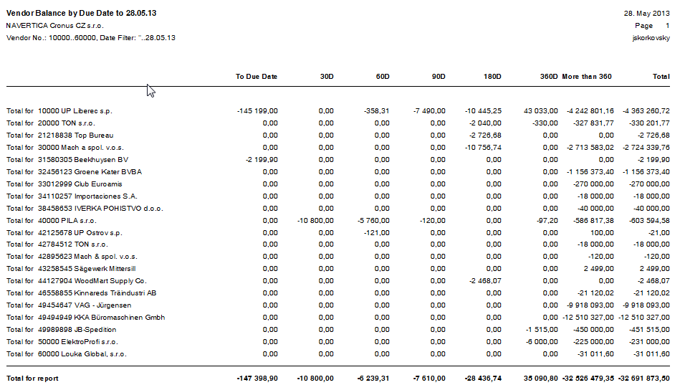
On line analysis example generated over database by directly from NAV
Account Payables

Slide 37
Simple business case
MS Dynamics NAV Nothing simpler
Purchase order creation
Booking (posting, registering to the system)
Impacts in transactions (G/L, Logistic, payables)
Some examples of MS Dynamics NAV financial reports

Slide 38

MS Dynamics NAV
F3
Notes:
The basics of simple business case. Purchase Order ->Posting ->Impacts of registration of Purchase order-> Sales Order->Posting->Impacts . On first slide you have started from menu Purchase ->Order processing ->Orders and you will see one of many Purchase Orders, which has been created by another user connected to NAV database. The next step will be creation a new Purchase Order by use of F3 key (create new)

Slide 39

MS Dynamics NAV
Notes:
After pushing a key F3 we will get an empty structure of the Purchase Order composed by header where a Vendor will be entered and lines for Item (G/L Account ,…) which will be purchased (supplied). Firstly but not lastly you have to push Enter key, which results creation of the unique document number. For selection of particular Vendor (in the purchase order header) and Item (purchase order line) we will use key F6 called look-up. Every chosen table (either Vendor table or Item table must be always confirmed by pushing Enter key.

Slide 40


MS Dynamics NAV
Notes:
The process of selection of the Vendor from the list of vendors by use of Look up key (F6)

Slide 41


MS Dynamics NAV
Notes:
After confirmed chosen Vendor we have to enter by some method an Item from list of items (by use of Look-up key F6 and confirmation of your choice by Enter key) .Than you have to enter quantity and inventory location. The cost price of the item is taken primarily from the Item card. Anyhow, it can be changed if you wish to do so.

Slide 42


MS Dynamics NAV
Notes:
On this slide you can see the finished Purchase Order. On the next slide we can print it by use of print button and on the next screen Preview button

Slide 43

MS Dynamics NAV
Notes:
Result of the preview of the Purchase Order. This can be sent by e-mail or post or can be printed as a pdf file (based fully on the user requirement)

Slide 44

MS Dynamics NAV
Notes:
By use of F9 key (Statistics- you can have a lot of different Statistics from different winds by use of F9 key) you can display a statistics of recently created document (Purchase Order). You can see automatically calculated VAT based on the setup of General Business Posting Group (Vendor Card) ,VAT Business Posting Group and Posting Groups setup on Item Card. This principle is also common for the Sales.

Slide 45


MS Dynamics NAV
Notes:
You can post Purchase Order by use of key F11. Meaning that MS Dynamics NAV system will automatically create general ledger entries, VAT entries and inventory and value entries (besides other entries such a possible reservation entries, dimension entries and so on). You have the third possibilities shown on the slide . Use the third one which is in fact preset one please. Be aware, that you have to enter before posting to the header of the Purchase Order Vendor Invoice Number .In this case the vendor invoice number is Miki_001. This code is important when apply invoice with payment.

Slide 46

MS Dynamics NAV
Notes:
After registration (posting) of the Purchase Order is done by use of key F11 recently created Purchase order disappears from orders pool and a new posted purchase invoice order is created and can be found in menu - > History->Posted Invoice -> and use key (see upper bar) to find the last created posted invoice

Slide 47



MS Dynamics NAV
Notes:
To observe all entries which have been created after posting Purchase Order by use of the key F11 we will firstly go to Menu Financial Management Module ->History ->Register where you can see all general ledger entries created by ERP system MS Dynamics NAV. The type of the transaction is marked by a code in the source code field (predefined subset of codes). For our purchasing example it is code „Purchases“ and by use of button Register and an option General ledger you will see all related entries. We have to say, that MS Dynamics NAV is firstly double-booking entry system. To distinguish Debit and Credit amount syntax of the NAV system uses positive/negative signs.

Slide 48




MS Dynamics NAV
Item card before
posting Purchase Order Posting
You can see even calculated
field showing, that Purchase Order
for 20 pcs has been created
Item card after posting
Notes:
Another impact of the posting Purchase Order is Inventory Accrual, meaning that system, beside automatically created Item Ledger entry, also calculates by use of flow field function on the item card a new final inventory level of the Item in question, so the original amount before purchase order posting was increased

Slide 49




MS Dynamics NAV
Vendor card before
posting
129446,40-11409,40=15350
Vendor card
after posting
Notes:
And lastly, a balance amount (payables) related to our Vendor, which has been used for delivery (purchase) increased. Firstly on the slide you see a Vendor card before a Purchase Order is posted, than a posting happened by F11 and we can see Vendor ledger entries where the last entry is connected with just posted Purchase Order. Finally you can see a actual Vendor card with new calculated payables amount ins the calculated field. And an equation on this slide shows ,that your payables has increased by a value from posted purchase order.

Slide 50



MS Dynamics NAV
Notes:
System automatically calculates a actual stock value as it is visible on the next two slides.

Slide 51

MS Dynamics NAV
Notes:
Inventory valuation report.

Slide 52



MS Dynamics NAV
Notes:
One of the system reports showing payables or Vendor/Item Purchases (based on the user´s requests). MS Dynamics NAV reporting system is amazingly powerful and flexible.

Slide 53

Customer –Summary Aging
Chosen financial MS Dynamics NAV reports I

Slide 54

Customer –Detailed Aging
Chosen financial MS Dynamics NAV reports II

Slide 55

Customer –Detailed Trial Balance
Chosen financial MS Dynamics NAV reports III

Slide 56

Reconstruction Customer Balance
Chosen financial MS Dynamics NAV reports IV

Slide 57

Customer Balance by Due Date
Chosen financial MS Dynamics NAV reports V

Slide 58

Customet Order Detail
Chosen financial MS Dynamics NAV reports IV

Slide 59




Balance Statement
See next slides

Slide 60

Balance Statement
PAGE 1

Slide 61

Balance Statement
PAGE 2

Slide 62


Detailed Income Statement
PAGE 1

Slide 63


Detailed Income Statement
PAGE 2
PAGE 3

Slide 64
Thank you for your time
Miki Skorkovský, Navertica South Africa

