Slide 1
Dell internationalization
Ivan Mitringa, Juraj Batovsky

Slide 2
Agenda
Introduction
Dell internationalization 1984 - 2013
Organizational structure
Q&A

Slide 3
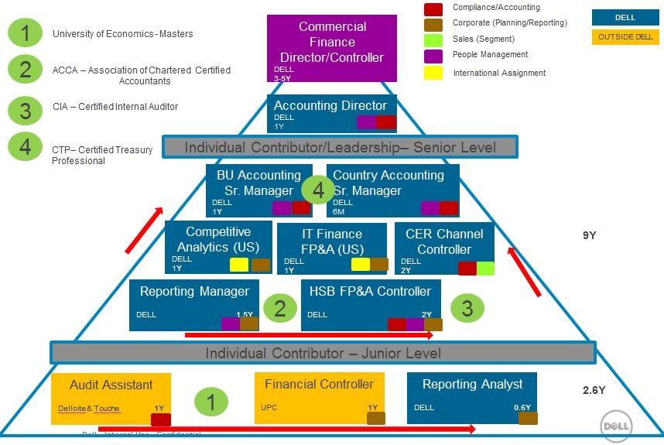
Ivan Mitringa

Slide 4
Dell internationalization 1984 - 2013

Slide 5
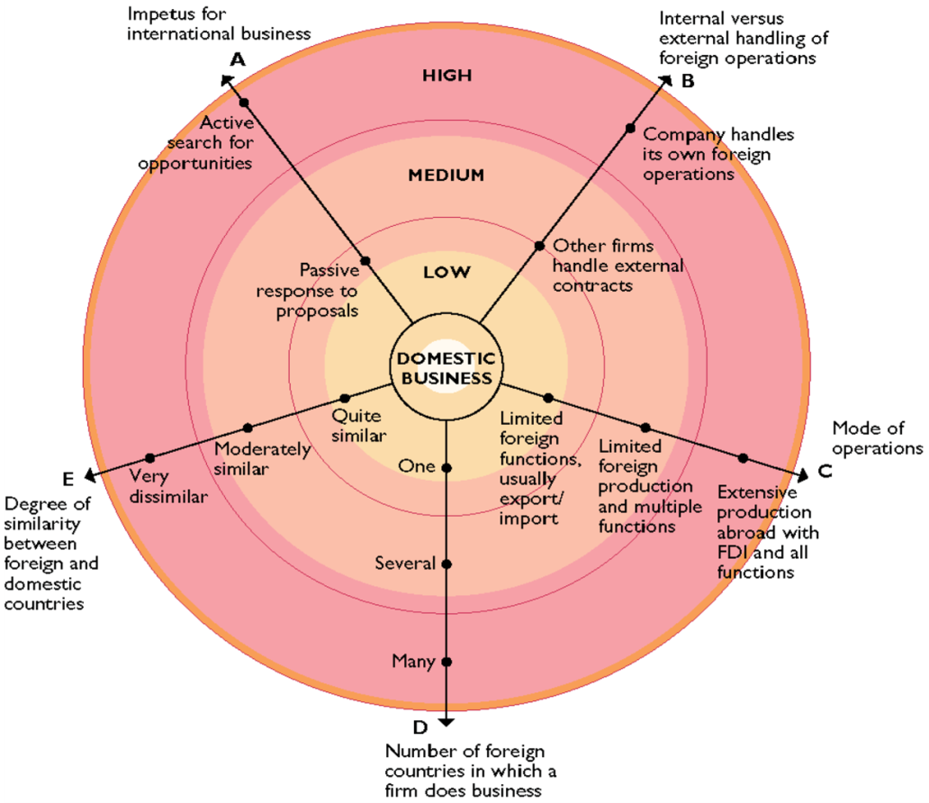
Patterns of International expansion
Daniels & Radebaugh’s model:
Extent of globalization
5 axes
Patterns of international expansion:
Passive to active expansion
External to internal handling of operations
Mode of operations
Deepening mode of commitment
Geographical diversification

Slide 6
Birth and childhood (1983-1987)
1984: PC’s Limited, University of Texas
Dell Direct business model
Production and focus only on US market
1985: revenue growth from $6M to $70M
Introduction of support services
Notes:
Competition – IBM, Apple, Japanese manufacturers
Competitive Advantage
Building a brand – 15% discount
First computer (1985): Turbo PC

Slide 7
Start of international expansion (1987-1991)
Challenges of internationalization:
FX Issue
Logistics
Competition
Language
Customer behavior
Geopolitics situation
Notes:
FX issues
Competition – followers as Gateway 2000 more aggressive in pricing (15-30% lower price)
Geopolitics – The Fall of Berlin wall 1990 – new markets
Improvement of logistics – Limerick factory

Slide 8
Puberty (1991-1995)
1991 - Dell entered the retail channel
  CompUSA
  Staples
  Best Buy
  PC World, etc.
Reducing suppliers
1992- First steps in Asia-Pacific-Japan (APJ)
1994- Dell quit the retail channel and focus only on Direct model
Notes:
Reaction to customers who preferred a face-to-face, physical access sales process -> Growing sales but with minimum profit ->cash issues ->
First operating loss in 1993
Indirect model didn’t work very well with Dell’s operating model and spartan approach
Mid 1994 – Dell pulled out of the retail market
1992 launching business in APJ (export).
Established competitors
different customer expectations ( in APJ they like to feel and touch products)
-> low revenue ($20M)

Slide 9
Internet era and exceptional growth (1995-2000)
1995: Dell.com
Establishing factories around the world
Decrease of direct cost by 15%
Growth in Asia-Pacific-Japan and Latin America
1994 – 1999: Sales grew at annual rate 49.5% from $3.5B to $25B

Slide 10
True Global Company (2000-2004)
2000: Community engagement - Michael and Susan Dell Foundation
2000: Fair practice
2000: Environment issues – recycling program
2003 & 2004: no.1 PC vendor worldwide
2004: Michael stepped down as CEO
Direct model as successful Global strategy

Slide 11
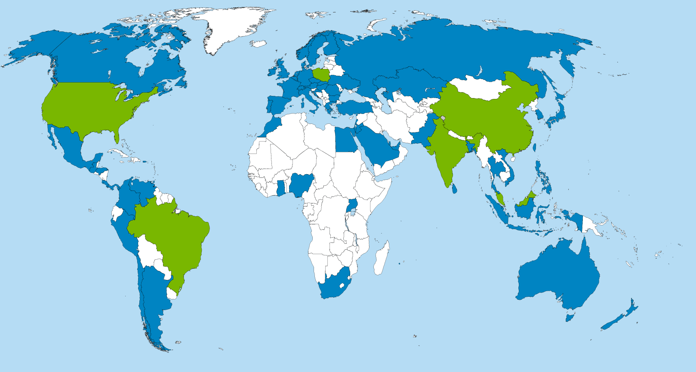
Current status (2013-Now)
Regional HQ United Kingdom
420 subsidiaries in 78 countries
3 regional HQs
7 manufacturing plants
111.300 employees WW
Private company
World HQ in Austin, Texas
Regional HQ Singapore
Notes:
Manufacturing:
Austin, Texas
Penang, Malaysia
Xiamen, China
Chengdu, China
Hortolandia, Brazil
Chennai, India
Lodz, Poland
Many products and all components obtained from 3rd party vendors. Significant portion of products assembled by various contract manufacturers mostly in Asia.

Slide 12
Organizational Structure

Slide 13
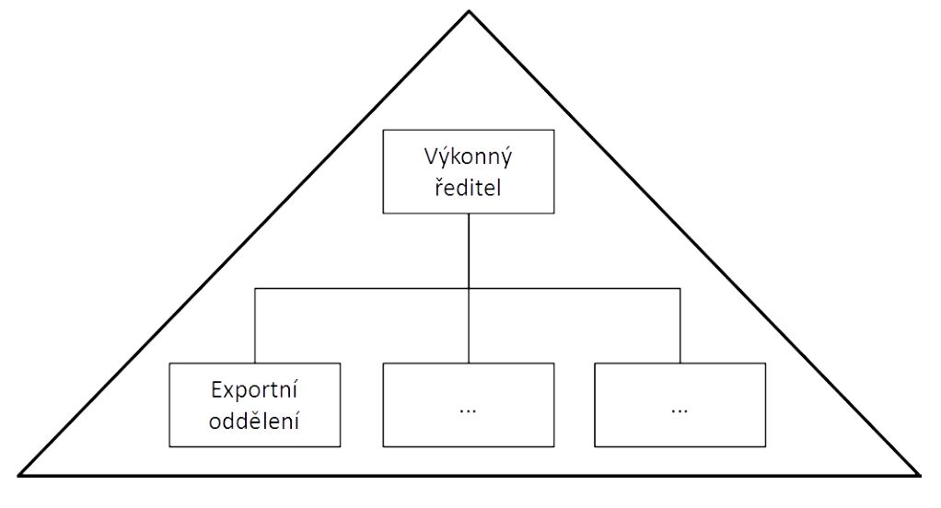
Organizational structure of international company
Export department
Strategic partnership
International subsidiary
International division
Global Structure
Multidimensional structure
Matrix organizational structure
Executive director
Export department

Slide 14
Dell organizational structure development
Regional BUs
Global customer BUs
Unified Sales under CBU
Solution BUs
AMERICAS
EUROPE
ASIA
JAPAN
LE
PUB
SMB
CS
CBU
EUC
ESG
SW
SVCs
Client
EUC
EC
Shared Go to Market Strategy
Mobile
ESG
Enterprise
Enterprise
Software
Services
Services
Notes:
Export department
Regional business units (First Europe then Asia + Japan as a separate due to high growth opportunity, 1995 Y/Y growth of 121% for Dell), 4 Regional HQs and manufacturing facility in each region (Austin, Limerick, Penang) → consolidation of common functions to reduce redundant costs and improve ability to deliver quality services in that market, Americas region first with customer segments: Business and US Consumer (1997) -> creation of global consumer business (2009) → creation of global business units based on customers reflecting the impact of globalization on customer base, customer requirements now share more commonality based on their sector rather than physical location (2010)
Global CBUs (2011): SMB, Consumer, PUB, LE → CSMB, PUB, LE → CSMB, PLE
Global CBU
Solution & Product led BUs with shared go to market strategy
EUC: Jeff Clarke (Vice Charmain and President)
ESG: Marius Haas (President)
SW: John Swainson (President)
SVC: Suresh Vaswani (President)
Marketing: Karen Quintos (Senior Vice President)
HR: Steve Price (Senior Vice President)
CFO: Tom Sweet (Senior Vice President)
CEO: Michael Dell

Slide 15
Thank you!
Q&A

Slide 16
Backup

Slide 17
Dell in Czech Republic
Dell Praha
Headcount: 108
Departments:
  Sales & Solutions
  Services & Delivery
  HR
  Finance
  Marketing
Dell Ostrava
Headcount: 40
Software group
  Architecture blueprint
  Design
  UI Specification
  Programming
  Final realization

Slide 18
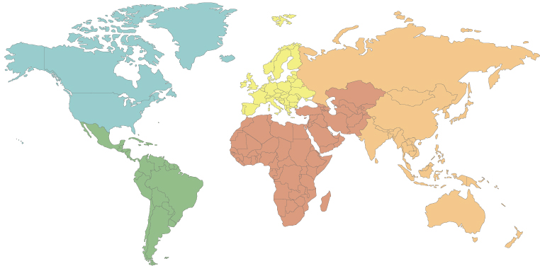

Regional structure to global SBUs
Before
Regional business structure
After
Global business structure
High reporting complexity
Complex Internal Tree
Lower complexity
Simplified hierarchy

Slide 19
Dell customer based organization
LE
Large corporations
PUB
Healthcare
SMB
Small business
Medium business
CS
Government
Schools
Consumers
World-wide view
Dell strategic business units (SBU’s) aligned to customer segments

Slide 20
Direct model
Pros
Direct contact with customers
Cons
High costs of demand generation (marketing, sales force, after sale support etc.)
Ability to provide customized products (build-to-order)
No need to share margin
Higher transportation costs
Supply chain management and cost
Customer has to wait for product
Too complex for non expert customers
No ability to see or touch product if selling via net or phone

Slide 21
Indirect model
Pros
External sales force, marketing
Cons
Lack of contact with end user
Easier coverage of new / minor markets (sales force, customer preferences, market restrictions etc.)
No need to have too diverse product portfolio
Ability to provide a solution or consultancy
Customer can see or touch product
Supply chain management
Risk that reseller will not know the product portfolio well
Risk that reseller will prefer to sell competitor’s products (on shelf placement etc.
Need to share margin

Slide 22
Summary Compensation Table 2013

Slide 23
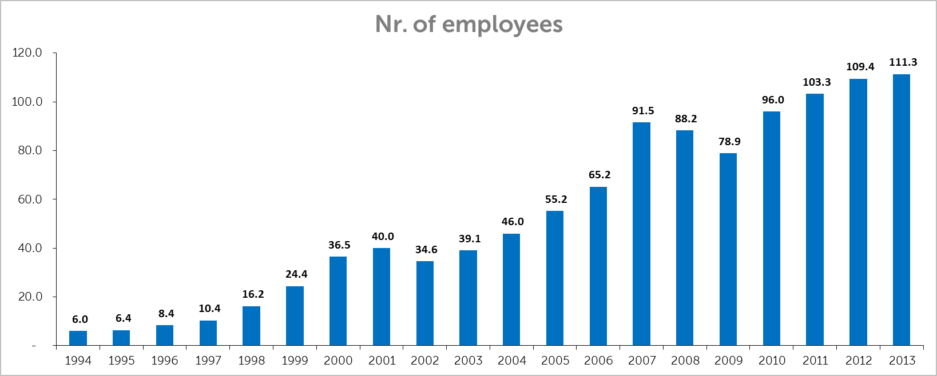
Headcount development

