Slide 1
Public choice and government failures
Miloš Fišar

Slide 2
What are we going to talk about?
How does decision making in private and public sectors differ?
How to make a good decision in public sector?
Are there any influences?
Or paradoxes?

Slide 3
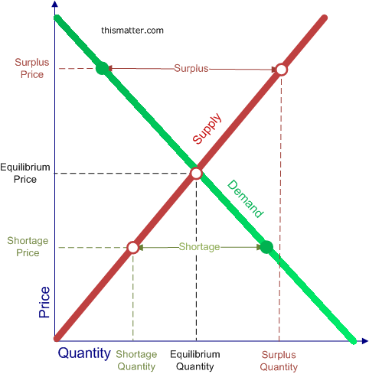
Private Sector
Equilibrium: demand curve and supply curve
Individuals reveal preferences about the private goods by buying them
Price reflects individual’s preferences

Slide 4
Public Sector
No demand x supply equilibrium
Price is not obvious
Decisions made by public agencies, not „customers“
Individuals vote to elect representatives who vote for public budget
Budget is spent by public agencies
No comparability to private sector

Slide 5
What is the public choice?
“Public choice can be defined as the economic study of nonmarket decision making“, “Application of economics to political science” (Mueller, 2009)
Covers:
theory of the state
voting rules
voters behavior
bureaucracy
legislatures
etc.

Slide 6
Voting in Public Sector
UNANIMITY
Time consuming
Leads to Pareto-preferred situation
Encounters strategic behavior
MAJORITY
Most used
Lower costs
Less time to make decision
Some individuals will be worse off

Slide 7
Majority rules:
Simple majority rule (>50%)
Runoff election (1st round >50% if not best 2 to 2nd round)
Plurality rule (most “popular” wins)
Approval voting (choose more options; most “popular” wins)
Borda count (n choices, give to each option points {1,2,…,n}, most popular n, least popular 1; most points wins)
Hare system (select best; in each round the least popular options leaves until there is only one)
Coombs system (select worse; in each round the least popular options leaves until there is only one)

Slide 8
What can influence the voting?
Personal constrains attitudes
Physical, social, economic, moral, psychological, etc.
External influences
Politics, lobbying, corruption, international relations, legislation, economics, labor unions, etc.
Would you make voting compulsory?

Slide 9
Tactical voting
Compromising (what happens if the country has first-past-the-post election systems?)
Burying - very useful if some party has open primaries
Push-over – Imagine you are a French voter, who likes Sarkozy. Polls for first round say:
Sarkozy 24%, Hollande 18%, Le Pen 17%, lot of other candidates, the Left has a majority.

Slide 10
Condorcet criterion
Used to measure efficiency of choices
Pair-wise comparison of possible outcomes

Slide 11
Tennessee needs a new capital, but where?

Slide 12
The preferences of the voters
42% of voters (close to Memphis) | 26% of voters (close to Nashville) | 15% of voters (close to Chattanooga) | 17% of voters (close to Knoxville)
Memphis Nashville Chattanooga Knoxville | Nashville Chattanooga Knoxville Memphis | Chattanooga Knoxville Nashville Memphis | Knoxville Chattanooga Nashville Memphis

Slide 13
Matrix
A
 |  | Memphis | Nashville | Chattanooga | Knoxville
B | Memphis |  | [A] 58% [B] 42% | [A] 58% [B] 42% | [A] 58% [B] 42%
 | Nashville | [A] 42% [B] 58% |  | [A] 32% [B] 68% | [A] 32% [B] 68%
 | Chattanooga | [A] 42% [B] 58% | [A] 68% [B] 32% |  | [A] 17% [B] 83%
 | Knoxville | [A] 42% [B] 58% | [A] 68% [B] 32% | [A] 83% [B] 17%
Ranking: |  | 4th | 1st | 2nd | 3rd

Slide 14
Arrow's impossibility theorem
Voting rule should fulfill:
Universality (all choices are allowed)
Non-dictatorship
Pareto efficiency
Independence of irrelevant alternatives.
But none of the rules does!
In other words: No voting rule is fair.

Slide 15
The paradox of voting
Also called Downs paradox
Individual preferences in a group may lead to ineffective outcome therefore voting becomes
Decision of people to cast a vote is led not only by a human rationality.

Slide 16
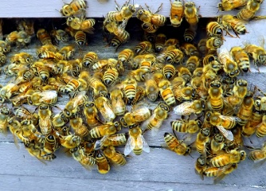
Not only humans vote
The honeybee occasionally needs
Find a new place for a nest.
The swarm sends out scout bees
To look for a new location

Slide 17
What method the bees use?
First the researchers thought bees prefered unanimity.
Then they observed that only a quorum is sufficient – 30 bees out of 75 bees at a potential nest site.

Slide 18
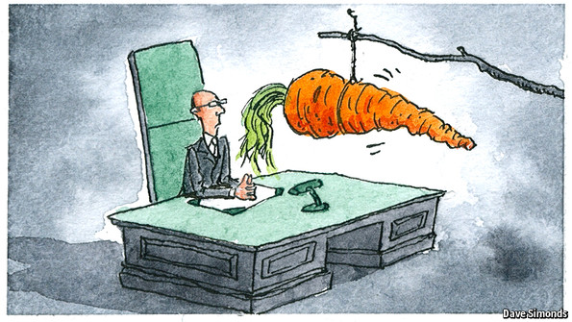
How to reward bureaucrats?

Slide 19
There are huge differences between countries:
Top pay for elite work
Strict seniority
Project management

Slide 20
Can we or governement punish bureacrats if something goes wrong?
Most projects end behind schedule.
Also more expensive and less useful then expected initially.
What exactly would we punish?

Slide 21
What to do when a buerocrat fails?
Jay, Antony, and Jonathan Lynn. "A Question of Loyalty." Yes, Minister. Prod. Peter Whitmore. BBC. S02E07, 6 Apr. 1981. Television.
https://www.youtube.com/watch?v=JU68wBR4pjQ

