Slide 1
3. Transportation demand
The discrete good case

Slide 2
3.1. Theory

Slide 3
Introduction
Some transportation choices are inherently discrete (either – or choice)
In this lecture we extend the theory of consumption to explicitly consider goods which have an either – or character

Slide 4
Intensive and extensive margin
When the good demanded is continuous, changes in the economic environment occur at the intensive margin = individuals consume a little more or less of the good when prices or income change.
When the good is discrete, consumers respond to changes in their economic environments by switching from one alternative to another, a demand response which is said to occur at the extensive margin.

Slide 5
Discrete alternatives
T_{a} = 1 if automobile is taken; = 0 if bus is taken
T_{b} = 1 if bus is taken; = 0 if automobile is taken
when it is recognized that T_{a}* a T_{b}* are mutually exclusive

Slide 6
Indirect utility function
U is called a direct utility function, which consumer maximizes subject to budget constraint.
Û is called an indirect utility function, wchich gives the maximum utility that a consumer can achieve for a particular economic enviroment as defined by one’s income and the existing level of prices.

Slide 7
Conditional indirect utility function
Let Û_{i} (p_{Ti}, p_{x}, Y, ɸ) be the conditional indirect utility function for choice i (i = a,b). Since this indirect utility is conditional upon a particular choice i, only the price of that alternative p_{Ti} is included as an argument in the function.
If the conditional indirect utility for the automobile mode is greater than that of the bus mode, then the consumer will take an automobile to work. Specifically, the auto is selected for the work trip if:
Û_{a} (p_{Ta}, p_{x}, Y, ɸ) > Û_{b} (p_{Tb}, p_{x}, Y, ɸ)

Slide 8
Market demand and consumption at the extensive margin
To develop a market demand model for work trip mode choice, suppose that we adopt the same assumptions as in the divisible choice models
Since all individuals are identical, economic theory predicts, that each individual selects the same mode in the trip to work. The market demand for one of the modes will be zero! Something is wrong!
The assumption that all consumers have identical preferences is implausible and for discrete goods case we need to explicitly incorporate variation in taste across population.

Slide 9
Observed and unobserved utility
Assume that each individual’s indirect utility function for the automobile and bus alternatives is given by:
where V_{i} (i=a,b) is an observable empirical function and (Y – p_{x} – V_{i}) is that portion of consumer’s conditional indirect utility which is observable and common across all individuals in the population. It reflects „representative“ or average tastes in the population.
ε_{i,} on the other hand is unobservable and individual specific
In general, identical observed portions of indirect utility do not imply identical total indirect utility levels and thus do not necessarily imply identical choice behavior.

Slide 10
Random utility model
Since each consumer’s utility depends upon an unobserved individual specific term, ε_{i} which is assumed to randomly vary from one individual to another, indirect utility also varies randomly from one individual to another.
The fact that we cannot observe ε for any individual implies that his choice cannot be predicted with certainty, but only probabilistically.
Thus, for an individual randomly selected, the probability that he chooses and automobile is:

Slide 11
Distribution function
A distribution function gives the probability that a random variable takes on a value which is less than or equal to a given value of x. If X is a random variable, the distribution function of X evaluated at point x is:
F(x) = Pr (X ≤ x)
Which is the probability that X is less or equal to a specific value x. Since the distribution function is a probabilioty, its value lies between zero and one.

Slide 12
Probabilistic choice models
Replacing the random variable X with ε_{b} – ε_{a} and x with V_{a} – V_{b} in distribution function gives the random utility model. In the other words, the probability function is a cumulative distribution function and the random utility model represents a probability model of transportation choice.
Specifically:
where F is a distribution function.

Slide 13

Logistic distribution function
What is the form of the distribution function F?
Although there are many such statistical functions from which to choose, the distribution function which has been found to be must useful in transportation analysis is a logistic distribution function.
The logistic distribution function for random variable X is:
$$F\left(x\right)=Pr\left(X≤x\right)=\frac{1}{1+e^{−x}}$$

Slide 14
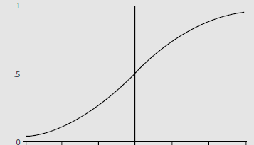
The cumulative logistic curve

Slide 15
Logit model
Adopting the logistic distribution function for our random utility probability model, replace x with the observed difference in indirect utilities V_{a}(p_{Ta}; Y; ɸ) - V_{b}(p_{Tb}; Y; ɸ).
This defines the probability of taking an automobile to be:

Slide 16
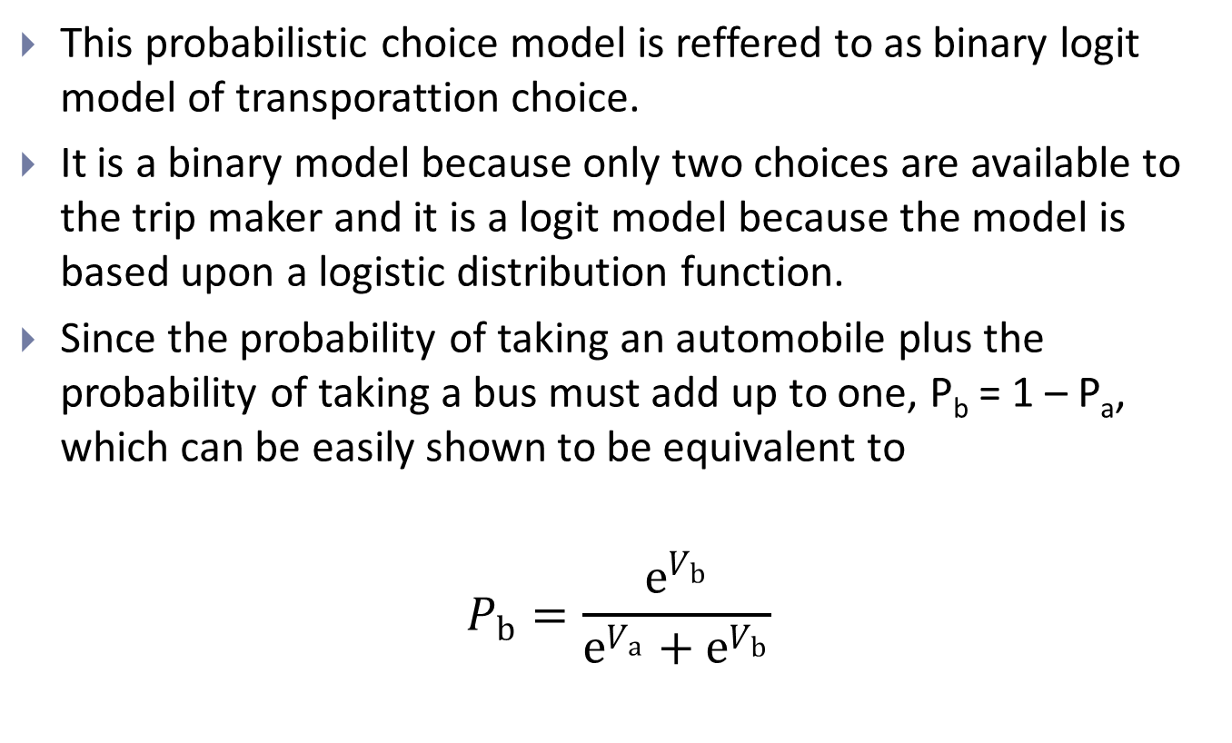
Binary logit model
This probabilistic choice model is referred to as binary logit model of transportation choice.
It is a binary model because only two choices are available to the trip maker and it is a logit model because the model is based upon a logistic distribution function.
Since the probability of taking an automobile plus the probability of taking a bus must add up to one, P_{b} = 1 – P_{a}, which can be easily shown to be equivalent to
$$P_{b}=\frac{e^{V_{b}}}{e^{V_{a}}+e^{V_{b}}}$$

Slide 17
Generic and alternative specific variable
In order to estimate our binary logit model, we need to identify the observable parts of consumer’s indirect utility function. Assume:
V_{a} = β₁p_{Ta} + β₂Y
V_{b} = β₁p_{Tb} + β₃Y
Generic variable = when marginal effect of a variable is assumed to have same impact on the indirect utility of each alternative (price)
Alternative specific variable = when marginal effect of a variable depends upon the alternative (income)

Slide 18
Transportation choice model - estimation

Slide 19
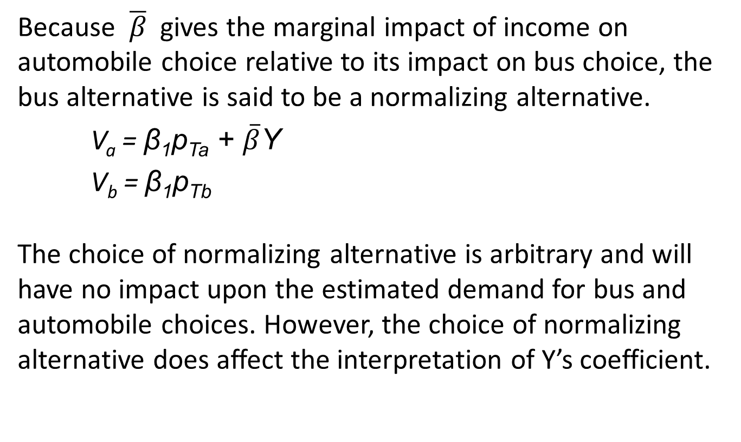
Normalizing alternatives
Because $\overline{β}$ gives the marginal impact of income on automobile choice relative to its impact on bus choice, the bus alternative is said to be a normalizing alternative.
V_{a} = β₁p_{Ta} + $\overline{β}$Y
V_{b} = β₁p_{Tb}
The choice of normalizing alternative is arbitrary and will have no impact upon the estimated demand for bus and automobile choices. However, the choice of normalizing alternative does affect the interpretation of Y’s coefficient.

Slide 20
The demand curve
Holding constant the price of bus travel and income, gives relationship between probability of choosing an automobile and the price of an automobile trip.
∆P_{a}/∆p_{Ta} = P_{a}(1-P_{a})β₁ < 0 for β₁ < 0

Slide 21
Elasticities

Slide 22
Value of time estimates

Slide 23
Multinominal logit - estimation

Slide 24
Multinominal logit - elasticities

Slide 25
3.2 Urban transportation mode choice
Binary logit model

Slide 26
Background
In order to fix ideas developed in the previous sections, lets examine a typical study of work-trip mode choice in which two alternative modes are available, automobile and public transit.

Slide 27
Work trip modal split and average travel time, 1990

Slide 28
Domenich – McFadden (1975)
Binary logit model for automobile and public transit base upon a sample od 115 commuter trips.
The analysis focused upon a suburban and downtown corridor in the Pittsburgh metropolitan area.
Of the 115 trip-makers, 54% commuted by automobile and 46% by public transport.
For each of the commuters, the observable indirect utilities for automobile and public transport respectively were:

Slide 29
Observable indirect utilities

Slide 30
Specification
Time and cost are generic variables, since the marginal effect of travel time and travel costs on indirect utility is assumed to be the same for the automobile and public transit modes, respectively.
Observed indirect utility for the automobile includes three alternative specific variables: Automobile/Worker, Race and White Collar. They are called alternative specific variable, because each is associated with a specific alternative, automobile choice.
β₀ is difference between the indirect utility of automobile choice and bus choice.

Slide 31
Hypotheses
1) By the law of demand we expect:
κ₁ < 0, β₁ < 0, κ₂ < 0
2) Income plays role in consumption + household use of automobile is constrained by the numbers of automobile available. Therefore: β₂ > 0
3) Socioeconomic characteristics such as Race and White Collar are included to reflect differences in preferences among consumers in automobile travel. A priori, however, we have no basis for expecting these variables to have a positive or negative sign.

Slide 32
Estimation results (1)

Slide 33
Estimation results (2)

Slide 34
Demand
1) All else constant, an increase in the cost of automobile trip to work reduces Pa, the probability of taking an automobile to work.
2) The coefficient estimate of Time is negative, which implies that higher automobile and bus travel times, respectively, decrease the probability of taking an automobile or bus in the journey to work.
3) An increase in Walk Time means that the bus stop is further away and, all else constant, is expected to reduce the probability of taking a bus in the work trip.

Slide 35
Change in the demand

Slide 36
Automobile choice elasticities

Slide 37
Modal demands and the value of time
The coefficient Walk Time is more than four times as large as coefficient estimate for Time.
Value of Travel Time –0.0382/-0.0256 = 1.49 cents/minute =0.89 USD/hour.
Value of Walk Time –0.158/-0.0256 = 6.17 cents/minute =3.70 USD/hour.
Important implications for he design of transport facilities.

Slide 38
3.3. Intercity demand for travel

Slide 39
Background
The private automobile is still the primary mode of travel, accounting for four fifths of all passenger miles in 1990 (USA).
What explains the continued dominance of the automobile for intercity trips? Given the relatively high price of airline tickets, why don't more travelers take bus or rail in their intercity trips? And do all intercity travelers value their time the same, or can we identify a relationship between value of time and mode taken?
In order to answer these questions, we shall analyze an intercity travel demand model for leisure (non-business) related trips.

Slide 40
Specification of indirect utility
Data: 1977 survey in the USA. 3623 vacation travelers. 69,3% vacationers traveled by automobile; 24,8% by air and 2-3% by bus and rail respectively.
Morrison and Winston (1985) estimated a multinomial logit intercity demand model for single destination trips.
A leisure travelers indirect utility for intercity travel is assumed to depend upon five basic determinants:
      A mode’s round-trip cost
      The round-trip travel time
      The average time between scheduled departures
      The number of people travelling together
      Household income

Slide 41
Hypotheses
It is expected that each of the travel cost and travel time variables will have a negative sign.
According to labor-leisure choice theories of labor supply, an individual’s opportunity cost of time is related to one’s wage rate. This implies that the marginal effect on indirect utility from an increase in travel time will be greater for higher income households than for lower income households.
Because the marginal cost of an extra traveler in an automobile trip is very low, it is expected that it will increase demand for automobile travel.
The presence of small children will increase demand for automobile on shorter and decrease it on longer trips.

Slide 42
Estimation results (1)

Slide 43
Estimation results (2)

Slide 44
Estimation results (3)

Slide 45
The demand curves for intercity travel
Consistent with expectations and with law of demand, the coefficient estimates for each of the travel time and travel cost variables are negative, giving us an inverse relationship between opportunity cost and choice probability.
Marginal disutility of cost is nearly identical for the common carrier modes (bus, rail and air), whereas cost plays a smaller, and somewhat less significant, role in the demand for automobile travel.

Slide 46
Elasticity

Slide 47
Value of time estimates

Slide 48
Policy implications
The USA is seriously considering the viability of high speed rail system. Given an estimated capital cost 16-30 mil. USD per mile, these system must have a large ridership to be economically viable.
Based on the results HSR will be viable in dense population centers and for trips that are medium travel range 200 – 400 miles.

Slide 49
3.4. Household demand for vehicle ownership

Slide 50
Vehicle ownership by number of adults in households

Slide 51
Vehicle ownership by household income, 1983

Slide 52
Indirect utility for vehicle ownership

Slide 53
Hypotheses
Increase in household income increases the demand for automobile ownership → α₁ > 0 β₁ > 0.
The greater the supply of public transport, the lower is the opportunity cost of using public transportation → α₄ < 0 β₄ < 0.
Increases in demand for automobile travel are expected to increase the level of ownership → α₂ > 0 α₃ > 0 β₂ > 0 β₃ > 0.
The more closely current household fleet matches its needs, the greater is the probability of owning that number of vehicles → γ > 0.

Slide 54
Household demand for vehicle ownership

Slide 55
Effects on vehicle demands from income increases

Slide 56
Effects on increase in per capita transit trips on vehicle demands

Slide 57
3.5. Summary

Slide 58
Summary (1)
Discrete transportation demands, such as choice of travel mode to work, are of an “either–or” nature and it is not possible to consume both simultaneously. Analysis of discrete choice commodities entails comparing the indirect utility of one alternative with the indirect utility of other available alternatives. A consumer’s indirect utility function gives the highest possible level of economic welfare for a given economic environment. A consumer’s indirect utility function is positively related to a rise in income and negatively relative to a rise in prices.

Slide 59
Summary (2)
Among a set of discrete transportation choices, a consumer maximizes economic welfare by choosing the transportation alternative with the highest level of conditional indirect utility. For these alternatives, changes in the economic environment occur at the extensive margin as consumers switch from one alternative to another.

Slide 60
Summary (3)
Because only part of a consumer’s indirect utility function is observable, a consumer’s choice of a discrete transportation alternative occurs with some probability. The probabilistic model that characterizes welfare-maximizing choices among a set of discrete transportation alternatives is referred to as the random utility model. Random utility models of transportation choice characterize the demands for each of the alternatives available to the decision-maker. In random utility models, observation errors primarily reflect taste differences among the population rather than measurement or optimization errors.

Slide 61
Summary (4)
When two transportation choices are available, a very common empirical model is the binary logit random utility model. When more than two alternatives are available, the binary logit model easily generalizes to a multinomial logit model. In addition to characterizing existing demands, logit models of transportation choice are used to forecast the market share of new alternatives. In discrete choice models, generic variables are those whose marginal impact upon indirect utility is common across the available alternatives; an alternative specific variable is one whose marginal impact upon indirect utility is specific to a particular transportation alternative.

Slide 62
Summary (5)
Because travel time and travel cost typically characterize transportation choices, empirical random utility models provide a convenient method for estimating the value that consumers place upon their travel time. The value corresponds to the estimated coefficient of the travel time variable divided by the estimated coefficient of the travel cost variable.
In random utility models of transportation choice, all available alternatives are substitutes in consumption. An increase in the opportunity cost of a given alternative reduces the probability of selecting the alternative, but shifts the probability demand curves of the other alternatives to the right.

Slide 63
Summary (6)
Consistent with other studies, an analysis of transportation mode choice in the trip to work indicates that workers are sensitive to a mode’s travel time and travel trip to work indicates that workers are sensitive to a mode’s travel time and travel cost. In addition, workers’ mode choices are more sensitive to out-of-vehicle time than in-vehicle time. Workers’ choices were twice as sensitive to an increase in walk time relative to travel time. Also consistent with other studies, workers in this analysis valued out-of vehicle time much more highly than in-vehicle travel time.

Slide 64
Summary (7)
In a case study of intercity modal choice for nonbusiness-related trips, modal choices were sensitive to a mode’s transportation cost. In addition, an increase in travel time on a public conveyance had a much greater disutility effect on rail and bus relative to air travel; and, holding all else constant, travelers prefer to travel by air or auto relative to making a trip by bus or rail. Among the modes, the choice of rail mode was most elastic to a change in cost and the choice of bus mode was most elastic to a change in travel time. As a percentage of their wage rate, air travelers place the greatest value on their travel time, but bus travellers place the highest value on the time between departures (in part due to the disutility of time spent at bus stations).

Slide 65
Summary (8)
Over the past 30 years, there has been a significant increase in automobile ownership, due to a general increase in the standard of living. After controlling for household size, the availability of public transit, and the number of workers, a case study of automobile ownership in the USA confirms that household ownership is strongly influenced by household income. An increase in household income is expected to decrease nonownership and single vehicle ownership to the benefit of multiple vehicle ownership. But, importantly for public transit policy, vehicle ownership is sensitive to the availability of public transit. The demands for nonownership, single vehicle ownership, and multi-vehicle ownership were elastic with respect to the availability of public transit.

Slide 66
Summary (9)
Consistent with expectations, a case study of carrier choice by freight shippers found that an increase in the transport rate charged or a decrease in a carrier’s service reliability reduced the probability of a shipper selecting the carrier. But shippers were more sensitive to reliability than to the rate charged. In addition, shippers were found to be sensitive to the inventory transit cost. Further, among three carrier modes studied – truck, rail, and piggyback – shippers preferred truck carriers, all else constant, which reflects the greater flexibility of truck carriage to the two other modes.

