Slide 1
USA

Slide 2
Content
A. Prior to WWI
B. Interwar period (revision)
C. After WWII
D. The 1950s and 1960s
E. The 1970s
F. Reaganomics
G. Summary of the after-war development
H. The 1990s

Slide 3
Basic characteristics
small government+ liberal principles ⇨ relatively:
low taxes+ little interference into the economy + minimal public ownership
entrepreneurial spirit
possibility from small-size companies ð big ones
Nike, Microsoft, Apple
venture capital
competitive environment
stock markets ð shareholders discontent (ò prices) ð dismissal of management
flexible labour markets + immigration
greater disproportions in income

Slide 4
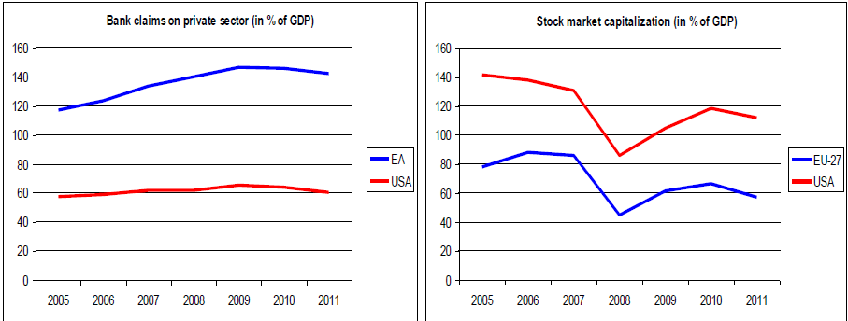
Companies financing EU in USA

Slide 5
Immigration to the USA by decades (million)

Slide 7
Prior to WWI

Slide 8
A. USA prior to WWI
political expansion
1898 war with ES ⇨ control over Cuba + annex of Puerto Rico, Hawaii, Philippines
fast economic development
⇧ GDP
crisis in the 1890s
BUT still relatively agricultural country
⇧ production
stable price level ð deflation
Gold standard

Slide 9
⇧ FT
⇧ export >  import
protection of the domestic market
large amount of foreign INV in USA (GB and FR)
to private sector
railways
USA - the biggest world debtor

Slide 10
Reasons of the US success
population growth
high birth rate+ immigration
raw materials and natural resources
size of the domestic market
development of transportation infrastructure- roadways, canals and mainly railways
⇨ development of iron and steel industry
use of modern technologies
fast implementation of machines
(LF expensive)
⇧ specialization and productivity

Slide 11
Length of railroads [km]
 | 1840 | 1870 | 1914
France | 410 | 15544 | 37400
Germany | 469 | 18876 | 61749
GB | 2390 | 21558 | 32623
USA | 4510 | 84675 | 410475

Slide 12
Relative shares in the world industrial production, 1750 – 1900 (in %)
 | 1770 | 1800 | 1830 | 1860 | 1880 | 1900
Europe total | 23.2 | 28.1 | 34.2 | 53.2 | 61.3 | 62
GB | 1.9 | 4.3 | 9.5 | 19.9 | 22.9 | 18.5
Japan | 3.8 | 3.5 | 2.8 | 2.6 | 2.4 | 2.4
Third world | 73 | 67.7 | 60.5 | 36.6 | 20.9 | 11
USA | 0.1 | 0.8 | 2.4 | 7.2 | 14.7 | 23.6
Source: Kennedy, Vzestup a pád velmocí, 1996

Slide 13
Inter-war period (revision)

Slide 14
B. Inter-war period in USA
1920s - very successful decade
modern structure of the economy
unwillingness to play the role of superpower
Great Depression
huge drop in production and high unemployment
crash on the stock exchange
collapse of banking system
protectionism
New Deal - mixed results

Slide 16
After WWII

Slide 17
C. USA after WWII
considerable growth during WWII
president Truman (1945 - 53)
after the war –economic and political superpower
responsibility for the world order
Bretton-Woods + Truman Doctrine + GATT + Marshall Plan + foreign aid for DC
bipolarity
persisting (limited) state interventions
Employment Act of 1946
program Fair Deal
social area– unfulfilled although  soc. exp.

Slide 18
Direct fiscal war-related costs of the USA
 | Common USD billion | USD billion of 1990 | % GDP | USD (1990) per capita
World War I (1917-18) | 26 | 197 | 24 | 1 911
World War II(1941-45) | 288 | 2 091 | 130 | 15 655
The Korean War (1950-53) | 54 | 264 | 15 | 1 740
The Vietnam War (1964-72) | 111 | 347 | 12 | 1 692
The Persian Gulf War (1990-91) | 61 | 61 | 1 | 235
Source: Carvalho, Suni: War, Oil and Economic Growth, 2002

Slide 19
Economic results
1945 – 1947 stagnation and recession
transition into peace economy
conversion of armament production
ð  P +  U (mainly among demobilized)
subsequently positive impact of
⇧ INV (manufacturing and housing)
modern infrastructure
share of state - power engineering, communications, railways, roadways
influence of postponed customer D
cars, TV, telephones
⇧ EX (loans for purchases of US goods + help)
1949 = recession
Truman ò taxes +  exp. on social and public
purposes

Slide 20
Public debt as % of GDP

Slide 21
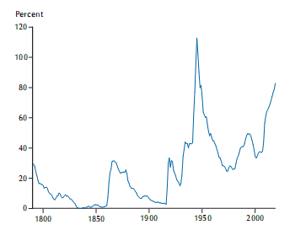
Public debt as % of GDP

Slide 22
Growth of real GDP and unemployment in the USA (%)
Source: Economic Report of the President 2007, 2007, Economic Report of the President 1953, 1953

Slide 23
The 1950s and 1960s

Slide 24
D. The 1950s
until 1973 - all in all, very successful period
president Eisenhower (1953-61)
in 1950s average growth of GDP = 3,2%
recession 1953 – 54
⇩ military exp. b/c the end of Korean war
reaction of monetary policy to the worsening
BofP in 1953
+ low inflation and U

Slide 25
Reasons of growth
same factors as after the war
+ ñ militarization b/c Korean war
+ accumulation of strategic reserves of raw materials and products for possible WWIII
+ extension of consumer loans
+ inflow of qualified labour
+ economic policy
Keynesianism ð Neokeynesianism
“fine tuning” = STOP and GO
recession ð Eisenhower òT + ñ U benefits

Slide 26
The 1960s
presidents Kennedy – Johnson – Nixon
USA faced to ñ domestic competition + ñ USSR
space technologies + exploration
ñ GDP
9 years of continuous growth
recession only in1970
1969 monetary and fiscal restrictions
BUT at the end of 1960s
loss of dynamics
ò construction + automobile industry
ñ price level
+ budget deficits

Slide 27
U.S. Fiscal policy in 1960-1969
 | 1960 | 1961 | 1962 | 1963 | 1964 | 1965 | 1966 | 1967 | 1968 | 1969
Government spendigs | 93 | 102,1 | 110,3 | 113,9 | 118,1 | 123,5 | 142,8 | 163,6 | 181,5 | 189,2
Revenues | 96,5 | 98,3 | 106,4 | 114,5 | 115 | 124,7 | 142,5 | 151,2 | 175 | 197,3
Surplus | 3,5 | -3,8 | -3,8 | 0,7 | -3 | 1,2 | -0,2 | -12,4 | -6,5 | 8,1
Inflation (%) | -,04 | 1,1 | - | 1,2 | 1,3 | 1,7 | 2,9 | 2,8 | 4,2 | 5,4

Slide 28
Reasons of economic growth
mass use of inventions from 1950s
high investment (public and private) to R&D
military and space research + aeronautics industry + petrochemistry + information technologies
War in Vietnam after 1965

Slide 29
Military expenses in the USA and the USSR, 1948-1970 (USD billion)
 | 1948 | 1949 | 1950 | 1951 | 1952 | 1953 | 1954 | 1955 | 1956 | 1957 | 1958 | 1959
USA | 10.9 | 13.5 | 14.5 | 33.3 | 47.8 | 49.6 | 42.7 | 40.5 | 41.7 | 44.5 | 45.5 | 46.6
USSR | 13.1 | 13.4 | 15.5 | 20.1 | 21.9 | 25.5 | 28 | 29.5 | 26.7 | 27.6 | 30.2 | 34.4
 | 1960 | 1961 | 1962 | 1963 | 1964 | 1965 | 1966 | 1967 | 1968 | 1969 | 1970
USA | 45.3 | 47.8 | 52.3 | 52.3 | 51.2 | 51.8 | 67.5 | 75.4 | 80.7 | 81.4 | 77.8
USSR | 36.9 | 43.6 | 49.9 | 54.7 | 48.7 | 62.3 | 69.7 | 80.9 | 85.4 | 89.8 | 72
Source: Kennedy, Vzestup a pád velmocí, 1996

Slide 30
U.S. Defence expenditures as percent of GDP
Source: Economic Report of the President 2007, 2007

Slide 31
Economic policy
Kennedy - New Economics
instead of balancing the cycle– continuous econ. ñ
fiscal expansion
war in Vietnam + research
INV in education
big social programs for the poorests
“War to Poverty”
“Great Society“
⇨ ñ redistribution
+ monetary policy also expansive
b/c recovery induced by fiscal policy had to be
accompanied by  M^{S}
⇧ inflationary tendencies

Slide 32
Economic growth (%), inflation (%) and the federal fiscal balance (% of GDP) in the USA, 1950–1969

Slide 33
The 1970s

Slide 34
E. USA in 1970s
presidents Nixon – Ford – Carter
1971 Nixon – New Economic Policy
ð econ ñ + X fiscal imbalances
also abandoning of convertibility of $ for AU + devaluation in 1971 and 1973 + wage and price control
recession 1973 –75
+ ñ price level+ ò stock exchange
high econ. ñ in 1976-78
BUT ongoing Π + high U

Slide 35
Causes of the crisis
increasing budget deficits in 1960s and 1970s
Vietnam + …
New Economics = expansive policy + underestimation of inflation
except the already mentioned factors
weakened built-in stabilizers= taxflation
mistake with the Phillips curve
inflation expectations of the inhabitants
collapse of the Bretton-Woods system + devaluation
Oil crises
foreign pressures =ñ competition
ò GDP
+ ñ prices = stagflation

Slide 36
Proportional changes in employment structure in the USA as a result of foreign trade, 1970-1980
Industry | Proportional changes
Shoe industry | -15.9
Automobile industry | -11.1
Electrical appliances and equipment | -7.8
Leather products | -6.3
Clothes | -6.3
Radio and television | -5.7
Various other products | -5
Furniture | -4.5
Services equipment | 5.7
Electrical machinery | 6.6
Electrical and industrial facilities | 7.1
Various machinery | 8
Aircraft and their parts | 12.8
Office, computer and accounting appliances | 16.1
Motors and turbines | 17.8
Construction and mining machinery | 19.9
Source: Salvatore, International Economics, 1987

Slide 37
Economic growth and inflation in the USA, 1960–1990 (%)
Source: Economic Report of the President 2007, 2007

Slide 38
International comparison
less effected by the crisis as other countries
domestic resources of raw materials
80% of oil consumption covered from domestic yield
but continuous ò US share in the world production
X JP and DE faster growth + large trade surpluses

Slide 39
Population, GNP per capita and GNP in 1980
 | Population (million) | GNP p.c. (in USD) | GNP (in USD billion)
USA | 228 | 11,360 | 2,590
USSR | 265 | 4,550 | 1,205
Japan | 117 | 9,890 | 1,157
EEC (12 countries) | 317 | - | 2,907
of which
Germany | 61 | 13,590 | 838
France | 54 | 11,730 | 633
GB | 56 | 7,920 | 443
Italy | 57 | 6,480 | 369
Source: Kennedy, Vzestup a pád velmocí, 1996

Slide 40
Reaganomics

Slide 41
F. USA during Reaganomics
Ronald Reagan (1981 -1984 and 1985 -1988)
after Carter – bad economic situation
Π two-digit + difficult to change the expectations
but since 2nd 1/2 1970s deregulation + monetary oriented EP + first law about ò T
from Keynesianism to Neokeynesianism
Reaganomics
deregulation + liberalization + supply side + bigger role of market (ò role of state) + ò T (marginal rates)
power industry, transportation, banking, telecommunication + complete deregulation of prices of oil and natural gas

Slide 42
Results
beginning of 1980s– short recession (6 months)
ñ prices b/c ñ oil prices
recession 1981 – 1982 = 16 months
ò Π = strict monetary policy ( r)
1979 new chairman of FED – P. Volcker
since 1983 3. longest uninterrupted growth
after 1985 recovery
faster ñ GDP and lower Π and U
1987 stock exchange crash
ALE FED learnt a lesson
⇨ money into circulation ⇨
impact on the real economy negligible

Slide 43
Budget deficit
government expenditures
defense
social
debt service ( r)
tax system
lower taxes (+ INV incentives)
budget deficit and higher debt

Slide 44
Comparison of the USA and the USSR weaponry in 1982
 | USA | USSR
Troops (in thousand) | 2,117 | 4,265
Ballistic missiles total | 1,572 | 2,387
Long-range bombers | 316 | 150
Tanks | 12,130 | 50,000
Helicopters | 1,000 | 2,300
Ships and submarines | 467 | 563
Source: Pechman, Setting National Priorities the 1984 Budget, 1983

Slide 45
Basic economic indicators the US economy, 1980-1990
 | Year-on-year change of GDP (%) | Year-on-year change of inflation (%) | Unemployment (%) | Fiscal balance (% of GDP) | Federal net public debt (% of GDP) | Current account balance (% GDP) | Federal government expenditures (%of GDP)
1980 | -0.2 | 13.5 | 7.2 | -3 | 30.3 | 0.1 | 21.7
1981 | 2.5 | 10.4 | 7.6 | -2.2 | 28.9 | 0.2 | 22.2
1982 | -1.9 | 6.2 | 9.7 | -4.8 | 33.2 | -0.2 | 23.1
1983 | 4.5 | 3.2 | 9.6 | -5.6 | 36.6 | -1.1 | 23.5
1984 | 7.2 | 4.4 | 7.5 | -4.8 | 37.8 | -2.4 | 22.2
1985 | 4.1 | 3.5 | 7.2 | -5 | 40.9 | -2.8 | 22.9
1986 | 3.5 | 1.8 | 7 | -5.2 | 44.4 | -3.3 | 22.4
1987 | 3.4 | 3.7 | 6.2 | -4.3 | 46.6 | -3.4 | 21.6
1988 | 4.1 | 4.1 | 5.5 | -3.6 | 48 | -2.4 | 21.3
1989 | 3.5 | 4.8 | 5.3 | -3.2 | 48.2 | -1.8 | 21.2
1990 | 1.9 | 5.4 | 5.6 | -4.2 | 49.4 | -1.4 | 21.8
Source: IMF: World Economic Outlook Database, http://www.imf.org/external/pubs/ft/weo/2006/02/data/index.aspx (9. 3. 2007);
Economic Report of the President 2007, 2007

Slide 46
Budget deficit
⇧ r b/c
monetary policy
budget deficit
⇧ r ⇨  inflow of capital to USA ⇨
appreciation of $ ⇨ IM and EX ⇨ trade DEF
+ ⇨ DC problems with debt service !!!
in addition ò savings x INV ⇨ need to import capital ⇨ trade DEF
⇨ ⇨ inflow of foreign capital – majority portfolio INV but since the beginning of 1970s also FDI
to gain market share
access to scientific knowledges
x protectionism
political stability
since the end of 1970S – petrodollars

Slide 47
All in all
long economic growth
ò U and Π
⇧ effectivity + flexibility of the economy
BUT ñ income inequality
+ DEF trade and budget
= so-called twin deficit

Slide 48
Summary of the after-war development
Tendencies:
Structural changes
GDP growth

Slide 49
G. a) Structural changes
After WW2 shift to services
Negative influence on productivity and economy ñ ð b/c There is smaller productivity in services than in industry.
since 1/2 70s expansion in S b/c deregulation of telecommunications and transportation
Structure of U.S. GDP in 1950–1990
Year | Agriculture | Industry | Services
1950 | 5,3 | 36 | 58,7
1960 | 4 | 38,8* | 57,2
1970 | 2,8 | 34,5* | 62,7
1980 | 2,6 | 33,6* | 63,8
1990 | 1,7 | 28* | 70,3
Structural change 1950 - 1990 | -3,6 | -8 | +11,6
* - Industry contains civil engineering
Source: Cihelková, Holub, Jakš: USA – Japonsko – SRN, 1994

Slide 50
G. b) GDP growth during presidencies of republicans and democrats
 | Year of presidency
Democrats | 1 | 2 | 3 | 4
Truman | 0 | 8,5 | 10,3 | 3,9
Kennedy/Johson | 2,6 | 5,3 | 4,1 | 5,3
Johson | 5,8 | 5,8 | 2,9 | 4,1
Carter | 4,7 | 5,3 | 2,5 | -0,2
Average | 3,3 | 6,2 | 5 | 3,3
Republicans
Eisenhower I | 4 | -1,3 | 5,6 | 2,1
Eisenhower II | 1,7 | -0,8 | 5,8 | 2,2
Nixon | 2,4 | -0,3 | 2,8 | 5
Nixon/Ford | 5,2 | -0,5 | -1,3 | 4,9
Reagan I | 1,9 | -2,5 | 3,6 | 6,8
Reagan II | 3,4 | 2,8 | 3,4 | 3,9
Average | 3,1 | -0,4 | 3,3 | 4,1

Slide 51
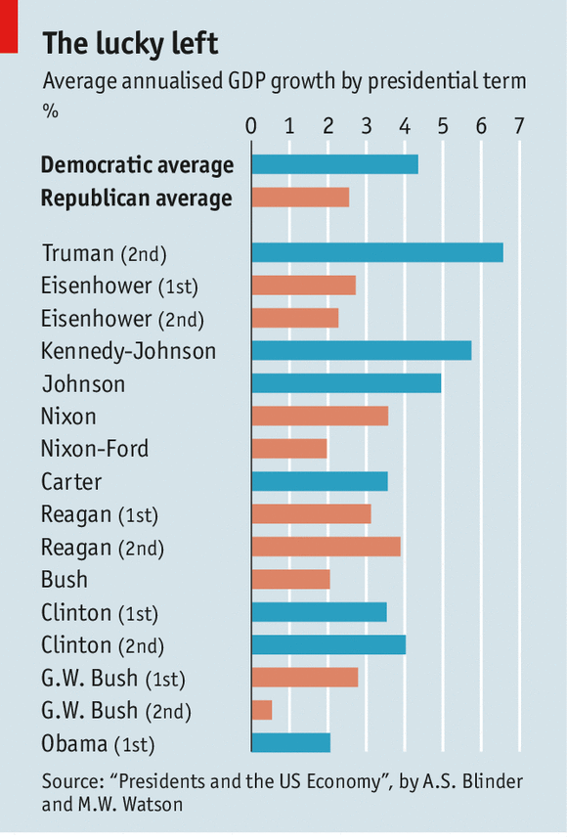

Slide 52
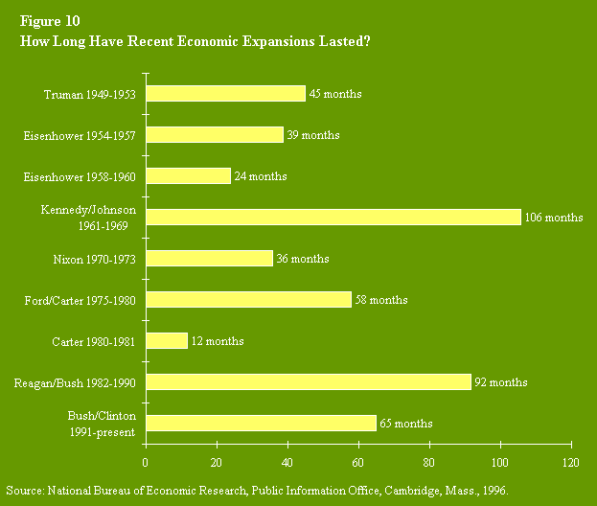
Length of economic expansion

Slide 53
The 1990s

Slide 54
H. The 1990s
1989 Bush X budget deficit and external imbalance
ð end of 1989 recession ð 9 months
rapid ò consumption of households + lower INV + weakening entrepreneurial confidence + ñ oil prices (Gulf War)
since1991 continuous econ. ñ
actual reasons
high AD and expectations
low Π ⇨  r ⇨  INV
changes in the economy
restructuring in the 1980s
from I to S ( services are less cyclical)
technological progress- use of PCs
better control of inventories - just in time system
end of after-war weakening of positions
ò U
Feb. 2000 record – period of econ. expansion
since ½ 19th century

Slide 55
Economic growth (%), inflation (%), unemployment (%) federal net public debt (% of GDP) in the USA, 1980-2009
Source: IMF: World Economic Outlook Database, http://www.imf.org/external/pubs/ft/weo/2008/02/data/index.aspx (9. 3. 2009)

Slide 56
Price level
FED NOT ñ r ð not inhibit econ.ñ
X Π circumstances until 1999
crisis in Asia ⇨  prices of raw materials
inflow of assets to USA ⇨  $
methodical – changes in the calculation of Π, production
budget surplus
⇧ labour productivity
character of the business cycle
cycle after WW2 – several years ⇨ AD > AS ⇨ FED  r ⇨  AD ⇨ firms stocks ⇨ recession⇨ FED r ⇨  AD
but  Π under control⇨ FED NOT  r ⇨
AD not b/c  r BUT  profits,  price of shares
+  INV

Slide 57
Dow-Jones and NASDAQ (1980-2009) – monthly values
Source: EconStatsTM – www.econstats.com (9. 1. 2009),
Finance Yahoo – http://finance.yahoo.com/q/hp?s=%5EIXIC&a=01&b=5&c=1971&d=02&e=9&f=2009&g=m (9. 3. 2009)

Slide 58
After 2000
= healthy EP
great opportunities:  r - chairman Greenspan !
+  G and  T
… fast recovery
continuous problem - trade deficit!
recession at the beginning of 2008
problems with financial sector, …

Slide 59
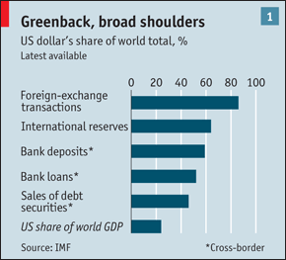
Importance of USD in 2010

Slide 60
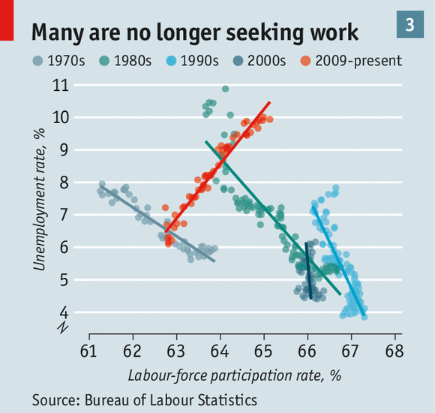

Slide 61
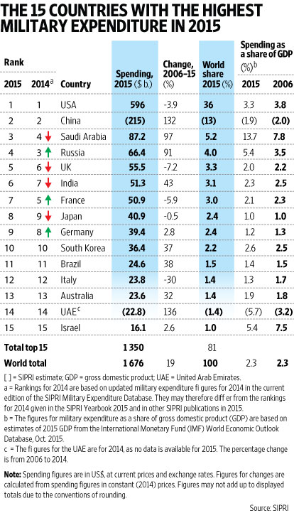

Slide 62
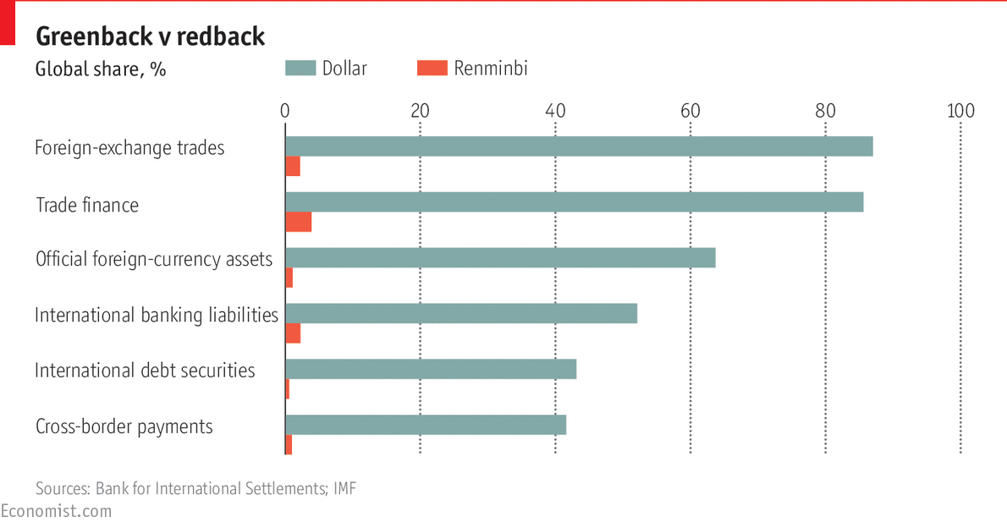

Slide 63
Thanks for your attention

