Slide 1

CROWDFUNDING
Finance (Basics)
Oslislo Elise

Slide 2

Summary
I- What is Crowdfunding ?
II- Benefits
    Investor’s view
    Entrepreneur’s view
III- Risks
    Investor’s view
    Entrepreneur’s view

Slide 3

I- What is Crowdfunding ?
Small amounts of capital from a large number of individuals
Helped anyone who has an idea throught social media
Inspired by Crowdsourcing = obtaining feedback from the crowd after posting an idea on a network.
Started in the 90’s with art projets
Really exploded in 2009 with Kickstarter
900 crowdfunding website today

Slide 4
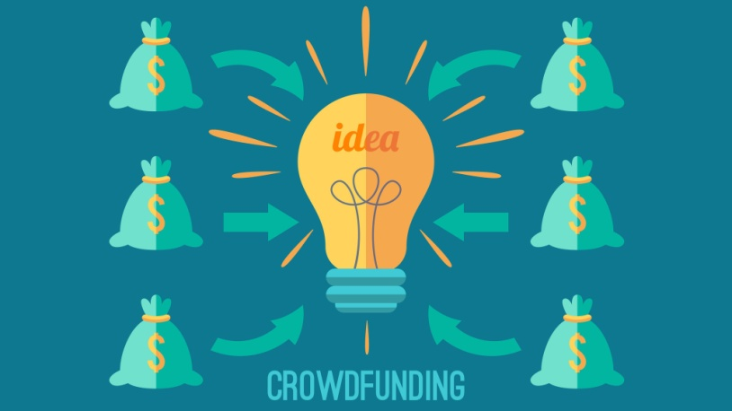
II- Benefits of Crowdfunding
For the Investors
  Reward-based in advance
  Without any minimal amount of money to invest
  Simple
For the Entrepreneur
  More accessible
  You don’t lose control of your compagny with venture capital investors
  Good for marketing
  Possibility to have feed back
  Immediate reaction from the market
  Solid consumer-base

Slide 5

III- The Risk of Crowdfunding
For the Investor
  Fraud
  No possibility to follow-up your money
  No possibility to be refunded when you doesn’t get your promise reward
For the Entrepreneur
  Incomprehension from the investor/consumer
  Easy fund raising ≠ easy commercialisation
  Must know how to balance their funds
  No protection of intellectual property
  Tax law regarding e-commerce are not clearly define.

Slide 6
Conclusion
Helpful for people who don’t have network
Accessible
Need some adjustment
A change in the economy we know: for a Participative economy ?

Slide 7
Thank you for listening !
Sources
http://www.forbes.com/sites/tanyaprive/2013/02/20/top-9-advantages-of-investment-crowdfunding/#70e80a2a2e14
https://www.nibusinessinfo.co.uk/content/advantages-and-disadvantages-crowdfunding
http://www.forbes.com/sites/tanyaprive/2012/11/27/what-is-crowdfunding-and-how-does-it-benefit-the-economy/#1d3e337a4ed4
http://www.investopedia.com/terms/c/crowdfunding.asp

