Slide 1
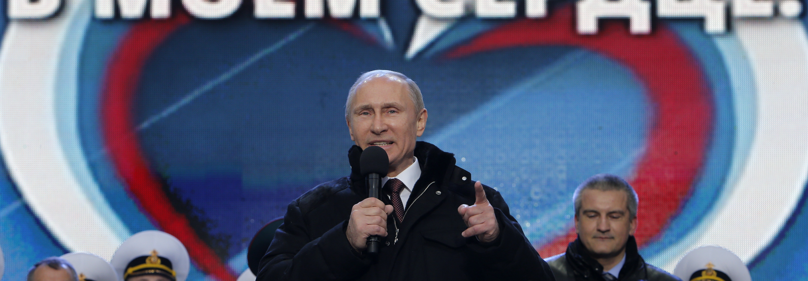
Consequences of economic sanctions on Russia after the Ukraine crisis
Nikulina Daria

Slide 2
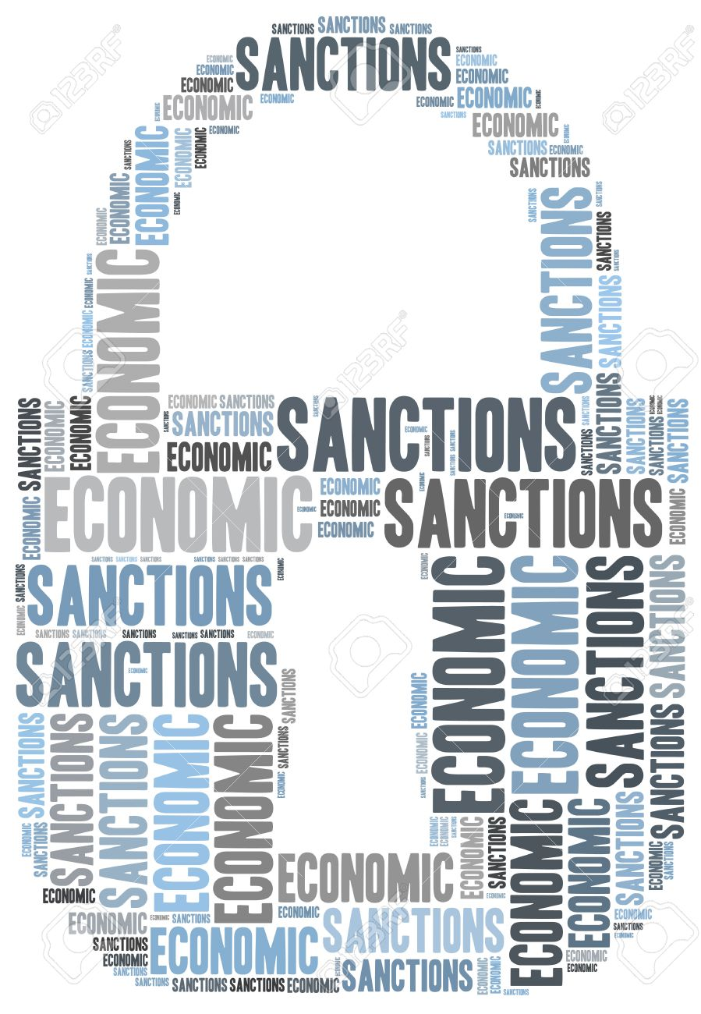
Outline
Introduction
Types of economic sanctions
Effect on Russia
Effect on Europe
Conclusion

Slide 3
Introduction
Strong connection of countries economies on the global market
Russia – one of 20 biggest importer and exporter countries
Sanctions as a political instrument

Slide 4
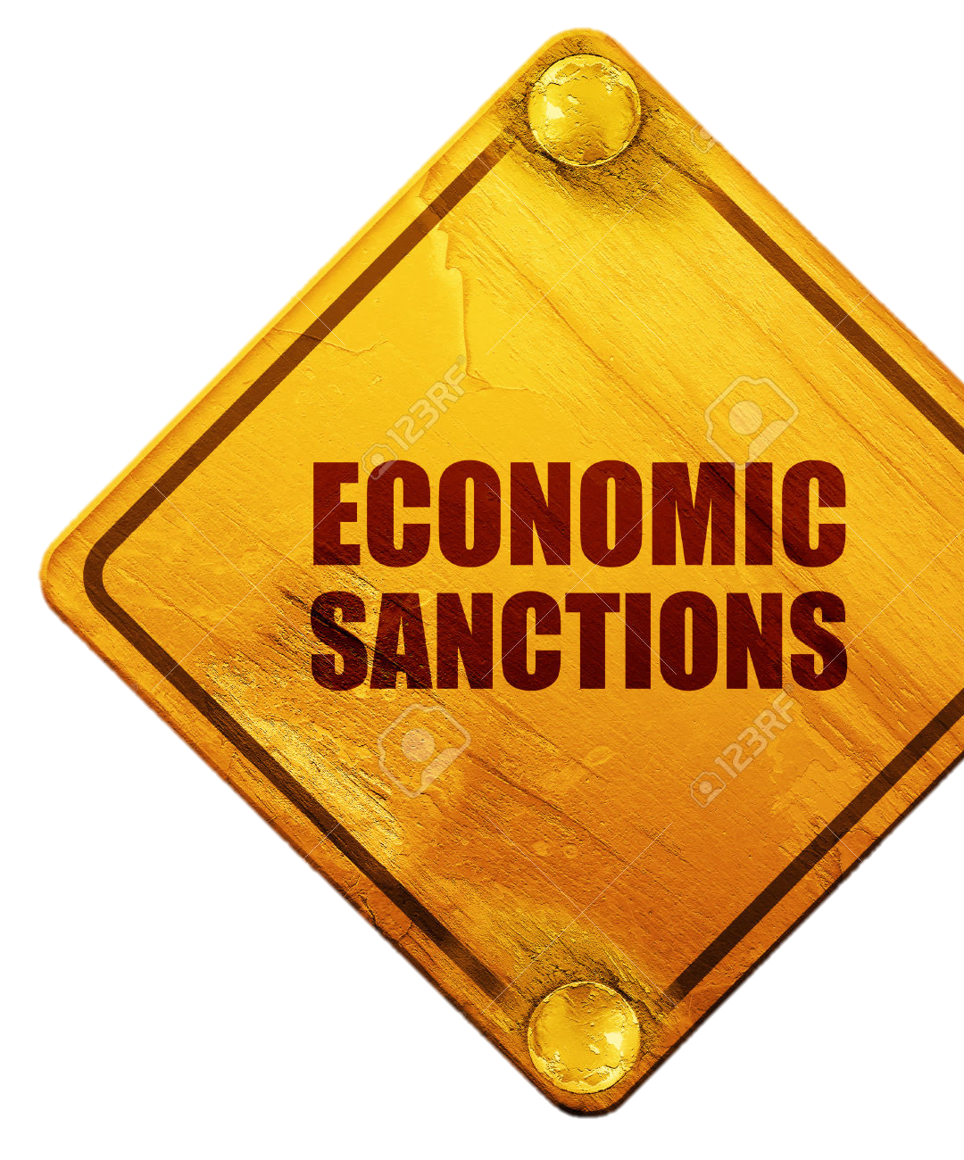
Sanctions
Restricted access of several Russian banking, military and energy companies to Western financial market
ban on export to Russia of oil exploration and production equipment
prohibition of export of military goods to Russia
Russian embargo on food imports

Slide 5
Effect on Russia
High inflation rate (17% in 2015)
GDP growth of -2.2% (1Q 2015 compared to 1Q 2014) and -1.2% in 1,2Q 2016
Ruble weakening
30-40% decrease of export and import rates

Slide 6
Effect on Russia
Expand of domestic producers
Drop of import quota in consumption
from48% to 20% for cheese
from 18% to 9% for pork
from 19% to 10%for chicken
Stronger cooperation with China

Slide 7
Effect on Europe
Loss of Russian market did not have unfavorable impact on EU economy
1Q 2015 compared to 1Q 2014 export to Russia decreased by 8,6 billion Euros, export to other destinations rose by 49 billion Euros
For Lithuania, Estonia, Finland, Latvia etc. loss of Russian market resulted in decrease of export by up to 336 million Euros

Slide 8
Conclusion
In process
Debatable issue of Russian embargo
Recession period for Russia
New opportunities
Changes in distribution of power

Slide 9
References
Michigan State University, Global EDGE, (2014). Russia: Trade Statistics [Online]. URL: http://globaledge.msu.edu/countries/russia/tradestats [Accessed: 27.09.2016].
Trading Economics, (2016). Russia Imports [Online]. URL: http://www.tradingeconomics.com/russia/imports [Accessed: 27.09.2016].
Trading Economics, (2016). Russia Exports [Online]. URL: http://www.tradingeconomics.com/russia/exports [Accessed: 27.09.2016].
Christie, E. (2015). Sanctions after Crimea: Have they worked? NATO Review Magazine, [Online]. URL: http://www.nato.int/docu/Review/2015/Russia/sanctions-after-crimea-have-they-worked/EN/index.htm [Accessed: 27.09.2016].
Аньков, В. (2015). Внешняя торговля России 2015: идем на Восток! РИА Новости, [Online]. URL: https://ria.ru/ny2016_resume/20151229/1350935820.html [Accessed: 27.09.2016].
Толочко, В. (2016). Российское продовольственное эмбарго в ответ на санкции ЕС и США. РИА Новости, [Online]. URL: https://ria.ru/spravka/20160806/1473673397.html [Accessed: 27.09.2016].
Galbert, S. (2015). A Year of Sanctions Against Russia – Now What? [pdf] Center for Strategic and International Studies. URL: https://csis-prod.s3.amazonaws.com/s3fs-public/legacy_files/files/publication/150929_deGalbert_SanctionsRussia_Web.pdf [Accessed: 27.09.2016].

Slide 10
Consequences of economic sanctions on Russia after the Ukraine crisis
Nikulina Daria

