Slide 1
Financial Bubble
Jerry Odogwu 443748

Slide 2
Definition
The term “bubble,” in the financial context, generally refers to a situation where the price for an asset exceeds its fundamental value by a large margin.
During a bubble, prices for a financial asset or asset class are highly inflated, bearing little relation to the intrinsic value of the asset. (Investopedia S., 2010). It may also be referred to as financial or speculative or asset price bubble.

Slide 3
Symptoms/Characteristics
Extremely strong demand of the asset in question (usually caused by change government policy or law, technology or nature)
Little or no correlation between price and intrinsic value of asset
Excess money in circulation
Failure to recognize that regular market participants and other forms of traders are engaged in a speculative exercise, which is not supported by previous valuation techniques. (Patton M., 2015)

Slide 4
Phases of a Financial Bubble
Displacement
investors get enamored by a new paradigm
Boom
Prices rise slowly at first, but then gain momentum as more and more participants enter the market
Euphoria
caution is thrown to the wind, as asset prices skyrocket. Valuations reach extreme levels during this phase.
Profit Taking
the smart money–heeding the warning signs–is generally selling out positions and taking profits.
Panic
asset prices reverse course and descend as rapidly as they had ascended. Investors and speculators now want to liquidate at any price

Slide 5
First Recorded Bubble: The Dutch Tulip Mania (1600s)
This bubble occurred between late 1636 and mid 1637. Tulips came out of nowhere, having been imported from Turkey.
Supply was low because of the 7-year growth cycle and further collapsed due to a virus. Thus, demand spiked and Tulips became so popular that their prices soared, some bulbs cost 10 times more than the annual wage of a skilled worker.
The crash of the tulip market started when no one showed up for a routine bulb auction in Haarlem. Within days, the panic had spread across the country.
Despite the efforts of traders to prop up demand, the market for tulips evaporated. Flowers that had commanded 5,000 guilders a few weeks before now fetched one-hundredth that amount. (Weisenthal, J. 2011)

Slide 6
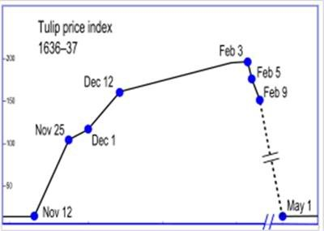
First Recorded Bubble: The Dutch Tulip Mania (1600s)
Tulip Price Index

Slide 7
Anatomy of a Bubble: The Tech Bubble (aka Dot-Com Bubble) of 2000
This was a period of time where the price of technology stocks soared. These companies where mostly funded by venture capitalists, offered free services and where expected to monetize some time in the future; forcing the demand and prices of their stocks to skyrocket.
But on the flip side, most of these companies had their books in red.

Slide 8
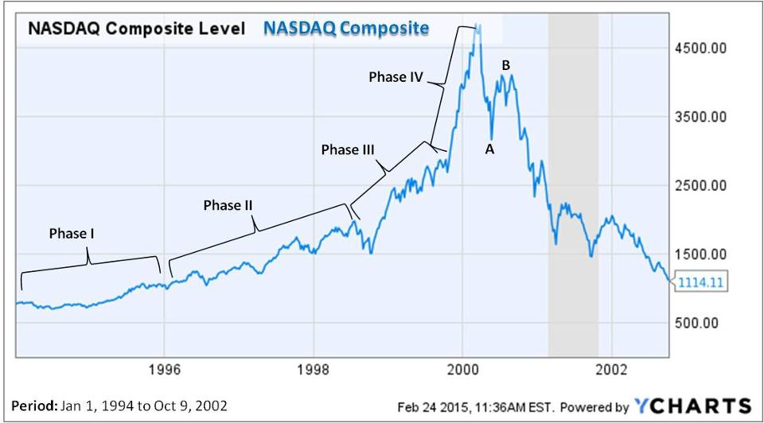
Anatomy of a Bubble: The Tech Bubble (aka Dot-Com Bubble) of 2000
Phase I: smart money invests
Phase II: institutional investors get into the game; bubble begins to form
Phase III: general public begins to notice and starts to invest
Phase IV: prices rise the steepest because everyone now knows about the “amazing” investment. Biggest losers are those that invest in this phase.
Point A: false bottom point, which gives the impression that prices are about to rebound
Point B: bear trap that gives the impression of a rebounding market.
The chart above represents the NASDAQ Composite which is an index of nearly 4,000 companies, almost two-thirds of which are technology companies. It covers the period of time from January 1, 1994 to October 9, 2002.

Slide 9
Other Significant Bubbles in History
The South Sea Bubble
Japan’s Real Estate and Stock Market Bubble
The US Housing Bubble

Slide 10
Protecting Our Investments
Diversification of investments
Avoiding “popular” investment opportunities
Gathering proper financial and managerial knowledge and information about companies before committing funds.
Seeking professional opinions that are backed up by data, research and experience.
Using standard stock valuation techniques to determine the real value of stocks
Fundamental Analysis (Price-Earning Method, Dividend Discount Model and Free Cash Flow model)
Technical Analysis. (Madura J. 2009)

Slide 11
References
Investopedia, S. (2010) Five steps of A bubble. Available at: http://www.forbes.com/2010/06/17/guide-financial-bubbles-personal-finance-bubble.html (Accessed: 13 October 2016).
Patton, M. (2015) The coming financial bubble: Why it may be the worst of all - part I. Available at: http://www.forbes.com/sites/mikepatton/2015/02/24/the-coming-financial-bubble-why-it-may-be-the-worst-of-all/#1edcf3775075 (Accessed: 13 October 2016).
Picardo, E. (2015) ‘Five of the largest asset bubbles in history’, in Available at: http://www.investopedia.com/articles/personal-finance/062315/five-largest-asset-bubbles-history.asp (Accessed: 13 October 2016).
Weisenthal, J. (2011) The most amazing bubbles in human history. Available at: http://www.businessinsider.com/the-biggest-bubbles-of-all-time-2010-5#the-dutch-tulip-bubble-1 (Accessed: 13 October 2016).
Madura, J. and Madura, P.J. (2009) Financial markets and institutions (with stock Trak coupon). 9th edn. United States: South Western Educational Publishing

Slide 12
Thank you

