Slide 1
Lebanon’s Economy
By
Caroline Al Ali

Slide 2
Outline
Lebanon
Economic System
Current Economic Situation
Questions

Slide 3
Lebanon
Capital: Beirut
Population: 5.8 Million
Member of the Arabian World
Official Language: Arabic
Other languages: French, English and Armenian
Religions: Islam, Christianity and Druze
Political System:
Parliamentary Democratic Republic
Follows the confessional system
It currently does NOT have a president

Slide 4
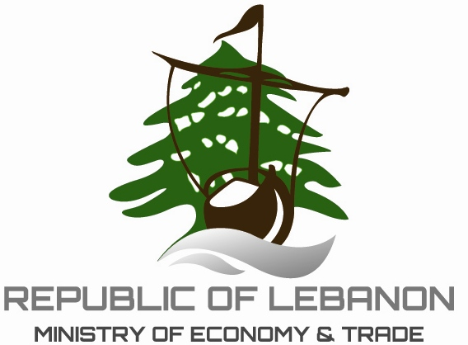
Economic System
Free-market
Open
Developing
Currency: Lebanese Pound (1$=1500 LBP)
Facts:
Minimum wage is 450$ (675,000 LBP)
Heavily relies on importation of goods
Limited natural resources
Attractive tax rates
3 main sectors: Service, Industrial and Agricultural
Note: the service sector makes up 70% of the GDP
Economy

Slide 5
Taxation System
Current Situation
15% tax on corporate profits
2% to 20% tax on all wages and salaries. The rate increases as the salary increases
10% tax on income from movable capital
0% to 14% property tax. Also varies depending on the value of the property
10% VAT tax
0 to 70% custom duties and a range of 0 to 5% tariffs on “industrial goods, tobacco and most of agricultural goods”.
Debt-to-GDP ratio is currently 120%
Public debt is around $69 billion
Tax income decreased by 2.2% from 2010 to 2014
Foreign direct investments has been decreasing since 2009 and are currently $2.3 billion

Slide 6
Current Situation (Cont.)
On the bright side:
Inflation levels have been decreasing since 2013
GDP has increased from $21.8 billion in 2006 to $47.1 billion in 2015
The Tourism & Hospitality sector is growing and had an additional 12% contribution to the GDP in 2015 (it was 21.2%)
On the dark side:
Lebanon is currently suffering from deflation (- 3.7%)
Economic growth has been decreasing for the past 5 years and is currently only 1%
The industrial (21%) and agricultural (5.5%) sectors’ contribution to the GDP is decreasing

Slide 7
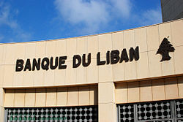
The Backbone of the Lebanese Economy: The Financial Services Sector
The Lebanese banking system managed to make itself the main recipient of the petrodollars during the oil boom in 1960
If it wasn’t for Lebanon’s Central bank strict policy, the economy wouldn’t have survived the many hits it had received in the last decade. And it wouldn’t have been growing for the past decade or so.
The banking sector is known for its “high liquidity and solid capital adequacy”
In 2015, private sector loans-to-deposits ratio was 32 percent
Loans to the private sector made up 94% of the GDP

Slide 8
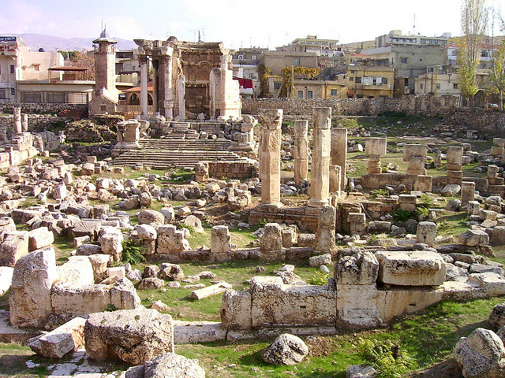
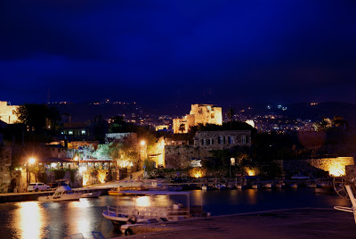
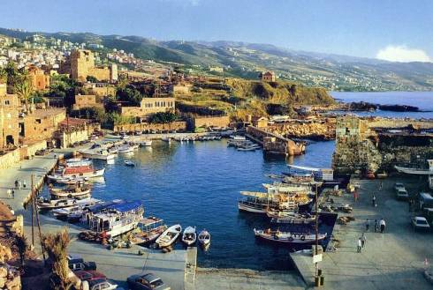
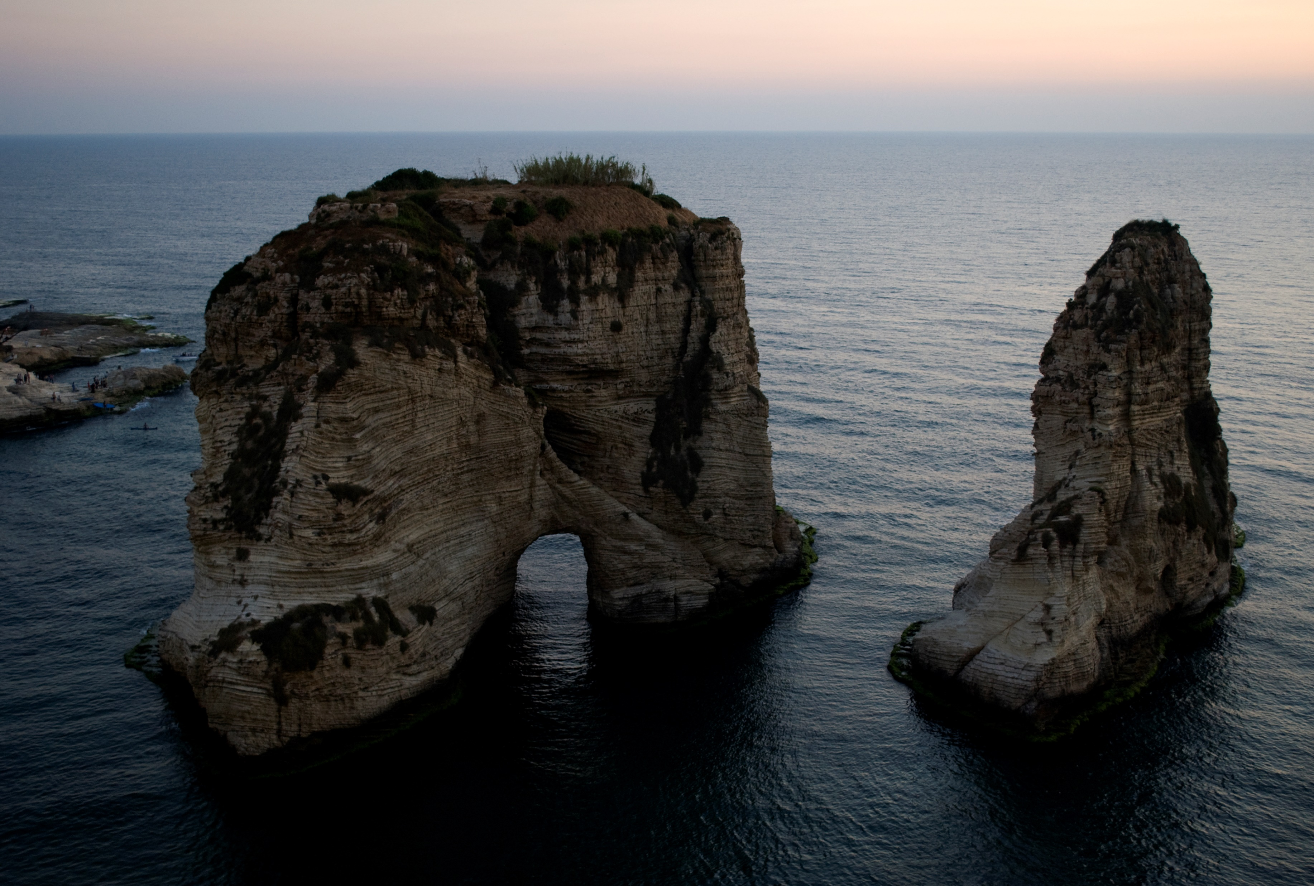

Slide 9
References
Aziz, J. (2015, December 8). Will Lebanon finally get a new president? Retrieved from Al Monitor: http://www.al-monitor.com/pulse/originals/2015/12/lebanon-president-elections-hariri-jumblatt-franjieh.html
BBC. (2015, November 12). Lebanon Profile-Overview. Retrieved from BBC: http://www.bbc.com/news/world-middle-east-14647311
Beyhum, M. A. (2016, July 16). Lebanon’s banking sector continues to thrive in spite of economic instability. Retrieved from World Finance: http://www.worldfinance.com/banking/lebanons-banking-sector-continues-to-thrive-in-spite-of-economic-instability
BlomInvest Bank. (2016). 2015: Another Recovery Year for the Lebanese Tourism Sector. Beirut: Blom Bank. Retrieved from http://blog.blominvestbank.com/wp-content/uploads/2016/02/2015-Another-Recovery-Year-for-the-Lebanese-Tourism-Sector.pdf
Central Intelligence Agency. (2016, September 19). The World FactBook. Retrieved from Central Intelligence Agency: https://www.cia.gov/library/publications/the-world-factbook/geos/le.html
Embassy of Lebanon. (2016). The Economy. Retrieved from The Embassy of Lebanon: http://www.lebanonembassyus.org/the-economy.html
IDAL. (n.d.). Taxation Schemes in Lebanon. Retrieved from Investment Development Authority of Lebanon: http://investinlebanon.gov.lb/Content/uploads/SideBlock/130306010904242~Taxation%20Schemes%20in%20Lebanon.pdf
Ministry of Finance. (2015). General Debt Overview. Retrieved from Ministry of Finance: http://www.finance.gov.lb/en-US/finance/PublicDebt/Documents/PublicDebtTimesSeries/General%20Debt%20Overview.pdf
Shelton, T. (2014, February 22). Why Lebanese Politics Are So Messed Up. Retrieved from Public Radio International: http://www.pri.org/stories/2014-02-22/why-lebanese-politics-are-so-messed
World Bank. (2016). Lebanon’s Economic Outlook- Spring 2016. Retrieved from The World Bank: http://pubdocs.worldbank.org/en/218531460208807979/Lebanon-MEM.pdf
World Travel & Tourism Council. (2015). Travel & Tourism Economic Impact 2015: Lebanon. London: World Travel & Tourism Council. Retrieved from https://www.wttc.org/-/media/files/reports/economic%20impact%20research/countries%202015/lebanon2015.pdf

Slide 10
Thank You for Listening
Any Questions? ☺

