Slide 1
Tax Haven
Author:
Elena Iabanji
Supervisors:
Ing. Luděk Benada
Ing. Josef Nešleha
7 October 2016

Slide 2
Summary
Introduction
The way tax havens develop
Facts about tax haven
Financial and economic implications
Fighting tax havens
Conclusion
Literature sources

Slide 3
Definition and features
Place where people/ companies pay less tax than they would pay in their own country. Usually is called and “Offshore zones”.
lack of effective exchange of information;
lack of transparency;
no substantial activities.

Slide 4
The way tax havens develop
35% CIT
Co X
$1M pre-tax profit
$350k Tax
$100k pre-tax profit
$35k Tax
$18k Tax
$900k
2% CIT
Subsidiary
Given IP

Slide 5
Tax haven countries
Facts about tax haven
British Virgin Island,
Bahamas,
The Netherlands,
Luxembourg, etc.

Slide 6
Financial and economic implications
Tax havens
Governments have to face budget deficit
Possibility of banks and investment funds to invest in any kind of asset, including "toxic assets“
Instead of long term investment, countries with low tax rates are used for money laundering.
The most taxes remain to be paid by middle and lower class, contributing to the increase in the gap between the best off and poorest in society

Slide 7
Fighting tax havens
Identify a practical monitoring method of international transactions
Improve the public transparency of the companies’ activity
Develop the worldwide transfer pricing practice
Creating a better business environment in developing and developed countries, as well

Slide 8
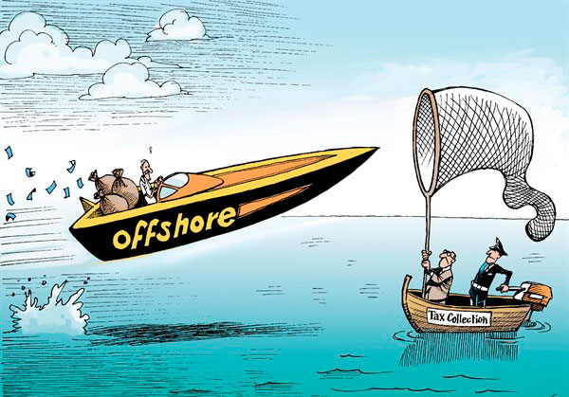
Conclusion

Slide 9
Literature sources
Countering offshore tax evasion report, OECD, 28 September 2009. https://www.oecd.org/ctp/harmful/42469606.pdf
Buettner, Thiess. (2003), “Tax base effects and fiscal externalities of local capital taxation: Evidence from a panel of German jurisdictions.” Journal of Urban Economics 54:110- 128.
Gabriel Zucman, La richesse cachée des nations. Enquête sur les paradis fiscaux. Seuil 2013
HowMuch, This Interactive Calculator Shows How Much Tax Havens Are Costing America, Article dated 27 July 2016
https://howmuch.net/articles/tax-havens
Study on Structures of Aggressive Tax Planning and Indicators, European Commission, 23 December 2015.
http://ec.europa.eu/taxation_customs/sites/taxation/files/resources/documents/taxation/gen_info/economic_analysis/tax_papers/taxation_paper_61.pdf

