Slide 1
Chapter no. 5:
International financial system: International finance and international financial institutions
Josef Nesleha
Department of Finance
josef.nesleha@econ.muni.cz

Slide 2
Content
Introduction
Direct and Indirect Quote
Money supply
Money demand
Clash of both the demands
Inflation, deflation and hyperinflation
Purchasing Power Parity
The World Bank
Conclusion and discussion

Slide 3
Financial system X International financial system
A financial system is the system that covers financial transactions and the exchange of money between investors, lender and borrowers
An international financial system means the same, but it involves investors, lenders and borrowers from different countries/states

Slide 4
Foreign exchange rate
Direct Quote
  a foreign exchange rate quoted as the domestic currency per unit of the foreign currency
  Example: 27 CZK / 1€
Indirect Quote
  A foreign currecny per unit of the domestic currency
  0.037 € / 1 CZK

Slide 5
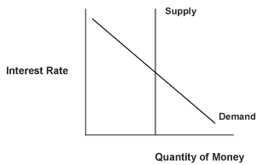
Money supply, money demand and the equilibrium

Slide 6
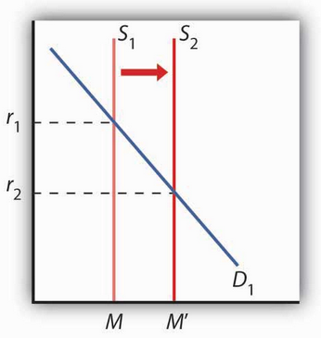
Change in money supply
M… quantity of money
S…. money supply
D… demand for money
r…. interest rate

Slide 7
How can money supply be changed?
Increase in money supply
  In the way of printing money (which is pumped into the financial system)
Decrease in money supply
  Probably more complicated (Central bank cannot come to citizens and ask them for their money…)
  Indirect withdrawal of money – how can this be done?
  Increase in state bonds interest rate?

Slide 8
Inflation, deflation and hyperinflation
Inflation
  refers to prices rising over time, either in a particular industry or throughout the entire economy
  Even healthy economics will always have some fluctuations, therefore, the inflation is not an unpleasant situation/state
Hyperinflation
  Unnatural situation (the value of a currency faces a sharp free fall)
  Appears when a country‘s government prints more and more money
Deflation
  Negative inflation

Slide 9
Purchasing Power Parity (PPP)
= an economic theory that compares different countries' currencies through a market "basket of goods" approach
According to this concept, two currencies are in equilibrium or at par when a market basket of goods (taking into account the exchange rate) is priced the same in both countries.
Such situation is not likely to work perfectly.

Slide 10
Purchasing Power Parity (PPP)
The relative version of PPP is calculated as:
  S = P1/P2
Where:
"S" represents exchange rate of currency 1 to currency 2
"P₁" represents the cost of good "x" in currency 1
"P₂" represents the cost of good "x" in currency 2

Slide 11
An example of PPP
Let‘s suppose a pair of shoes costs 1,200 CZK in the Czech Republic. The same pair of shoes costs 40€ in Germany. If we take into account the up-to-date exchange rate of CZK and €, it might be concluded that this pair of shoes is more expensive in the Czech Republic (27CZK*40€=1,080CZK). If the PPP worked, the exchange rate of these two currencies would have to be:
    S=P1/P2
    S=1,200/40
    S=30

Slide 12
Why PPP is unlikely to work?
Transport costs
  Even if two products/services have the same real value/price, costs of transport might eventually affect this equation
Government interventions
  Some governments might (intentionally) influence prices, either of domestic or foreign production
Limited possibilities to transport some types of goods or mainly services
  How can you transport services provided by a barber?
Inflation

Slide 13
The World Bank
The goal of the World Bank is to reduce poverty
Loans are provided to citizens of developing countries (towards those people who would be hardly granted a loan from a bank)
Created at the end of World War II

Slide 14
Advantages and disadvantages of such microloans
+
  Help to support world economy and developing countries
  Gives a chance those who are unlikely to prosper without such type of bailout/support
-
  More risky loans, higher probability of defaults
  Difficult to assess client‘s creditworthiness

Slide 15
Thank you for your attention

Slide 16
References
MANKIW, Gregory N. Principles of Economics. 7. vyd. : Cengage Learning, 2014. ISBN 978-1-285-16587-5.
GITMAN, Lawrence J. and Jeff MADURA. Introduction to finance. 1st d. Boston: Addison-Wesley, 2001. xxx, 755. ISBN 0201635372
Financial System Definition | Investopedia. Investopedia - Sharper Insight. Smarter Investing. [online]. [cit. 2016-10-21]. Dostupné z: http://www.investopedia.com/terms/f/financial-system.asp

