Slide 1
Chapter no. 2: Financial markets

Slide 2
Content
Introduction and purpose statement
Primary and secondary market
Direct vs. Indirect finance
Functions of financial market
Types of financial market
Money market
Bond market
Stock market
Asymmetric information
Up-to-date trends
Important terms, revision and conclusion

Slide 3
Financial market
= a market in which people and institutions trade financial securities, commodities, and other items of value
= the set price is a result of supply and demand
Does not have physical existence

Slide 4
Primary and secondary market
Primary market
a financial market in which new issues of a security, such as a bond or a stock, are sold to initial buyers
Investments banks usually help with the first/initial process of selling
IPO = Initial Public Offering (flotation)
Secondary market
A financial market in which securities that have been previously issued can be resold

Slide 5
Direct vs. Indirect finance
Direct finance
Without any middlemen
For some types of trades such connection is not possible
Indirect finance
The communication between a buyer and a seller is administered by an intermediary (middleman)
Higher transaction costs – why?

Slide 6
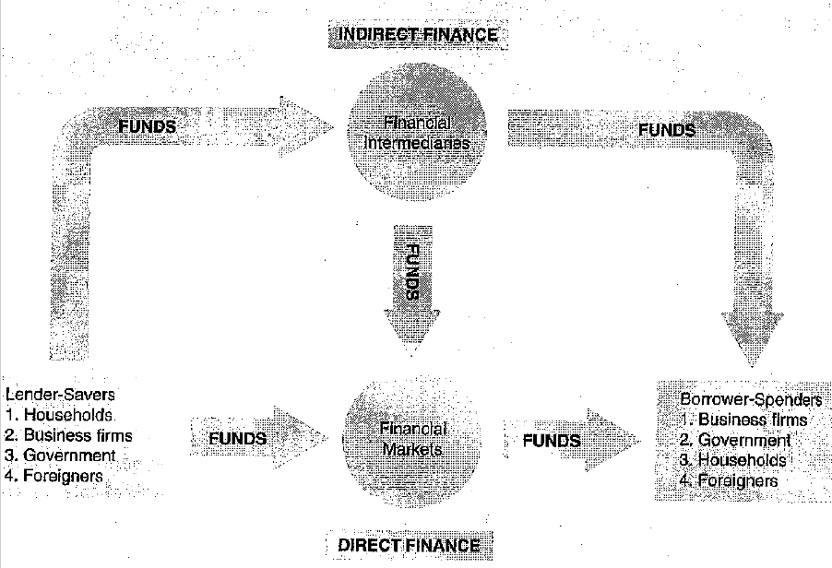
Direct and Indirect finance

Slide 7
Functions of financial market
Transfer of resources
Money is transferred from surplus do deficit units, using different types of tools
Price determination
The price is set due to the demand and supply on the market
Productive usage
Enhancing income
The financial market enables surplus units to enhance their financial sources
Information
Various types of information are available on the market

Slide 8
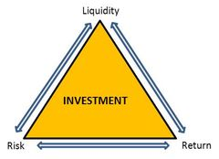
Magic triangle
Can you reach all of the poitns at the same time?

Slide 9
Money market
= short-time investments
Products:
Cheque
Banking products (e.g.: savings account)
Assets with due date in shorter period than one year
What is the main advantage?

Slide 10
Bond market
= a debt investment in which an investor loans money to an entity (typically corporate or governmental) which borrows the funds for a defined period of time at a variable or fixed interest rate
Less risky than shares but more risky than products of money market
Various types of bonds -

Slide 11
Stock market
Share/stock = a claim on the company's assets and earnings
Different types of shares: ordinary, preferred shares, common stocks
Different forms of shares
Rights related to shares holding:
A part of the decision-making process
Right to payment of the liquidation value
Right to be paid dividends
More risky but more profitable (comparing to bonds/debentures or products traded on the money market)

Slide 12
Asymmetric information: Adverse Selection + Moral Hazard
Adverse Selection
Originally used in insurance
situation where sellers have information that buyers do not, or vice versa, about some aspect of product quality
Moral Hazard
the risk that a party to a transaction has not entered into the contract in good faith, has provided misleading information about its assets, liabilities or credit capacity, or has an incentive to take unusual risks in a desperate attempt to earn a profit before the contract settles

Slide 13
Market bubbles
Market bubble
speculative bubble, a market bubble, a price bubble, a financial bubble, a speculative mania or a balloon
Based on wrong assumption of society behaviour
People tend to believe in the value of something which is actually worthless or has very low value
Various bubbles which happened in the past
Tulip mania (around 1637)
Dot-com bubble (1991-2001)
Railway mania (1840)
Housing bubble (2007-2008)

Slide 14
Up-to-date trends on the financial market
Globalization
Internationalization
International trade
Dematerialization
Financial literacy
Behavioural finance

Slide 15
Terms to be familiar with
IPO (flotation)
Initial Public Offering
The very first offer of a company‘s shares
Transaction costs
The time and money spent in carrying out financial transactions
OTC market
Bonds/shares/stocks/stakes
Financial derivatives – different types
Bond coupon
Principal

Slide 16
Questions for revision
What is the difference between stocks and bonds?
What is the main disadvantage of stocks/shares from the point of an investor?
What is the difference between direct and indirect finance?
What are main functions of financial market?
What are financial derivatives?
Which types of financial derivatives do you know?
Describe the intuition of moral hazard.
What are main attributes of shares/stocks in comparison with bonds and products of money market?

Slide 17
Thank you for your attention

Slide 18
References
MISHKIN, Frederic S. Financial markets and institutions. Eight edition, global edition. Boston: Pearson, 2016. Always learning (Pearson). ISBN 978-1-292-06048-4.
Moral Hazard Definition | Investopedia. Investopedia [online]. [cit. 2016-09-29]. Dostupné z: http://www.investopedia.com/terms/m/moralhazard.asp
Adverse Selection Definition | Investopedia. Investopedia [online]. [cit. 2016-09-29]. Dostupné z: http://www.investopedia.com/terms/a/adverseselection.asp
BODIE, Zvi, Alex KANE a Alan J. MARCUS. Investments. 10th global ed. Maidenhead: McGraw-Hill Education, 2014. ISBN 978-0-07-716114-9.

