Slide 1
Econometrics - Lecture 4
Heteroskedasticity and Autocorrelation

Slide 2
Contents
Violations of V{ε} = σ² I_{N}: Illustrations and Consequences
Heteroskedasticity
Tests against Heteroskedasticity
GLS Estimation
Autocorrelation
Tests against Autocorrelation
Inference under Autocorrelation

Slide 3
Gauss-Markov Assumptions
Observation y_{i} is a linear function
  y_{i} = x_{i}'β + ε_{i}
  of observations x_{ik}, k =1, …, K, of the regressor variables and the error term ε_{i}
  for i = 1, …, N; x_{i}' = (x_{i1}, …, x_{iK}); X = (x_{ik})
In matrix notation: E{ε} = 0, V{ε} = σ² I_{N}
A1 | E{ε_{i}} = 0 for all i
A2 | all ε_{i} are independent of all x_{i} (exogeneous x_{i})
A3 | V{ε_{i}} = σ² for all i (homoskedasticity)
A4 | Cov{ε_{i}, ε_{j}} = 0 for all i and j with i ≠ j (no autocorrelation)

Slide 4
OLS Estimator: Properties
Under assumptions (A1) and (A2):
1. The OLS estimator b is unbiased: E{b} = β
Under assumptions (A1), (A2), (A3) and (A4):
2. The variance of the OLS estimator is given by
V{b} = σ²(Σ_{i} x_{i} x_{i}’)⁻¹ = σ²(X‘ X)⁻¹
3. The sampling variance s² of the error terms ε_{i},
s² = (N – K)⁻¹ Σ_{i} e_{i}²
is unbiased for σ²
4. The OLS estimator b is BLUE (best linear unbiased estimator)

Slide 5
Violations of V{ε} = σ²I_{N}
Implications of the Gauss-Markov assumptions for ε:
V{ε} = σ²I_{N}
Violations:
Heteroskedasticity
V{ε} = diag(σ₁², …, σ_{N}²)
with σ_{i}² ≠ σ_{j}² for at least one pair i ≠ j, or using σ_{i}² = σ² h_{i}²,
V{ε} = σ²Ψ = σ² diag(h₁², …, h_{N}²)
Autocorrelation: V{ε_{i}, ε_{j}} ≠ 0 for at least one pair i ≠ j or
V{ε} = σ²Ψ
with non-diagonal elements different from zero

Slide 6
Example: Household Income and Expenditures
70 households (HH):
monthly HH-income and expenditures for durable goods
2400
2000
1600
1200
expentidures for durable goods
800
400
0
0
2000
4000
6000
8000
10000
12000
HH-income

Slide 7
Household Income and Expenditures, cont‘d
Residuals e = y- ŷ from
Ŷ = 44.18 + 0.17 X
X: monthly HH-income
Y: expenditures for durable goods
the larger the income, the more scattered are the residuals
600
400
200
0
residuals e
-200
-400
-600
0
2000
4000
6000
8000
10000
12000
HH-income

Slide 8
Typical Situations for Heteroskedasticity
Heteroskedasticity is typically observed
in data from cross-sectional surveys, e.g., surveys in households or regions
in data with variance that depends of one or several explanatory variables, e.g., variance of the firms’ turnover depends on firm size
in data from financial markets, e.g., exchange rates, stock returns

Slide 9
Example: Household Expenditures
Variation of expenditures, increasing with growing income; from Verbeek, Fig. 4.1

Slide 10
Autocorrelation of Economic Time-series
Consumption in actual period is similar to that of the preceding period; the actual consumption „depends“ on the consumption of the preceding period
Consumption, production, investments, etc.: to be expected that successive observations of economic variables correlate positively
Seasonal adjustment: application of smoothing and filtering algorithms induces correlation of the smoothed data

Slide 11
Example: Imports
Scatter-diagram of by one period lagged imports [MTR(-1)] against actual imports [MTR]
Correlation coefficient between MTR und MTR(-1): 0.9994

Slide 12
Example: Import Function
MTR: Imports
FDD: Total Demand
(from AWM-database)
Import function: MTR = -227320 + 0.36 FDD
R² = 0.977, t_{FFD} = 74.8

Slide 13
Import Function, cont‘d
MTR: Imports
FDD: Total Demand
(from AWM-database)
RESID: e_{t} = MTR - (-227320 + 0.36 FDD)

Slide 14
Import Function, cont‘d
Scatter-diagram of by one period lagged residuals [Resid(-1)] against actual residuals [Resid]
Serial correlation!

Slide 15
Typical Situations for Autocorrelation
Autocorrelation is typically observed if
a relevant regressor with trend or seasonal pattern is not included in the model: miss-specified model
the functional form of a regressor is incorrectly specified
the dependent variable is correlated in a way that is not appropriately represented in the systematic part of the model
Warning! Omission of a relevant regressor with trend implies autocorrelation of the error terms; in econometric analyses, autocorrelation of the error terms is always to be suspected!
Autocorrelation of the error terms indicates deficiencies of the model specification
Tests for autocorrelation are the most frequently used tool for diagnostic checking the model specification

Slide 16
Import Functions
Regression of imports (MTR) on total demand (FDD)
MTR = -2.27x10⁹ + 0.357 FDD, t_{FDD} = 74.9, R² = 0.977
Autocorrelation (of order 1) of residuals:
  Corr(e_{t}, e_{t-1}) = 0.993
Import function with trend (T)
MTR = -4.45x10⁹ + 0.653 FDD – 0.030x10⁹ T
t_{FDD} = 45.8, t_{T} = -21.0, R² = 0.995
Multicollinearity? Corr(FDD, T) = 0.987!
Import function with lagged imports as regressor
MTR = -0.124x10⁹ + 0.020 FDD + 0.956 MTR₋₁
t_{FDD} = 2.89, t_{MTR(-1)} = 50.1, R² = 0.999

Slide 17
Consequences of V{ε} ≠ σ²I_{N} for OLS estimators
OLS estimators b for β
are unbiased
are consistent
have the covariance-matrix
V{b} = σ² (X'X)⁻¹ X'ΨX (X'X)⁻¹
are not efficient estimators, not BLUE
follow – under general conditions – asymptotically the normal distribution
The estimator s² = e'e/(N-K) for σ² is biased

Slide 18
Consequences of V{ε} ≠ σ²I_{N} for Applications
OLS estimators b for β are still unbiased
Routinely computed standard errors are biased; the bias can be positive or negative
t- and F-tests may be misleading
Remedies
Alternative estimators
Corrected standard errors
Modification of the model
Tests for identification of heteroskedasticity and for autocorrelation are important tools

Slide 19
Contents
Violations of V{ε} = σ² I_{N}: Illustrations and Consequences
Heteroskedasticity
Tests against Heteroskedasticity
GLS Estimation
Autocorrelation
Tests against Autocorrelation
Inference under Autocorrelation

Slide 20
Example: Labor Demand
Verbeek’s data set “labour2”: Sample of 569 Belgian companies (data from 1996)
Variables
  labour: total employment (number of employees)
  capital: total fixed assets
  wage: total wage costs per employee (in 1000 EUR)
  output: value added (in million EUR)
Labour demand function
labour = β₁ + β₂*wage + β₃*output + β₄*capital

Slide 21
Labor Demand and Potential Regressors

Slide 22
Inference under Heteroskedasticity
Covariance matrix of b:
V{b} = σ² (X'X)⁻¹ X'ΨX (X'X)⁻¹
with Ψ = diag(h₁², …, h_{N}²)
Use of σ² (X'X)⁻¹ (the standard output of econometric software) instead of V{b} for inference on β may be misleading
Remedies
Use of correct variances and standard errors
Transformation of the model so that the error terms are homoskedastic

Slide 23
The Correct Variances
V{ε_{i}} = σ_{i}² = σ²h_{i}², i = 1,…,N: each observation has its own unknown parameter h_{i}
N observation for estimating N unknown parameters?
To estimate σ²_{i} – and V{b}
Known form of the heteroskedasticity, specific correction
  E.g., h_{i}² = z_{i}’α for some variables z_{i}
  Requires estimation of α
White’s heteroskedasticity-consistent covariance matrix estimator (HCCME)
Ṽ{b} = σ²(X'X)⁻¹(Σ_{i}ĥ_{i}²x_{i}x_{i}’) (X'X)⁻¹
with ĥ_{i}²=e_{i}²
  Denoted as HC₀
  Inference based on HC₀: “heteroskedasticity-robust inference”

Slide 24
White’s Standard Errors
White’s standard errors for b
Square roots of diagonal elements of HCCME
Underestimate the true standard errors
Various refinements, e.g., HC₁ = HC₀[N/(N-K)]
In GRETL: HC₀ is the default HCCME, HC₁ and other modifications are available as options

Slide 25
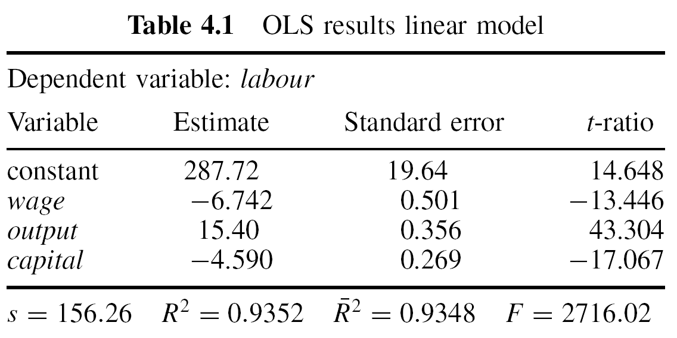
Labor Demand Function
For Belgian companies, 1996; Verbeek’s “labour2”
labour = β₁ + β₂*wage + β₃*output + β₄*capital

Slide 26
Labor Demand Function, cont’d
Can the error terms be assumed to be homoskedastic?
They may vary depending on the company size, measured by, e.g., size of output or capital
Regression of squared residuals on appropriate regressors will indicate heteroskedasticity

Slide 27
Labor Demand Function: Residuals vs output

Slide 28
Labor Demand Function, cont’d
Auxiliary regression of squared residuals, Verbeek
Indicates dependence of error terms on output, capital, not on wage

Slide 29
Labor Demand Function, cont’d
With White standard errors: Output from GRETL
Dependent variable : LABOR
Heteroskedastic-robust standard errors, variant HC0,
coefficient std. error t-ratio p-value
-------------------------------------------------------------
const 287,719 64,8770 4,435 1,11e-05 ***
WAGE -6,7419 1,8516 -3,641 0,0003 ***
CAPITAL -4,59049 1,7133 -2,679 0,0076 ***
OUTPUT 15,4005 2,4820 6,205 1,06e-09 ***
Mean dependent var 201,024911 S.D. dependent var 611,9959
Sum squared resid 13795027 S.E. of regression 156,2561
R- squared 0,935155 Adjusted R-squared 0,934811
F(2, 129) 225,5597 P-value (F) 3,49e-96
Log-likelihood 455,9302 Akaike criterion 7367,341
Schwarz criterion -3679,670 Hannan-Quinn 7374,121

Slide 30
Labor Demand Function, cont’d
Estimated function
labour = β₁ + β₂*wage + β₃*output + β₄*capital
OLS estimates and standard errors: without (s.e.) and with White correction (White s.e.) and GLS estimates with w_{i} = 1/(e_{i}²)
The White standard errors are inflated by factors 3.7 (wage), 6.4 (capital), 7.0 (output) with respect to the OLS s.e.
 | β₁ | β₂ | β₃ | β₄
Coeff OLS | 287.19 | -6.742 | 15.400 | -4.590
s.e. | 19.642 | 0.501 | 0.356 | 0.269
White s.e. | 64.877 | 1.852 | 2.482 | 1.713
Coeff GLS | 321.17 | -7.404 | 15.585 | -4.740
s.e. | 20.328 | 0.506 | 0.349 | 0.255

Slide 31
An Alternative Estimator for b
Idea of the estimator
Transform the model so that it satisfies the Gauss-Markov assumptions
Apply OLS to the transformed model
Results in an (at least approximately) BLUE
Transformation often depends upon unknown parameters that characterizing heteroskedasticity: two-step procedure
Estimate the parameters that characterize heteroskedasticity and transform the model
Estimate the transformed model
The procedure results in an approximately BLUE

Slide 32
An Example
Model:
y_{i} = x_{i}’β + ε_{i} with V{ε_{i}} = σ_{i}² = σ²h_{i}²
Division by h_{i} results in
y_{i} /h_{i} = (x_{i} /h_{i})’β + ε_{i} /h_{i}
with a homoskedastic error term
V{ε_{i} /h_{i}} = σ_{i}²/h_{i}² = σ²
OLS applied to the transformed model gives
This estimator is an example of the “generalized least squares” (GLS) or “weighted least squares” (WLS) estimator

Slide 33
Weighted Least Squares Estimator
A GLS or WLS estimator is a least squares estimator where each observation is weighted by a non-negative factor w_{i} > 0:
Weights w_{i} proportional to the inverse of the error term variance σ²h_{i}²: Observations with a higher error term variance have a lower weight; they provide less accurate information on β
  Needs knowledge of the h_{i}
    Is seldom available
    Estimates of h_{i} can be based on assumptions on the form of h_{i}
    E.g., h_{i}² = z_{i}’α or h_{i}² = exp(z_{i}’α) for some variables z_{i}
  Analogous with general weights w_{i}
  White’s HCCME uses w_{i} = e_{i}⁻²

Slide 34
Labor Demand Function, cont’d
Regression of “l_usq1”, i.e., log(e_{i}²)
Dependent variable : l_usq1
coefficient std. error t-ratio p-value
-------------------------------------------------------------
const 7,24526 0,0987518 73,37 2,68e-291 ***
CAPITAL −0,0210417 0,00375036 −5,611 3,16e-08 ***
OUTPUT 0,0359122 0,00481392 7,460 3,27e-013 ***
Mean dependent var 7,531559 S.D. dependent var 2,368701
Sum squared resid 2797,660 S.E. of regression 2,223255
R- squared 0,122138 Adjusted R-squared 0,119036
F(2, 129) 39,37427 P-value (F) 9,76e-17
Log-likelihood −1260,487 Akaike criterion 2526,975
Schwarz criterion 2540,006 Hannan-Quinn 2532,060

Slide 35
Labor Demand Function, cont’d
Estimated function
labour = β₁ + β₂*wage + β₃*output + β₄*capital
OLS estimates and standard errors: without (s.e.) and with White correction (White s.e.); and GLS estimates with w_{i} = e_{i}⁻², with fitted values for e_{i} from the regression of log(e_{i}²) on capital and output
 | β₁ | wage | output | capital
OLS coeff | 287.19 | -6.742 | 15.400 | -4.590
s.e. | 19.642 | 0.501 | 0.356 | 0.269
White s.e. | 64.877 | 1.852 | 2.482 | 1.713
FGLS coeff | 321.17 | -7.404 | 15.585 | -4.740
s.e. | 20.328 | 0.506 | 0.349 | 0.255

Slide 36
Contents
Violations of V{ε} = σ² I_{N}: Illustrations and Consequences
Heteroskedasticity
Tests against Heteroskedasticity
GLS Estimation
Autocorrelation
Tests against Autocorrelation
Inference under Autocorrelation

Slide 37
Tests against Heteroskedasticity
Due to unbiasedness of b, residuals are expected to indicate heteroskedasticity
Graphical displays of residuals may give useful hints
Residual-based tests:
Breusch-Pagan test
Koenker test
Goldfeld-Quandt test
White test

Slide 38
Breusch-Pagan Test
For testing whether the error term variance is a function of Z₂, …, Z_{p}
Model for heteroskedasticity
σ_{i}²/σ² = h(z_{i}‘α)
with function h with h(0)=1, p-vectors z_{i} und α, z_{i} containing an intercept and p-1 variables Z₂, …, Z_{p}
Null hypothesis
H₀: α = 0
implies σ_{i}² = σ² for all i, i.e., homoskedasticity
Auxiliary regression of the squared OLS residuals e_{i}² on z_{i} (and squares of z_{i});
Test statistic: BP = N*R² with R² of the auxiliary regression; BP follows approximately the Chi-squared distribution with p d.f.

Slide 39
Breusch-Pagan Test, cont‘d
Typical functions h for h(z_{i}‘α)
Linear regression: h(z_{i}‘α) = z_{i}‘α
Exponential function h(z_{i}‘α) = exp{z_{i}‘α}
  Auxiliary regression of the log (e_{i}²) upon z_{i}
  “Multiplicative heteroskedasticity”
  Variances are non-negative
Koenker test: variant of the BP test which is robust against non-normality of the error terms
GRETL: The output window of OLS estimation allows the execution of the Breusch-Pagan test with h(z_{i}‘α) = z_{i}‘α
  OLS output => Tests => Heteroskedasticity => Breusch-Pagan
  Koenker test: OLS output => Tests => Heteroskedasticity => Koenker

Slide 40
Labor Demand Function, cont’d
Auxiliary regression of squared residuals, Verbeek
Tests of the null hypothesis of homoskedasticity
Breusch-Pagan: BP = NR² = 5931.82, p-value = 0
Koenker: LM = 331.04, p-value = 2.17E-70

Slide 41
Goldfeld-Quandt Test
For testing whether the error term variance has values σ_{A}² and σ_{B}² for observations from regime A and B, respectively, σ_{A}² ≠ σ_{B}²
Regimes can be urban vs rural area, economic prosperity vs stagnation, etc.
Example (in matrix notation):
  y_{A} = X_{A}β_{A} + ε_{A}, V{ε_{A}} = σ_{A}²I_{NA} (regime A)
  y_{B} = X_{B}β_{B} + ε_{B}, V{ε_{B}} = σ_{B}²I_{NB} (regime B)
Null hypothesis: σ_{A}² = σ_{B}²
Test statistic:
with S_{i}: sum of squared residuals for i-th regime; follows under H₀ exactly or approximately the F-distribution with N_{A}-K and N_{B}-K d.f.

Slide 42
Goldfeld-Quandt Test, cont‘d
Test procedure in three steps:
Sort the observations with respect to the regimes A and B
Separate fittings of the model to the N_{A} and N_{B} observations; sum of squared residuals S_{A} and S_{B}
Calculate the test statistic F

Slide 43
White Test
For testing whether the error term variance is a function of the model regressors, their squares and their cross-products; generalizes the Breusch-Pagan test
Auxiliary regression of the squared OLS residuals upon x_{i}’s, squares of x_{i}’s, and cross-products
Test statistic: NR² with R² of the auxiliary regression; follows the Chi-squared distribution with the number of coefficients in the auxiliary regression as d.f.
The number of coefficients in the auxiliary regression may become large, maybe conflicting with size of N, resulting in low power of the White test

Slide 44
Labor Demand Function, cont’d
White's test for heteroskedasticity
OLS, using observations 1-569
Dependent variable: uhat^2
coefficient std. error t-ratio p-value
--------------------------------------------------------------
const -260,910 18478,5 -0,01412 0,9887
WAGE 554,352 833,028 0,6655 0,5060
CAPITAL 2810,43 663,073 4,238 2,63e-05 ***
OUTPUT -2573,29 512,179 -5,024 6,81e-07 ***
sq_WAGE -10,0719 9,29022 -1,084 0,2788
X2_X3 -48,2457 14,0199 -3,441 0,0006 ***
X2_X4 58,5385 8,11748 7,211 1,81e-012 ***
sq_CAPITAL 14,4176 2,01005 7,173 2,34e-012 ***
X3_X4 -40,0294 3,74634 -10,68 2,24e-024 ***
sq_OUTPUT 27,5945 1,83633 15,03 4,09e-043 ***
Unadjusted R-squared = 0,818136
Test statistic: TR^2 = 465,519295,
with p-value = P(Chi-square(9) > 465,519295) = 0

Slide 45
Contents
Violations of V{ε} = σ² I_{N}: Illustrations and Consequences
Heteroskedasticity
Tests against Heteroskedasticity
GLS Estimation
Autocorrelation
Tests against Autocorrelation
Inference under Autocorrelation

Slide 46
Transformed Model Satisfying Gauss-Markov Assumptions
Model:
y_{i} = x_{i}’β + ε_{i} with V{ε_{i}} = σ_{i}² = σ²h_{i}²
Division by h_{i} results in
y_{i} /h_{i} = (x_{i} /h_{i})’β + ε_{i} /h_{i}
with a homoskedastic error term
V{ε_{i} /h_{i}} = σ_{i}²/h_{i}² = σ²
OLS applied to the transformed model gives
This estimator is an example of the “generalized least squares” (GLS) or “weighted least squares” (WLS) estimator

Slide 47
Properties of GLS Estimators
The GLS estimator
is a least squares estimator; standard properties of OLS estimator apply
The covariance matrix of the GLS estimator is
Unbiased estimator of the error term variance
Under the assumption of normality of errors, t- and F-tests can be used; for large N, these properties hold approximately without normality assumption

Slide 48
Generalized Least Squares Estimator
A GLS or WLS estimator is a least squares estimator where each observation is weighted by a non-negative factor
Example:
y_{i} = x_{i}’β + ε_{i} with V{ε_{i}} = σ_{i}² = σ²h_{i}²
  Division by h_{i} results in a model with homoskedastic error terms
V{ε_{i} /h_{i}} = σ_{i}²/h_{i}² = σ²
  OLS applied to the transformed model results in the weighted least squares (GLS) estimator with w_{i} = h_{i}⁻²:
  Transformation corresponds to the multiplication of each observation with the non-negative factor h_{i}⁻¹
The GLS estimator is a least squares estimator that weights the i-th observation with w_{i} = h_{i}⁻², so that the Gauss-Markov assumptions are satisfied

Slide 49
Feasible GLS Estimator
Is a GLS estimator with estimated weights w_{i} = h_{i}⁻²
Substitution of the weights w_{i} = h_{i}⁻² by estimates ĥ_{i}⁻²
Feasible (or estimated) GLS or FGLS or EGLS estimator
For consistent estimates ĥ_{i}, the FGLS and GLS estimators are asymptotically equivalent
For small values of N, FGLS estimators are in general not BLUE
For consistently estimated ĥ_{i}, the FGLS estimator is consistent and asymptotically efficient with covariance matrix (estimate for σ²: based on FGLS residuals)
Warning: The transformed model is uncentered

Slide 50
Multiplicative Heteroskedasticity
Assume V{ε_{i}} = σ_{i}² = σ²h_{i}² = σ²exp{z_{i}‘α}
The auxiliary regression
log e_{i}² = log σ² + z_{i}‘α + v_{i}
provides a consistent estimator a for α
Transform the model y_{i} = x_{i}’β + ε_{i} with V{ε_{i}} = σ_{i}² = σ²h_{i}² by dividing through ĥ_{i} from ĥ_{i}² = exp{z_{i}‘a}
Error term in this model is (approximately) homoskedastic
Applying OLS to the transformed model gives the FGLS estimator for β

Slide 51
FGLS Estimation
In the following steps (y_{i} = x_{i}’β + ε_{i}):
Calculate the OLS estimates b for β
Compute the OLS residuals e_{i} = y_{i} – x_{i}‘b
Regress log(e_{i}²) on z_{i} and a constant, obtaining estimates a for α
log e_{i}² = log σ² + z_{i}‘α + v_{i}
Compute ĥ_{i}² = exp{z_{i}‘a}, transform all variables and estimate the transformed model to obtain the FGLS estimators:
y_{i} /ĥ_{i} = (x_{i} /ĥ_{i})’β + ε_{i} /ĥ_{i}
The consistent estimate s² for σ², based on the FGLS-residuals, and the consistently estimated covariance matrix
are part of the standard output when regressing the transformed model

Slide 52
FGLS Estimation in GRETL
Preparatory steps:
Calculate the OLS estimates b for β of y_{i} = x_{i}’β + ε_{i}
Under the assumption V{ε_{i}} = σ_{i}² = σ²h_{i}², conduct an auxiliary regression for e_{i}² or log(e_{i}²) that provides estimates ĥ_{i}²
Define wtvar as weight variable with wtvar _{i} = (ĥ_{i}²)⁻¹
FGLS estimation:
Model => Other linear models => Weighted least squares
Use of variable wtvar as “Weight variable”: both the dependent and all independent variables are multiplied with the square roots (wtvar)^{1/2}

Slide 53
Labor Demand Function
For Belgian companies, 1996; Verbeek
Log-transformation is expected to reduce heteroskedasticity

Slide 54
Labor Demand Function, cont’d
Estimated function
log(labour) = β₁ + β₂*log(wage) + β₃*log(output) + β₄*log(capital)
The table shows: OLS estimates and standard errors: without (s.e.) and with White correction (White s.e.); FGLS estimates and standard errors
 | β₁ | wage | output | capital
OLS coeff | 6.177 | -0.928 | 0.990 | -0.0037
s.e. | 0.246 | 0.071 | 0.026 | 0.0188
White s.e. | 0.293 | 0.086 | 0.047 | 0.0377
FGLS coeff | 5.895 | -0.856 | 1.035 | -0.0569
s.e. | 0.248 | 0.072 | 0.027 | 0.0216

Slide 55
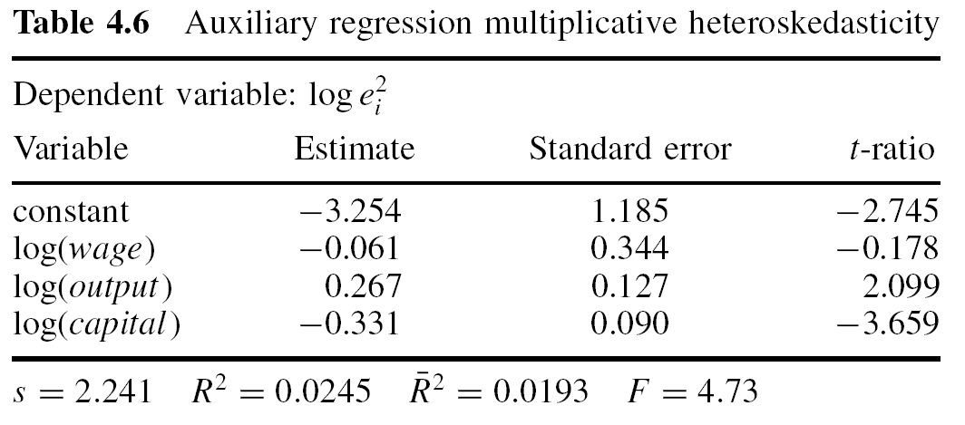
Labor Demand Function, cont’d
For Belgian companies, 1996; Verbeek
Breusch-Pagan test: NR² = 66.23, p-value: 1,42E-13

Slide 56
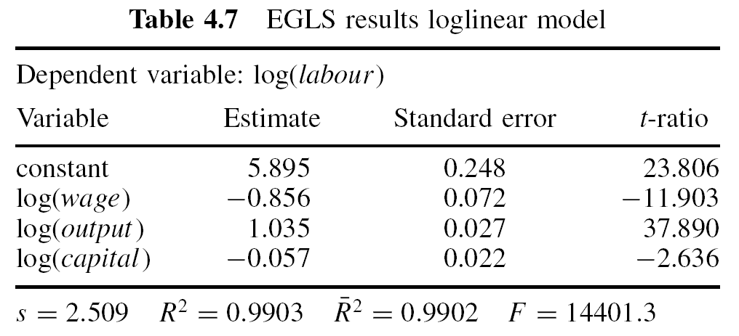
Labor Demand Function, cont’d
For Belgian companies, 1996; Verbeek
Weights estimated assuming multiplicative heteroskedasticity

Slide 57
Labor Demand Function, cont’d
Estimated function
log(labour) = β₁ + β₂*log(wage) + β₃*log(output) + β₄*log(capital)
The table shows: OLS estimates and standard errors: without (s.e.) and with White correction (White s.e.); FGLS estimates and standard errors
 | β₁ | wage | output | capital
OLS coeff | 6.177 | -0.928 | 0.990 | -0.0037
s.e. | 0.246 | 0.071 | 0.026 | 0.0188
White s.e. | 0.293 | 0.086 | 0.047 | 0.0377
FGLS coeff | 5.895 | -0.856 | 1.035 | -0.0569
s.e. | 0.248 | 0.072 | 0.027 | 0.0216

Slide 58
Labor Demand Function, cont’d
Some comments:
Reduction of standard errors in FGLS estimation as compared to heteroskedasticity-robust estimation, efficiency gains
Comparison with OLS estimation not appropriate
FGLS estimates differ slightly from OLS estimates; effect of capital is indicated to be relevant (p-value: 0.0086)
R² of FGLS estimation is misleading
  Model has no intercept, is uncentered
  Comparison with that of OLS estimation not appropriate, explained variables are different

Slide 59
Contents
Violations of V{ε} = σ² I_{N}: Illustrations and Consequences
Heteroskedasticity
Tests against Heteroskedasticity
GLS Estimation
Autocorrelation
Tests against Autocorrelation
Inference under Autocorrelation

Slide 60
Example: Demand for Ice Cream
Verbeek’s time series dataset “icecream”
30 four weekly observations (1951-1953)
Variables
  cons: consumption of ice cream per head (in pints)
  income: average family income per week (in USD, red line)
  price: price of ice cream (in USD per pint, blue line)
  temp: average temperature (in Fahrenheit); tempc: (green, in °C)

Slide 61
Demand for Ice Cream, cont’d
Time series plot of consumption of ice cream per head (in pints), cons, over observation periods

Slide 62
Demand for Ice Cream, cont’d
Consumption of ice cream per head (in pints), cons: scatter diagramme of actual values cons over lagged values cons₋₁

Slide 63
Autocorrelation
Typical for time series data such as consumption, production, investments, etc., and models for time series data
Autocorrelation of error terms is typically observed if
  a relevant regressor with trend or seasonal pattern is not included in the model: miss-specified model
  the functional form of a regressor is incorrectly specified
  the dependent variable is correlated in a way that is not appropriately represented in the systematic part of the model
Autocorrelation of the error terms indicates deficiencies of the model specification such as omitted regressors, incorrect functional form, incorrect dynamic
Tests for autocorrelation are the most frequently used tool for diagnostic checking the model specification

Slide 64
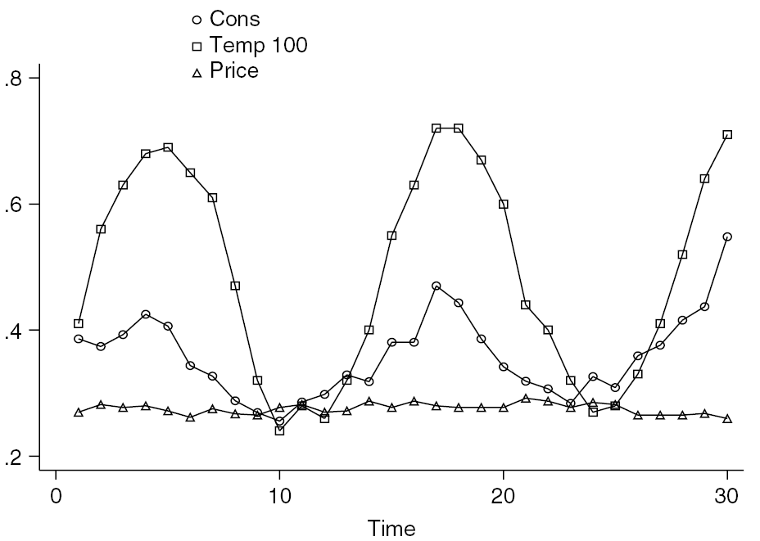
Demand for Ice Cream, cont’d
Time series plot of
Cons: consumption of ice cream per head (in pints); mean: 0.36
  Temp/100: average temperature (in Fahrenheit)
  Price (in USD per pint); mean: 0.275 USD

Slide 65
Demand for Ice Cream, cont’d
Demand for ice cream, measured by cons, explained by price, income, and temp

Slide 66
Demand for Ice Cream, cont’d
Time series diagramme of demand for ice cream, actual values (o) and predictions (polygon), based on the model with income and price

Slide 67
Demand for Ice Cream, cont’d
Ice cream model: Scatter-plot of residuals e_{t} vs e_{t-1} (r = 0.401)

Slide 68
A Model with AR(1) Errors
Linear regression
y_{t} = x_{t}‘β + ε_{t} ¹⁾
with
ε_{t} = ρε_{t-1} + v_{t} with -1 < ρ < 1 or |ρ| < 1
where v_{t} are uncorrelated random variables with mean zero and constant variance σ_{v}²
For ρ ≠ 0, the error terms ε_{t} are correlated; the Gauss-Markov assumption V{ε} = σ_{ε}²I_{N} is violated
The other Gauss-Markov assumptions are assumed to be fulfilled
The sequence ε_{t}, t = 0, 1, 2, … which follows ε_{t} = ρε_{t-1} + v_{t} is called an autoregressive process of order 1 or AR(1) process
_____________________
¹⁾ In the context of time series models, variables are indexed by „t“

Slide 69
Properties of AR(1) Processes
Repeated substitution of ε_{t-1}, ε_{t-2}, etc. results in
ε_{t} = ρε_{t-1} + v_{t} = v_{t} + ρv_{t-1} + ρ²v_{t-2} + …
with v_{t} being uncorrelated and having mean zero and variance σ_{v}²:
E{ε_{t}} = 0
V{ε_{t}} = σ_{ε}² = σ_{v}²(1-ρ²)⁻¹
This results from V{ε_{t}} = σ_{v}² + ρ²σ_{v}² + ρ⁴σ_{v}² + … = σ_{v}²(1-ρ²)⁻¹ for |ρ|<1; the geometric series 1 + ρ² + ρ⁴ + … has the sum (1- ρ²)⁻¹ given that |ρ| < 1
  for |ρ| > 1, V{ε_{t}} is undefined
Cov{ε_{t}, ε_{t-s} } = ρ^{s} σ_{v}² (1-ρ²)⁻¹ for s > 0
all error terms are correlated; covariances – and correlations Corr{ε_{t}, ε_{t-s} } = ρ^{s} (1-ρ²)⁻¹ – decrease with growing distance s in time

Slide 70
AR(1) Process, cont’d
The covariance matrix V{ε}:
V{ε} has a band structure
Depends only of two parameters: ρ and σ_{v}²

Slide 71
Consequences of V{ε} ≠ σ²I_{T}
OLS estimators b for β
are unbiased
are consistent
have the covariance-matrix
V{b} = σ² (X'X)⁻¹ X'ΨX (X'X)⁻¹
are not efficient estimators, not BLUE
follow – under general conditions – asymptotically the normal distribution
The estimator s² = e'e/(T-K) for σ² is biased
For an AR(1)-process ε_{t} with ρ > 0, s.e. from σ² (X'X)⁻¹ underestimates the true s.e.
and

Slide 72
Inference in Case of Autocorrelation
Covariance matrix of b:
V{b} = σ² (X'X)⁻¹ X'ΨX (X'X)⁻¹
Use of σ² (X'X)⁻¹ (the standard output of econometric software) instead of V{b} for inference on β may be misleading
Identification of autocorrelation:
Statistical tests, e.g., Durbin-Watson test
Remedies
Use of correct variances and standard errors
Transformation of the model so that the error terms are uncorrelated

Slide 73
Estimation of ρ
Autocorrelation coefficient ρ: parameter of the AR(1) process
ε_{t} = ρε_{t-1} + v_{t}
Estimation of ρ
by regressing the OLS residual e_{t} on the lagged residual e_{t-1}
estimator is
  biased
  but consistent under weak conditions

Slide 74
Autocorrelation Function
Autocorrelation of order s:
Autocorrelation function (ACF) assigns r_{s} to s
Correlogram: graphical representation of the autocorrelation function
GRETL: Variable => Correlogram
Produces (a) the autocorrelation function (ACF) and (b) the graphical representation of the ACF (and the partial autocorrelation function)

Slide 75
Example: Ice Cream Demand
Autocorrelation function (ACF) of cons
LAG ACF PACF Q-stat. [p-value]
1 0,6627 *** 0,6627 *** 14,5389 [0,000]
2 0,4283 ** -0,0195 20,8275 [0,000]
3 0,0982 -0,3179 * 21,1706 [0,000]
4 -0,1470 -0,1701 21,9685 [0,000]
5 -0,3968 ** -0,2630 28,0152 [0,000]
6 -0,4623 ** -0,0398 36,5628 [0,000]
7 -0,5145 *** -0,1735 47,6132 [0,000]
8 -0,4068 ** -0,0299 54,8362 [0,000]
9 -0,2271 0,0711 57,1929 [0,000]
10 -0,0156 0,0117 57,2047 [0,000]
11 0,2237 0,1666 59,7335 [0,000]
12 0,3912 ** 0,0645 67,8959 [0,000]

Slide 76
Example: Ice Cream Demand
Correlogram of cons

Slide 77
Contents
Violations of V{ε} = σ² I_{N}: Illustrations and Consequences
Heteroskedasticity
Tests against Heteroskedasticity
GLS Estimation
Autocorrelation
Tests against Autocorrelation
Inference under Autocorrelation

Slide 78
Tests for Autocorrelation of Error Terms
Due to unbiasedness of b, residuals are expected to indicate autocorrelation
Graphical displays, e.g., the correlogram of residuals may give useful hints
Residual-based tests:
Durbin-Watson test
Box-Pierce test
Breusch-Godfrey test

Slide 79
Durbin-Watson Test
Test of H₀: ρ = 0 against H₁: ρ ≠ 0
Test statistic
For ρ > 0, dw is expected to have a value in (0,2)
For ρ < 0, dw is expected to have a value in (2,4)
dw close to the value 2 indicates no autocorrelation of error terms
Critical limits of dw
  depend upon x_{t}’s
  exact critical value is unknown, but upper and lower bounds can be derived, which depend upon x_{t}’s only via the number of regression coefficients
Test can be inconclusive
H₁: ρ > 0 may be more appropriate than H₁: ρ ≠ 0

Slide 80
Durbin-Watson Test: Bounds for Critical Limits
Derived by Durbin and Watson
Upper (d_{U}) and lower (d_{L}) bounds for the critical limits and α = 0.05
dw < d_{L}: reject H₀
dw > d_{U}: do not reject H₀
d_{L} < dw < d_{U}: no decision (inconclusive region)
T | K=2 |  | K=3 |  | K=10
 | d_{L} | d_{U} | d_{L} | d_{U} | d_{L} | d_{U}
15 | 1.08 | 1.36 | 0.95 | 1.54 | 0.17 | 3.22
20 | 1.20 | 1.41 | 1.10 | 1.54 | 0.42 | 2.70
100 | 1.65 | 1.69 | 1.63 | 1.71 | 1.48 | 1.87

Slide 81
Durbin-Watson Test: Remarks
Durbin-Watson test gives no indication of causes for the rejection of the null hypothesis and how the model to modify
Various types of misspecification may cause the rejection of the null hypothesis
Durbin-Watson test is a test against first-order autocorrelation; a test against autocorrelation of other orders may be more suitable, e.g., order four if the model is for quarterly data
Use of tables unwieldy
  Limited number of critical bounds (K, T, α) in tables
  Inconclusive region
GRETL: Standard output of the OLS estimation reports the Durbin-Watson statistic; to see the p-value:
  OLS output => Tests => Durbin-Watson p-value

Slide 82
Asymptotic Tests
AR(1) process for error terms
ε_{t} = ρε_{t-1} + v_{t}
Auxiliary regression of e_{t} on x_{t} and e_{t-1}: produces
R_{e}²
Test of H₀: ρ = 0 against H₁: ρ > 0 or H₁: ρ ≠ 0
Breusch-Godfrey test (GRETL: OLS output => Tests => Autocorr.)
  R_{e}² of the auxiliary regression: close to zero if ρ = 0
  Under H₀: ρ = 0, (T-1) R_{e}² follows approximately the Chi-squared distribution with 1 d.f.
  Lagrange multiplier F (LMF) statistic: F-test for explanatory power of e_{t-1}; follows approximately the F(1, T-K-1) distribution if ρ = 0
  General case of the Breusch-Godfrey test: Auxiliary regression based on higher order autoregressive process

Slide 83
Asymptotic Tests, cont’d
Box-Pierce test
  The t-statistic based on the OLS estimate r of ρ from ε_{t} = ρε_{t-1} + v_{t},
  t = √(T) r
  follows approximately the t-distribution, t² = T r² the Chi-squared distribution with 1 d.f. if ρ = 0
  Test based on √(T) r is a special case of the Box-Pierce test which uses the test statistic Q_{m} = T Σ_{s}^{m} r_{s}²
  Similar the Ljung-Box test, based on
  follows the Chi-squared distribution with m d.f. if ρ = 0
    GRETL: OLS output => Tests => Autocorrelation
    GRETL: OLS output => Graphs => Residual correlogram

Slide 84
Asymptotic Tests, cont’d
  GRETL: Ljung-Box test is conducted by
    OLS output => Tests => Autocorrelation (shows Ljung-Box statistic)
    OLS output => Graphs => Residual correlogram (shows for lag = 1: Ljung-Box statistic and p-value)
Remarks
If the model of interest contains lagged values of y the auxiliary regression should also include all explanatory variables (just to make sure the distribution of the test is correct)
If heteroskedasticity is suspected, White standard errors may be used in the auxiliary regression

Slide 85
Demand for Ice Cream, cont’d
OLS estimated demand function: Output from GRETL
Dependent variable : CONS
coefficient std. error t-ratio p-value
-------------------------------------------------------------
const 0.197315 0.270216 0.7302 0.4718
INCOME 0.00330776 0.00117142 2.824 0.0090 ***
PRICE -1.04441 0.834357 -1.252 0.2218
TEMP 0.00345843 0.000445547 7.762 3.10e-08 ***
Mean dependent var 0.359433 S.D. dependent var 0,065791
Sum squared resid 0,035273 S.E. of regression 0,036833
R- squared 0,718994 Adjusted R-squared 0,686570
F(2, 129) 22,17489 P-value (F) 2,45e-07
Log-likelihood 58,61944 Akaike criterion -109,2389
Schwarz criterion -103,6341 Hannan-Quinn -107,4459
rho 0,400633 Durbin-Watson 1,021170

Slide 86
Demand for Ice Cream, cont’d
Test for autocorrelation of error terms
H₀: ρ = 0, H₁: ρ ≠ 0
dw = 1.02 < 1.21 = d_{L} for T = 30, K = 4; p = 0.0003 (in GRETL: 0.0003025); reject H₀
GRETL also shows the autocorrelation coefficient: r = 0.401
Plot of actual (o) and fitted (polygon) values

Slide 87
Demand for Ice Cream, cont’d
Auxiliary regression ε_{t} = ρε_{t-1} + v_{t}: OLS estimation gives
e_{t} = 0.401 e_{t-1}
with s.e.(r) = 0.177, R² = 0.154
Test of H₀: ρ = 0 against H₁: ρ > 0
Box-Pierce test:
  t ≈ √(30) 0.401 = 2.196, p-value: 0.018
  t-statistic: 2.258, p-value: 0.016
Breusch-Godfrey test
  LMF = (T-1) R² = 4.47, p-value: 0.035
Both reject the null hypothesis
GRETL: OLS Output =>Tests => Autocorrelation: similar p-value for Box-Pierce (0.040) and Breusch-Godfrey test (0.053)

Slide 88
Contents
Violations of V{ε} = σ² I_{N}: Illustrations and Consequences
Heteroskedasticity
Tests against Heteroskedasticity
GLS Estimation
Autocorrelation
Tests against Autocorrelation
Inference under Autocorrelation

Slide 89
Inference under Autocorrelation
Covariance matrix of b:
V{b} = σ² (X'X)⁻¹ X'ΨX (X'X)⁻¹
Use of σ² (X'X)⁻¹ (the standard output of econometric software) instead of V{b} for inference on β may be misleading
Remedies
Use of correct variances and standard errors
Transformation of the model so that the error terms are uncorrelated

Slide 90
HAC-estimator for V{b}
Substitution of Ψ in
V{b} = σ² (X'X)⁻¹ X'ΨX (X'X)⁻¹
by a suitable estimator
Newey-West: substitution of S_{x} = σ²(X'ΨX)/T = (Σ_{t}Σ_{s}σ_{ts}x_{t}x_{s}‘)/T by
with w_{j} = j/(p+1); p, the truncation lag, is to be chosen suitably
The estimator
T (X'X)⁻¹ Ŝ_{x} (X'X)⁻¹
for V{b} is called heteroskedasticity and autocorrelation consistent (HAC) estimator, the corresponding standard errors are the HAC s.e.

Slide 91
Demand for Ice Cream, cont’d
Demand for ice cream, measured by cons, explained by price, income, and temp, OLS and HAC standard errors
 | coeff | s.e.
 |  | OLS | HAC
constant | 0.197 | 0.270 | 0.288
price | -1.044 | 0.834 | 0.876
income*10⁻³ | 3.308 | 1.171 | 1.184
temp*10⁻³ | 3.458 | 0.446 | 0.411

Slide 92
Cochrane-Orcutt Estimator
GLS estimator
With transformed variables y_{t}* = y_{t} – ρy_{t-1} and x_{t}* = x_{t} – ρx_{t-1}, also called “quasi-differences”, the model y_{t} = x_{t}‘β + ε_{t} with ε_{t} = ρε_{t-1} + v_{t} can be written as
y_{t} – ρy_{t-1} = y_{t}* = (x_{t} – ρx_{t-1})‘β + v_{t} = x_{t}*‘β + v_{t} (A)
The model in quasi-differences has error terms which fulfill the Gauss-Markov assumptions
Given observations for t = 1, …, T, model (A) is defined for t = 2, …, T
Estimation of ρ using, e.g., the auxiliary regression ε_{t} = ρε_{t-1} + v_{t} gives the estimate r; substitution of r in (A) for ρ results in FGLS estimators for β
The FGLS estimator is called Cochrane-Orcutt estimator

Slide 93
Cochrane-Orcutt Estimation
In following steps
OLS estimation of b for β from y_{t} = x_{t}‘β + ε_{t}, t = 1, …, T
Estimation of r for ρ from the auxiliary regression ε_{t} = ρε_{t-1} + v_{t}
Calculation of quasi-differences y_{t}* = y_{t} – ry_{t-1} and x_{t}* = x_{t} – rx_{t-1}
OLS estimation of β from
y_{t}* = x_{t}*‘β + v_{t}, t = 2, …, T
resulting in the Cochrane-Orcutt estimators
Steps 2. to 4. can be repeated in order to improve the estimate r : iterated Cochrane-Orcutt estimator
  GRETL provides the iterated Cochrane-Orcutt estimator:
  Model => Time series => Autoregressive estimation

Slide 94
Demand for Ice Cream, cont’d
Iterated Cochrane-Orcutt estimator
Durbin-Watson test: dw = 1.55; d_{L}=1.21 < dw < 1.65 = d_{U}

Slide 95
Demand for Ice Cream, cont’d
Demand for ice cream, measured by cons, explained by price, income, and temp, OLS and HAC standard errors (se), and Cochrane-Orcutt estimates
 | OLS-estimation |  |  | Cochrane-Orcutt
 | coeff | se | HAC | coeff | se
constant | 0.197 | 0.270 | 0.288 | 0.157 | 0.300
price | -1.044 | 0.834 | 0.881 | -0.892 | 0.830
income | 3.308 | 1.171 | 1.151 | 3.203 | 1.546
temp | 3.458 | 0.446 | 0.449 | 3.558 | 0.555

Slide 96
Demand for Ice Cream, cont’d
Model extended by temp₋₁
Durbin-Watson test: dw = 1.58; d_{L}=1.21 < dw < 1.65 = d_{U}

Slide 97
Demand for Ice Cream, cont’d
Demand for ice cream, measured by cons, explained by price, income, and temp, OLS and HAC standard errors, Cochrane-Orcutt estimates, and OLS estimates for the extended model
Adding temp₋₁ improves the adj R² from 0.687 to 0.800
 | OLS |  | Cochrane-Orcutt |  | OLS
 | coeff | HAC | coeff | se | coeff | se
constant | 0.197 | 0.288 | 0.157 | 0.300 | 0.189 | 0.232
price | -1.044 | 0.881 | -0.892 | 0.830 | -0.838 | 0.688
income | 3.308 | 1.151 | 3.203 | 1.546 | 2.867 | 1.053
temp | 3.458 | 0.449 | 3.558 | 0.555 | 5.332 | 0.670
temp₋₁ |  |  |  |  | -2.204 | 0.731

Slide 98
General Autocorrelation Structures
Generalization of model
y_{t} = x_{t}‘β + ε_{t}
with ε_{t} = ρε_{t-1} + v_{t}
Alternative dependence structures of error terms
Autocorrelation of higher order than 1
Moving average pattern

Slide 99
Higher Order Autocorrelation
For quarterly data, error terms may develop according to
ε_{t} = γε_{t-4} + v_{t}
or - more generally - to
ε_{t} = γ₁ε_{t-1} + … + γ₄ε_{t-4} + v_{t}
ε_{t} follows an AR(4) process, an autoregressive process of order 4
More complex structures of correlations between variables with autocorrelation of order 4 are possible than with that of order 1

Slide 100
Moving Average Processes
Moving average process of order 1, MA(1) process
ε_{t} = v_{t} + αv_{t-1}
ε_{t} is correlated with ε_{t-1}, but not with ε_{t-2}, ε_{t-3}, …
Generalizations to higher orders

Slide 101
Remedies against Autocorrelation
Change functional form, e.g., use log(y) instead of y
Extend the model by including additional explanatory variables, e.g., seasonal dummies, or additional lags
Use HAC standard errors for the OLS estimators
Reformulate the model in quasi-differences (FGLS) or in differences

Slide 102
Your Homework
Use the data set “labour2” of Verbeek for the following analyses:
  Estimate (OLS) the model for log(labor) with regressors log(output) and log(wage); generate a display of the residuals which may indicate heteroskedasticity of the error term.
  Compare (i) the OLS and (ii) the White standard errors with HC0 of the estimated coefficients.
  Perform (i) the Breusch-Pagan test with h(z_{i}‘α) = exp{z_{i}‘α} and (ii) the White test without interactions; explain the tests and compare the results; use z_{i} = (capital_{i}, output_{i}, wage_{i})’.
  Estimate (i) the model of a), using FGLS and weights obtained in the auxiliary regression of the Breusch-Pagan test in c); (ii) comment the estimates of the coefficients, the standard errors, and the R² of this model and those of b)(i) and c)(ii).

Slide 103
Your Homework, cont’d
Use the data set “icecream” of Verbeek for the following analyses:
  Estimate the model where cons is explained by income and temp; show a diagramme of the residuals which may indicate autocorrelation of the error terms.
  Use the Durbin-Watson and the Box-Pierce test against autocorrelation; state suitably H₀ and H₁.
  Compare (i) the OLS and (ii) the HAC standard errors of the estimated coefficients.
  Repeat a), using (i) the iterative Cochrane-Orcutt estimation and (ii) OLS estimation of the model in differences; compare and interpret the result.
For the Durbin-Watson test: (a) show that dw ≈ 2 – 2r; (b) can you agree with the statement “The Durbin-Watson test is a misspecification test”.

