Slide 1
Auditing – Lecture 8
Part III. Audit process by cycle: Sales and collection cycle

Slide 2
Content
Accounts and classes of transactions
Business functions
Tests of transactions for sales, cash receipts and write-offs
Effect of tests of transactions
Tests of details of balances
Recommended reading

Slide 3
Accounts and classes of tran-ns
Accounts and classes of transactions - the overall objective in the audit of the sales and collection cycle is to evaluate whether the account balances affected by the cycle are fairly presented in accordance with accounting standards. The nature of the accounts may vary, of course, depending on the industry and client involved. There are differences in the nature and account titles for a service industry, a retail company, and an insurance company, but the key concepts remain the same. To provide a frame of reference for understanding the material in this lecture, let’s assume we’re dealing with a wholesale merchandising company. There are five classes of transactions in the sales and collection cycle:
sales (cash and sales on account)
cash receipts;
sales returns and allowances;
write-off of uncollectible accounts;
estimate of bad debt expense.

Slide 4
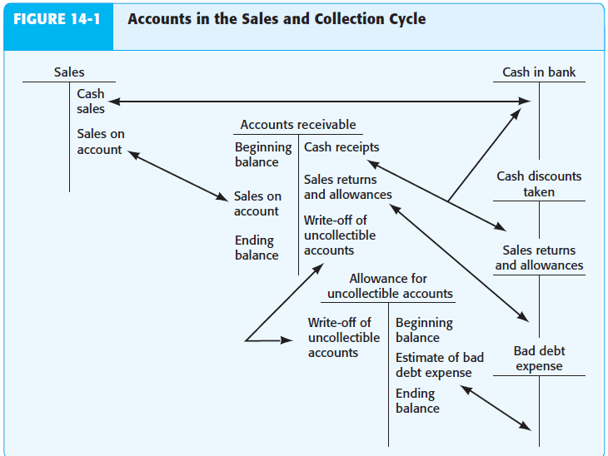
Accounts and classes of tran-ns

Slide 5
Business functions
Before auditors can assess control risk and design tests of controls and substantive tests of transactions, they need to understand the business functions and documents and records in a business. Business functions in the sales and collection cycle involves the decisions and processes necessary for the transfer of the ownership of goods and services to customers after they are made available for sale. There are eight business functions for the sales and collection cycle are: processing customer orders, granting credit, shipping goods, billing customers and recording sales, processing and recording cash receipts, processing and recording sales returns and allowances, writing off uncollectible accounts receivable, providing for bad debts. They occur in every business in the recording of the five classes of transactions in the sales and collection cycle.
Processing сustomer orders - legally, it is an offer to buy goods under specified terms. The receipt of a customer order often results in the immediate creation of a sales order.

Slide 6
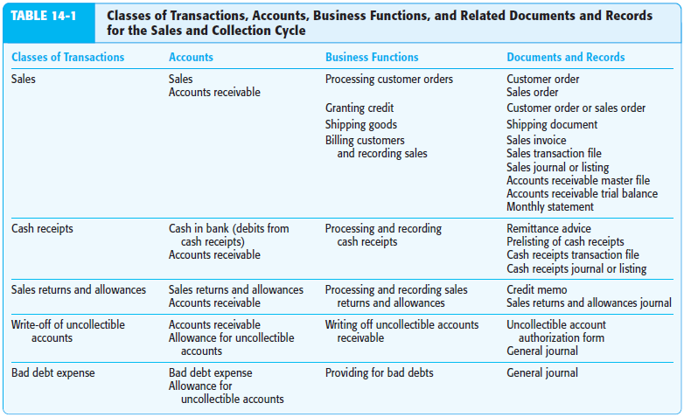
Business functions

Slide 7
Business functions
Customer order - a request for merchandise by a customer. It may be received by telephone, letter, a printed form that has been sent to prospective and existing customers, through salespeople, electronic submission of the customer order through the Internet.
Sales order - a document for communicating the description, quantity, and related information for goods ordered by a customer. This is often used to indicate credit approval and authorization for shipment.
Granting credit - before goods are shipped, a properly authorized person must approve credit to the customer for sales on account. Weak practices in credit approval often result in excessive bad debts and accounts receivable that may be uncollectible. In some companies, the computer automatically approves a credit sale based on preapproved credit limits maintained in a customer master file. The computer allows the sale to proceed only when the proposed sales order total plus the existing customer balance is less than the credit limit in the master file.

Slide 8
Business functions
Shipping goods - this critical function is the first point in the cycle at which the company gives up assets. Most companies recognize sales when goods are shipped. The shipping document, which is often a multicopy bill of lading, is essential to the proper billing of shipments to customers. A shipping document is prepared to initiate shipment of the goods, indicating the description of the merchandise, the quantity shipped, and other relevant data. The company sends the original to the customer and retains one or more copies. The shipping document serves as a signal to bill the customer and may be in electronic or paper form.
One type of shipping document is a bill of lading, which is a written contract between the carrier and the seller of goods. Often, bills of lading include only the number of boxes or pounds shipped, rather than complete details of quantity and description. It is often transmitted electronically, once goods have been shipped, and automatically generates the related sales invoice as well as the entry in the sales journal.

Slide 9
Business functions
Billing customers and recording sales - because billing customers is the means by which the customer is informed of the amount due for the goods, it must be done correctly and on a timely basis. The most important aspects of billing are:
all shipments made have been billed (completeness).
no shipment has been billed more than once (occurrence).
each one is billed for the proper amount (accuracy).
Billing the proper amount is dependent on charging the customer for the quantity shipped at the authorized price, which includes consideration for freight charges, insurance, and terms of payments.
In most systems, billing of the customer includes preparation of an electronic record or a multicopy sales invoice and real-time updating of the sales transactions file, accounts receivable master file, and general ledger master file for sales and accounts receivable. It is used to create a

Slide 10
Business functions
sales journal and, along with cash receipts and miscellaneous credits, to prepare the accounts receivable trial balance.
Processing and recording cash receipts - the four sales transaction functions are necessary for getting the goods into the hands of customers, correctly billing them, and reflecting the information in the accounting records. The remaining four functions involve the collection and recording of cash, sales returns and allowances, write-off of uncollectible accounts, and providing for bad debt expense. Processing and recording cash receipts includes receiving, depositing, and recording cash. Cash includes currency, checks, and electronic funds transfers. The most important concern is the possibility of theft. It is important that all cash receipts are deposited in the bank at the proper amount on a timely basis and recorded in the cash receipts transaction file. This file is used to prepare the cash receipts journal and update the accounts receivable and general ledger master files.

Slide 11
Business functions
Processing and recording sales returns and allowances - when a customer is dissatisfied with the goods, the seller often accepts the return of the goods or grants a reduction in the charges. The company prepares a receiving report for returned goods and returns them to storage. Returns and allowances are recorded in the sales returns and allowances transaction file, as well as the accounts receivable master file. Credit memos are issued for returns and allowances to aid in maintaining control.
Writing off uncollectible accounts receivable - regardless of the diligence of credit departments, some customers do not pay their bills. After concluding that an amount cannot be collected, the company must write it off. Typically, this occurs after a customer files for bankruptcy or the account is turned over to a collection agency.
Providing for bad debts - because companies cannot expect to collect on 100% of their sales, accounting principles require them to record bad debt expense for the amount they do not expect to collect.

Slide 12
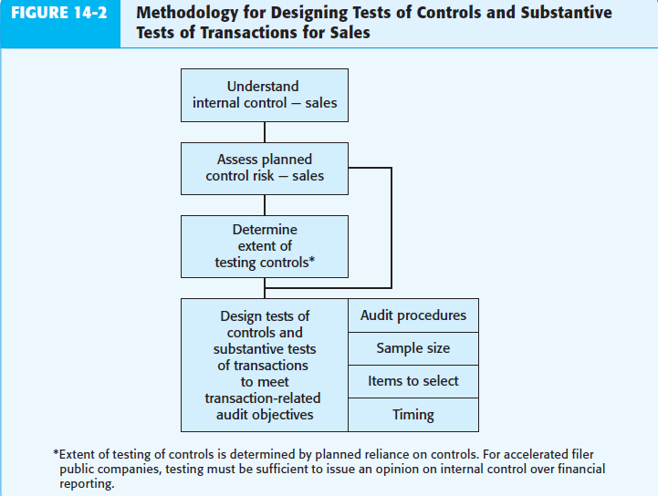
Tests of trans-s for sales

Slide 13
Tests of trans-s for sales
Methodology for designing TT for sales
Understanding IC - How do auditors obtain an understanding of internal control? Using one typical approach for sales, auditors study the client’s flowcharts, make inquiries of the client using an internal control questionnaire, and perform walkthrough tests of sales.
Assessment of planned control risk - the auditor uses the information obtained in understanding internal control to assess control risk. There are four steps for this:
1. step - the auditor needs a framework for assessing control risk. The six transaction-related audit objectives provide this framework. These objectives are the same for all sales and collection cycles in all companies.
2. step - the auditor must identify the key internal controls and deficiencies for sales. These will differ for every audit because every client has different internal controls.

Slide 14
Tests of trans-s for sales
3. step - after identifying the controls and deficiencies, the auditor associates them with the objectives.
4. step - the auditor assesses control risk for each objective by evaluating the controls and deficiencies for each objective. This step is critical because it affects the auditor’s decisions about both tests of controls and substantive tests. It is a highly subjective decision.
Determining the extent of testing controls - after auditors identify the key internal controls and control deficiencies, they assess control risk. For audits of accelerated filer public companies, the auditor must perform extensive tests of key controls and evaluate the impact of the deficiencies on the auditor’s report on internal control over financial reporting. The extent of testing of controls in audits of nonaccelerated filers and nonpublic companies depends on the effectiveness of the controls and the extent to which the auditor believes they can be relied on to reduce control risk. In determining the extent of reliance to place on controls, the auditor also

Slide 15
Tests of trans-s for sales
considers the cost of the increased tests of controls compared to the potential reduction in substantive tests. A lower assessed level of control risk will result in increased testing of controls to support the lower control risk, with a corresponding increase in detection risk and decrease in the amount of substantive tests.
Design of tests of controls for sales and STT for sales –
For each key control, one or more tests of controls must be designed to verify its effectiveness. In most audits, it is relatively easy to determine the nature of the test of the control from the nature of the control. For example, if the internal control is to initial customer orders after they have been approved for credit, the test of control is to examine the customer order for proper initials. For example, one key internal control for the occurrence objective is “sales are supported by authorized shipping documents and approved customer orders.” The test of control is to “examine sales invoice for

Slide 16
Tests of trans-s for sales
supporting bill of lading and customer order.” For this test, the auditor should start with sales invoices and examine documents in support of the sales invoices rather than going in the opposite direction. If the auditor traced from shipping documents to sales invoices, it is a test of completeness. As for the completeness objective, a common test of control for sales is to account for a sequence of various types of documents. For example, accounting for a sequence of shipping documents and tracing each one to the duplicate sales invoice and recording in the sales journal provides evidence of completeness. To simultaneously provide evidence of both the occurrence and completeness objectives, an auditor can check the sequence of sales invoices selected from the sales journal and watch for duplicate and omitted numbers or invoices outside the normal sequence. Assume the auditor selects sales invoices #18100 to #18199. The completeness objective for this

Slide 17
Tests of trans-s for sales
procedure will be satisfied if all 100 sales invoices are recorded. The occurrence objective will be satisfied if there is no duplicate.
In deciding substantive tests of transactions, auditors commonly use some procedures on every audit regardless of the circumstances, whereas others are dependent on the adequacy of the controls and the results of the tests of controls. The substantive tests of transactions are related to the transaction-related audit objectives and are designed to determine whether any monetary misstatements for that objective exist in the transaction. The audit procedures used are affected by the internal controls and tests of controls for that objective. Materiality and results of the prior year also influence the procedures used. Determining the proper substantive tests of transactions procedures for sales is relatively difficult because they vary considerably depending on the circumstances.

Slide 18
Tests of trans-s for sales
The following paragraphs discuss substantive tests of transaction audit procedures that are done only when there are specific circumstances that require special audit attention, such as when there is a deficiency in internal control.
Recorded sales occurred - for this objective, the auditor is concerned with the possibility of three types of misstatements: (1) sales included in the journals for which no shipment was made; (2) sales recorded more than once; (3) shipments made to nonexistent customers and recorded as sales. The first two types of misstatements can be due to an error or fraud. The last type is always a fraud. The potential consequences of all three are significant because they lead to an overstatement of assets and income. Unintentional overstatements of sales are typically more easily discovered than fraudulent overstatements. An unintentional overstatement normally also results in an overstatement of

Slide 19
Tests of trans-s for sales
accounts receivable, which the client can detect by sending monthly statements to customers. With fraudulent overstatements, the perpetrator will attempt to conceal the overstatement, making it more difficult for auditors to find. Substantive tests of transactions may be necessary to discover overstated sales in these circumstances.
The appropriate substantive tests of transactions for testing the occurrence objective depend on whether the auditor believes misstatements are likely. Many auditors do substantive tests of transactions for the occurrence objective only if they believe that a control deficiency exists.
Recorded sale for which there was no shipment - the auditor can vouch selected entries in the sales journal to related copies of shipping and other supporting documents to make sure they occurred. If the auditor is concerned about the

Slide 20
Tests of trans-s for sales
possibility of a fictitious duplicate copy of a shipping document, it may be necessary to trace the amounts to the perpetual inventory records as a test of whether inventory was reduced.
Sale recorded more than once - duplicate sales can be determined by reviewing a numerically sorted list of recorded sales transactions for duplicate numbers. The auditor can also test for the proper cancellation of shipping documents.
Shipment made to nonexistent customers - this type of fraud normally occurs only when the person recording sales is also in a position to authorize shipments. Deficient internal controls make it difficult to detect fictitious shipments, such as shipments to other locations of the company. To test for nonexistent customers, the auditor can trace customer information on the sales invoice to the customer master file. These revenue frauds are often referred to as “sham sales.”

Slide 21
Tests of trans-s for sales
Existing sales transactions are recorded - in many audits, no substantive tests of transactions are done for the completeness objective. This is because overstatements of assets and income from sales transactions are more likely than understatements, and overstatements also represent a greater source of audit risk. To test for unbilled shipments, auditors can trace selected shipping documents from a file in the shipping department to related duplicate sales invoices and the sales journal. To conduct a meaningful test using this procedure, the auditor must be confident that all shipping documents are included in the file. This can be done by accounting for a numerical sequence of the documents. Generalized audit software tools, such as ACL or IDEA, can be used to efficiently identify duplicates and gaps in the numerical sequence of electronic records.

Slide 22
Tests of trans-s for sales
Direction of tests - auditors need to understand the difference between tracing from source documents to the journals and vouching from the journals back to source documents. The former tests for omitted transactions (completeness objective); the latter tests for nonexistent transactions (occurrence objective).
To test for the occurrence objective, the auditor starts by selecting a sample of invoice numbers from the journal and vouches them to duplicate sales invoices, shipping documents, and customer orders. In testing for the completeness objective, the auditor typically starts by selecting a sample of shipping documents and traces them to duplicate sales invoices and the sales journal as a test of omissions.
Sales are accurately recorded - the accurate recording of sales transactions concerns:
Shipping the amount of goods ordered

Slide 23
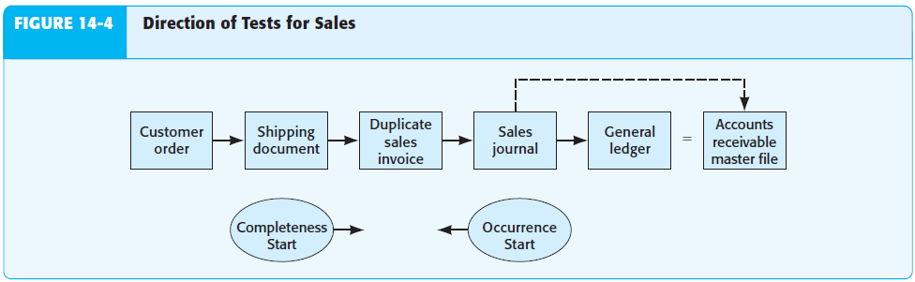
Tests of trans-s for sales

Slide 24
Tests of trans-s for sales
Accurately billing for the amount of goods shipped
Accurately recording the amount billed in the accounting records
Auditors typically do substantive tests of transactions in every audit to ensure that each of these three aspects of accuracy are done correctly by recalculating information in the accounting records and comparing information on different documents. Auditors commonly compare prices on duplicate sales invoices with an approved price list, recalculate extensions and footings, and compare the details on the invoices with shipping records for description, quantity, and customer identification. Often, auditors also examine customer orders and sales orders for the same information.
Sales transactions are correctly included in the master file and correctly summarized - the proper inclusion of all sales transactions in the accounts receivable master file

Slide 25
Tests of trans-s for sales
is essential because the accuracy of these records affects the client’s ability to collect outstanding receivables. Similarly, the sales journal must be correctly totaled and posted to the general ledger if the financial statements are to be correct. In most engagements, auditors perform some clerical accuracy tests, such as footing the journals and tracing the totals and details to the general ledger and the master file, to check whether there are errors or fraud in the processing of sales transactions. The extent to which such tests are needed is determined by the quality of internal controls. Generalized audit software allows for efficient testing of the accuracy of electronic journals and records.
Posting and summarization tests differ from those for other transaction-related audit objectives because they include footing journals, master file records, and ledgers, and tracing from one to the other among these three.

Slide 26
Tests of trans-s for sales
Recorded sales are correctly classified - although it is less of a problem in sales than in some transaction cycles, auditors must still be concerned that transactions are charged to the correct general ledger account. With cash and credit sales, company personnel should not debit accounts receivable for a cash sale or credit sales for collection of a receivable. They should also not classify sales of operating assets, such as buildings, as sales. For those companies using more than one sales classification, such as companies issuing segmented earnings statements, proper classification is essential. Auditors commonly test sales for proper classification as part of testing for accuracy. They examine supporting documents to determine the proper classification of a given transaction and compare this with the actual account to which it is charged.

Slide 27
Tests of trans-s for sales
Sales are recorded on the correct dates - sales should be billed and recorded as soon after shipment takes place as possible to prevent the unintentional omission of transactions from the records and to make sure that sales are recorded in the proper period. Timely recorded transactions are also less likely to contain misstatements. When auditors do substantive tests of transactions procedures for accuracy they commonly compare the date on selected bills of lading or other shipping documents with the date on related duplicate sales invoices, the sales journal, and the accounts receivable master file. Significant differences indicate potential cutoff problems in the test of year-end balances.

Slide 28
Tests of trans-s for cash receipts
Methodology for designing ToC and ST for cash receipts - auditors use the same methodology for designing tests of controls and substantive tests of transactions for cash receipts as they use for sales. Cash receipts tests of controls and substantive tests of transactions audit procedures are developed around the same framework used for sales, but of course the specific objectives are applied to cash receipts. Given the transaction-related audit objectives, the auditor follows this process:
Determine key internal controls for each audit objective
Design tests of control for each control used to support a reduced control risk
Design substantive tests of transactions to test for monetary misstatements for each objective
As in all other audit areas, the tests of controls depend on the controls the auditor identifies, the extent they will be relied on to reduce assessed control risk, and whether the company being audited is publicly traded.

Slide 29
Tests of trans-s for cash receipts
Because the methodology for cash receipts is similar to that for sales, our discussion is not as detailed as our discussion of the internal controls, tests of controls, and substantive tests of transactions for the audit of sales. Instead, we focus on the substantive audit procedures that are most likely to be misunderstood. An essential part of the auditor’s responsibility in auditing cash receipts is to identify deficiencies in internal control that increase the likelihood of fraud. It is done by means of the following actions:
Determining whether cash receipt was recorded - the most difficult type of cash embezzlement for auditors to detect is when it occurs before the cash is recorded in the cash receipts journal or other cash listing, especially if the sale and cash receipt are recorded simultaneously. For example, if a grocery store clerk takes cash and intentionally fails to record the sale and receipt of cash on the cash register, it is extremely difficult to discover the theft. To prevent this type of fraud, special internal controls are implemented by many companies. The type of control will, of course, depend

Slide 30
Tests of trans-s for cash receipts
on the type of business. For example, the controls for a retail store in which the cash is received by the same person who sells the merchandise and enters cash receipts in a cash register should be different from the controls for a company in which all receipts are received through the mail several weeks after the sales have taken place. It is normal practice to trace from prenumbered remittance advices or prelists of cash receipts to the cash receipts journal and subsidiary accounts receivable records as a substantive test of the recording of actual cash received. This test will be effective only if a cash register tape or some other prelisting was prepared at the time cash was received.
Preparing proof of cash receipt - a useful audit procedure to test whether all recorded cash receipts have been deposited in the bank account is a proof of cash receipts. In this test, the total cash receipts recorded in the cash receipts journal for a given period, such as a month, are

Slide 31
Tests of trans-s for cash receipts
reconciled with the actual deposits made to the bank during the same period. A difference in the two may be the result of deposits in transit and other items, but the amounts can be reconciled and compared. This procedure is not useful in discovering cash receipts that have not been recorded in the journals or time lags in making deposits, but it can help uncover recorded cash receipts that have not been deposited, unrecorded deposits, unrecorded loans, bank loans deposited directly into the bank account, and similar misstatements. Ordinarily, this somewhat time-consuming procedure is used only when the controls are deficient.
Testing to discover lapping of accounts receivable - lapping of accounts receivable is the postponement of entries for the collection of receivables to conceal an existing cash shortage. The embezzlement is perpetrated by a person who handles cash receipts and then enters them into the computer system. He or she defers recording

Slide 32
Tests of trans-s for cash receipts
the cash receipts from one customer and covers the shortages with receipts of another. These in turn are covered from the receipts of a third customer a few days later. The employee must continue to cover the shortage through repeated lapping, replace the stolen money, or find another way to conceal the shortage.
This embezzlement can be easily prevented by separation of duties and a mandatory vacation policy for employees who both handle cash and enter cash receipts into the system. It can be detected by comparing the name, amount, and dates shown on remittance advices with cash receipts journal entries and related duplicate deposit slips. Because this procedure is relatively time-consuming, it is ordinarily performed only when specific concerns with embezzlement exist because of a deficiency in internal control.

Slide 33
Tests of trans-s for write-offs
Audit tests for write-offs - the same as for sales returns and allowances, the auditor’s primary concern in the audit of the write-off of uncollectible accounts receivable is the possibility of client personnel covering up an embezzlement by writing off accounts receivable that have already been. The major control for preventing this fraud is proper authorization of the write-off of uncollectible accounts by a designated level of management only after a thorough investigation of the reason the customer has not paid.
Normally, verification of the accounts written off takes relatively little time. Typically, the auditor examines approvals by the appropriate persons. For a sample of accounts written off, it is also usually necessary for the auditor to examine correspondence in the client’s files establishing their uncollectibility. In some cases, the auditor also examines credit reports. After the auditor has concluded that the accounts written off by general journal entries are proper, selected items should be traced to the accounts receivable master file to test whether the write-off was properly recorded.

Slide 34
Effect of tests of trans-s
The results of the tests of controls and substantive tests of transactions have a significant effect on the remainder of the audit, especially on substantive tests of details of balances. The parts of the audit most affected by the tests of controls and substantive tests of transactions for the sales and collection cycle are the balances in accounts receivable, cash, bad debt expense, and allowance for doubtful accounts.
Furthermore, if the test results are unsatisfactory, it is necessary to do additional substantive testing of sales, sales returns and allowances, write-off of uncollectible accounts, and processing cash receipts. Auditors of accelerated filer public companies must also consider the impact of the unsatisfactory test results on the audit of internal control over financial reporting.
At the completion of the tests of controls and substantive tests of transactions, auditors must analyze each exception, for both public and nonpublic audits, to determine its cause and the implication of the exception on assessed control risk, which may affect the supported detection risk and related remaining substantive tests.

Slide 35
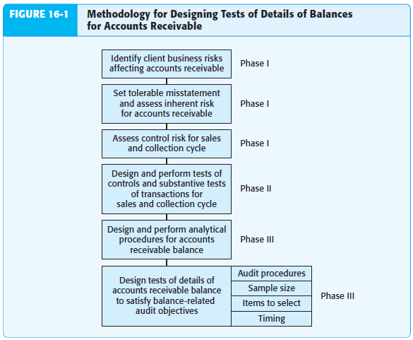
Tests of details of balances

Slide 36
Tests of details of balances
The appropriate evidence to be obtained from tests of details of balances must be decided on an objective-by-objective basis. Because several interactions affect the need for evidence from test of details of balances, this audit decision can be complex. For example, the auditor must evaluate the potential for fraud and also consider inherent risk, which may vary by objective, as well as the results of tests of controls and the related control risk assessment, which also may vary by objective. The auditor must also consider the results of substantive tests of sales and cash receipts. In designing tests of details of balances for accounts receivable, auditors must satisfy each of the eight balance-related audit objectives. These eight general objectives are the same for all accounts. Specifically applied to accounts receivable, they are called accounts receivable balance-related audit objectives and are as follows:
Accounts receivable in the aged trial balance agree with related master file amounts, and the total is correctly added and agrees with the general ledger. (Detail tie-in)

Slide 37
Tests of details of balances
Recorded accounts receivable exist. (Existence)
Existing accounts receivable are included. (Completeness)
Accounts receivable are accurate. (Accuracy)
Accounts receivable are correctly classified. (Classification)
Cutoff for accounts receivable is correct. (Cutoff)
Accounts receivable are stated at realizable value. (Realizable value)
The client has rights to accounts receivable. (Rights)
The methodology for designing TDB for accounts receivable include the following actions undertaken by the auditor:
Identifying the client business risk affecting accounts receivable - tests of accounts receivable are based on the auditor’s risk assessment procedures that provide an understanding of the client’s business and industry. As part of this understanding, the auditor studies the client’s industry and external environment and evaluates management objectives and business processes to

Slide 38
Tests of details of balances
identify significant client business risks that could affect the financial statements, including accounts receivable. As part of gaining this understanding, the auditor also performs preliminary analytical procedures that may indicate increased risk of misstatements in accounts receivable.
Client business risks affecting accounts receivable are considered in the auditor’s evaluation of inherent risk and planned evidence for accounts receivable. For example, as a result of adverse changes in the industry’s economic environment, the auditor may increase inherent risk for net realizable value of accounts receivable.
Setting of tolerable misstatement and assessing of IR - auditor first decides the preliminary judgment about materiality for the entire financial statements, and then allocates the preliminary judgment amount to each significant balance sheet account, including accounts receivable. This allocation is called setting tolerable misstatement. Accounts receivable is typically one of the

Slide 39
Tests of details of balances
most material accounts in the financial statements for companies that sell on credit. For even small accounts receivable balances, the transactions in the sales and collection cycle that affect the balance in accounts receivable are almost certain to be highly significant.
Auditors assess inherent risk for each objective for an account such as accounts receivable, considering client business risk and the nature of the client and industry. ISA indicate that auditors must normally identify a specific fraud risk for revenue recognition. This likely affects the auditor’s assessment of inherent risk for the following objectives: existence, sales cutoff, and sales returns and allowances cutoff. It is common for clients to misstate cutoff either by error or through fraud. It is also common for clients to unintentionally or fraudulently misstate the allowance for uncollectible accounts (realizable value) because of the difficulty of the judgments to determine the correct balance.

Slide 40
Tests of details of balances
Assessing control risk for S&C cycle - internal controls over sales and cash receipts and the related accounts receivable are at least reasonably effective for most companies because management is concerned with keeping accurate records to maintain good relations with customers. Auditors are especially concerned with three aspects of internal controls:
Controls that prevent or detect embezzlements
Controls over cutoff
Controls related to the allowance for uncollectible accounts
The auditor must relate control risk for transaction-related audit objectives to balance-related audit objectives in deciding planned detection risk and planned evidence for tests of details of balances. For the most part, this relationship is straightforward. For example, assume the auditor concluded that control risk for both sales and cash receipts transactions is low for the accuracy transaction-related

Slide 41
Tests of details of balances
audit objective. The auditor can therefore conclude that controls for the accuracy balance-related audit objective for accounts receivable are effective because the only transactions that affect accounts receivable are sales and cash receipts. Of course, if sales returns and allowances and write-off of uncollectible accounts receivable are significant, assessed control risk must also be considered for these two classes of transactions.
Design and performance of ToC and STT – it includes designing audit procedures for tests of controls and substantive tests of transactions, deciding sample size, and evaluating the results of those tests. The results of the tests of controls determine whether assessed control risk for sales and cash receipts needs to be revised. Auditors use the results of the substantive tests of transactions to determine the extent to which planned detection risk is satisfied for each accounts receivable balance-related audit objective.

Slide 42
Tests of details of balances
Design and performance of TD of accounts receivable balance - when analytical procedures in the sales and collection cycle uncover unusual fluctuations, however, the auditor should make additional inquiries of management. Management’s responses should be critically evaluated to determine whether they adequately explain the unusual fluctuations and whether they are supported by corroborating evidence.
The task of combining the factors that determine planned detection risk is complex because the measurement for each factor is imprecise and the appropriate weight given to each factor is highly subjective. Conversely, the relationship between each factor and planned detection risk is well established. For example, auditors know that a high inherent risk or control risk decreases planned detection risk and increases planned substantive tests, whereas good results of substantive tests of transactions increase planned detection risk and decrease other planned substantive tests. As we’ve

Slide 43
Tests of details of balances
discussed, planned audit evidence is the inverse of planned detection risk. After deciding whether planned audit evidence for a given objective is high, medium, or low, the auditor must then decide on the appropriate audit procedures, sample size, items to select, and timing.
For our discussion of tests of details of balances for accounts receivable, we will focus on balance-related audit objectives. The audit procedures selected and their sample size will depend heavily on whether planned evidence for a given objective is low, medium, or high.
Account receivable are correctly added and agree with MF and GL - most tests of accounts receivable and the allowance for uncollectible accounts are based on the aged trial balance. An aged trial balance lists the balances in the accounts receivable master file at the balance sheet date, including individual customer balances outstanding and a breakdown of each balance by the time passed between the date of sale and the balance sheet date. Ordinarily, auditors test the

Slide 44
Tests of details of balances
information on the aged trial balance for detail tie-in before any other tests to verify that the population being tested agrees with the general ledger and accounts receivable master file. The total column and the columns depicting the aging must be test footed and the total on the trial balance compared with the general ledger. In addition, auditors should trace a sample of individual balances to supporting documents such as duplicate sales invoices to verify the customer’s name, balance, and proper aging. The extent of the testing for detail tie-in depends on the number of accounts involved, the degree to which the master file has been tested as a part of tests of controls and substantive tests of transactions, and the extent to which the schedule has been verified by an internal auditor or other independent person before it is given to the auditor. Auditors often use audit software to foot and cross-foot the aged trial balance and to recalculate the aging.

Slide 45
Tests of details of balances
Recorded amounts receivable exist - confirmation of customers’ balances is the most important test of details of balances for determining the existence of recorded accounts receivable. When customers do not respond to confirmations, auditors also examine supporting documents to verify the shipment of goods and evidence of subsequent cash receipts to determine whether the accounts were collected. Normally, auditors do not examine shipping documents or evidence of subsequent cash receipts for any account in the sample that is confirmed, but they may use these documents extensively as alternative evidence for nonresponses.
Existing accounts receivable are included - it is difficult for auditors to test for account balances omitted from the aged trial balance except by relying on the self-balancing nature of the accounts receivable master file. For example, if the client accidentally excluded an account receivable from the trial balance, the only likely way it will be discovered is for the auditor to foot the

Slide 46
Tests of details of balances
accounts receivable trial balance and reconcile the balance with the control account in the general ledger. If all sales to a customer are omitted from the sales journal, the understatement of accounts receivable is almost impossible to uncover by tests of details of balances. For example, auditors rarely send accounts receivable confirmations to customers with zero balances, in part because research shows that customers are unlikely to respond to requests that indicate their balances are understated. In addition, unrecorded sales to a new customer are difficult to identify for confirmation because that customer is not included in the accounts receivable master file. The understatement of sales and accounts receivable is best uncovered by substantive tests of transactions for shipments made but not recorded and by analytical procedures.
Accounts receivable are accurate - confirmation of accounts selected from the trial balance is the most common test of details of balances for the accuracy of

Slide 47
Tests of details of balances
accounts receivable. When customers do not respond to confirmation requests, auditors examine supporting documents in the same way as described for the existence objective. Auditors perform tests of the debits and credits to individual customers’ balances by examining supporting documentation for shipments and cash receipts.
Accounts receivable are properly classified - normally, auditors can evaluate the classification of accounts receivable relatively easily, by reviewing the aged trial balance for material receivables from affiliates, officers, directors, or other related parties. Auditors should verify that notes receivable or accounts that should be classified as noncurrent assets are separated from regular accounts, and significant credit balances in accounts receivable are reclassified as accounts payable.
Account receivable are stated at RV - accounting standards require that companies state accounts receivable at the amount that will ultimately be collected. The realizable value of accounts receivable

Slide 48
Tests of details of balances
equals gross accounts receivable less the allowance for uncollectible accounts. To calculate the allowance, the client estimates the total amount of accounts receivable that it expects to be uncollectible. Obviously, clients cannot predict the future precisely, but it is necessary for the auditor to evaluate whether the client’s allowance is reasonable, considering all available facts.
Bad debt expense - after the auditor is satisfied with the allowance for uncollectible accounts, it is easy to verify bad debt expense. Assume that:
The beginning balance in the allowance account was verified as a part of the previous audit.
The uncollectible accounts written off were verified as a part of the substantive tests of transactions.
The ending balance in the allowance account has been verified by various means.
Bad debt expense is then simply a residual balance that can be verified by recalculation.

Slide 49
Recommended reading
Arens et al. (2015) – chosen chapters will be uploaded to IS
Ch. 14-17 (whole)

