Slide 1

Auditing | ING. OLEKSANDRA LEMESHKO
By Liliya Zakieva

Slide 2
Introduction
OAO Gazprom is the largest energy producer in Russia. During the 1990s, Gazprom was arguably the most important Russian company, which accounted for nearly 10% of Russia’s gross domestic product and 20% of its exports and tax revenues.
The audit firm is PricewaterhouseCoopers (PwC)
The scandal burst out at 2001, caused by so called “Itera transactions”

Slide 3
Backdrop
Privatization programme
Advantages
free market economy
Drawbacks
Survival only with subsidies
“Red directors”
“Rogue Capitalism”
Notes:
The collapse of Soviet Union gave a significant impact on evolving business environment, which resulted in embracing capitalism. To accomplish this objective, Russia’s new democratic government implemented a “privatization programme” intended to convert the country from communism to capitalism in a span of a few years. Russian citizens the right to acquirers ownership interests in thousands of Russian firms at a nominal cost. This programme had several consequences. Finally, free market economy was achieved. Neverthless, it was flawed in many respects. Firstly, most companies were insolvent and able to survive only with subsidies. Secondly, people closest to hold the power acquired top management positions-red directors. Thirdly, all this policy caused “rogue capitalism’-including hundreds of murders and contract killings, kickbacks, bribes, and “organized robbery.” In fact, it was an engine to generate the profit for the very narrow group of people.

Slide 4
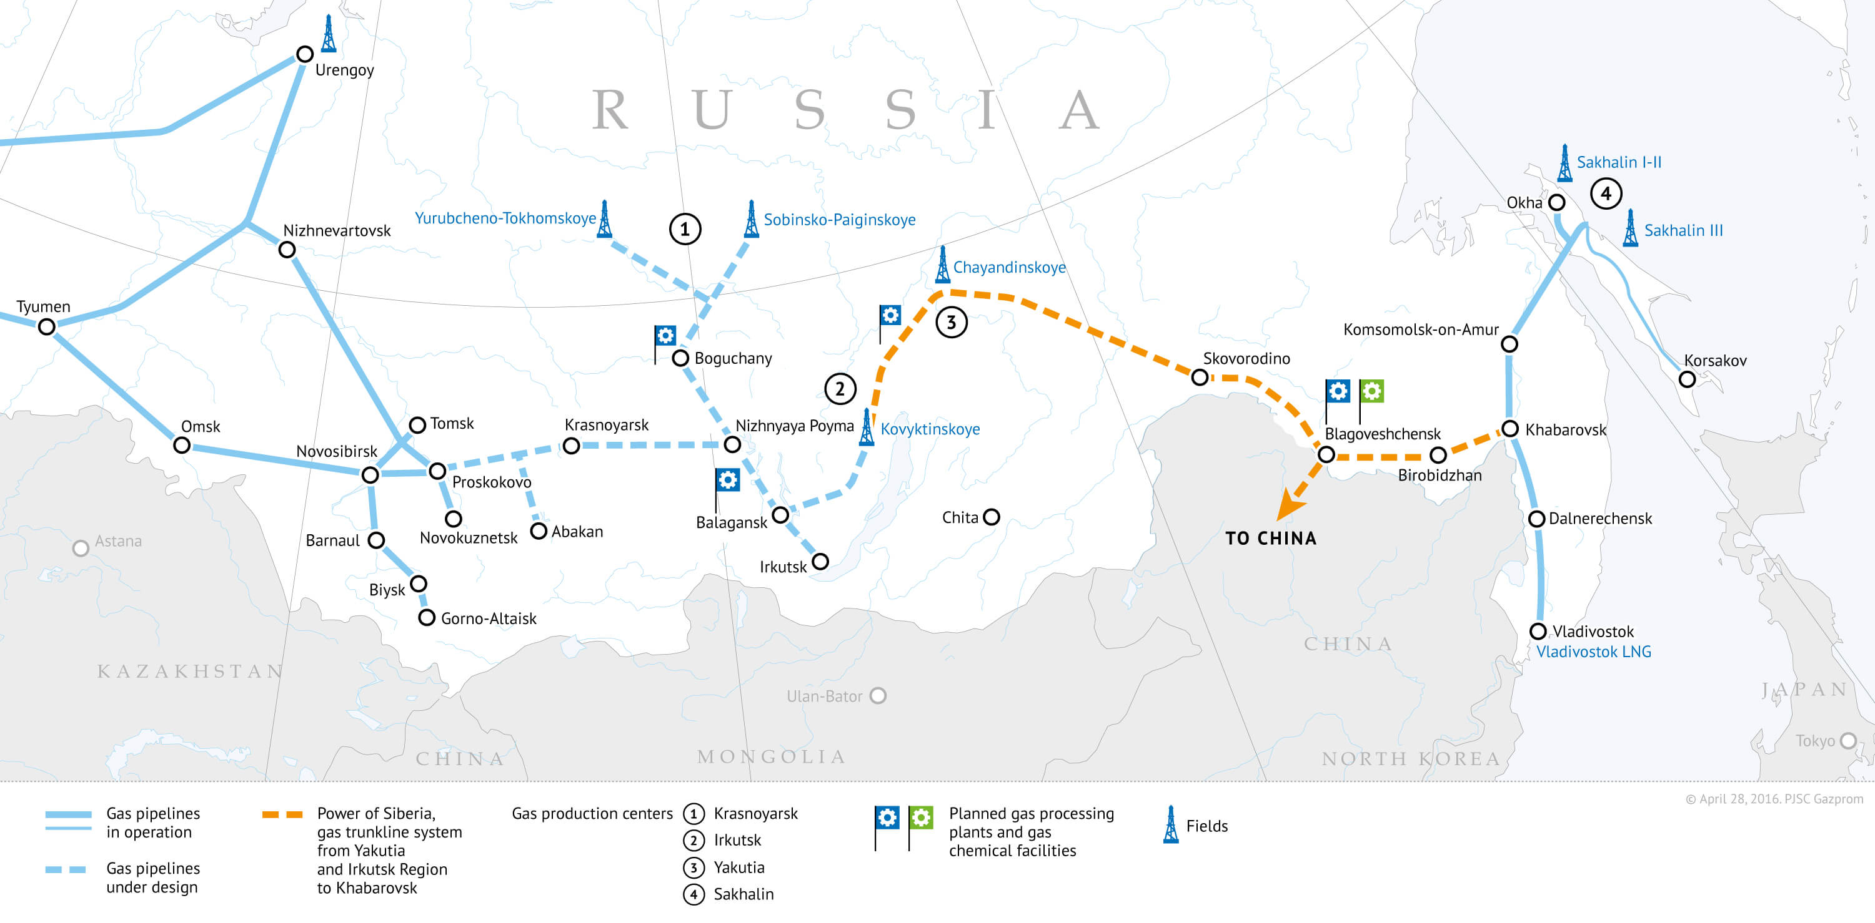
Backdrop
The company’s most important assets are enormous natural gas reserves discovered in Siberia following World War II. Gazprom was one of the first publicly owned firms created by Russia’s privatization program.
Notes:
Gazprom, a term that means “gas industry,” was initially a privately owned company created by officials of the Soviet Union to assume control of the country’s natural gas industry. The company’s most important assets are enormous natural gas reserves discovered in Siberia following World War II. Gazprom was one of the first publicly owned firms created by Russia’s privatization program.

Slide 5
Gazprom’s main shareholders
Notes:
Fifteen percent of Gazprom’s common stock was given to employees and 28 percent to customers, while the federal government retained a 40 percent ownership interest in the company. Most of Gazprom’s remaining common stock was sold to foreign investors. To ensure that domestic investors maintained control of major Russian companies, foreign investors (mostly, William Browder) were permitted to buy only a small fraction of a Russian company’s stock.

Slide 6
Accounting Manipulations
In December 1992, when Boris Yeltsin, the Russian President appointed Chernomyrdin, Gazprom's Chairman, his Prime Minister, the company's political influence increased.
Rem Viakhirev took the chairmanship of Gazprom's Board of Directors and Managing Committee.
Notes:
All these people are key figures. They are all might be friends.
Chernomyrdin was ofthen charged that he used his political power to grant large tax concessions and other economic benefits to Gazprom. These critics also maintained that Chernomyrdin and Vyakhirev diverted billions of dollars of Gazprom’s assets to themselves and family members. Allegedly, the two men and their colleagues established a network of private companies and then channeled Gazprom assets to those companies through an array of complex and clandestine transactions.

Slide 7
Accounting Manipulations
Itera transactions
Gazprom sold a large volume of natural gas to Itera for $2 per cubic meter, which Itera then resold to European customers for more than $40 per cubic meter.
Gazprom sold its 32 percent ownership interest in a gas-producing subsidiary, Purgas, to Itera for $1,200. Industry insiders estimated that the market price of that ownership interest was approximately $400 million.
Itera became the world’s seventh largest natural gas company in a span of only seven years during the 1990s.
Gazprom was losing the equivalent of $2 billion to $3 billion each year due to “corruption, nepotism, and simple theft.
Notes:
According to press reports, Gazprom officials sold a huge amount of natural gas at nominal prices to Itera, a privately owned company based in the Netherlands.
In one confirmed case, Gazprom sold a large volume of natural gas to Itera for $2 per cubic meter, which Itera then resold to European customers for more than $40 per cubic meter. In another transaction, Gazprom sold its 32 percent ownership interest in a gas-producing subsidiary, Purgas, to Itera for $1,200. Industry insiders estimated that the market price of that ownership interest was approximately $400 million. Thanks to such transactions, Itera grew from a small, unknown entity to the world’s seventh largest natural gas company in a span of only seven years during the 1990s.
Although Itera appears to be the company that has profited the most from Gazprom’s generosity, several other firms have been the beneficiaries of similar sweetheart deals. Among these firms is Stroitransgaz, a pipeline construction company that landed a large number of lucrative contracts with Gazprom during the 1990s. According to the Russian press, Stroitransgaz’s principal owners include Viktor Chernomyrdin’s two sons and Rem Vyahkirev’s daughter.
Gazprom was losing the equivalent of $2 billion to $3 billion each year due to “corruption, nepotism, and simple theft. That same newspaper went on to report that its own five-week investigation had uncovered evidence that Gazprom assets have been systematically handed over to company managers.

Slide 8
Investigation
William Browder started investigation of Gazprom stock in the mid-1990s.
In January 2001“special audit” of the Gazprom-Itera transactions-PwC (audit itself)
PwC had failed to even require Gazprom to disclose Itera as a related party in the footnotes.
Deloitte & Touche -parallel investigation of those same transactions.
Notes:
The increasingly revealing and hostile reports focusing on Gazprom’s business dealings with Itera and other related companies outraged the international investors provided billions of dollars for the fledgling Russian economy. Even more outraged were foreign investors who owned Gazprom stock. Among these investors was William Browder, Hermitage’s chairman.
William Browder had begun accumulating Gazprom stock for Hermitage in the mid-1990s. He recognized that the huge natural gas reserves owned by the company were not properly impounded into Gazprom’s stock market price. He expected that the stock’s market price would rise dramatically, but in the real terms it decresed. Browder attributed the lack of interest in Gazprom’s common stock to the fact that the company was literally “giving away” huge gas oil reserves year to Itera and other privately owned companies controlled by Gazprom executives, their family members, and their close friends and associates.
It forced the company’s board to call for a “special audit” of the Gazprom-Itera transactions in January 2001.
When Gazprom’s board announced that PwC had been retained to perform the Itera audit, critics immediately charged that PwC would effectively be auditing “itself”. Most galling to critics was that PwC had failed to even require Gazprom to disclose Itera as a related party in the footnotes to the company’s financial statements over the previous several years.
Shortly after Gazprom’s board hired PwC to investigate the company’s business deals with Itera, a group of minority stockholders led by Federov appointed Deloitte & Touche to perform a parallel investigation of those same transactions.

Slide 9
No smoking guns
PwC did not identify any “deals in which Itera benefited at the expense of Gazprom
PwC purchased fullpage ads in major Russian newspapers which suggested that PwC had been singled out for criticism based on “an inaccurate understanding of the roles and responsibilities of auditors.
The court resolved allegations in the lawsuits were “completely unfounded” and that the firm’s audits had “met all applicable legal and professional standards”.
Notes:
PwC completed its four-month investigation of Gazprom’s business dealings with Itera 67-page confidential report. PwC did not identify any “deals in which Itera benefi ted at the expense of Gazprom. Not surprisingly, the results of the PwC investigation failed to placate Boris Federov, William Browder.
PwC purchased fullpage ads in major Russian newspapers. These ads attempted to rebut much of the criticism that had been directed at the fi rm over the previous two years for its Gazprom audits. The ads suggested that PwC had been singled out for criticism based on “an inaccurate understanding of the roles and responsibilities of auditors. The court resolved allegations in the lawsuits were “completely unfounded” and that the firm’s audits had “met all applicable legal and professional standards”.

Slide 10
Questions
№1
List the challenges that a major accounting firm faces when it establishes its first practice office in a foreign country. Identify the key factors that accounting firms should consider when deciding whether to establish a practice office in a new market.
Political (P):-Political situation in the country accounting firm plans to take its business to is highly critical. The main issues addressed in this section include political stability, tax guidelines, trade regulations, safety regulations, and employment laws.
Economical (E):- This include factors like inflation, interest and exchange rates, tax rates economic growth, the unemployment rate and policies.
Social (S):- Concerning performance of accounting firms I think it is related mostly to ethics in accounting and auditing. Each culture may put its specific cultural limitations.

Slide 11
Questions
№1
In addition
Attracting & Developing New Business
Attracting and developing new business is the top challenge for accounting and financial services firms. Today, it’s growing more and more challenging to generate new clients. The competition is fierce. Specifically, international companies suffer from competition with the local auditing firms.
Finding & Keeping Good People
A firm’s brand plays a crucial role in this process, and part of a firm’s brand is its reputation for employing and cultivating leaders.

Slide 12
Questions
№2
Suppose that a U.S.-based accounting firm has a major audit client in a foreign country that routinely engages in business practices that are considered legal in that country but that would qualify as both illegal and unethical in the United States. What specific moral or ethical obligations, if any, would these circumstances impose on this accounting firm? Explain.
If audit client’s practices are considered to be illegal and unethical in the US it means that they do not meet the requirements of IFRS GAAP. Therefore, US accounting firm are not allowed to take this client, otherwise, it will break the law.

Slide 13
Questions
№3
What responsibilities, if any, do you believe PwC had to Gazprom’s minority investors?
Minority investor is an equity holder of a firm who does not have the voting control of the firm.
Notes:
Firstly, let’s make it clear who the minority investors are. Minority investor is an equity holder of a firm who does not have the voting control of the firm, which means that he acquires less than 50% of ownership of the firm’s equity capital. Gazprom’s main shareholders:
40% government owned
28% customers
15% employees
17% sold for foreign investors, specifically, William Browder
Note: Foreign investors were permitted to buy only small fraction of stocks to insure that domestic investors have prevailing share fraction.

Slide 14
Questions
№3
Ethnical
Credible
Disclosure
Independence
disclosure itera as a related party
Itera transactions
Notes:
Consequently, PwC’s responsibilities to Minority investors:
Main responsibility
disclosure itera as a related party
Minor responsibility- so called “Itera transactions”
Natural Gas Reserves-discounted
Gazprom sold a large volume of natural gas to Itera for $2 per cubic meter, which Itera then resold to European customers for more than $40 per cubic meter Purgas
Gazprom sold its 32 percent ownership interest in a gas-producing subsidiary, Purgas, to Itera for $1,200. Industry insiders estimated that the market price of that ownership interest was approximately $400 million.

Slide 15
Questions
№4
In your opinion, should PwC have agreed to perform the “special audit” of the Itera transactions? Defend your answer. In your answer, identify the specific ethical issues or challenges that the engagement posed for PwC.
No, it should not have agreed, because it meant that the company audited itself. It should disclose Itera as a related party in the footnotes to the company’s financial statements.

Slide 16
Questions
№4
PwC’s special audit included the following:
“self-review”
crediability lost
Deloitte and Touche which was appointed by the Boris Federov to perform a parallel investigation of those same transactions

Slide 17
Questions
№4
Challenges and ethical issues:
“Fierce competition”
Nature of the country’s auditing rules.
Notes:
Challenges and ethical issues:
The inherently problematic nature of the auditor-client relationship is made even more problematic within Russia for PwC by two key factors.
“fierce competition” among the major accounting firms to acquire and retain the relatively few large and lucrative Russian audit clients had resulted in auditors feeling pressured
nature of the country’s auditing rules. Professional auditing standards are too “flexible,” which ultimately results in less rigorous audits and lower-quality financial statements.
One former PwC auditor provided an example of this mindset. This individual reported that a large automobile manufacturer that was a PwC audit client effectively gave away huge amounts of inventory by routinely shipping cars to supposed “dealers” who never paid for those shipments. The former PwC auditor recalled thinking, “‘What’s going on? You aren’t getting paid—no guarantees, no nothing. It was clear to me that it was organized robbery. In its audit report, PwC commented on the fact that the client was using different methods to account for certain domestic sales and sales made to foreign customers.

Slide 18
Questions
№5
In the United States, what responsibility do auditors have to determine whether or not “related parties” exist for a given audit client? Explain.
Checking whether there was a fraud in the company to be audited
Checking whether there were some illegal transactions
If auditing company realized it after making an agreement with its client than the disclaimer should be issued.
The disclaimer is issued when the auditor has been unable to satisfy himself or herself that the overall financial statements are fairly presented. It can arise only from a lack of knowledge by the auditor, whereas to express an adverse opinion, the auditor must have knowledge that the financial statements are not fairly stated.

Slide 19
Questions
№6
Explain how the British “true and fair” audit approach or strategy differs from the audit philosophy applied in the United States. In your opinion, which of the two audit approaches is better or, at least, more defensible?
American approach
litigious nature of corporate life
accountants to be very precise
British approach
precision in accounting is a dream
Rely on figures
Notes:
The cases Enron and WorldCom highlighted a contrast between the modern American approach to accounting and the more old-fashioned British approach. America's accounting rules have developed in the context of the increasingly litigious nature of that country's corporate life. This has put pressure on American accountants to be very precise about what is and what is not permissible in company accounts.
In the UK, by contrast, accountants have tried to stick more closely to the old idea of “true and fair”, of accepting that precision in accounting is a dream, that the best you can hope for is that the figures appear (to an honest, independent expert of goodwill) to be as true and fair a reflection of the corporate reality as it is possible to achieve. In the UK, auditors are required to state whether the accounts they are signing show a “true and fair view” of the organisation's affairs.
Two things in particular have compromised the accountants' vision of what is true and fair. One is their desire to do (more glamorous) things than accounting and auditing—in particular, consulting. Arthur Andersen, for example, earned $25m from its audit of Enron in 2000 and $27m in consulting fees from that company in the same year. The other distortion comes from the excessively familiar relationships that grow up in cases where an auditor remains with the same client for many years. At Enron, many of the employees in the company's accounts department had previously worked for Arthur Andersen, and vice versa.

Slide 20
Questions
№7
In recent years, there has been an ongoing debate in the accounting profession focusing on the quality of the accounting standards issued by the International Accounting Standards Board versus those issued by the Financial Accounting Standards Board. Research and briefl y explain the key philosophical difference between those two important rule-making bodies that signifi cantly affects the nature of the accounting standards promulgated by each.
The International Accounting Standards Board (IASB), responsible for International Financial Reporting Standards (IFRS), and the Financial Accounting Standards Board (FASB), responsible for US Generally Accepted Accounting Principles (US GAAP.
Notes:
The International Accounting Standards Board (IASB), responsible for International Financial Reporting Standards (IFRS), and the Financial Accounting Standards Board (FASB), responsible for US Generally Accepted Accounting Principles (US GAAP.

Slide 21
Questions
№7
IFRS
principles based
future benefits+realibility
GAAP
rules based
Fair value
Notes:
At the conceptually level, IFRS is considered more of a "principles based" accounting standard in contrast to U.S. GAAP which is considered more "rules based." By being more "principles based", IFRS, arguably, represents and captures the economics of a transaction better than U.S. GAAP. Some of differences between the two accounting frameworks are highlighted below:
Intangibles
The treatment of acquired intangible assets helps illustrate why IFRS is considered more "principles based." Acquired intangible assets under U.S. GAAP are recognized at fair value, while under IFRS, it is only recognized if the asset will have a future economic benefit and has measured reliability. Intangible assets are things like R&D and advertising costs.
Inventory Costs
Under IFRS, the last-in, first-out (LIFO) method for accounting for inventory costs is not allowed. Under U.S. GAAP, either LIFO or first-in, first-out (FIFO) inventory estimates can be used. The move to a single method of inventory costing could lead to enhanced comparability between countries, and remove the need for analysts to adjust LIFO inventories in their comparison analysis.
Write Downs
Under IFRS, if inventory is written down, the write down can be reversed in future periods if specific criteria are met. Under U.S. GAAP, once inventory has been written down, any reversal is prohibited.

Slide 22
Questions
№7
IFRS
LIFO is not allowed
Write downs can be reversed
GAAP
LIFO is allowed
Reversal is prohibited
Notes:
At the conceptually level, IFRS is considered more of a "principles based" accounting standard in contrast to U.S. GAAP which is considered more "rules based." By being more "principles based", IFRS, arguably, represents and captures the economics of a transaction better than U.S. GAAP. Some of differences between the two accounting frameworks are highlighted below:
Intangibles
The treatment of acquired intangible assets helps illustrate why IFRS is considered more "principles based." Acquired intangible assets under U.S. GAAP are recognized at fair value, while under IFRS, it is only recognized if the asset will have a future economic benefit and has measured reliability. Intangible assets are things like R&D and advertising costs.
Inventory Costs
Under IFRS, the last-in, first-out (LIFO) method for accounting for inventory costs is not allowed. Under U.S. GAAP, either LIFO or first-in, first-out (FIFO) inventory estimates can be used. The move to a single method of inventory costing could lead to enhanced comparability between countries, and remove the need for analysts to adjust LIFO inventories in their comparison analysis.
Write Downs
Under IFRS, if inventory is written down, the write down can be reversed in future periods if specific criteria are met. Under U.S. GAAP, once inventory has been written down, any reversal is prohibited.

Slide 23
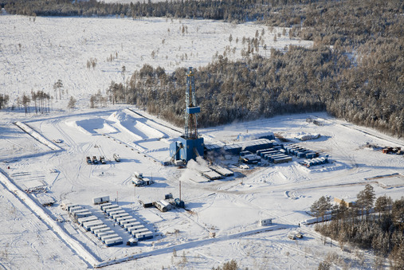
Thank you for attention

