Slide 1
Organization Development and Change
Introduction to
Organization Development and Change
Mariann Benke
University of Pécs, Faculty of Business and Economics
Source: Thomas G. Cummings - Christopher G. Worley

Slide 2
Mariann Benke
E-mail: benkem@ktk.pte.hu
Research fields:
Change management
Organizational Development
Management and Organization
Organizational Behaviour

Slide 3
Learning Objectives
To provide a definition of Organization Development (OD)
To distinguish OD and planned change from other forms of organization change
To describe the historical development of OD
To understand how leadership is linked to change activities
To describe and compare three major perspectives on changing organizations.
To describe how planned change can be adopted to fit different kinds of conditions
To understand the different elements of a successful change program

Slide 4
Burke’s Definition of OD
OD is a planned process of change in an organization’s culture through the utilization of behavioral science technology, research, and theory.

Slide 5
French’s Definition of OD
OD refers to a long-range effort to improve an organization’s problem-solving capabilities and its ability to cope with changes in its external environment with the help of external or internal behavioral-scientist consultants.

Slide 6
Beckhard’s Definition of OD
OD is an effort
planned,
(2) organization-wide, and
(3) managed from the top, to
(4) increase organization effectiveness and health through
(5) planned interventions in the organization’s “processes,” using behavioral science knowledge.

Slide 7
Beer’s Definition of OD
OD is a system-wide process of data collection, diagnosis, action planning, intervention, and evaluation aimed at:
enhancing congruence between organizational structure, process, strategy, people, and culture;
developing new and creative organizational solutions; and
developing the organization’s self-renewing capacity.
It occurs through collaboration of organizational members working with a change agent using behavioral science theory, research, and technology.

Slide 8
Geert Hofstede
Gerard Hendrik (Geert) Hofstede (born 2 October 1928)
Dutch social psychologist, former IBM employee, and Professor Emeritus of Organizational Anthropology and International Management at Maastricht University in the Netherlands,
well known for his pioneering research on cross-cultural groups and organizations.
Dimensions of national cultures:
Power distance index (PDI)
Individualism vs. collectivism (IDV)
Uncertainty avoidance index (UAI)
Masculinity vs. femininity (MAS)
Long-term orientation vs. short-term orientation (LTO)
Indulgence vs. restraint (IND)

Slide 9
Culture differences by Hofstede

Slide 10
Culture differences by Hofstede

Slide 11
Culture differences by Hofstede

Slide 12
Organization Development is...
a system-wide application and transfer of behavioral science knowledge to the planned development, improvement, and reinforcement of the strategies, structures, and processes that lead to organization effectiveness.

Slide 13
Five Stems of OD Practice
Laboratory Training
Action Research/Survey Feedback
Current Practice
Normative Approaches
Quality of Work Life
Human Capital Approach from Garry S. Becker, Nobel Prise 1962
Strategic Change
1950 1960 1970 1980 1990 2000 Today
Resource-based view 1984

Slide 14
Part I:
The Nature of Planned Change The OD Practitioner
Part II: The Process of Organization Development
Entering & Diagnosing Diagnosing Collecting
Contracting Organizations Groups & Jobs Diagnostic
Information
Feeding Back Designing OD Leading and Evaluating &
Diagnostic Data Interventions Managing Institutionalizing
Change Change

Slide 15
Part III:
Human
Process
Interventions
Individual,
Interpersonal,
& Group
Process
Approaches
Organization
Process
Approaches
Part IV:
Techno-structural
Interventions
Restructuring
Organizations
Employee
Involvement
Work Design
Part V:
Human
Resources
Management
Interventions
Performance
Management
Developing and
Assisting
Members
Part VI:
Strategic
Interventions
Competitive and
Collaborative
Strategies
Organization
Transformation
Part VII: Special Topics in Organization Development
Organization Development OD in Nonindustrial Future Directions
in Global Settings Settings in OD

Slide 16
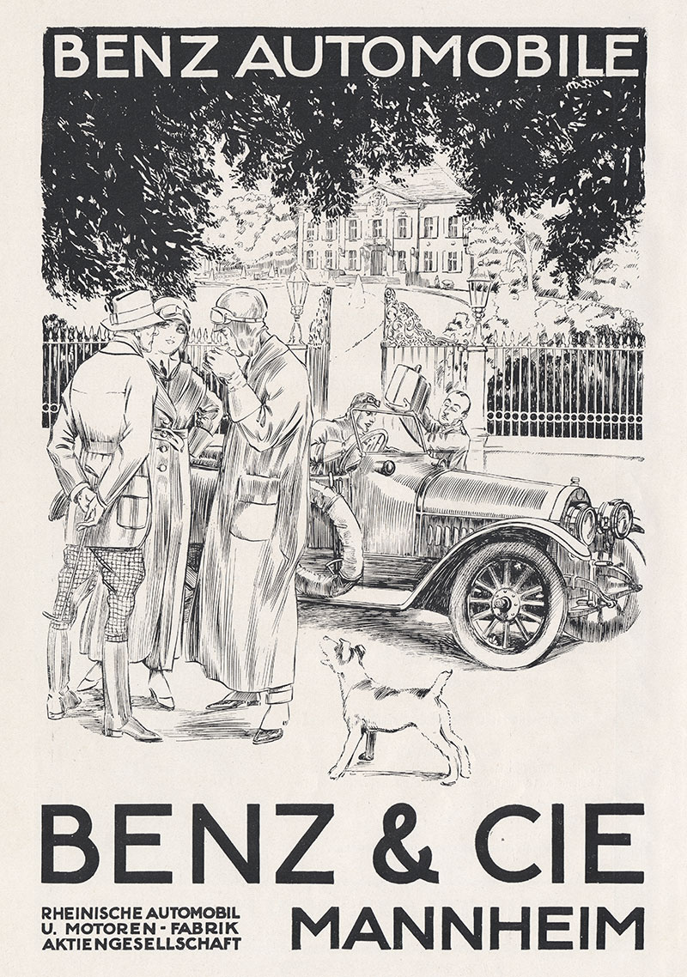
OD planned change: M&A activity
Mercedes + Daimler Benz = Benz&Cie → Mercedes-Benz (1926 - …) ☺

Slide 17
OD planned change: M&A activity
BMW + Rover → (1994 – 1998) ☹

Slide 18
OD planned change: M&A activity
Daimler + Chrysler = DaimlerChrysler (1998 – 2005) ☹

Slide 19
OD planned change: M&A activity
Renault + Nissan → 1999 ☺
Renault + Nissan + Mitsubishi → 2015 ?

Slide 20
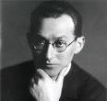
Lewin’s Change Model (1954)
Unfreezing
Movement
Refreezing

Slide 21
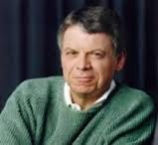
Kotter’s 8-Step Process for Leading Change (1996)

Slide 22
General Model of Planned Change
Planning
and
Implementing
Change
Evaluating
and
Institutionalizing
Change
Entering
and
Contracting
Diagnosing

Slide 23
Different Types of Planned Change
Magnitude of Change
Incremental
Radical
Degree of Organization
Over-organized
Under-organized
Domestic vs. International Settings
https://www.youtube.com/watch?v=__IlYNMdV9E

Slide 24
Critique of Planned Change
Conceptualization of Planned Change
Change is not linear
Change is not rational
The relationship between change and performance is unclear
Practice of Planned Change
Limited consulting skills and focus
Quick fixes vs. development approaches

Slide 25
Change Management Activities
Motivating Change
Creating Vision
Effective
Change
Management
Developing
Political Support
Managing the Transition
Sustaining Momentum

Slide 26
Motivating Change
Creating Readiness for Change
Sensitize the organization to pressures for change
Identify gaps between actual and desired states
Convey credible positive expectations for change
Overcoming Resistance to Change
Provide empathy and support
Communicate
Involve members in planning and decision making

Slide 27
Creating a Vision
Discover and Describe the Organization’s Core Ideology
What are the core values that inform members what is important in the organization?
What is the organization’s core purpose or reason for being?
Construct the Envisioned Future
What are the valued outcomes?
What is the desired future state?

Slide 28
Developing Political Support
Assess Change Agent Power
Identify Key Stakeholders
Influence Stakeholders

Slide 29
Sources of Power and Power Strategies for Change Agents
Individual Sources of Power
Power Strategies
Knowledge
Playing it Straight
Knowledge
Playing it Straight
Others’ Support
Using Social
Networks
Others’ Support
Personality
Going Around the
Formal System
Personality

Slide 30
Examples for human power
Ford 1968:
https://www.youtube.com/watch?v=DZ509hHkHO8
Iron Lady (1979 – 1990):
https://www.youtube.com/watch?v=hZrAKdlX0SA

Slide 31
Managing the Transition
Activity Planning
What’s the “roadmap” for change?
Commitment Planning
Who’s support is needed, where do they stand, and how to influence their behavior?
Change-Management Structures
What’s the appropriate arrangement of people and power to drive the change?

Slide 32
Change as a Transition State
Current
State
Transition
State
Desired
Future
State

Slide 33
Sustaining Momentum
Provide Resources for Change
Build a Support System for Change Agents
Develop New Competencies and Skills
Reinforce New Behaviors
Stay the Course

Slide 34
Restructuring Organizations: Contingencies Influencing
Structural Design
Environment
Organization
Size
Worldwide
Operations
Structural
Design
Organization
Goals
Technology

Slide 35
Structural Design
Functional Organization
The Divisional Organization
The Matrix Organization
The Process-Based Structure
The Network Organization

Slide 36
The Reengineering Process
Prepare the organization
Specify the organization’s strategy and objectives
Fundamentally rethink the way work gets done
Identify and analyze core business processes
Define performance objectives
Design new processes
Restructure the organization around the new business processes.

Slide 37
Organization Development and Change
Thank you for your attention!
Mariann Benke
University of Pécs, Faculty of Business and Economics
Source: Thomas G. Cummings - Christopher G. Worley

