Slide 1


Slide 2
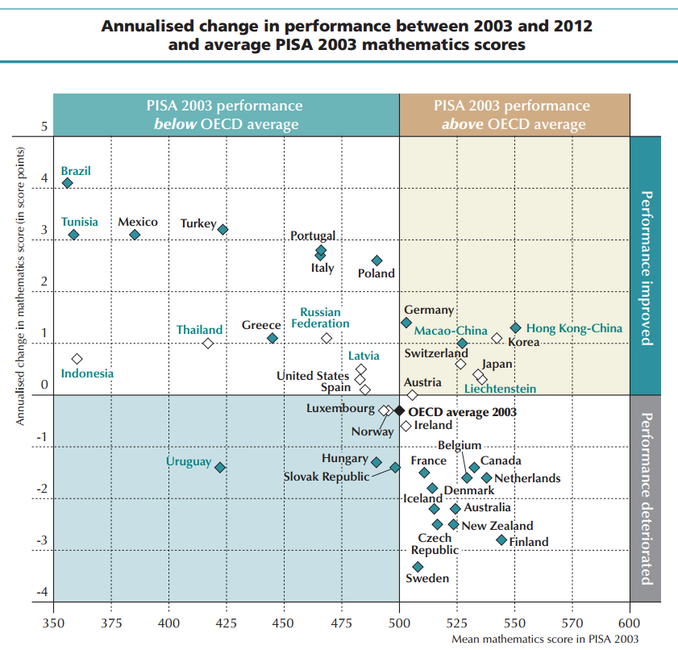
// Introduction
The gap between highschool and university level of knowledge in math keeps getting bigger (1)
The job market sorely needs
gratuates with math skills (2)
Czech republic PISA scores
keep getting worse (3)

Slide 3
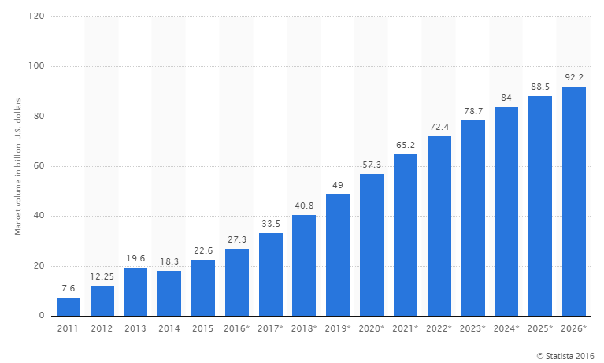
// Why we need it
The market volume for big data is expected to triple by 2026
Significant growth in job demand of big data related vacancies (4)

Slide 4
// The service so far (1/4)
Timeframe:
(1 semester)
Total visits:
Unique visitors:
od 22. 2. 2016
do 4. 7. 2016
300
146

Slide 5
// The service so far (2/4)
ESF dominates:
FSS follows:
Other faculties:
Outside MUNI:
246
20
24
7

Slide 6
// The service so far (3/4)
Percentage of visits regarding final theses:
27%

Slide 7
// The service so far (4/4)
Stats and metrics
Average hits per month (website) 1800
Average time of visit (website) 00:03:02
Peak reach (Facebook) 1105
Likes in the first month (Facebook) 228

Slide 8
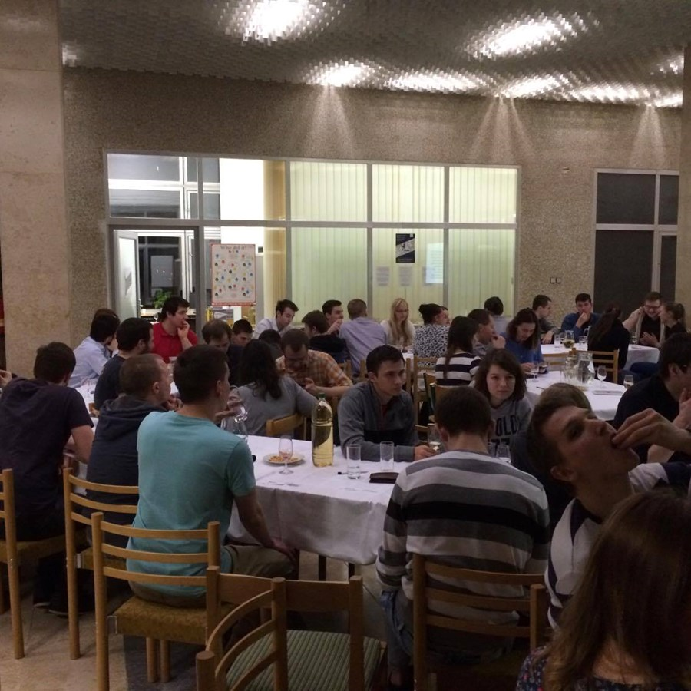
// Events
The Support Centre regularly organizes events for students
„Quantified Nature“ or
„The answer of Kurt Gödel to Pontius Pilate‘s question“
are just a few of them

Slide 9
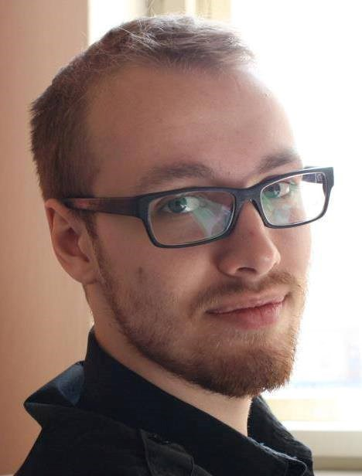
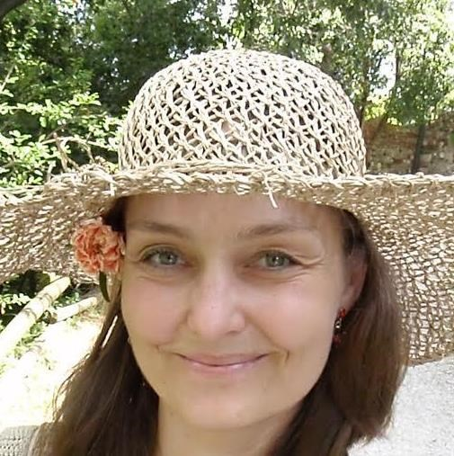
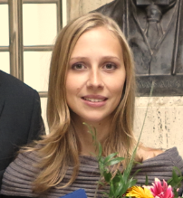
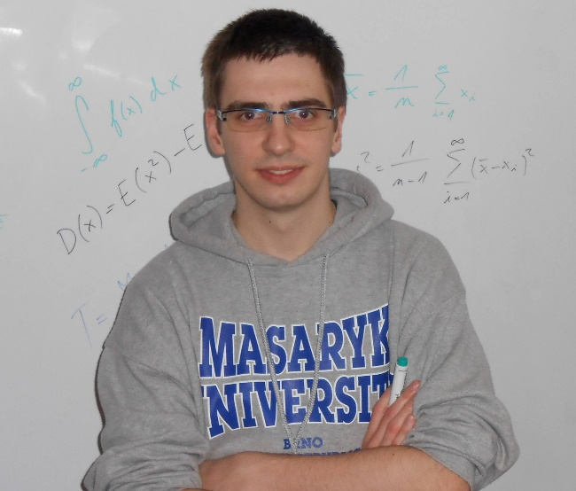
// Our team
So far the Support Centre operated through volunteers.
Students and teachers alike offered their time to help others with math and statistics.

Slide 10
// Visitor feedback (1/3)
„ (…) chci (znovu) projekt pochválit :) zatím jsem konzultaci nepotřebovala, ale to, že centrum funguje a že s ním můžu počítat je skvělé“ – Respondent 3
„Pan Josef Nešleha vysvětluje opravdu dobře a vždy si našel čas ikdyž to vypadá, že jeho den má 40 hodin.“ – Respondent 14
„Myslím si, že Maths and Stats Support Centre je skvělý nápad a budu moc rád, pokud jeho fungování bude pokračovat.“ – Respondent 76

Slide 11
// Visitor feedback (2/3)
„(…) veľmi ma potešilo, že sa niečo také vytvorilo, je to super pre študentov. Našťastie som zatiaľ Vašu pomoc nepotreboval ale rád ju využijem v budúcnosti ak bude príležitosť “ – Respondent 65
„Ačkoliv jsem nevyužil jeho služeb, tak jsem ho doporučil několika kamarádům (…) Ti, kteří služeb centra využili si ho moc pochvalovali.“ - Respondent 76
„Support Centre je super projekt, jsem hrozně rád, že se ho podařilo otevřít! Díky paní doktorce Králové i všem tutorům. :)“ – Respondent 23

Slide 12
// Visitor feedback (3/3)
Traits liked the most:
Tutors‘ friendly and non-critical approach
Tutor explained all questions
Tutor was able to explain complicated issues in simple terms (6)

Slide 13



// Spreading the idea
3 other support centers were inspired and are taking off
  VŠB Technical University of Ostrava
  - wants to cooperate with MSSC as much as possible
  UTB Tomáš Baťa University in Zlín (Dr. Zuzana Pátiková)
  - scheduled launch in September 2016
  VUT Brno Technical University (FME)
  - launches in April 2017 with support from OP VVV project

Slide 14

// Outlook (1/2)
Engage more people
- spark interest in math and statistics
- break the „I‘m bad at math“ mindset
Improve the website
- reduce bounce rate
- incentivise visitors to browse sylabi
- create a problém-solving platform
Reduce math and stats failing grades at MU

Slide 15

// Outlook (2/2)
  Labor costs
  -two part time tutors
  Technical background
  -projector
  -interactive whiteboard
  -software and web development
  Marketing
  -leaflets, DTP labor, print
Academic year
2016/2017 target budget:
550 000 CZK

Slide 16
// Sources
(1) http://archiv.ihned.cz/c1-65399490-ustup-maturity-z-matematiky
(2) http://www.statista.com/statistics/254266/global-big-data-market-forecast/
(3) https://www.oecd.org/pisa/keyfindings/pisa-2012-results-overview.pdf
(4) https://acadgild.com/blog/big-data-job-opportunities-in-2016-and-the-coming-years/
(5) Google and Facebook analytics internal data
http://mathstat.econ.muni.cz/
https://www.facebook.com/supportcentre/
(6) Google forms questionnare survey

