Slide 1
Economic Policy #2
Limits of Economic Policy

Slide 2
Limits of Economic Policy
Uncertainty and risk
The limits of confidence
The limits of information
Conflicts of interests
Solution
External limits

Slide 3
Motivation
Governments are not as omniscient and omnipotent as was implicitally assumed after WWII till 1970s.
Government interact with other players in imperfect information world and their EP have been deeply affected by the rise of international interdependence.

Slide 4
Uncertainty and risk
Government doesn’t have extensive knowledge of the preferences of economic agents and of the economic structure
=> uncertainty about adequate choice of policy tools
Many policy decisions have irreversible consequences
=> ‘precautionary principle‘ of economic policymaking (e.g. joining eurozone), creating a decision-under-uncertainty framework

Slide 5
Surprises and outturns in 15 EU budgetary plans, 1998-2006
 | Nominal GDP growth, % | Nominal government revenue growth, % | Nominal government expenditure growth, % | Nominal government balance as percentage of GDP, %
“Positive” surprises | 50 | 58 | 76 | 36
“Negative” surprises | 50 | 42 | 24 | 64
In spite of higher-than-expected revenues, frequent expenditures overruns often have resulted in the deficit exceeding target => governments do not manage public finances in a way to take into account risks to revenues and expenditures.

Slide 6
The limits of confidence: credibility problems #1
Credibility problems arise from intertemporal inconsistency (often called time inconsistency), i. e. temptation for government to mislead private agents in the name of general interest => ex post and ex ante optimal policies do not coincide.

Slide 7
The limits of confidence: credibility problems
Example:
Government announces it will scrap taxes on fixed capital to encourage investment. Then reneges on its promise because it is socially optimal ex post to finance public goods by taxing capital. What will be the result?
Another application to monetary policy, exchange-rate policy, ..
Unfulfilled promises undermine confidence in EP and hamper its effectiveness.

Slide 8
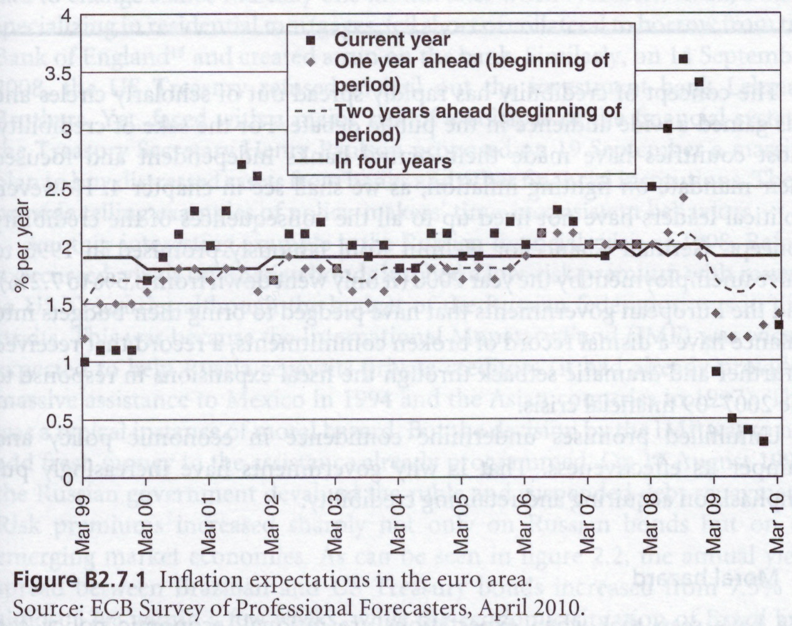

Responsible and irresponsible credible behaviour #1

Slide 9
Responsible and irresponsible credible behaviour #2
Shorter-term expectations are more volatile, but volatility decreases as the expectation horizon lenghtens > ECB has achieved a high degree of credibility.
But sometimes it may be important to be credibly irresponsible (e.g. deflationary crisis)

Slide 10
The limits of confidence: credibility problems (cont.)
Solutions:
  Delegation to independent agencies: central banks, regulatory agencies,…
  Banish discretionary policies and follow fixed policy rules: inflation targeting, fiscal rules, currency boards…
  Transparency

Slide 11
The limits of confidence: moral hazard
Moral hazard problems arise when likelihood of government intervention alters private behaviour and induces more risk taking.
Examples: IMF interventions in emerging countries, role of lender of last resort of the central bank, public insurance schemes…
Solution:
  make public intervention rare and costly (e.g. lender-of-last resort doctrine)

Slide 12
The limits of information #1
Policymakers do not have full access to information and it is used strategically by those with access to it
Risk of regulatory capture
Major issue for
  regulation and supervision in technical areas (telecom, energy, finance…)
  contracts (e. g. for provision of government-financed services such as health care)
  internal organization of government

Slide 13
The limits of information #2
Theory:
  principal-agent model: the principal, who delegates a task to the agent, does not have full info about agent’s capabilities and performance => suboptimal results
Solution:
  incentive contracts, possibly within the government (such as performance-related compensation and promotion, e.g. Walsh contract for central bankers)

Slide 14
Conflict of interests #1
Why politicians may deviate from general interest?
shortsightedness (electoral cycles)
pressures from interest groups (“pork-barrel politics”)
reelection motivation (political business cycles)
partisan behaviour
divided electorate

Slide 15
Conflict of interests #2
Models:
attrition wars, vote theory
Solutions:
Incentive contracts for politicians, procurement rules, antibribery, delegation to independent agencies

Slide 16
Evidence of politically-motivated decisions

Slide 17
The median voter
Voter chooses the party whose preferences are close to his or her own: voters V₁ to V₄ will for example vote for candidate C₁ and voters V₅ to V₉ to candidate C₂.
If there are only two parties (left-wing and right-wing), they will converge on the preference of the median voter V₅ => limited program differentiation

Slide 18
Should policymaking be delegated?
Technocrats are better in presence of:
  technical complexity (e.g. financial/safety regulation)
  judicial nature of decisions (merger control)
  undesirable trade-offs (public health and safety)
  intertemporal concerns (distributions across generations)
  significant international independence
  benefits to groups likely to engage into political lobbying

Slide 19
Should policymaking be delegated?
But decision needs to remain political when:
  social preferences are unstable
  policy involves unavoidable trade-offs
  policy involves significant redistributions within generations
  => Today’s hot topics: balanced budget rules, fiscal councils

Slide 20
Living with interdependences
Some indicators of international integration exceed level before WWI
(e.g. trade openness), others do not (international migration flows).

Slide 21
The pros and cons of coordination #1
Arguments for coordination
  Global public goods
  Policy spillovers
    Demand, price and interest rate spillover
    Competitiveness and the ’n-1’ problem (if all n countries behave the same way, the economic indicator (e.g. exchange rates) will remain unchanged
      => beggar-thy-neighbor policies

Slide 22
The pros and cons of coordination #2
Arguments against coordination
  Commitments not followed by actual policy decision
  Model and parameter uncertainty: imperfect information may lead to wrong choices
  Coordination as a form of collusion when seen as a coalition among policymakers to weaken market discipline
  Partial coordination (e.g. within a subset of countries) may worsen policy outcome

