Slide 1
Economic Policy #05_06
Monetary Policy

Slide 2
Monetary Policy
Objectives
Institutions
Instruments
Transmission channels
Rules in monetary policy

Slide 3
Overview
Money is old device but the concept of monetary policy (MP) emerged during interwar period
During 50s and 60s MP was eclipsed by fiscal policy and primarily concentrated on minimizing the cost of public borrowing
In the 70s the role of MP was reassessed with disinflation as an overriding policy objective
By the late 90s MP geared toward achieving price stability
Financial crisis in 2008 highlighted the role of CB as guarantors of financial stability, CB engaged in unconventional MP actions

Slide 4
What do central banks do?
Central banks:
issue banknotes
provide banks with liquidity
impose compulsory reserves on commercial banks
act as ’lender of last resort’ to banks

Slide 5
What is liquidity?
Market liquidity: the ease with which a position in an asset can be liquidated without appreciably altering its price. This concept is asset-specific.
Funding liquidity: the ease with which a solvent institution can service its liabilities as they fall due. This concept is institution-specific.
The 2007-2008 crisis started as market-liquidity crisis (first on mortgage-backed securities, then on all fixed-income markets) and morphed into a funding-liquidity crisis.

Slide 6
Liquidity provision
Liquidity is provided through:
open market operations (purchases of financial assets by the CB from commercial banks)
repurchase agreements or repos (CB holds the corresponding assets for a fixed period)
In so doing central banks set price of liquidity and control the quantity of base money.
CB can also influence the banks’ lending behaviour through reserve requirements.

Slide 7
The objectives of monetary policy
The objectives of MP varied significantly over time:
in 70s CB had broad mandates involving difficult trade-offs between alternative targets
after inflation period during 70s price stability emerged as dominant goal
some CBs pursue other objectives simultaneously
after financial crisis 2007-09 discussion about gearing MP more towards financial stability

Slide 8
The objectives of MP: price stability #1
Inflation should be neither too high:
  Shoeleather costs, menu costs, redistribution effects, uncertainty weighting on individual decisions, risk of generalized indexation and ultimately of hyperinflation,..
  Ex: Germany in the 1930s, Argentina in the 80s, Zimbabwe in the 2000s,..

Slide 9
The objectives of MP: price stability #2
… nor too low
  Upward bias in measured CPI
  Risk of deflation and liquidity trap
  Downward rigidity of nominal wages points toward 1-4 % inflation band
=> Most central banks have objectives between 1-3 %

Slide 10
The pros and cons of stabilizing asset prices
Central banks have traditionally been reluctant to target asset prices, but:
• there are other instruments than the policy rate to promote financial stability (counter- cyclical capital buffers, taxes)
• the debate has been revived by the crisis

Slide 11
The objectives of MP: exchange rate stability
Until 90s transition countries relied on a fixed exchange rates as a means of controlling inflation
MP of many European countries was geared toward maintaining the external value of the currrency vis-à-vis some larger country
The attraction of fixed exchange rates has faded away in recent years

Slide 12
The objectives of MP: output stabilization
MP can be used to stabilize aggregate demand, i.e. support demand through an expansionary MP in recession and a restrictive MP when demand is ballooning.
The rationale for counter-cyclical MP goes back to the Great Depression in 1930s.
But desirability and effectiveness of counter-cyclical MP are debated because of variable time lags involved in the transmission mechanism which can transform MP into a procyclical policy.

Slide 13
The objectives of MP: financial stability
Usually not a formal objective, but in the ’genetic code’ of CB
Responsibility of the CB as a lender of last-resort to banks is inevitable, but should be exerted with great caution by:
  Limiting moral hazard
  Being closely connected with banking supervisors
  Coordinating with fiscal authority (because losses should be ultimately borne by taxpayers)
Asset-price targeting as part of the central bank mandate?

Slide 14
The mandates of four central banks (US Fed)
Legal vehicle
  Full Employment and Balanced Growth Act (“Humphrey Hawkins Act”)
Price stability
  Yes
Exchange-rate stability
  No, but may intervene on exchange markets, at the request of the US Treasury
Output stabilization
  Yes, on an equal footing with price stability
Financial stability
  Yes

Slide 15
The mandates of four central banks (ECB)
Legal vehicle
  EU Treaty (since Maastricht Treaty of 1992)
Price stability
  Yes
Exchange-rate stability
  No, but exchange rates are part of the second pillar of the monetary-policy strategy, and the ECB has the sole right to conduct foreign-exchange operations
Output stabilization
  No, but may intervene on exchange markets
Financial stability
  Not explicitly

Slide 16
The mandates of four central banks (Bank of England)
Legal vehicle
  Bank of England Act, 1998
Price stability
  Yes, definition of price stability belongs to government
Exchange-rate stability
  No
Output stabilization
  Yes, secondary to price stability
Financial stability
  Yes

Slide 17
The mandates of four central banks (Bank of Japan)
Legal vehicle
  Bank of Japan Law, 1997
Price stability
  Yes
Exchange-rate stability
  No, but may be instructed to intervene to exchange markets
Output stabilization
  No, only as a consequence of price stability
Financial stability
  Yes

Slide 18
Mandates of CB: key differences
US Fed has dual mandate of full employment and price stability, while ECB has not
ECB decides on objectives, while BoE and RBNZ do not
Crisis has prompted fresh discussion on the central bank role in financial stability
Example: creation in 2011 of European Systemic Risk Board chaired by ECB President.

Slide 19
Central bank credibility
CB credibility is very important for effective MP.
If the CB exploits expectation errors of economic agents and targets a higher level of output (i.e. output above its natural level) in order to reduce unemployment, the outcome is bound to be inflationary because only structural policies can lower structural unemployment. The other result is a lack of credibility.

Slide 20
Central bank credibility (cont.)
How can CB enhance its credibility?
By adequate institutional design (independence, transparency and accountibility)
By tying its hands: exchange rate peg, monetary policy rules
By selecting conservative central bankers, i.e. more adverse to inflation than the average of society (K. Rogoff)

Slide 21
Central bank transparency
Ejffinger and Geraats (2006): the extent to which central banks disclose information that is related to the policymaking process
  political transparency (information on policy objectives)
  procedural transparency (the way monetary decisions are taken)
  policy transparency (explanation of policy decisions)
  operational transparency (information on errors and unexpected events).

Slide 22
Central bank transparency index (2002)
 | Aus | Can | Euro | Jap | NZ | Swe | Swi | UK | US
Political | 3 | 3 | 3 | 1.5 | 3 | 3 | 2.5 | 3 | 1
Economic | 2 | 2.5 | 2.5 | 1.5 | 3 | 2 | 1.5 | 3 | 2.5
Procedural | 1 | 1 | 1 | 2 | 3 | 3 | 1 | 3 | 2
Policy | 1.5 | 2 | 2 | 1.5 | 3 | 3 | 2 | 1.5 | 3
Operational | 1.5 | 2 | 2 | 1.5 | 2 | 3 | 0.5 | 2.5 | 1.5
Total | 9 | 10.5 | 10.5 | 8 | 14 | 14 | 7.5 | 13 | 10
Source: Eijffinger&Geraats (2006)

Slide 23
Central bank independence
Consider three measures of CB independence:
instrument independence: the central bank is free to set any monetary policy instrument/variable
goal independence: the central bank is free to set its own goals for monetary policy
political independence: the central bank is able to conduct monetary policy without legislative influence

Slide 24
Importance of CB independence
Why is CB independence so important?
independent central bank is insulated from the political pressures
fiscal policy tends to follow a political business cycle, if central banks were subject to political approval, monetary policy would also follow this volatile pattern
elected politicians do not have the technical savvy to conduct monetary policy
If the CB was beholden to political interests, the federal government could amass large budget deficits then turn to the Fed to pay off its debts

Slide 25
CB independence
Increasing number of countries granted full independence to their CB during 1990s and 2000s.

Slide 26
CB independence and inflation
This institutional move to independence resulted from the better ability of independent CB to cope with the inflationary pressures of previous decades.

Slide 27
What relation between FP and MP?
FP and MP are interdependent in the long run because unsustainable FP deteriorates monetary stability (e.g. 2002 crisis in Argentina).
In the short run, there is no consensus about desirable policy-mix:
FP and MP should be coordinated, because governments and CBs are jointly responsible for macroeconomic management and noncooperative equilibrium could emerge (result: MP is too tight and FP too relaxed)
Opponents: coordination by nature threatens CB independence; full independence solves game-theoretical problem => monetary dominance regime
Infrequent in peacetime is fiscal policy regime, where MP ensures solvency of government.

Slide 28
Central bank accountability
CB accountability reflects its exposure to external scrutiny and its answerability vis-à-vis its principal.
in most countries CB are accountable to the legislative branch
  US ‘Humphrey Hawkins’ testimony
  ‘Monetary dialogue’ at European Parliament
  BoE governor letter

Slide 29
Accountability in New Zealand
Before appointing the Governor, the Minister is required to fix policy targets during that person's term of office
The Bank delivers to the Minister and publishes at least every six months a monetary policy statement reviewing and assessing recent monetary policy and articulating the policies and means by which the Bank intends to achieve the policy targets
The Minister may seek the removal of the Governor if inter alia:
  the Bank does not adequately carry out its functions (the primary function being monetary policy); or
  the performance of the Governor in ensuring the Bank achieves the policy targets has been inadequate; or
  a monetary policy statement is inconsistent in a material respect with the Bank's primary function, or with any policy target fixed in the Policy Targets Agreement.

Slide 30
Communication
Central banks can reduce uncertainty by communicating relevant information about macroeconomic fundamentals, the condition of financial institutions and the financial sector more generally, and the conduct of policy.
Their communication differs quite a lot
  ECB Press conference (ECB)
  Disclosure of FOMC and BoE MPC meetings minutes and individual votes
  Disclosure of expected interest rate path by Swedish Riskbank, Bank of Norway, RBNZ, Fed

Slide 31
Instruments of European Central Bank (ECB)
Minimum reserves (1 % of the demand deposits and of time deposits shorter than two years)
Two overnight standing facilities:
  Marginal lending facility (ceiling rate)
  Marginal deposit facility (floor rate)
Weekly refinancing operations (competitive bids through which ECB provides liquidity against collateral => refinancing rate (the main rate of Eurosystem)
These three rates are sometimes called leading interest rates. Interbank rate fluctuates between floor and ceiling rate and in normal time close to refinancing rate.

Slide 32
Conventional and non-conventional reactions to the crisis
Lower official rates
Massive liquidity provision
  Extension of refinancing maturity (up to 3 years)
  Fixed rate, full allotment tenders (ECB)
  New instruments such as TALF (Fed), covered bonds purchase program (ECB)
  Broader collateral basket
  Quantitative easenning (Fed, ECB, BoE, BoJ)
International liquidity arrangements
  Currency swap lines
  Short-term IMF financing
Repairing transmission mechanisms
  ECB’s temporary ’Securities Market Program’ and ’Outright Monetary Transactions’

Slide 33
Refinancing rates and market rate in euro area

Slide 34
Refinancing rates in the US, the euro area and Japan

Slide 35
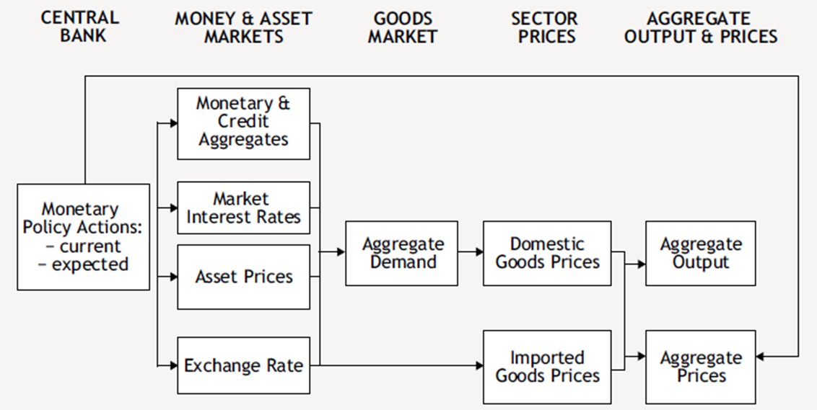
Transmission channels of MP
Transmission channels: the way monetary policy
decisions affect output and inflation

Slide 36
The interest rate channel
Traditional Keynesian channel:
Monetary expansion in the presence of nominal rigidities leads to a fall in the interest rate, hence to a revival of investment and durable-goods consumption and via multiplier affect to rise of aggregate demand (AD)
Uncertainty: CB can directly affect overnight nominal interest rate, while AD rather depends on expected real long-term interest rates.

Slide 37
The asset-price channel
Lower interest rate raises asset prices held by households, who in turn partially consume this extra wealth, which then stimulates AD.
E.g. Japan in the early 1990s, U.S. in 2001.
The importance of this channel has increased as a consequence of the general rise in the wealth-to-income ratio.

Slide 38
The credit channel
Lower policy rates stimulate commercial banks to relax credit constraints and hence to stimulate credit supply.
The banks’ financial health is crucial for the transmission of MP. When the banks’ balance sheets are burdened with nonperforming loans (loans with high probability of default) or with impaired assets (assets not traded any more or whose market value is much lower than they were purchased), banks are less willing to grant new loans => credit crunch (e.g. Japan at the end 90s and beginning of the 2000s).

Slide 39
The risk taking channel
Short-term interest rates play a key role in determining future bank profitability, the risk-taking capacity of financial intermediaries and real activity.
Relatively small changes in short-term interest rates can have a large impact on risk taking.
A cut in the short rate induces lowly capitalized banks i) to expand credit to riskier firms, ii) to end credit to riskier firms less often, iii) to more likely grant loans to applicants with a worse credit history, and iv) to grant them larger loans or loans with a longer maturity than highly capitalised firms.

Slide 40
The foreign-exchange channel
lower policy rates stimulate net exports through an exchange-rate depreciation (Mundell- Fleming)
important in small, open economies
  interests rates alone cannot be sufficient indicator of the stance of monetary policy
  monetary condition index (MCI)

Slide 41
ECB transmission mechanism

Slide 42
Monetary-policy rules
Rules useful to enhance credibility
Intermediate targeting (e.g. of monetary aggregates) out of fashion
  however ECB’s monetary pillar has proved useful to monitor credit growth
Inflation targeting (IT) has become increasingly popular in the 2000s:
  Target = CB inflation forecast, conditional on market expectation and policy rate
  IT requires transparency on models, procedures and forecasts
  Most central banks implement flexible inflation targeting, with some weight on the output gap

Slide 43
Inflation targeting in 2012

