Slide 1
Economic Policy #11
Labour Market Policy

Slide 2
Labour Market Policy
Labor market: definitions and indicators
Efficiency of labor market
Policies
  active labor market policies
  regulations of labor market
  labor taxation
  social policy incentives

Slide 3
Definitions
Total population P
Working age population (15-64): T
Labour Force A
Inactive I
less than a year
Employment: E
Unemployed U
more than a year
Self-employed
Employees
full time job (permanent or temporary)
part-time job (permanent or temporary)

Slide 4
Basic indicators
Participation rate: A/T
Employment rate: E/T
Unemployment rate: U/A
EU-27 (2016)
P = 510,3 mil.
T = 333,2 mil. (15<age<64)
A = 240,8 mil. A/T = 72,2 %
E = 219,9 mil. E/T = 66,0 %
U = 20,9 mil. U/A = 8,7 %

Slide 5
Participation rate (OECD, 2017)

Slide 6
Unemployment over time and across countries
Unemployment rates vary a lot across countries and over time

Slide 7
The impact of the crisis
Fig. Evolution of the unemployment rate, OECD, Q4 2007 – Q4 2017

Slide 8
Supply and demand constraints
Supply constraint (e.g. due to high real wage)
  classical unemployment
  => policies aimed at lowering labor costs
Demand constraint (e.g. due to drop in consumption)
  keynesian unemployment
=> stimulus policies
In the long run, supply and demand equalize
  equilibrium unemployment (≠ full employment)
  => labor market policies

Slide 9
Labor market policy (LMP)
LMP comprise policies that influence the interaction between supply and demand in order to enhance efficiency of job matching.
How to assess labor market efficiency?
  NAIRU rate
  Beveridge curve

Slide 10
The NAIRU
Lower u* => labor market policy, structural policy
Move u closer to u* => stabilization policy

Slide 11
The NAIRU in OECD countries

Slide 12
The Beveridge curve (BC)
Cyclical fluctuations move up and down the unemployment-vacancy combination along given BC.
Change in the efficiency of the labor market cause shift of the BC.

Slide 13
The Beveridge curve in EU
These shifts in the BC are suggestive of structural changes
in the labor market.

Slide 14
How to enhance efficiency of labor markets?
Active labor market policy (ALMP)
Regulations
  Minimal wages
  Regulations of dismissal
Taxation
Social policy incentives

Slide 15
Active labor market policy
ALMP is set of measures aiming to activate various groups of unemployment.
Types of ALMP:
  training
  subsidized employment
  public employment services
  activation
ALMPs may reduce mismatch in the labor market
But these policies may lead to opposite results through displacement effect, deadweight effect or substitution effect.

Slide 17
Minimum wages
Most countries in the world have some form of minimum wage, the scale, eligibility and operational details change from country to country.
A large body of theoretical and empirical research examines the effects of the minimum wage
  In theory: no clear-cut predictions (depends on competitiveness of labor markets
  Empirical results: also point in both direction – positive and negative effects of the minimum wage on employment

Slide 18
Ratio of minimum wages

Slide 19
Regulation of dismissal
Employment protection legislation (EPL): legal restrictions on dismissals and compensations to workers in case of early termination of employment contract
Severance regulations make it difficult for firms to reduce employment in the short run => firms are more reluctant to hire in good times
Empirical results:
  EPL negatively affects unemployment inflows and outflows
  coutries with stricter EPL dislay higher youth unemployment rates and lower unemployment among prime-aged groups

Slide 20
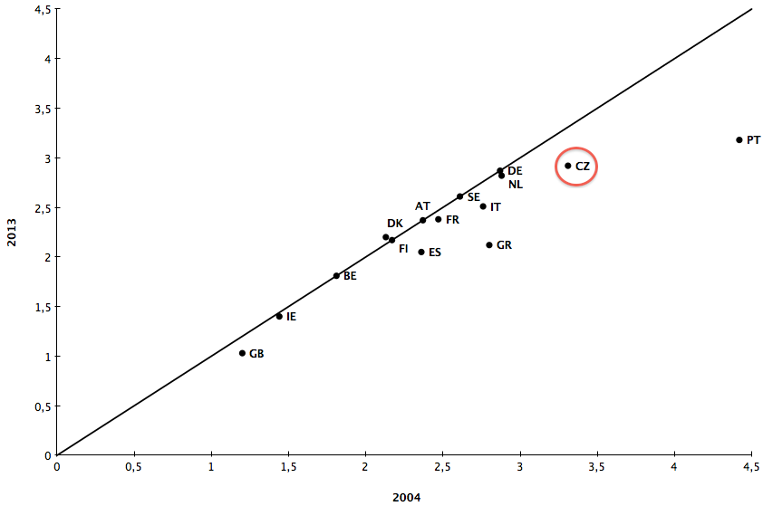
Change in EPL index (regular contracts)

Slide 21
Employment protection and duration of unemployment

Slide 22
Labor and product market regulation

Slide 23
Labor taxation
Labor is subject not only to income taxes paid by households but also to a number of social security contributions by both employees and employers.
Higher taxes raise the real cost of labor faced by firms, leading to lower employment in the sector that pays the tax.
Net effect depends on the elasticity of labor demand and supply.
  In Europe: wages are set in collective bargaining => flatter labor suply curve => stronger impact on employment

Slide 24
Total tax wedge on a single worker (OECD, 2014)

Slide 25
Social policy incentives
Taking up a job not only means receiving salary but also paying taxes (if the salary is high enough) and losing eligibility in income maintenance program => some people can by worse off by taking a job.
Safety net programmes may lead to a welfare trap, inducing people to remain unemployed or stay out of the labor force.
Experiences of ’work-to-welfare’ in UK and USA indicates importance of this incentive aspect.

Slide 27
Feasible supply-side policy: peanats or big payoffs?
The case of Netherlands:
During the 70s the Netherlands was the mother of the Dutch disease, unemployment almost reached 12 % in 1983. A generous social system was proving unsustainable at those rates of unemployment.
Wassenaar Accord in 1982: long-term agreement between social partners which moderated real wage growth, better treated part-time employment and lower labor taxation
Employment agencies provided more carrot-and-stick incentives for the unemployed to return to work.

Slide 28
Feasible supply-side policy: peanats or big payoffs?
The case of Ireland
Anaemic growth rates, high budget deficits and unemployment reaching 18 % in the late 1980s.
R. Dornbusch: “Ireland is a sick man of Europe“.
In the late 1980s: programme of fiscal consolidation was adopted, social partners agreed on stipulating modest increase in money wages, government reduced labor taxation
In the early 90s: ALMPs were implemented, products market deregulated.

Slide 29
Results

