Slide 1
Introduction to MS Dynamics NAV (Expected Costs)
Ing.J.Skorkovský,CSc.
MASARYK UNIVERSITY BRNO, Czech Republic
Faculty of economics and business administration
Department of corporate economy

Slide 2
Expected costs initial setup
Expected costs are the estimate that you make of the cost of, for example, purchasing an item before you actually receive the invoice for the item
You can post expected cost to both inventory and to G/L. Whenever you post a document, such as an order or a journal, as received or shipped, a value entry line will be created with the expected cost. This expected cost will affect inventory value, but it will not be posted to G/L unless you have set the program up to do that
Expected costs are posted to interim accounts in the general ledger. If you want to post expected cost, you must set up interim accounts for the relevant posting groups in the General Posting Setup table.
See setup later in this show

Slide 3
Počáteční nastavení očekávaných nákladů
Jde o odhad nákladů v případě nákupu a to před tím, než dojde skutečná faktura a za nakupované zboží.
Můžete dočasně zaúčtovat očekávané (odhadované) náklady a to jak na skladové účty tak na účet dodavatele v hlavní knize. Po zaúčtování se vytvoří i položka ocenění (u zboží nad položkou zboží) s očekávanou hodnotou
Tato očekávaná hodnota ovlivní hodnotu skladu , ale není zaúčtována do hlavní knihy pokud to programu nedovolíte. Viz nastavení
Očekávané náklady jsou účtovány na dočasný účet. Tento účet musí být v systému nastaven pro odpovídající účetní skupinu (viz tabulka )

Slide 4
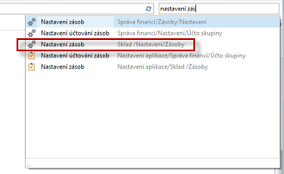
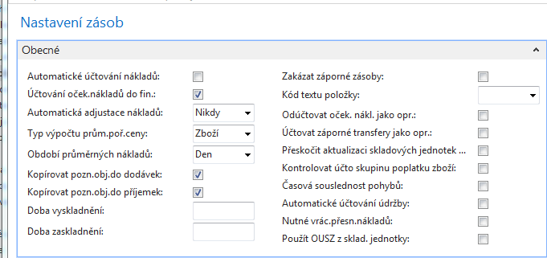
Expected costs initial setup I
If there is a check mark in the field, the program will post expected costs to interim accounts.

Slide 5
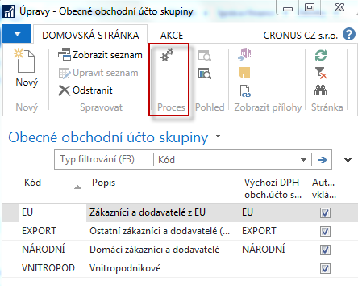
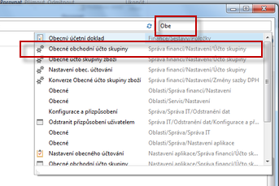
Expected costs initial setup II.

Slide 6
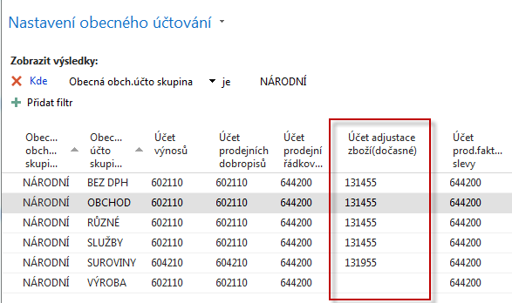
General Business Posting groups

Slide 7
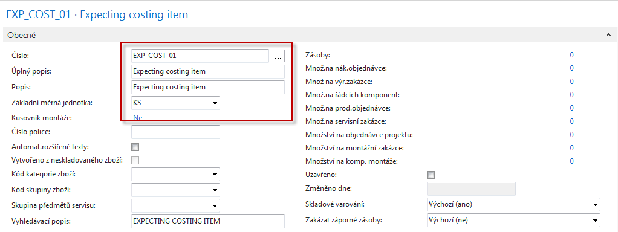
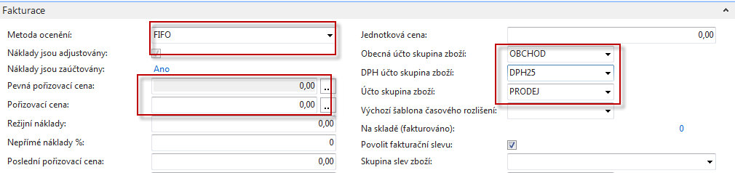
New item – have to be created for modelling

Slide 8
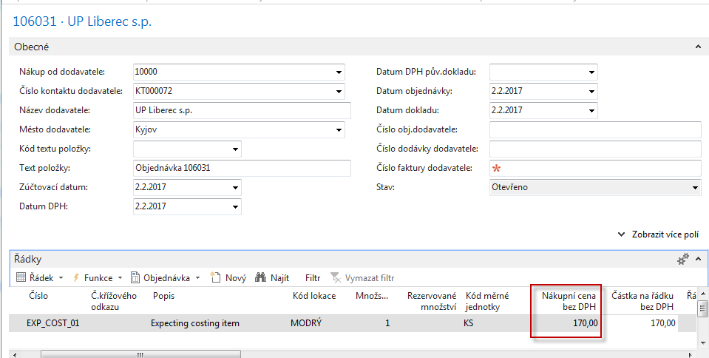
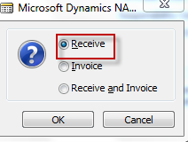
Purchase order (original cost=190)
Posting : Only shiping !!!
Expected cost
F9

Slide 9
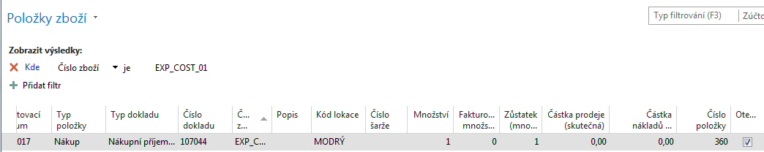
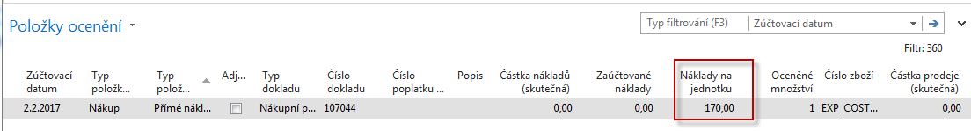
Item card-entries after posting
Ctrl-F7
Adjustment see next slide

Slide 10
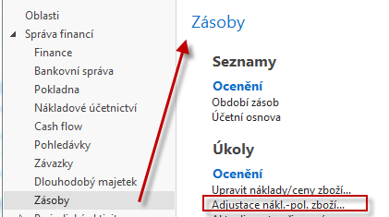
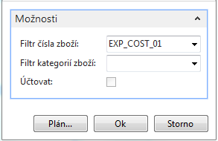
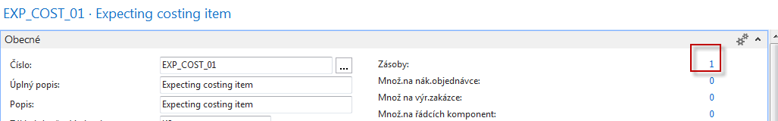
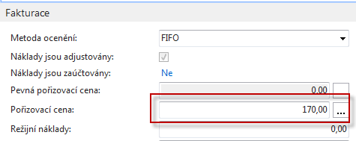
Adjustment
See next slide

Slide 11
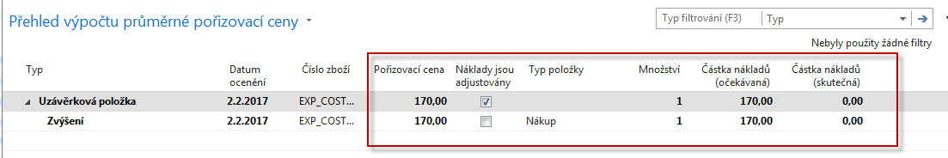
Adjustment – cost history

Slide 12
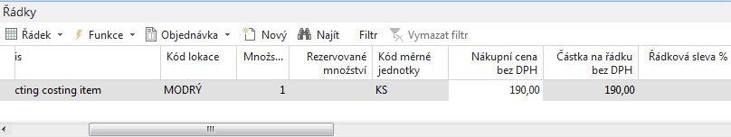
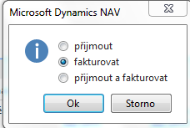
Post Purchase Order with original cost
Purchase order line (before it is necessary to reopen PO again !)
F9

Slide 13
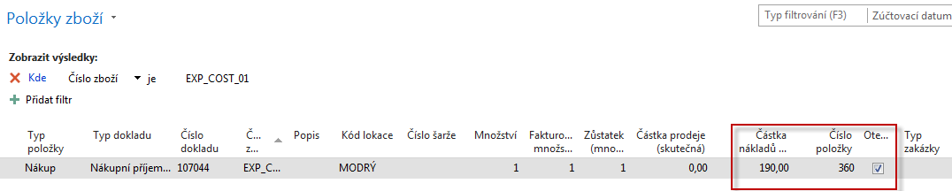
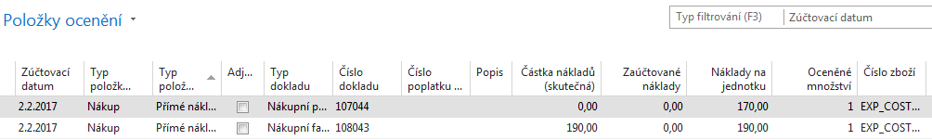
Item ledger entries and value entry

Slide 14
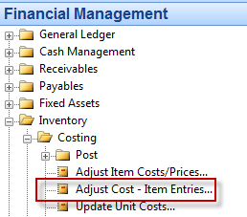
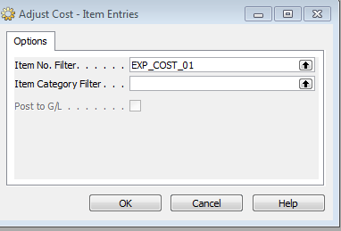
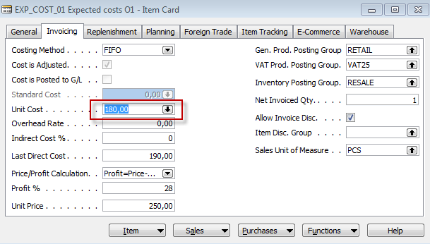
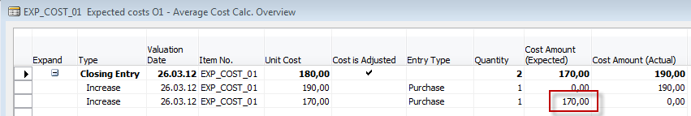
Adjustment
(190+170)/2=180

Slide 15
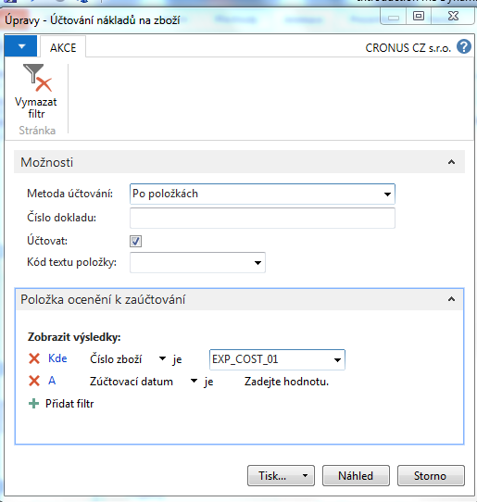
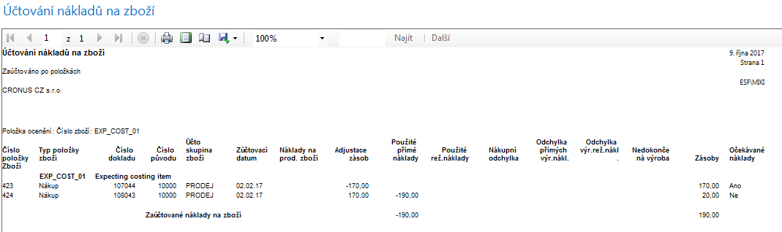
Posting to General Ledger

Slide 16
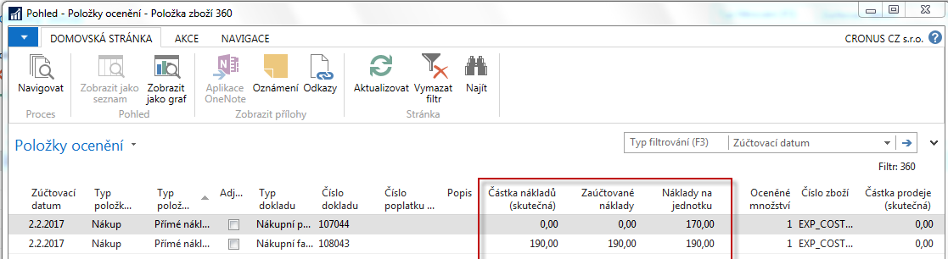
Value entry

Slide 17
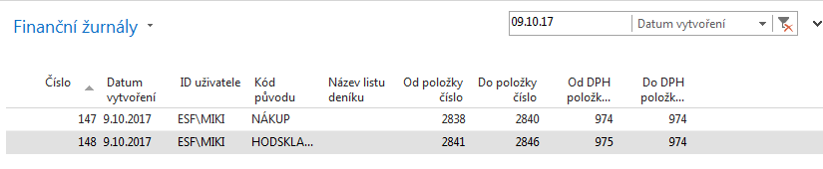
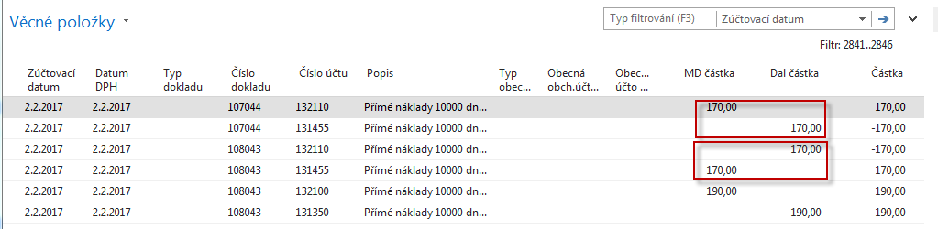
General Ledger Entries

Slide 18

End of the section
(Expected Costs)

