Slide 1
Introduction to MS Dynamics NAV (Item Charges)
Ing.J.Skorkovský,CSc.
MASARYK UNIVERSITY BRNO, Czech Republic
Faculty of economics and business administration
Department of corporate economy

Slide 2
Item Charges
It enables to post and apply additional costs of various types to :
  stored away items
  items which were already sold
  Item, which were used as a components (part of BOM) of produced products
TEXT from Microsoft material
Manage item charges. Include the value of additional cost
components such as freight or insurance into the unit cost or unit
price of an item.

Slide 3
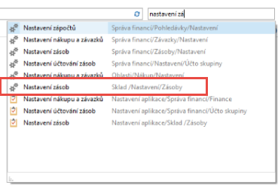
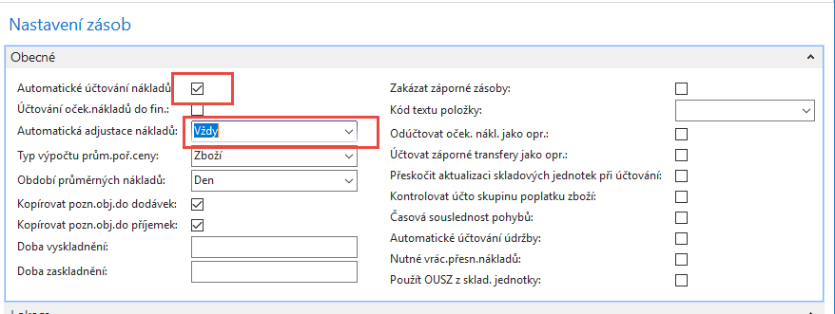
Inventory setup (Nastavení zásob)
Automatické účtování nákladů : zatržení v tomto poli znamená, že program bude používat funkci Automatického účtování spotřeby.
Používáte-li tuto funkci ve chvíli, kdy účtujete zboží na účet zboží, bude program automaticky účtovat na skladový účet, na účet adjustace a na účet spotřeby zboží (NNPZ) ve finančním deníku.
I v případě použití této funkce však bude třeba pravidelně spouštět dávkové úlohy Adjustace nákl.-položky zboží (nebo použít funkci Automatická adjustace nákladů) – což zde je nastaveno na Vždy - a Účtování nákladů na zboží. Používáte-li pouze funkci Automatické účtování nákladů, nebude v případech, kdy neznáte cenu zboží v okamžiku jeho prodeje, váš skladový účet přesný. Jedná se například o případ, kdy prodáváte ještě před nákupem.

Slide 4
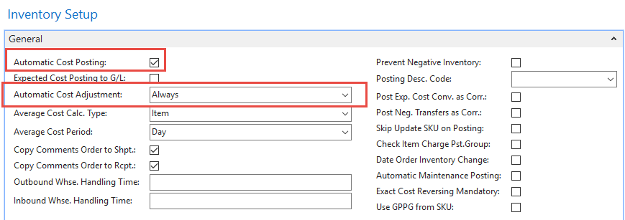
Inventory setup (Nastavení zásob)
Automatic Cost Posting : Specifies that the Automatic Cost Posting function is used.
If you use this function when posting items to an item account, the program will automatically post to the inventory account, adjustment account and COGS account in the general ledger.
If you use this function, however, it is still necessary to run the Adjust Cost - Item Entries (or use Automatic Cost Adjustment) – we do have it - and Post Inventory Cost to G/L batch jobs periodically. If you only use Automatic Cost Posting, your inventory account will not be accurate in cases where you do not know the cost of items at the time of sale. For example, if you sometimes sell before buying.

Slide 5
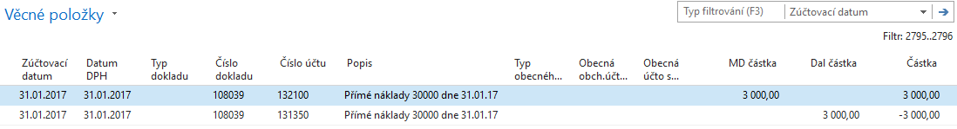
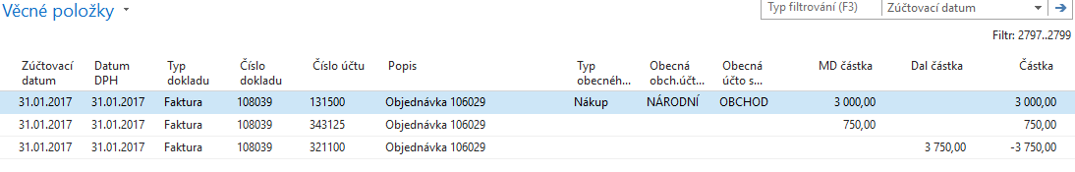
Automatic Cost Posting
(Automatické účtování nákladů -další informace k pochopení adjustace)
Purchase of an item (Purchase cost = 3000 )
The cost adjustment forwards any cost changes from inbound entries, such as those for purchases or production output, to the related outbound entries, such as sales or transfers

Slide 6
Item Card used in this model
Find in demo-database Item card with no one
entry !!
Found card must have ZERO in all calculated field such as :
  Inventory
  Quantity on Purchase Order
  Quantity on Sales Order
  Quantity on component lines
You have to erase exiting costs and unit price on Tab Invoicing

Slide 7
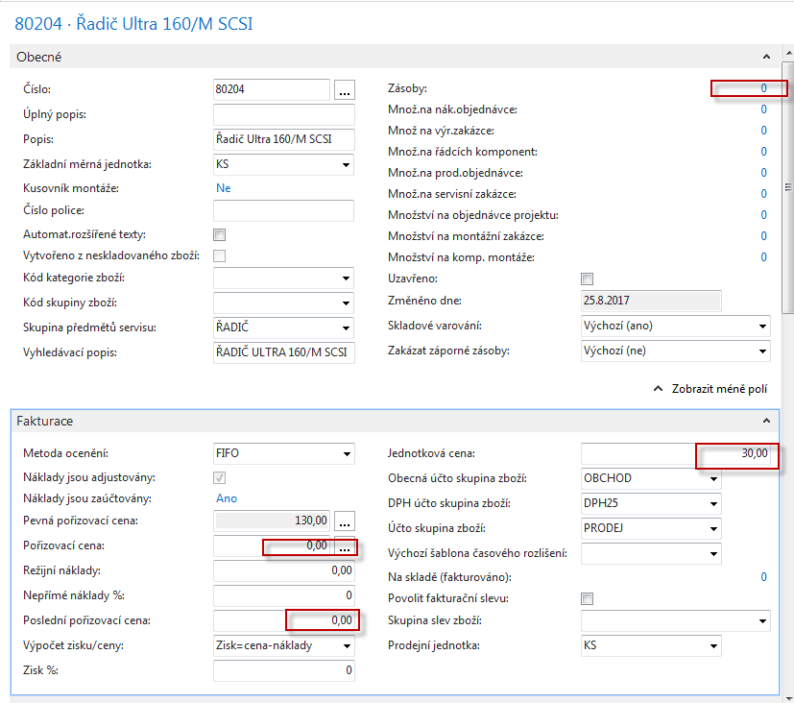
Item Card used in this model
NEXT Step will be Purchase Order creation->10 Pcs of
above specified item. Purchase price of one item will be 10,0 !!

Slide 8
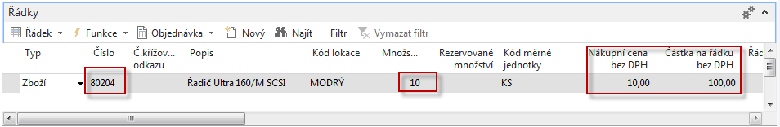
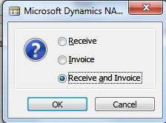
Purchase Order line
Purchase Order creation
And NEXT step is Purchase Order Posting by use of F9 !!!
See next slide

Slide 9
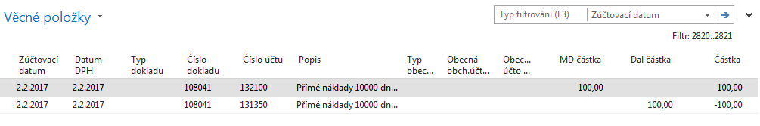
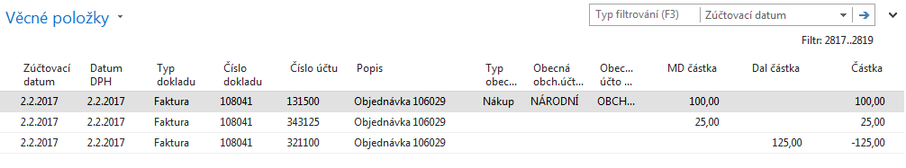
General Ledger Entries
AND
Setup of adjustment account : a possibility having only one
adjustment account (131350 or 131500)

Slide 10
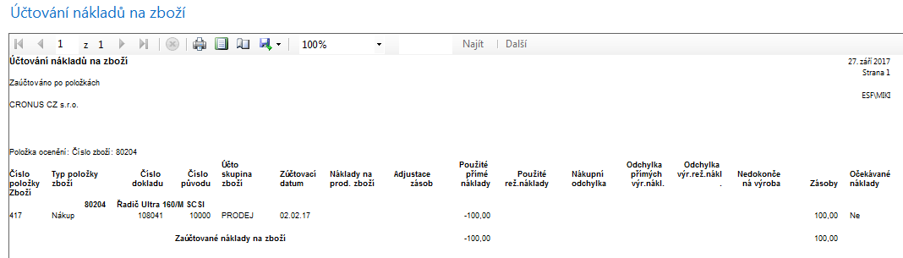
Value entries (will be explained)
After manual adjustment and posted cost to G/L

Slide 11
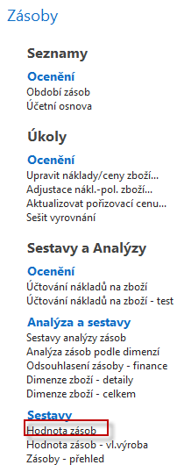
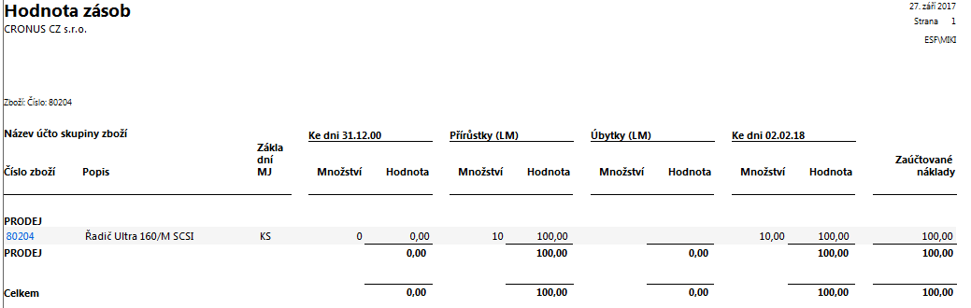
Inventory value (for Item 80204)

Slide 12
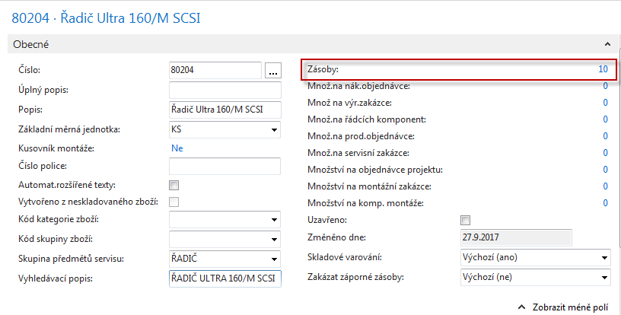
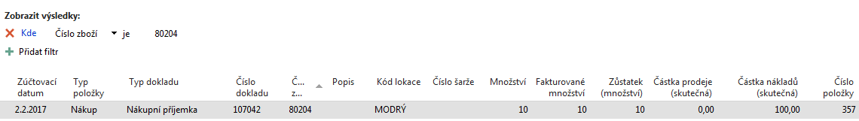
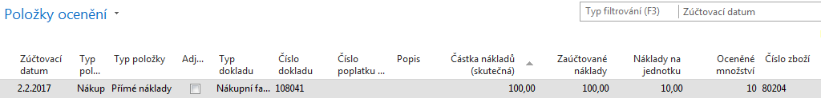
Item and Value Ledger Entries after PO was posted
Ctrl-F7
Ctrl-F7

Slide 13
Value Entry explanantion
This window shows all amounts relating to an item
Every time you post an order, invoice or credit memo as invoiced, revalue an item or do anything else that means a change in value for items in your inventory, the program creates one or more value entries.
Changes in quantity on inventory are stored as quantity postings in the Item Ledger Entry table.
When the inventory is reconciled with the general ledger, G/L entries are created on the basis of Value entries. The amount to be posted to general ledger is calculated from the value entry as:
Cost Amount (Actual)- Cost Posted to G/L.

Slide 14
Item card after Purchase Order was posted

Slide 15
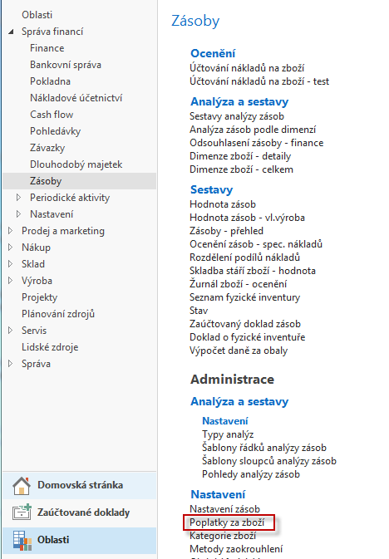
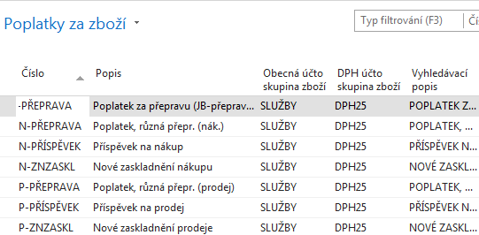
Charge Items parameters (CZ data in database were used)

Slide 16
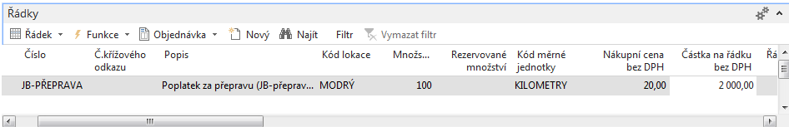
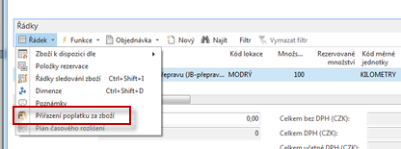
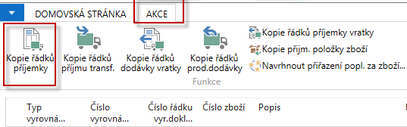
Purchase Order lines – (transport costs, Vendor 1000)
Item Charge Assignment

Slide 17
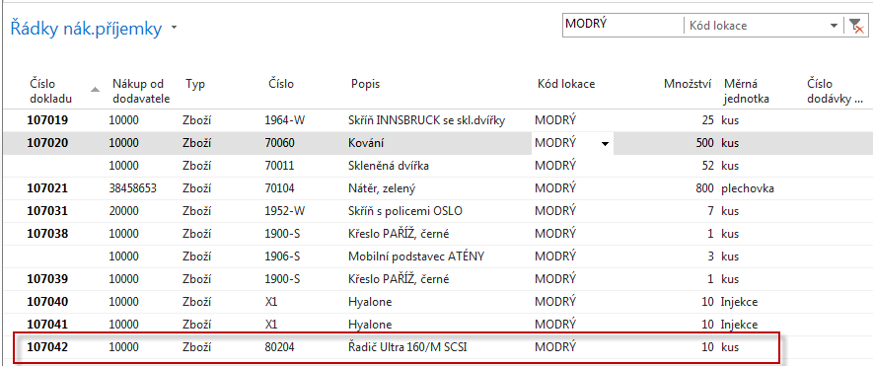
Item Charge Assignment

Slide 18
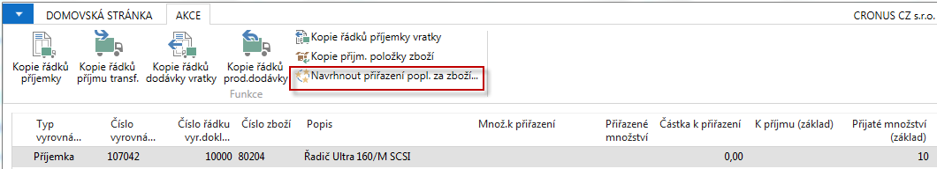
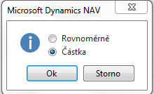
Item Charge Assignment
F9

Slide 19
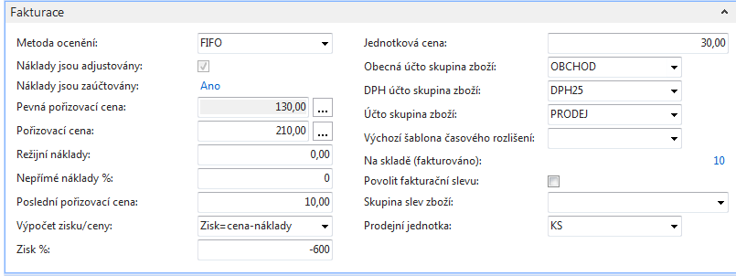
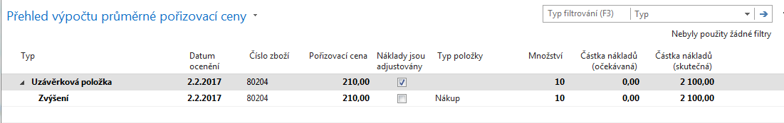
Item Card after PO for transport was posted
(Item Card-Tab Invoicing)

Slide 20
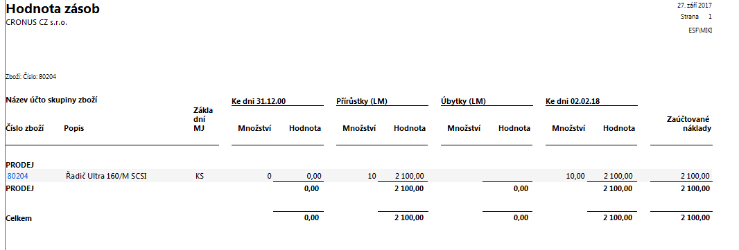
Inventory Valuation

Slide 21
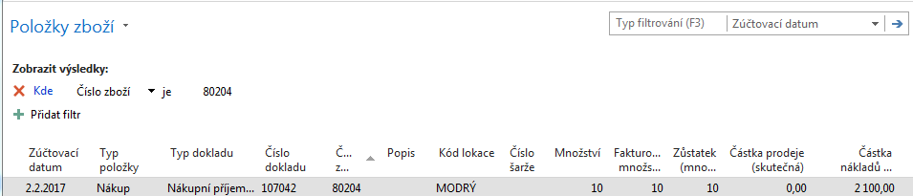

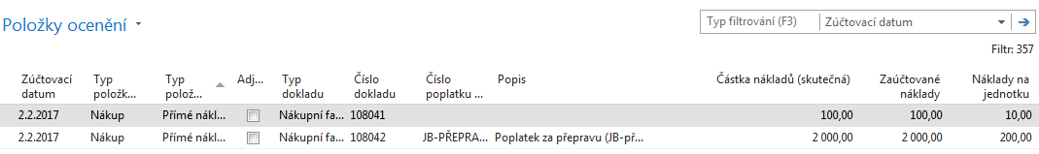
Item Ledger Entries and Value Entries
Item Ledger Entry
Value Entry

Slide 22
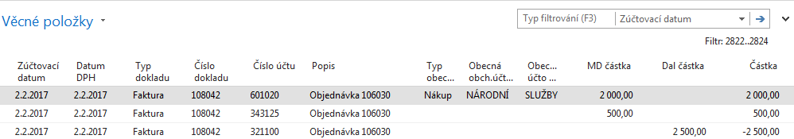
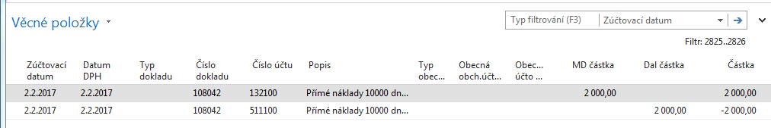
G/L Entries

Slide 23

End of the section
(Item charges)

