Slide 1
The Lehman Brothers Case
Natalia BUDA
Thibaut MARCELIN

Slide 2
The Cotton Kings
→ 1844 - Henry Lehman, an immigrant from Germany opened a small dry good store in Alabama.
→ 1850 - Henry is joined by brothers Emanuel and Mayer - they named the business Lehman Brothers.
→ Brothers became cotton merchants.
→ 1858 - they opened the office near to Wall Street financial district.
→ 1861 - Brothers closed their office.
→ 1861-1865 - American Civil War.
→ 1865 - Brothers established the New York Cotton Exchange.
→ 1887 → Lehman Brothers became members of the New York Stock Exchange

Slide 3
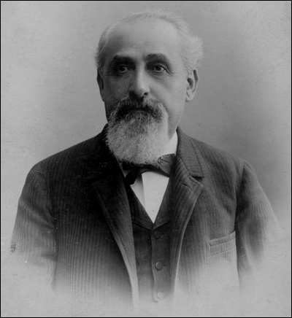
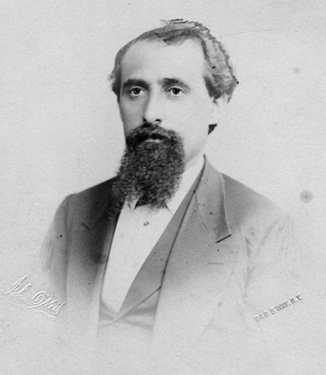
Emanuel Lehman joined his brothers Henry and Mayer as a clerk, and their little store was renamed Lehman Brothers. He arrived in America in 1847.
In 1850, Mayer Lehman joined his brother Henry in Montgomery, Alabama, to become a partner in Lehman Brothers.

Slide 4
The Second Generation
→ Focused on the investment banking industry.
→ 1929 - The Lehman Corporation is created - a closed-end investment company.
→ Lehman Brothers became major players in financial derivative markets that emerged in the final decade of the twentieth century.
→ Mid-1990 - new genre of exotic financial derivatives became increasingly more prevalent; these new derivatives collateralized debt obligations, credit default swaps, and interest rate swaps, among many others.

Slide 5
Playing with fire…
The Lehman Brothers Company was a major player in the financial derivatives market.
A derivative is a security with a price that is dependent upon or derived from one or more underlying assets. The derivative itself is a contract between two or more parties based upon the asset or assets. Its value is determined by fluctuations in the underlying asset. The most common underlying assets include stocks, bonds, commodities, currencies, interest rates and market indexes. Ref: http://www.investopedia.com/terms/d/derivative.asp
Lehman Brothers was “particularly active in the market for RMBS”
A mortgage-backed security (MBS) is a type of asset-backed security that is secured by a mortgage or collection of mortgages Ref: http://www.investopedia.com/terms/m/mbs.asp
Behaviour : Transfer the risks

Slide 6
Playing with fire...
→ By 2005 LB produced more RMBS annually than any other entity.
→ Housing prices peaked in the US in 2006, but by late 2007 had begun to tumble, declining in many residential markets by 20% or more by mid-2008. In some of the residential markets that had seen the sharpest increases over the previous years, such Las Vegas and south Florida, housing prices plunged by 50%.
→ By 2008 early 9 million Americans had a negative equity in their homes, which caused a rapid rise in mortgage defaults and foreclosures.
→ At the end of 2007, LB owned nearly 90 billion of toxic assets. By comparison, LB’s total stockholders equity at that time was only 22.5 billion.

Slide 7
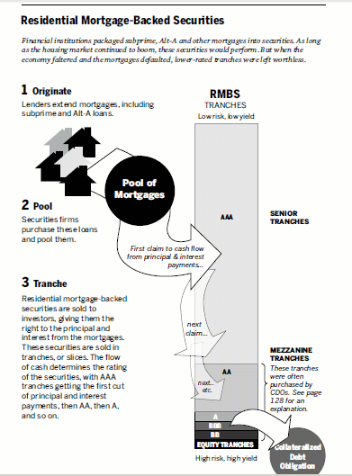
→ Securisation process involved purchasing residential mortgages from banks, mortgage companies, and other entities that originated them, bundling or “pooling” these mortgages together and then selling ownership interests (securities) in these pools. The purchasers of the RMBS were actually purchasing a claim on the cash flows generated by the mortgages that “backed” those securities.
→ Subprime is a classification for borrowers with a tarnished or limited credit history. Subprime loans carry more credit risk, and as such, will carry higher interest rates as well.

Slide 8
And yet, LB was apparently having strong results…
Auditing Cases, International Edition, 9th Edition.
Extract from the course of Oleksandra Lemeshko : Auditing MPF_AAUD

Slide 9
PROBLEM :
SOLUTION
The firm was « overleveraged »
MEANING : Overleveraged is when a business is carrying too much debt, and is unable to pay interest payments from loans. Overleveraged companies are unable to pay their expenses because of over excessive costs. Ref: http://www.investopedia.com/terms/o/overleveraged.asp#ixzz4uwLFvgnu
« Deleveraging strategy »
HOW ? Accounting-motivated transactions
NAME : Repo 105

Slide 10
Repo Central :
SFAS No.140
Unusual conditions are met
Financing transactions
Sales of securities

Slide 11
Auditors on the firing line
http://thetravellingsquid.com/2014/02/23/seven-great-reasons-to-travel-with-an-auditor/ernst-and-young-building/

Slide 12
→ E&Y were has been Lehman’s independent audit firm from 1994 to 2008, with the final audit before the bankruptcy filing being for fiscal 2007.
→ Bankruptcy examiner pointed out the audit firm as a guilty of professional malpractice which caused the losses to stakeholders

Slide 13
“Window-dressing” is the accounting technique used to temporarily enhance the appearance of a company’s balance sheet for creditors and investors without permanently changing the true amount of asset and liability balances. It’s not always illegal or fraudulent.

Slide 14
Main charges against E&Y
“Failure to conduct adequate inquiry” into the whistleblower’s allegations and “failing to properly inform management and the audit comittee”
Failure to “take proper action” to investigate whether Lehman’s financial statements for the first two quarters of 2008 were materially misleading due to the company’s failure to disclose its Repo 105 transactions.
Extracts from the bankruptcy report

Slide 15
“If auditors issue opinions that are unreliable or provide cover for their clients by helping to hide material information, that harms the investing public, our economy, and our country,”
Eric Schneiderman, New York attorney-general

Slide 16
Q1
When Lehman was developing its Repo 105 accounting policy, did E&Y have a responsibility to be involved in that process?
What role should an audit firm have when a client develops an important new accounting policy?

Slide 17
A1
E&Y was not directly involved in the process but auditors were aware about the Repo 105. They didn’t formally approve it, but they didn’t formally reject it.
=> Professional responsibility
PCAOB AU Section 110.02 : “The auditor has a responsibility to plan and perform the audit to obtain reasonable assurance about whether the FS are free of material misstatements, whether caused by error or fraud”
Important role on the confidence in the economy. They don’t work only for one company, and it is not the purpose of the profession to let their clients wheel and deal with the gap of the law.
Part of ethic

Slide 18
Q2, Q3
Do you agree with the assertion that “intent doesn’t matter” when applying accounting rules? That is, should reporting entities be allowed to apply accounting rules or approved exceptions to accounting rules for the express purpose of intentionally embellishing their financial statements or related financial data?
Do auditors have a responsibility to determine whether the transactions of a client are “accounting-motivated”?

Slide 19
A2, A3
→ Audit risk - Materiality
If window dressing in fact has a material effect on the firm financial health, it should be disclosed in the financial statements. Failure to disclose the effect of the window dressing is then a violation of the accounting framework. Failure to disclose was in fact misleading the investors to believe that Lehman financial health was good when it was not.
→ Understanding (of the entity and its environment)
Ernst and Young needed to identify and focus on areas that posed the highest risk. The Repo “105” transactions posed significant risks since recognition of these transactions had direct impact on Lehman leverage ratio.
→ ISA 315
An external auditors are obligated to evaluate business entities and provide a reasonable assurance that the financial statements are a true reflection of the entities’ financial health and that the statements are compliant with the appropriate financial reporting framework i.e. US (GAAP)/IFRS

Slide 20
Q4
Do you believe that Schlich or one of his subordinates should have reviewed that letter? Why or why not? In general, how should the responsibility for different facets of a multinational audit be allocated between or among the individual practice offices involved in the engagement?

Slide 21
A4
Schlich or one of his subordinates should have reviewed the letter from the British law firm, as no law firm in the United States would review Lehman’s Repo 105 accounting policy, which should have caused concern for E&Y that something with the Repo 105 policy would be subject to legal issues. Any time a company transfers assets to one of its international divisions, the independent audit firm should review both sides of the asset transfer, and maybe even use it own international divisions who are more familiar with the foreign regulations to input various opinions.
The auditing standard AU 336 provides guidelines on when to rely on the work of an expert. In addition, the auditor is required to exercise professional skepticism and judgment when deciding to what extent he or she will rely on the work of an expert.

Slide 22
Q5
What responsibility, if any, do auditors have to assess the material accuracy of financial data included in those two sections of a client’s annual report?
At this era, the NLR didn’t have to be included in the company's audited financial statement and it was not a “GAAP financial measure subject to being audit” (extract from the case).
But : Auditors have to identify the risks that are pervasive (= potential impact on a large number of items in the FS). Have to identify the risks that could result in a material misstatement of the financial statement.
Here : huge materiality

Slide 23
A5
At this era, the NLR didn’t have to be included in the company's audited financial statement and it was not a “GAAP financial measure subject to being audit” (extract from the case).
But : Auditors have to identify the risks that are pervasive (= potential impact on a large number of items in the FS). Have to identify the risks that could result in a material misstatement of the financial statement.
Here : huge materiality

Slide 24
Summary - E&Y did not suffer the consequences
Auditors are not responsible of detecting fraud or unintentional material misstatements as they accept audit risk of incorrect acceptance/ rejection through materiality and sampling methodology. What they provide is simply reasonable (not absolute) assurance. The most telling assertion in the complaint concerning E&Y's supposed misrepresentation of Lehman's compliance with applicable accounting standards is that E&Y didn't require the financial statements to reflect economic substance rather than just legal form.

