Slide 1
Why companies should not do csr
Aung Myo thet
Dušan Gabrijelčič
Notes:
Good Morning everyone, today my colleague Dusan and I will discuss about “ Why Companies should not do CSR”

Slide 2
What is Argued
Doing CSR does not meet Shareholders expectation of Profit return.
Companies Reputation in danger.
It increases Costs.
Competitive Advantage and Disadvantages.
Notes:
And We have argued following subtopics

Slide 3
Not meeting Shareholders Expectations
Why do businesses Exist?
“a corporation’s responsibility is to make as much money for the stockholders as possible.”
“Milton Friedman”
Notes:
First of all, let’s see why doing csr does not meet shareholders expectation of profit.
Why do we do business and why do we establish companies?,
Milton Friedman quote
The focus of profit making shifts
The company ignores obligations towards shareholders
Instead of profit, they engage in csr
instead of a smooth, it affects an outflow

Slide 4
Companies Reputation in danger
Disclose shortcomings of own products
Customers lose trust
Decrease in sales
Market Share lost
Even Penalties
Notes:
According to CSR policies, companies have to disclose shortcomings, causes damage to their reputation.
This creates inconvenience to the customers, and they lose trust in the manufacturer and may never buy this product again.
TOYOTA, which had to recall 9 million cars from the market in 2010 because those cars had some minor problems and they seem to be caring so much about Corporate social responsibilities.
The company revealed that the recall could cost up to 180 billion yen which is equivalent of 2 billion US, with 100 billion yen for repairs and 80 billion yen in lost sales. It said the recalls reduced global demand for Toyota by 100,000 vehicles.
The problems didn’t end there, their percentage of market share also decreased with a significant figure.
Volkswagen had even bigger problem, in 2015 they recalled nearly 500,000 vehicles from US market that cost them about 7 billion USD.
In addition to these costs, they had to pay $15.3 billion to US government which is the largest auto-related consumer class-action lawsuit in the United States history, consequently sales have significantly dropped within days after the incident.
Organizations should instead consider factors that will affect the community before doing their businesses instead of compensating after they have affected.

Slide 5
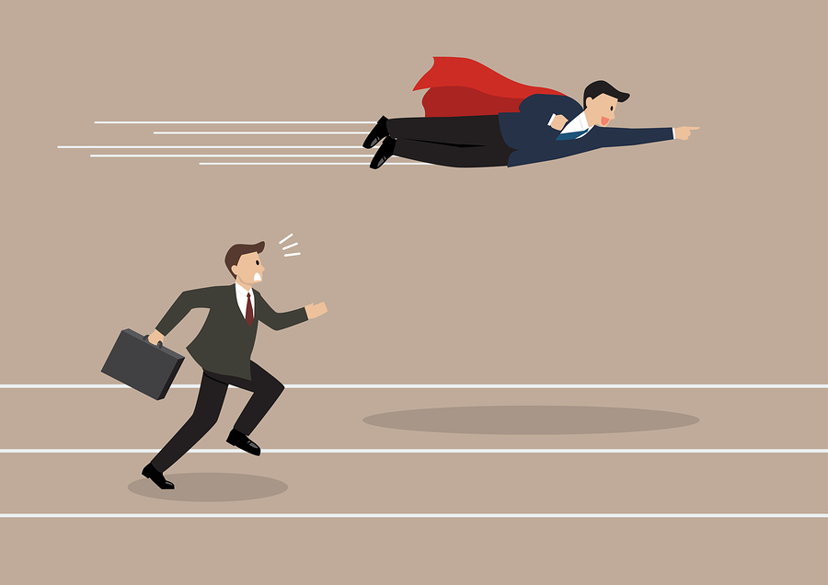
Competitive advantage and Disadvantage
Unfair competition
Higher Expenses = Higher Prices
Higher Price = Less competitive
Notes:
As mentioned earlier, big companies can allocate budget for CSR activities, but smaller companies may not be able to do this. This may result in unfairness in the competition giving the bigger companies competitive advantage.
Small business will not be able to compete against bigger competitors who are using CSR as a marketing weapon.
If society forces business to undertake social responsible activities, it will result in higher prices.
Corporations would need to absorb the cost of such things a dirty air and unsafe products that were previously passed on to society.
By absorbing these costs, they would increase their prices and therefore be less competitive.

Slide 6
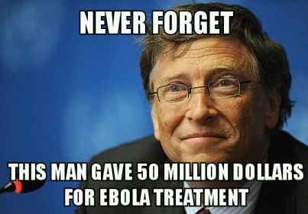
Real man don‘t do CSR
-Bill Gates of Microsoft
-Jack Welch of GE

Slide 7
It's not the responsibility of the companies to deal with all this stuff
It‘s the responsibility of the polititians to deal with all this stuff
Milton Friedman claimed that free markets, rather than companies, should decide what is best for the world
Adam Smith’s “invisible hand” will do all the work
companies are meant to create products or provide services
Companies do not have the expertise to do CSR
The increased cost will be passed on to the consumer
Hard to measure

Slide 8
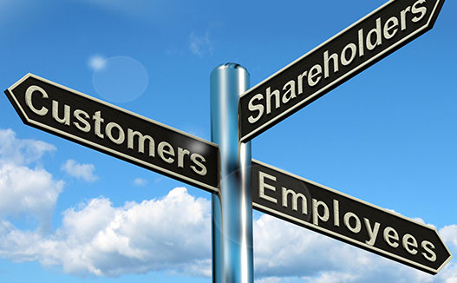
Problems with Stakeholder theory
Responsibility to shareholders
Social problems are more complex than stakeholder theorist’s claim
Overregulation
disagreement among shareholders

Slide 9
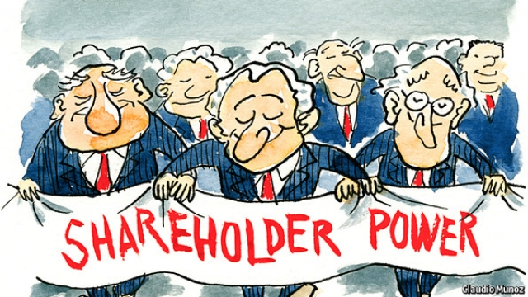
Shareholder theory
maximize long-term shareholder wealth
Shareholders do not hire CEOs to act like a charity
Steve Milloy, Adam Smith and Milton Friedman (the business of business is to make money)
CSR promotes incompetence
for every five CSR actions a firm
takes, you can expect it to commit
one-act of CSiR

Slide 11
References
corporate social responsibility, Friedman’s view. https://bfi.uchicago.edu/news/feature-story/corporate-social-responsibilty-friedmans-view
TOYOTA recall expects to cost $2 billion. https://www.forbes.com/2010/02/04/toyota-earnings-recall-markets-equities-prius.html#204baf435668
Is The Toyota Brand in a Free Fall? http://businesstheory.com/oh-what-a-feeling-is-the-toyota-brand-in-a-free-fall/
Michael Lewis (2016-06-28). "Volkswagen agrees to landmark $15.3-billion emissions settlement in U.S". Thestar.com. Retrieved 2017-07-24.
Mallen Baker‘s blog (23.8.2008) Arguments against CSR http://mallenbaker.net/article/clear-reflection/arguments-against-corporate-social-responsibility-and-some-responses
Sumaiyya Saleem, Amit Kumar & Adeeba Shahid. Arguments against CSR http://www.imperialjournals.com/index.php/IJIR/article/view/1524/1466
Zachary Cheers (2011) The CSR debate
http://digitalcommons.liberty.edu/cgi/viewcontent.cgi?article=1229&context=honors

