Slide 1
Operational
Management
Paper
Lilia Tugulea
UCO: 440131

Slide 2
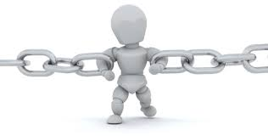
TOC
Some facts:
Five Focusing Steps:
– Identify
– Exploit
– Subordinate
– Elevate
– Repeat
Every system has
a constraint!
Key questions:
– What to change?
– What to change to?
– How to cause the change?

Slide 3
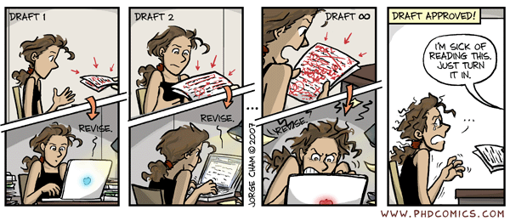
The Project
Goal: Qualitative written thesis within the deadline

Slide 4
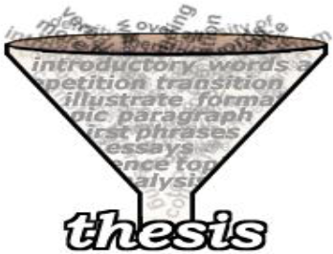
The Project
Goal: Qualitative written thesis
within the deadline
Main Steps:
Identify thesis outline
Gathering information and writing the theoretical part
Gathering data and writing the practical part
Writing conclusion & introduction
Preparing bibliography
Preparing list of supplements
Formatting and revision

Slide 5
Project & TOC
Identify
– writing process
Exploit & Subordinate
– resource availability& efficient use
Elevate
– work hard, no procrastination
Repeat

Slide 6
Project Risks
What is?
Uncertain event that, if it occurs, has a positive or a negative effect on at least one project objective
How to manage:
Risk Management Planning
Risk Identification
Qualitative Risk Analysis
Quantitative Risk Analysis
Risk Response Planning
Risk Monitoring & Control

Slide 7
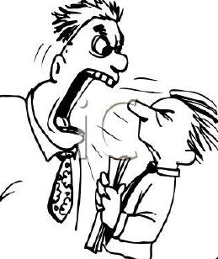
Project Risks
Aware of:
– Timeline following
– Relevant literature
– Supervisor challenge
– Multitasking
– Fear and panic
– Procrastination

Slide 8
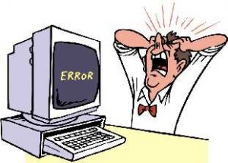
Project Risks
Predictable:
– Find a job
– Computer errors
– Holliday and vacation
Unpredictable risks:
– Illness of any kind
– Family problems

Slide 9
Time Buffers
What is?
Extra time added into a time estimate to keep a project on track
Types:
Project Buffer – whole project
Feeding Buffers – for each task that feeds into the critical chain
Resource Buffers – assigned to ensure that the necessary resources will be available

Slide 10
Time Buffers
Important:
Uncertainty exists – additional time
Do not abuse
– too many : poor planning
– no value added
– Parkinson’s Law
Project buffer – 50% of total length

Slide 11
Thinking Process Tools: CRT
What is CRT?
Used to fully describe an existing situation
Purpose: understand how the problems are related to each other
Cause and effect relationship
"if..., then..." or "if...and if...and if..., then..."

Slide 12
Thinking Process Tools: CRT
Undesirable effects
lack of necessary literature
reading too much, no writing
difficulties starting the process
supervisor issue
ignore the Gantt chart (Parkinson syndrome)
lack of time
not focused
student syndrome
bad multitasking, confusing priorities
fear and panic
computer failure

Slide 13
Thinking Process Tools: CRT
No necessary literature
Bad Priorities
Not focused
Too much reading
Lazy
Procrastinate
Travel
Ignore deadlines
No writing
Chaos
Fear and Panic
Not starting
Low quality & not in time

Slide 14
Pareto Analysis
UDE | Importance | Cumulative Count | % | Cumulative %
Time management | 60 | 60 | 18.18 | 18.18
Bad multitasking | 42 | 102 | 12.73 | 30.91
Follow/Ignore the Gantt chart | 40 | 142 | 12.12 | 43.03
Bad priorities | 38 | 180 | 11.52 | 54.55
Laziness and procrastination | 38 | 218 | 11.52 | 66.06
No writing | 36 | 254 | 10.91 | 76.97
Student syndrome | 34 | 288 | 10.30 | 87.27
Too much reading | 27 | 315 | 8.18 | 95.45
Computer Failure | 15 | 330 | 4.55 | 100.00

Slide 15
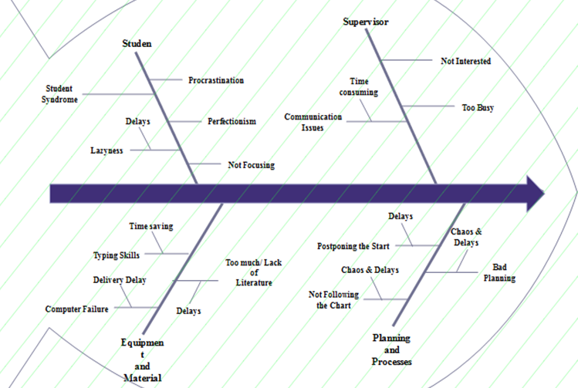
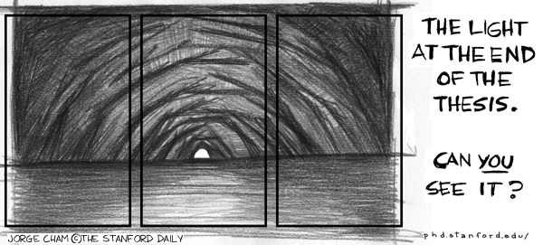
Fishbone diagram

Slide 16
Conclusion

Slide 17
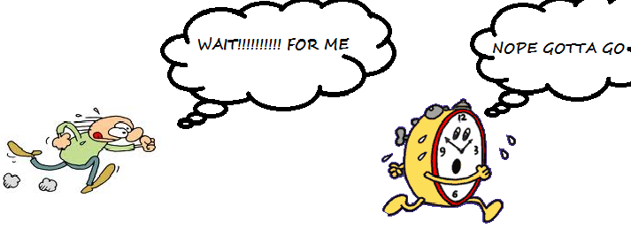
Suggestions
Time management

Slide 18
Suggestions
Self improvement

Slide 19
Suggestions
Reward system
Level of satisfaction
Rewards

Slide 20
Conclusion
Benefits:
Delivery in time of a qualitative thesis
Process : less stressful & smoother
Workload equally distributed

Slide 21
Thank you!

