Slide 1
Decision trees(basics)
Ing.J.Skorkovský, CSc,
Department of Corporate Economy
FACULTY OF ECONOMICS AND ADMINISTRATION
Masaryk University Brno
Czech Republic

Slide 2
Description
Diagramming technique which uses :
Decision points – points in time when decisions are made, squares called nodes
Decision alternatives – branches of the tree off the decision nodes
Chance events – events that could affect a decision, branches or arrows leaving circular chance nodes
Outcomes – each possible alternative listed

Slide 3
DT diagrams
Decision trees developed by
Drawing from left to right
Use squares to indicate decision points
Use circles to indicate chance events
Write the probability of each chance by the chance (sum of associated chances = 100%)
Write each alternative outcome in the right margin
1

Slide 4
DT-Example I
A restaurant owner has determined that he needs to expand his facility. He has two alternatives. One is one large expand now and risk smaller demand later or the second alternative is expand on a smaller scale now knowing, that he might need to expand again in three years. Which alternative would be most attractive?
High demand (0,70)
Expand
200 000
2
200000
Do not expand
150 000
Expand small
164000
Low demand (0,30)
80 000
1
[0,3..0,7]
Probability of occurance
High demand (0,70)
300 000
Expand large
225000
200000
Low demand (0,30)
Expected value
analysis
164000
225000
[50 000 , 80 000 …]
Chance event outcomes

Slide 5
DT-Example I
Decision tree analysis utilizes Expected Value Analysis (EVA), which is a weighted average of the chance events :
Probability of occurrence * chance event outcome
High demand (0,70)
Expand
200 000
2
200000
Do not expand
150 000
Expand small
164000
Low demand (0,30)
80 000
At
2
we do have
200 000 >150 000
So EXPAND !!!
1
High demand (0,70)
300 000
Expand large
Calculated (Expected value) is : EVA small =0,3*80 000+0,7*200 000=164 000
Calculated (Expected value) is : EVA large =0,3*50 000+0,7*300 000=225 000
At decision point 1 we have got clear result
Choose Expand Large !
despite the fact , that there is 30 % chance , that
this might be worst decision !
225000
Low demand (0,30)
50 000

Slide 6
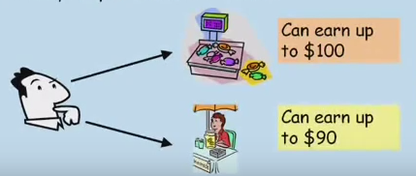
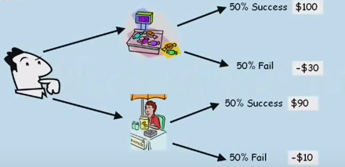
DT-Example II
Project to sell candies or lemonade. At the first sight it is clear : Candy !!
0,5*100+ 0,5*(-30)=35 USD
0,5*90+ 0,5*(-10)=40 USD
Resource: MBABullshit.com

Slide 7
DT-Example II
So now it would be better to choose lemonade business ! So we have chosen bigger EVA. But..
0,5*100+ 0,5*(-30)=35
0,5*90+ 0,5*(-10) = 40
Decision based on EVA? Does this mean, that
If you do Lemonade project, you will earn 40? NO !
If you did the IDENTICAL Lemonade project
very many times (in exactly the same situation), then your
average earnings will be probably 40 per time.
This means that you will not get 40 US each time !!
Because EVA(x) =∑ p(xi)xi for=1 to n,
Where Xi = outcome i and p(xi) is a probability
of outcome i
Resource: MBABullshit.com

Slide 8
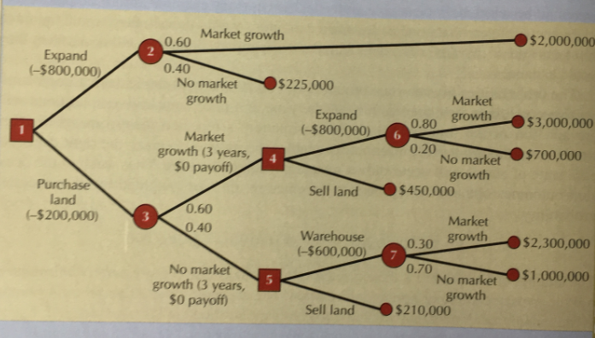
DT-Example III
Resource: Russel and Taylor Operation management pages 66-67

Slide 9
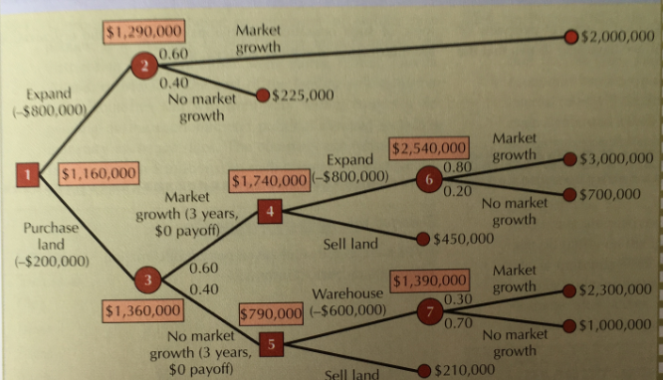
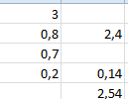
DT-Example III

Slide 10
 | Decision tree calculation
 | Outcome | Probability | EVA | Expand
 | 3 000 000,00 | 0,80
 | 700 000,00 | 0,20 | 2 540 000,00
 | 2 540 000,00 |  | 1 740 000,00 | -800 000,00
 | 1 740 000,00 | 0,60
 | 790 000,00 | 0,40 | 1 360 000,00
 | 1 360 000,00 |  | 1 160 000,00 | -200 000,00
 | 1 290 000,00 |  | 490 000,00 | -800 000,00

Slide 11
Thanks for your attention my dear decision makers !

