Slide 1
Corporate Economics
Organization as a part of national economy

Slide 2
Content:
Economy and economic principles
Concept of organization
Organization and economical system
Typology of organization

Slide 3
1. Economy and economic principles
Corporate economics = constituent part of economical science
The common object of research and description of economic science is economy.
Economy = the area of human activity which concerns the satisfaction of human needs.
Human needs are nearly unlimited.
x
GOODS (the means by which it is possible to meet these needs)
are fundamentally scarce and limited.
The difference between unlimited needs and limited goods forces a person to behave economically.

Slide 4
Economic activity = the using of available resources to achieve
the greatest possible satisfaction.
Need to make decisions:
Production of goods
consumption of goods.
The object of production:
material goods (products)
immaterial goods (services).

Slide 5
Economic behavior is subject to general
the principle of rationality:
„Particular benefit (aim) must be achieved with the least number of offer (with minimum spending)."
The economy has the principle of rationality
form of economic principle, respectively,
the principle of economy.

Slide 6
Factors of production
Basic factors of production : Land, labor, capital.
Primary factors: land, labor, and capital goods
Secondary factors: material and energy ( are obtained from land, labor and capital)
The number and definition of factors varies, depending on theoretical purpose or economic school.
Recent authors add the list of factors of production with - knowledge, information, human capital, skills etc.
Productivity - is expressed as the ratio of output to inputs (factors of production) used in a production process, i.e. output per unit of input

Slide 7
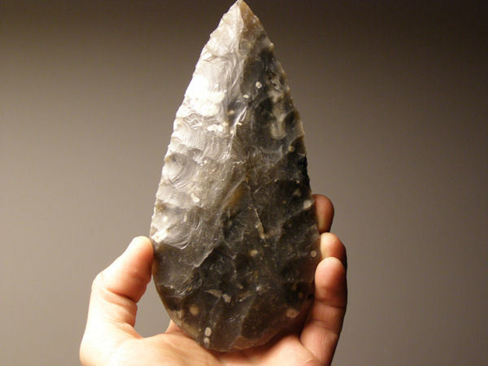
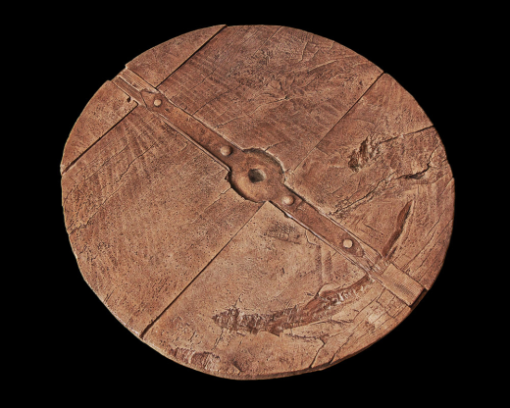
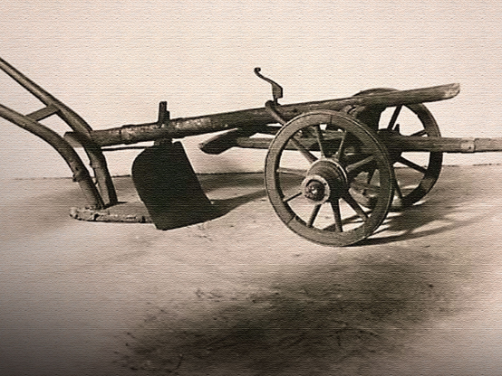
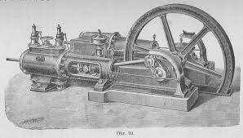
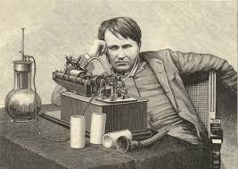
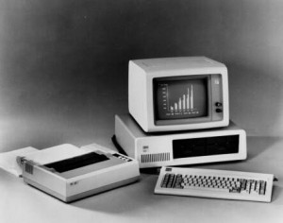
Productivity

Slide 8
How it the productivity connected with organisation?
https://www.youtube.com/watch?v=r211u89eUaY

Slide 9
The principle of economy (the economic principle) is a purely formal principle - it does not indicate anything about the aims and motives of the action.
The business entity can not only seek profit, but for example:
improving the supply of goods to the customers
gaining economic power or political influence
increasing market share, ...
"The economy is a sum of all planned human activities that are carried out on an economic principle (the principle of economy) and whose purpose is to satisfy (unlimited) human needs with limited goods."

Slide 10
2. The concept of organization
The process of producing goods and providing services, selling goods and services and consuming them takes place in organized economic units - self-management units (stand-alone economies).
production units
(companies)
Self-managed units
consumer units
(private households and public budgets)
Consumer units
generate demand for goods and services -> provide an important basis for marketing decision-making (eg decision-making on sales quantities or types of distributed goods).

Slide 11
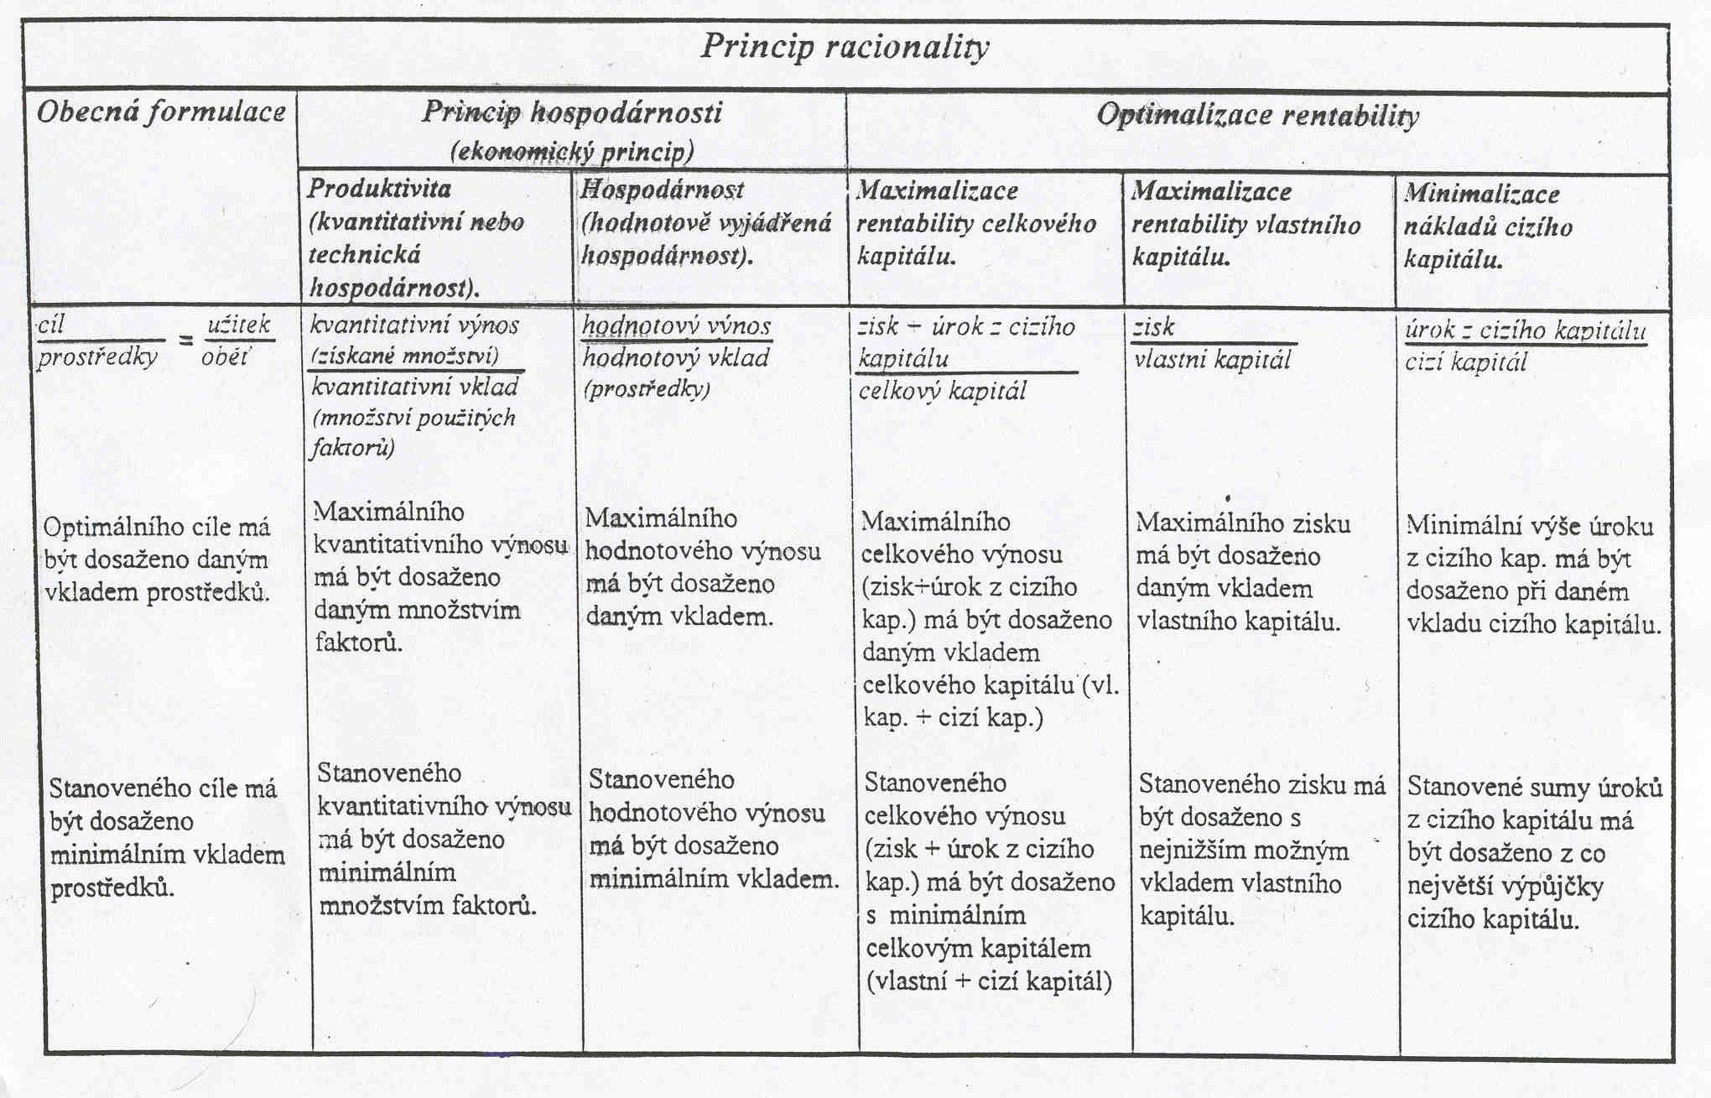

Slide 12
Organisations
= Planningly organized economic unit in which goods and services are produced and distributed (consuming, selling).
These organizations are divided into:
businesses (both private and public);
consumer economies (private households and public budgets).
The corporate economy is the behavior and therefore the decision-making process in the enterprise. This includes deciding on:
business objectives
construction of a business
how to make and enhance performance.
=> all decisions on the use of factories in an enterprise to achieve the goals set

Slide 13
Organisations - Typology
Organisations
Business
manufacturing
commercial
services
Public administration
-government
-autonomy
-public law corporation
Households

Slide 14
Organisations – other typology
Formal sector
Non-profit public sector
Informal sector
Public organizations
Nonprofit private sector
Private organizations
Non-profit household sector
Profitable private sector
Nonprofit organizations
Profitable organizations

Slide 15
3. Organization and Economic System
Organization
- in the central planning system
- in the market system.
Business characters
Systemically indifferent
System-based
Combination of factors of production
The principle of economy
The principle of financial equilibrium
Principle of autonomy
Earnings principle
The principle of private ownership

Slide 16
Central planning vs free market economy
https://www.youtube.com/watch?v=Ve6K10-Yx_M

Slide 17
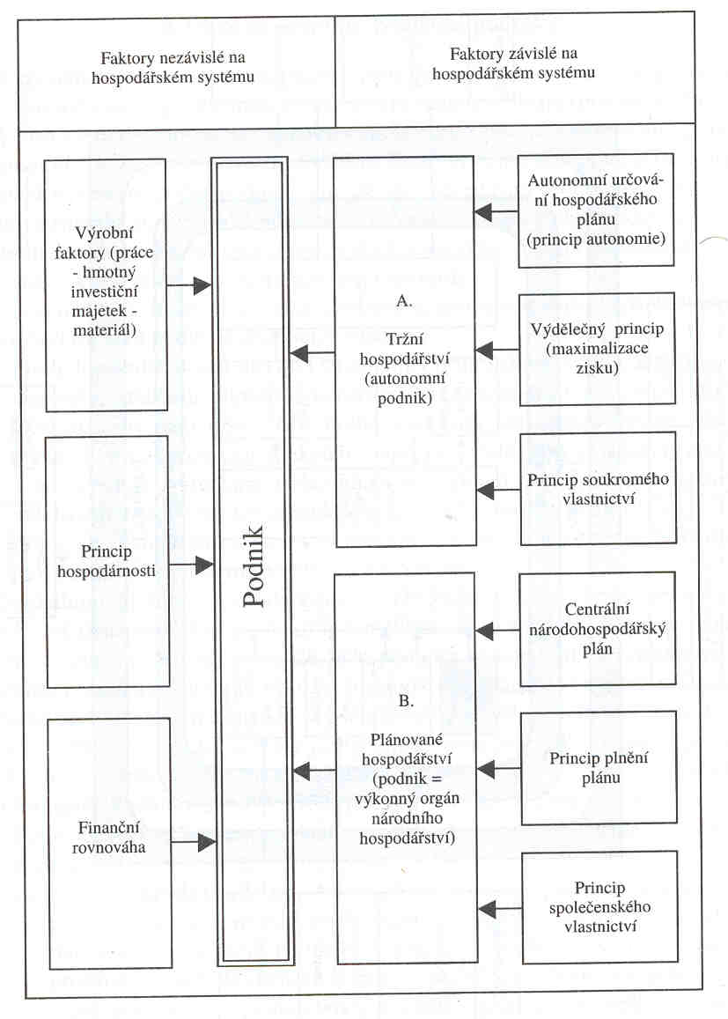

Slide 18
System-indifferent characters
1. Combination of Factors of Production - Manufacturing Factors (Manufacturing) Factors:
- Executive work
- dispositive work
- tangible fixed assets
- material
2. The principle of economy - resource limitation and unlimited needs => the organization must submit its actions to the economic principle, respectively, the principle of the minimum or principle of maxima.
3. Principal of financial equilibrium - An organization may only exist for a long time if it is able to meet its payment obligations within the specified deadlines.

Slide 19
System-based features (for market economy)
1.Principality of autonomy:
- The organization determines its production and sales plans itself, based on the market situation, without any interference from the state.
- It is governed by the factors of production factors, event. the prices at which the goods can be sold on the sales market.
- These prices express in the market system the limitation of production factors and manufactured goods.
2. The principle of profitability:
- The reason for doing business = to maximize profit by producing and selling performances (not necessarily for public enterprises or organizations).
- The organization is based on applicable law and information on purchasing and sales markets.

Slide 20
3. Principle of private ownership (applies to businesses):
- The means of production belong to the persons who provided their own capital
- Entitlement to exclusive decision-making is immediate (executive entrepreneur) or mediated.
- Managing decisions may be taken by owners not by their owners (such as the board of directors of the joint stock company) or by senior executives on behalf of owners under statutory or contractual arrangements.
The advantages of the market economy system
- personal liberty given by the guarantee of private property, private inheritance law and the autonomy of the enterprise.
- technical progress is being used immediately
- profit principle increases motivation and efficiency

Slide 21
Public enterprises (enterprises of the state or municipalities)
- the principle of the autonomy of the economic plan and the principle of profitability are often abolished, or restricted and replaced by:
- an effort to achieve a reasonable profit,
- efforts to cover the costs with income.

Slide 22
Weaknesses of the market system
1. Tendency to concentration - The company successful in market competition is growing and pushing its less successful competitors. The process of concentration limits the market competition to eliminate it.
2. Trends in unequal distribution - The market system is based on the differentiation of income from work by performance and income from the invested own capital, according to the rate of profit. It allows large income differences between individuals that lead to unequal distribution of property
3. Trends in cyclical fluctuations - Differences between supply and demand are offset by cyclical fluctuations - boom in surplus, price increases, over-employment and inflation, and in the period of recession of production decline, rising unemployment, decreasing living standards, …

Slide 23
Removing the weaknesses of the market economy - system-conforming (system-adapted) legislative intervention by the state
- ensure the functioning of the market competition
- remove the system's immanent (system-specific) weakness. Eg: the law on the protection of competition
- Legislative adjustments to income distribution and guarantees (eg income tax, labor protection, asset management, etc.) correct the unequal distribution of income and wealth

Slide 24
4. Typology of organizations
The most important sorting characteristics:
By sectors and economic sectors
Depending on the type of performance
Depending on the way of performance (only businesses)
According to the predominant factor of production
The size of the organization
Other sorting points:
dependency on the site
mobility
organizational legal form of business (enterprises only)

Slide 25
Breakdown by sectors and economic sectors
Public
Sector
Private
Mixed
Primary
Agriculture
Secondary
Sector
Industry
Terciary
Services
In CZ the breakdown of industry, agriculture and services by CZ-NACE - sectoral classification of economic activities

Slide 26
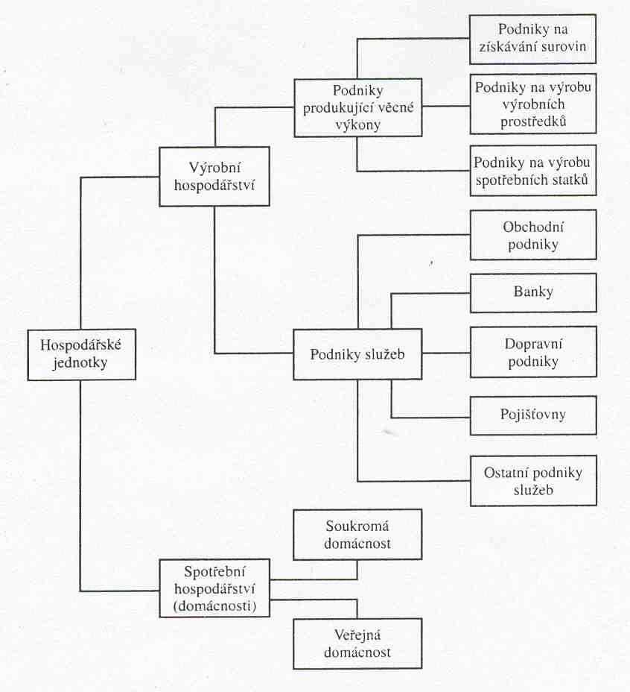
Členění dle druhu výkonů

Slide 27
Segmentation according to the manufacturing method of performance
according to production principles (production types)
- Based on repeatability of production
according to production methods (organizational types of production)
- Based on the differences in the way the machines are placed, respectively. of the differences in the organization of workplaces.
Breakdown by dominant production factor
labor intensive
investment-intensive
material intensive

Slide 28
Breakdown by size
Breakdown criteria:
- Number of employees
- turnover
- size of property, ...
Organization:
- small
- medium
- large

Slide 29
Breakdown by site dependence
Dependent on materials
Organization
Dependent on energy
Dependent on the workforce
Dependent on sales

Slide 30
Breakdown by mobility
companies wholly or partly linked to the site
mobile companies.
Breakdown by organizational-legal form
Individuals
Companies
Personal companies
Capital companies
Criteria:
- Liability - Limited x Unlimited
- the tax burden
- funding opportunities

Slide 31
Breakdown of public sector organizations
Criteria used:
- Character of goods (private, public, mixed)
- Financial flows (to institutions, to population)
- Founder (municipality, state administration, statutory)
- Functions (economic, social, political, ethical)
-Share of property ownership (private, municipal, state)
- Requirements (production, final - social or individual)

