Slide 1
Introduction to MS Dynamics NAV (Reservations-basics)
Ing.J.Skorkovský,CSc.
MASARYK UNIVERSITY BRNO, Czech Republic
Faculty of economics and business administration
Department of corporate economy

Slide 2
Reservation-benefits
Required items are not used for different operations (unexpected sales or consumption in production)
Due date performance is higher because either production managers of salesperson have in the right time exactly what they need.

Slide 3
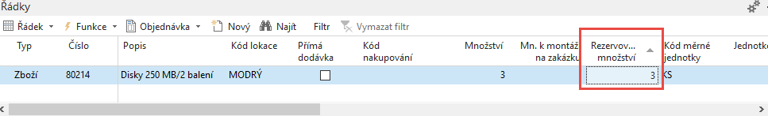
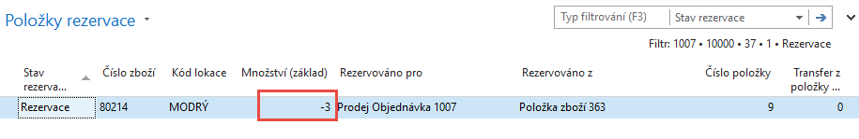
Reservations
Sales Order.
Reserved by use of Function icon in line and Reservation
Reservation entries from stock (in this case not from Purchase order)

Slide 4
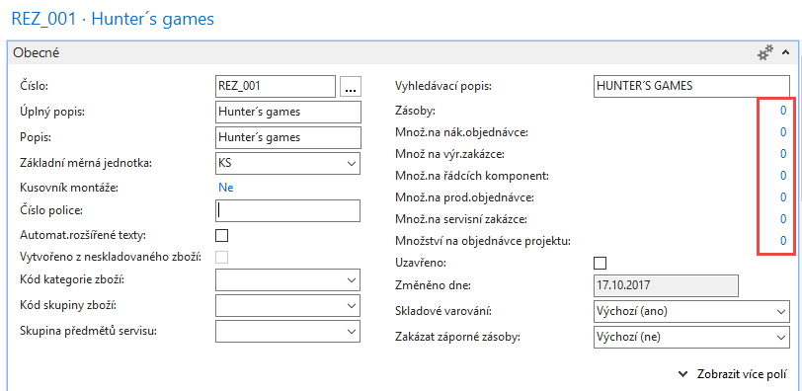
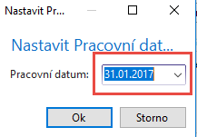
Item card - book

Slide 5
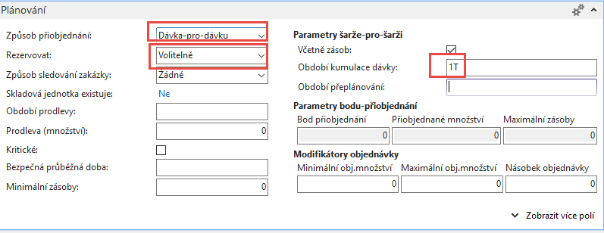
Item card-Planning tab
Nikdy | Zboží nelze rezervovat.
Volitelně | Program zboží nerezervuje automaticky. Toto zboží je nutné rezervovat ručně.
Vždy | Program vždy rezervuje dané zboží.

Slide 6
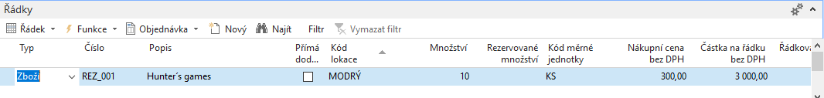
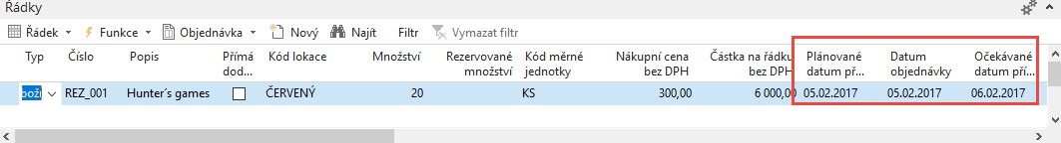
Purchase Order 1 and 2
Purchase Order header 1 (was delivered 31.1.2017) nebo 2.2.
F9
Purchase Order header 2 (will be delivered 5.2.2017) 7.2.2017 – change date in PO document
6.2. 17
PO Expected Receipt
time
31.1.17
Inventory
5.2. 17
PO Planned Receipt
10.2. SO=Sales Order
Date of Delivery

Slide 7
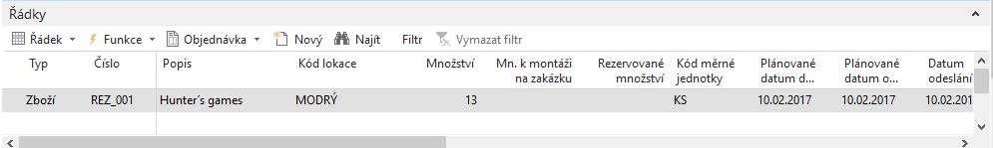
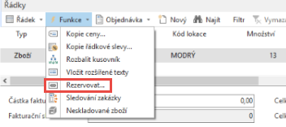
Reservations (SO-PO)
Sales Order header (Shipment planned to 10.2.2017)
See next slide
10 (stock) + 20(PO) =30 and 30-13 (SO)=17

Slide 8
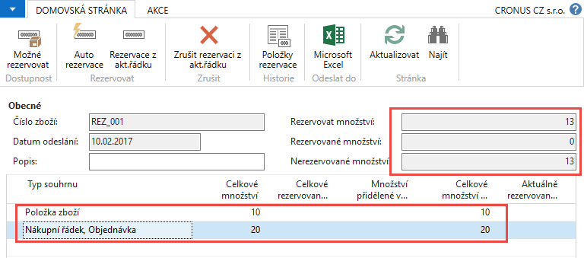
Reservations (SO-PO)

Slide 9
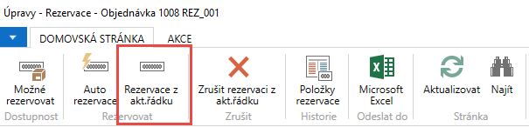
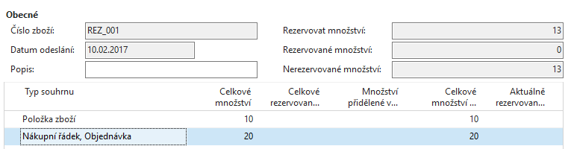
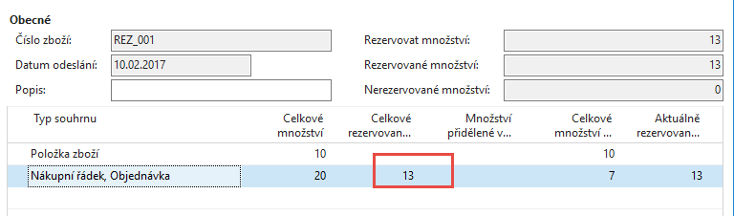
Reservations (SO-PO)
After reservation
Before reservation
After reservation

Slide 10
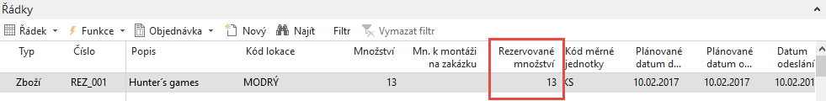
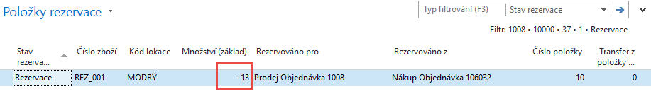
SO and reservation entries
Sales Order header (Shipment planned to 10.12.2014)
Drill down to reservation entry (F4)
You can cancel reservation from entries

Slide 11
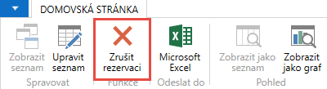
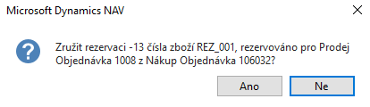
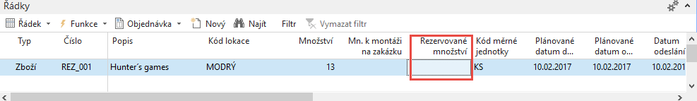
Cancel of the reservation
You can cancel reservation from reservation window

Slide 12
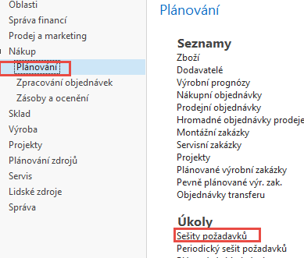
Reservation-Requisition worksheet
13
See next slide

Slide 13
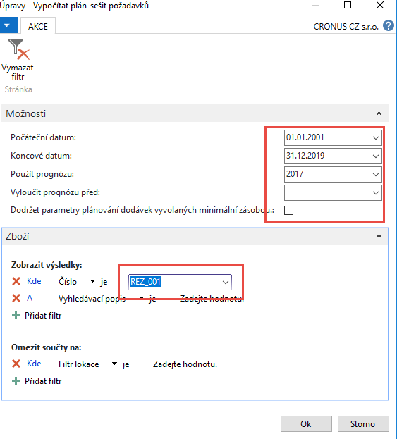
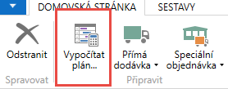
Reservation-Requisition worksheet
Inventory=10, Sales Order total = 13, Purchase Order =20, Requirement =13
Suggested quantity -> 3 , 10 (inventory) + 3(nákup), původní nákup z 20 byl změněný na 3

Slide 14

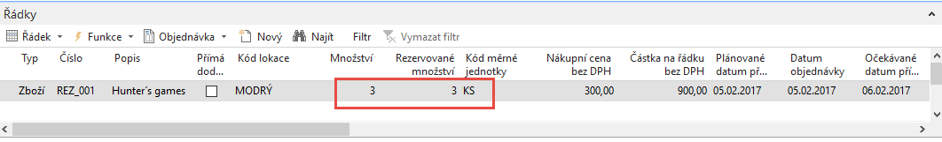
Calculations
Requisition worksheet suggested to rewrite current Purchase Order from Current Qty=20 and Reservation Quantity=13 to the new PO where Qty=3 only as well as reserved quantity=3
New PO line

Slide 15
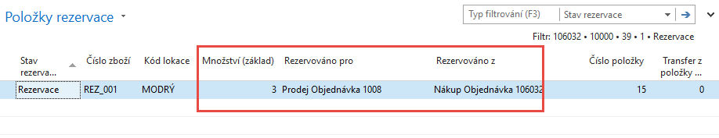
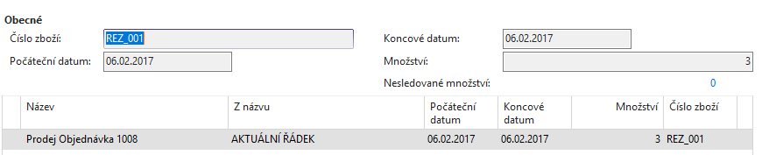
Reservation entries from PO lines
Order tracking (sledování zakázky) -> from PO to SO

Slide 16
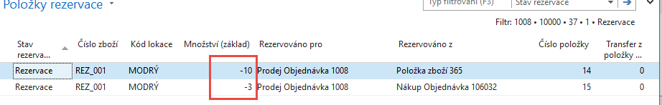
Reservation entries from SO

Slide 17
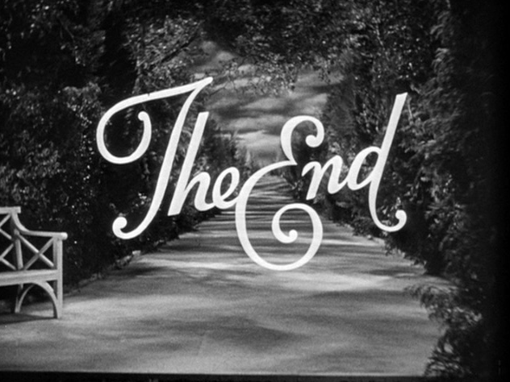
End of section
(Reservations-basics)

