Slide 1
“HRM & KD”
Dipl.-Ing. Johannes GÖLLNER, MSc
Masaryk University, Brno, CZ
October, 05th, 2018, 10:00–15:50, following
Lecture 2

Slide 2
Relevant CONTENT of HRM & OrgDev:
Which problems should have been solved by Human Resource Management in organizations, and in further consequence in economy and society?
Relation between organizational and individual capabilities and skills for strategic and operational organizational development
Relevance of Knowledge Management for Human Capital Leadership?
Models and methods for skill analysis and development (input, output and comparison models and methods with a special focus on assessment centres)
A practical example for the application of the assessment centre method in context of HRM
Relation between HRM, Knowledge Management and Risk Management for organizational development, controlling and leadership

Slide 3
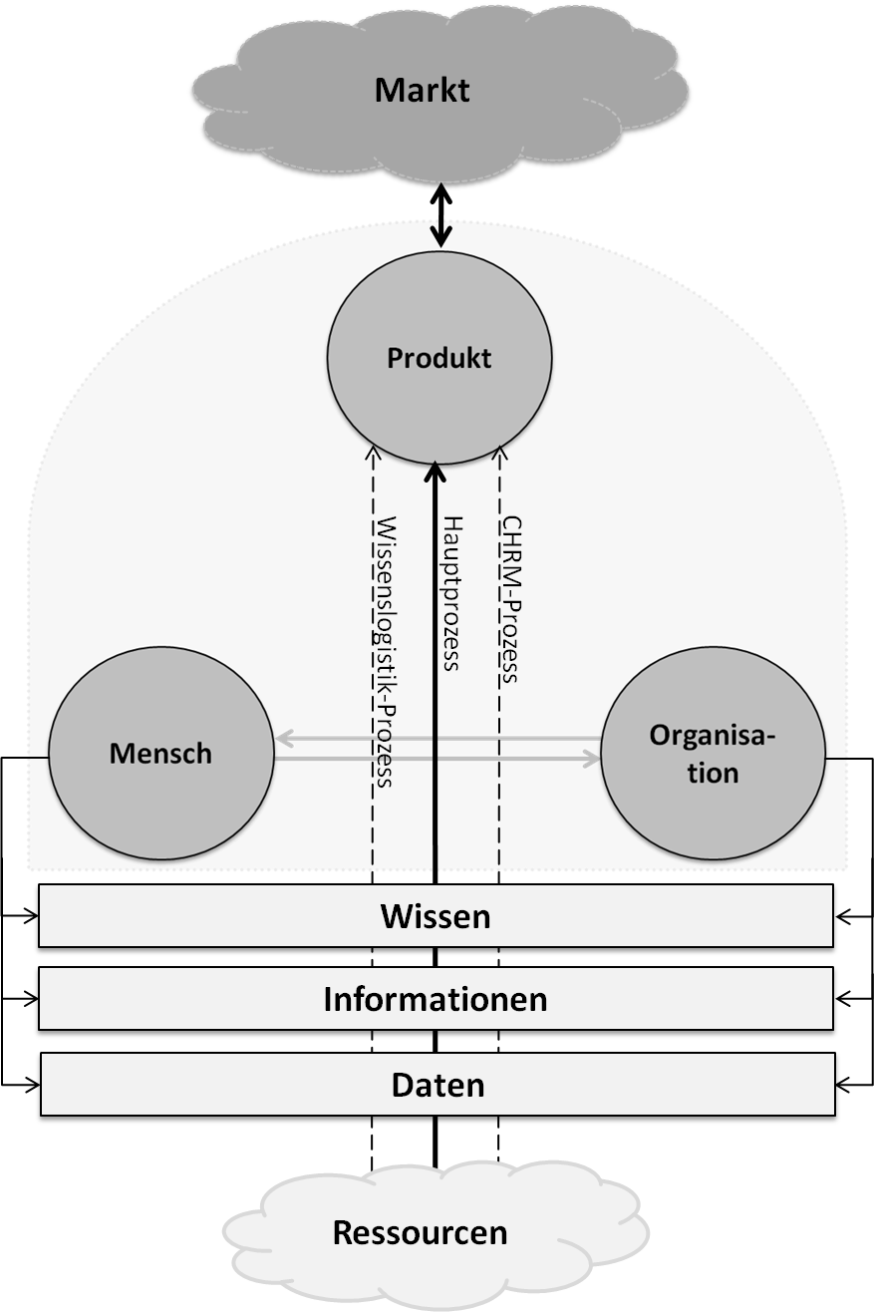
/market
Generic description
of the system ORGANISATION
/product
/human being
/main process
/knowledge
/data
Quelle: Copyright by GÖLLNER,
publiziert iRd MT-Hartinger, Donau Universität Krems, 05/2012, S.71
/resources

Slide 4
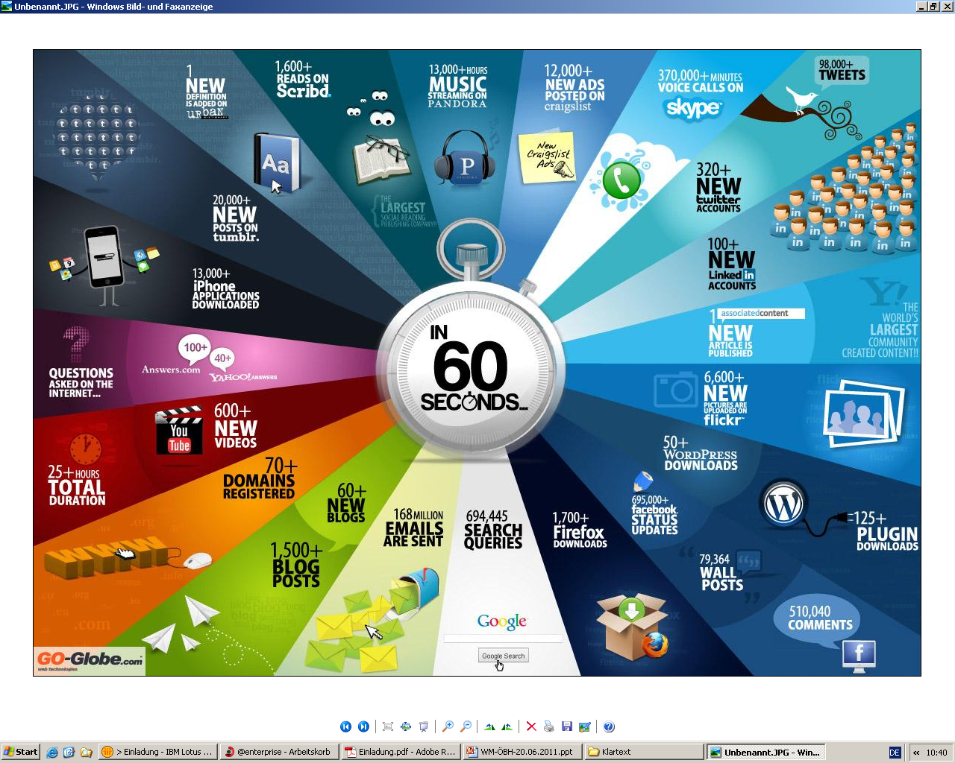

Slide 5

Organisation-Development
EVALUATION
(Controlling)
SCENARIO
Knowledge
(FC, SC, HC, RC)
ORGANISATIONAL
OPERATION

Slide 6
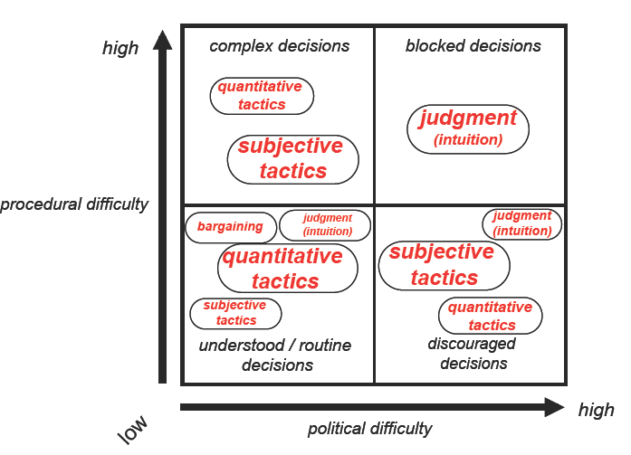
Entscheidungsfindung
30%
4%
49%
17%
Quelle: Paul C. Nutt, 1998
Notes:
References Paul C. Nutt
How Decision Makers Evaluate Alternatives and the Influence of Complexity Management Science 1998 44:1148-1166;

Slide 8
Challenges of HR in a Organisation
  1.1 Support for capability development
  1.2 Enabler for organisational/system interoperability
  1.3 Improvement of the evaluation quality
  („learning organisation“)

Slide 9

Building
the Knowledge Performance System
with a Model Based
Approach
No engineer, designer or architect works without a
plan / planning / BPM - tool!
Do we have a KM - System, a Knowledge planning/
modelling tool and a KM/Evaluation tool in our
organisation?

Slide 10
  1.1 Support for capability development
    Capability is the entirety of a system that delivers an output or effect. It will most likely be a complex combination of:
      Strategy, Organisation, Training, Material,
      Leadership, Personnel,Facilities.
  Holistic approach: „Product View“
  - output or effect (capability) defined as a product/knowledge product?
  - product - view for complex organisations/systems?

Slide 11
Knowledge is a Product
  If you can`t measure it -
  you can`t manage it!
You have to design, produce and evaluate a product with resources, skills, processes and knowledge!
Do you know, what quality/quantity of knowledge you need for a organisational development?

Slide 12
  1.2 Enabler for interoperability
    Political
    Legal
    Organisational
    Semantical
    Technical
  interoperability for a specific task/goal
  Managing approach:
  „Process-Oriented KM & Model-Based KM - View“
  - Do we have a tool for analysing, planning, documenting, managing and evaluating knowledge?

Slide 13
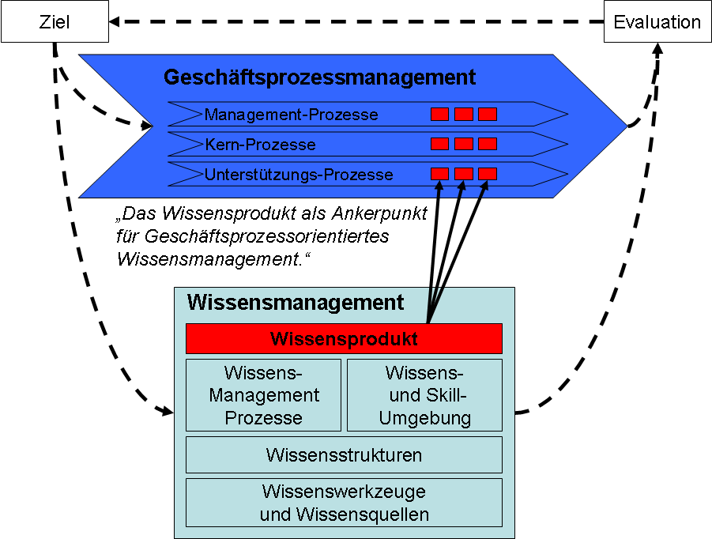
  IF YOU CAN`T MEASURE -
  YOU CAN`T MANAGE IT!
„idea“
Goal/Task
Evaluation
Business-Process
Management-Process
Core-Process
Support-Process
„The Knowledge-Product – anchor point
of business process oriented
Knowledge Management“
Knowledge Management System
Knowledge Management System
Knowledge Product
Use case and product
Knowledge-
Management
Process
Knowledge-
and Skill
Environment
HC relations and skills
Processes and structures
Knowledge Structures
Ressources and support
Knowledge Tools & Knowledge Sources

Slide 14
  1.3 Improvement of the evaluation quality
Support the organisational development
in the fields of:
Resources, Human Capital, Processes, Use Cases
    Managing Approach:
    „Knowledge Performance System - View“
    - Realisation of the „Roadmap to Knowledge
    Monitoring“ in Organisations possible?

Slide 15
Knowledge Scorecard
  Business instrument for
  measuring knowledge!
We have to design and integrate a knowledge scorecard in corporate environments!
Do we have the quality/quantity of knowledge workers (skills) we need in our organisation?

Slide 16
2. Common Denominator for Challenge
  3 pillars of a Knowledge Product
  x
  4 perspectives of the scorecard
  =
  12 views of the Architecture of the
  Knowledge Performance System (KPS)
National Defence Academy, Vienna, 2008

Slide 17
„Meta Layer“ combination of organisational & knowledge view
Task
Vision
Mission
Knowledge
Architecture
„model“
Goals
Success
Factors
Cause &
Effect
Relations
Business
Scorecard
Knowledge
Scorecard
Comprehensive analysing,
planning, documenting, managing & evaluating instrument

Slide 18
Z-Model:
Future of strategic long-term planning
Big Data Analysis
Generation of
Data,
Information &
Knowledge
Information Analysis
Horizon Scanning
Automated
RM - Process
Scenario
Development
Risk Evaluation
Situational Awareness
Risk Analysis
Ratings/Portfolio
Knowledge- Models
Risk Management
Customer Correlation
Options for Decisions
Copyright by Goellner J./Klerx J., 06/2013-12/2013

Slide 19
LEGAL COMPLIANCE
 | Austria | Germany | U.K. | USA
Gesetze | AktG, GmbHG, IRÄG, URÄG, RLÄG | KontTraG, dAktG, dHGB, | - | Sarbanes-Oxley Act (2002)
Corporate Governance Kodizes | Nationaler CGC (2002) | Nationaler CGC (2006) | Combined Code on Corporate Governance (2003) | Final NYSE Corporate Governance Rules (2003)
Standards & Empfehlungen | ONR 49000:2010 ON ISO 31000 ISO 31010 | - | Revised Turnbull Guidance (2005), Orange Book (2004), BS 31100 | COSO I & II
Exemplarely Documentation of different Regulations

Slide 20
All measures designed to ensure the correct conduct of a company, its management and supervisory bodies and its employees.
CORPORATE COMPLIANCE
The main task of the Board / CEO is to ensure that:
- organizational measures, training and controls and
- the correct conduct of the company and its employees
is ensured.
The company should be protected from claims for damages and judicial and administrative authorities penalties.
Source: Copyright by GÖLLNER,
LV Risikomanagement I, BOKU Wien, 2012
Notes:
Text ergänzen aus Folienvortrag RM Vortrag BOKU: HANNES

Slide 21
vs.
HRM
CONTROLLING
Strategic HRM
= Strategic HR-Controlling
Strategic
CONTROLLING
Integrierted CONTROLLING/
Balanced Controlling
Operatively HRM
= Operatively HR-Controlling
Operatively
CONTROLLING
Finance
IKS
Accounting
Notes:
CO OVERVIEW – SUBMODULES / SYSTEM

Slide 22
CONTENT.:
2.2. Knowledge Management II. :
2.2.3. Practical example: System of organizational
knowledge development and knowledge
management at a Austrian Governmental
Organisation and its documentary, process and
technical parameters.

Slide 23
Building
the Knowledge Performance System
with a Model Based
Approach
No engineer, designer or architect works without a
plan / planning / BPM - tool!
Do we have a KM - System, a Knowledge planning/
modelling tool and a KM/Evaluation tool in our
organisation?

Slide 24
Knowledge Flow in a Organisation
SCENARIO
EVALUATION
Knowledge
ORGANISATIONAL
OPERATION

Slide 25
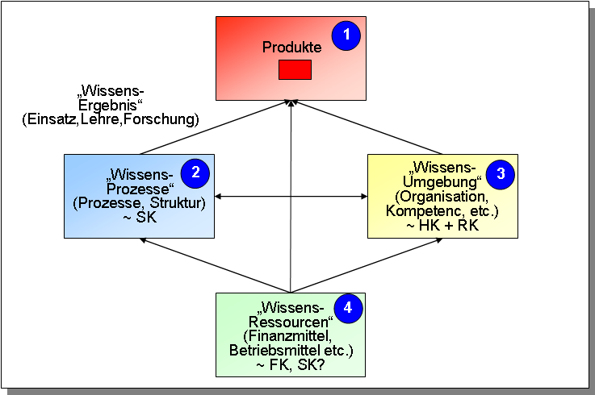
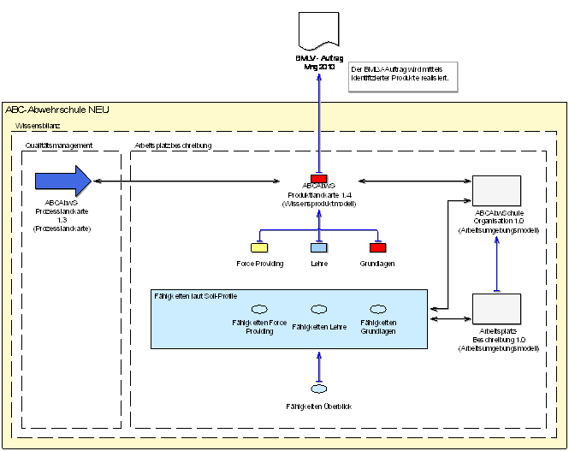
Methods and
Tools
(e.g. Scenario-
management)
CEO Level (strat.)
Knowledge-Results
Covering different layers
Environment
Threat Scenario /
Threat Analysis
Mission-
report
Strategic Concept
threat scenarios
Instruction scenario
Research scenario
Training-
report
Research-
report
Mission
Assignment
Training
Assignment
Research
Assignment
Knowledge
Risk
CEO (ops)
Level
Expert
Level
Product Catalogue
Mission, Training, Research
Processes
Structures
Environment,
Employees
Skills Catalogue
Resources

Slide 26
Knowledge Balance:
Specification of Goals
INPUT: Structure quality based:
  Human Resources
    Employee's knowledge
    Partner Knowledge
    Suppliers Knowledge
  Material Resources
    Material Knowledge
    Facility Knowledge
  Market, Product, Customer Knowledge
OUTPUT: Result quality based:
  Effectiveness
    Costs Knowledge
    Effectively Knowledge
    Financial Capital Knowledge
  Efficiency
    Efficiency Knowledge
    Productivity Knowledge
    Social Knowledge
  Customer Satisfaction, Quality and Environmental knowledge
TRANSFORMATION: Process Quality based:
  Process planning (Planning Knowledge, Method Knowledge)
  Process steering (Steering Knowledge, Relationship Knowledge)
  Transaction based Best Practise Process standard (Organisational Knowledge, Process Knowledge)
  Process execution (Technical Knowledge, Execution Knowledge)
  Process controlling (Controlling Knowledge, Criteria Knowledge)
Quelle: Binner H.F., Wissensbasiertes Prozessmanagement sichert den Unternehmenserfolg, Wissensmanagement 4/2006

Slide 27
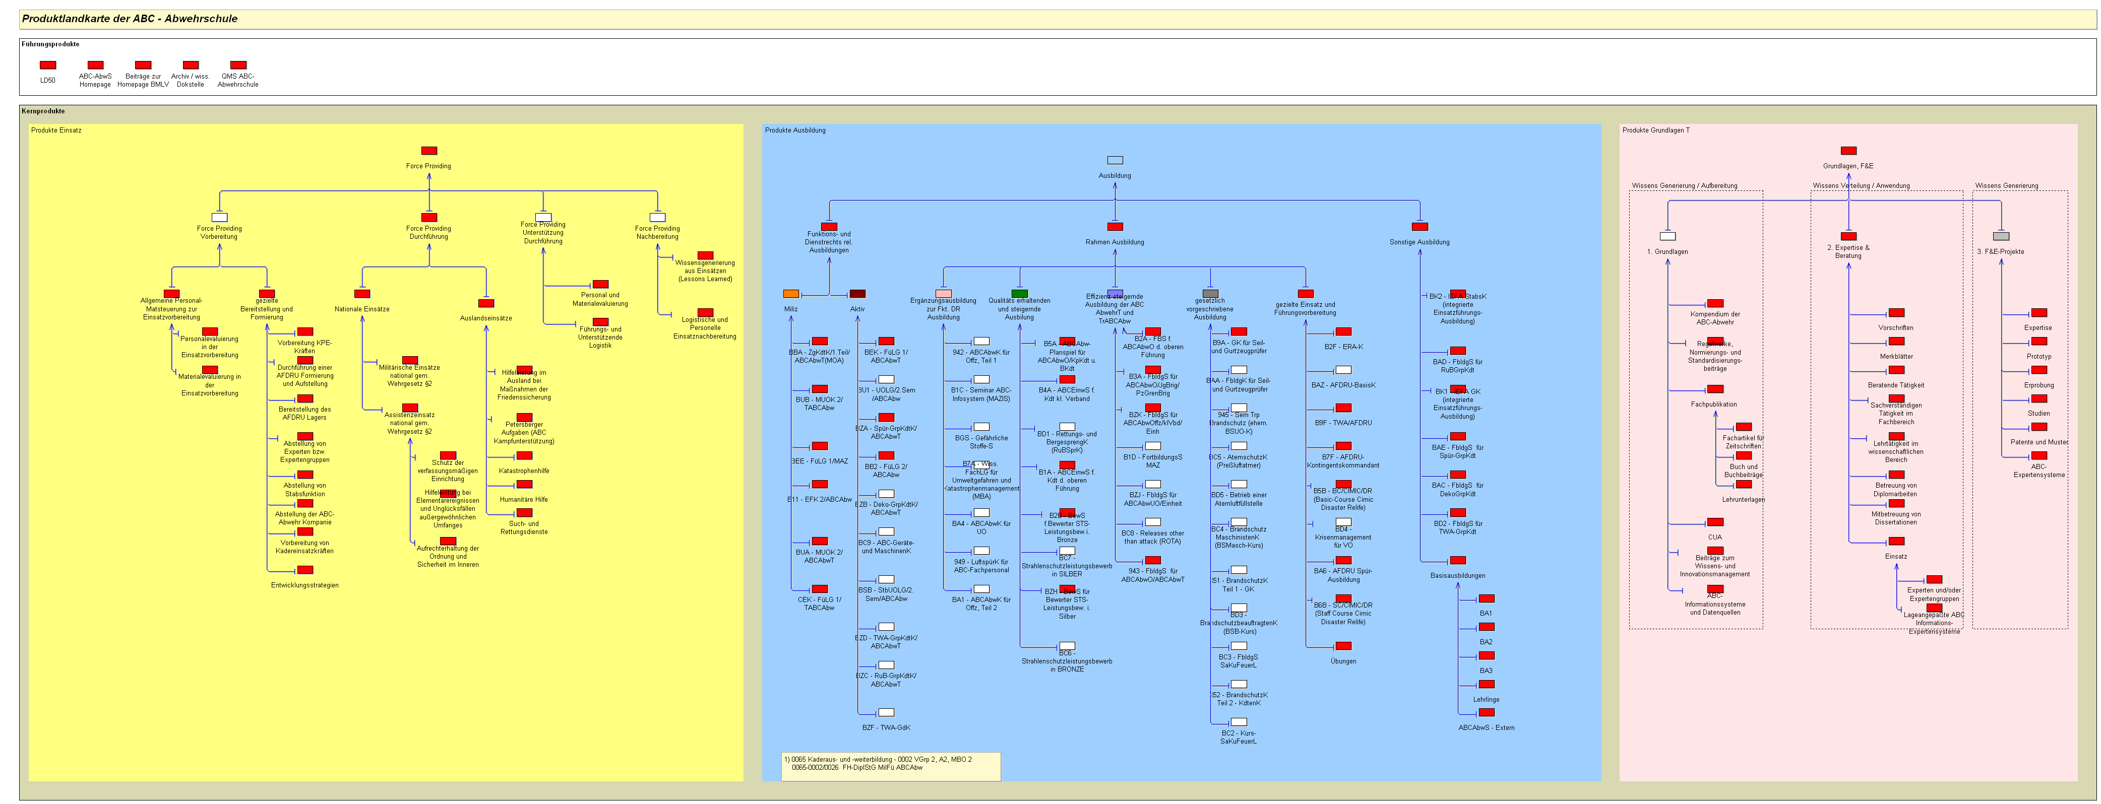
Knowledge Products of a
Organisation „XYZ“
Production
Training
R & D
According to the Organsational Preconditions?

Slide 28
  IF YOU CAN`T MEASURE -
  YOU CAN`T MANAGE IT!
„idea“
Goal/Task
Evaluation
Business-Process
Management-Process
Core-Process
Support-Process
„The Knowledge-Product – anchor point
of business process oriented
Knowledge Management“
Knowledge Management System
Knowledge Management System
Knowledge Product
Use case and product
Knowledge-
Management
Process
Knowledge-
and Skill
Environment
HC relations and skills
Processes and structures
Knowledge Structures
Ressources and support
Knowledge Tools & Knowledge Sources

Slide 29

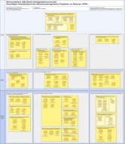
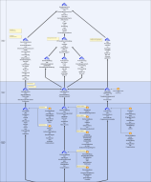
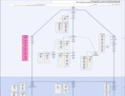

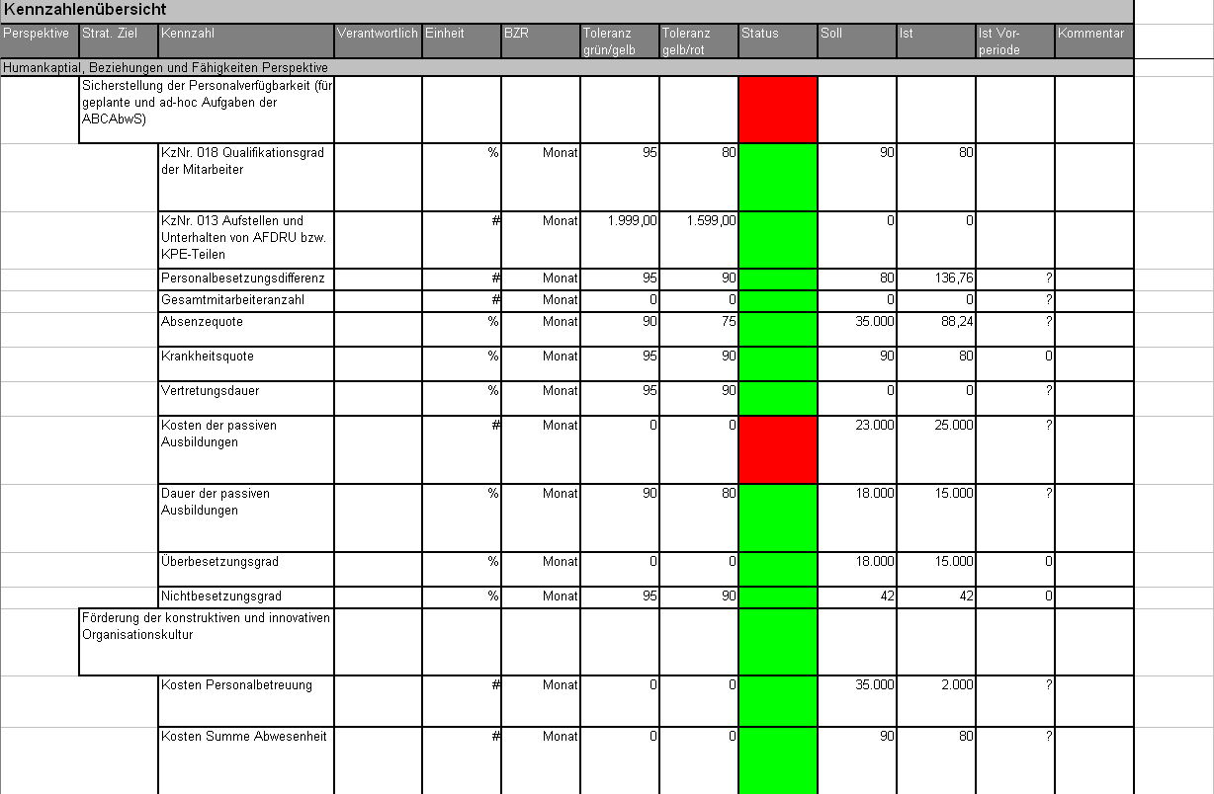
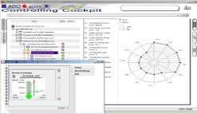

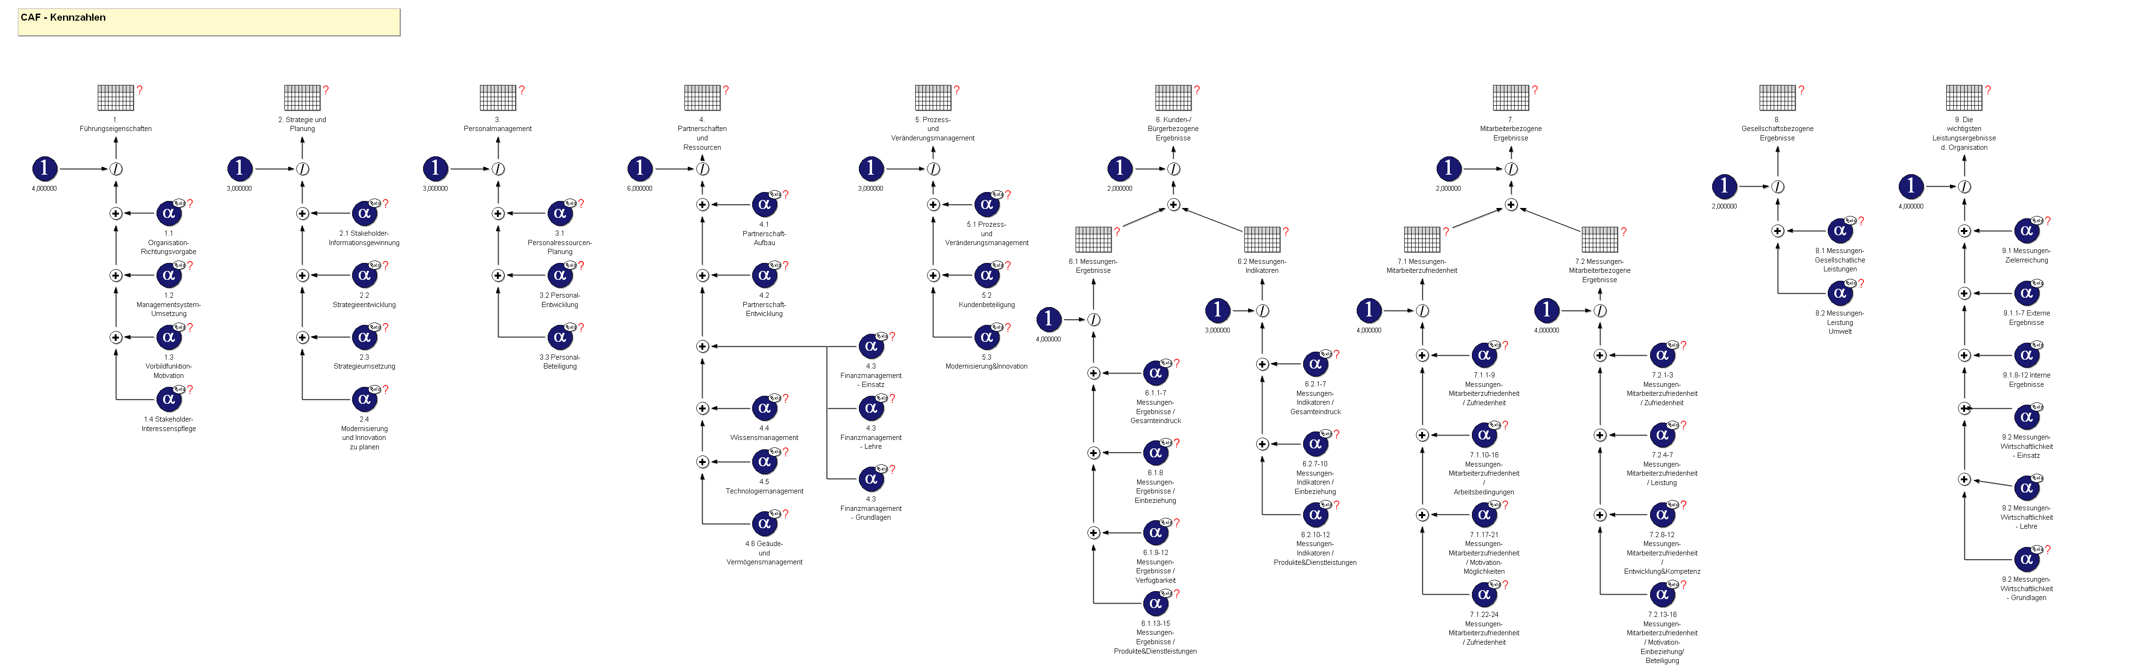

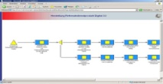
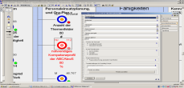



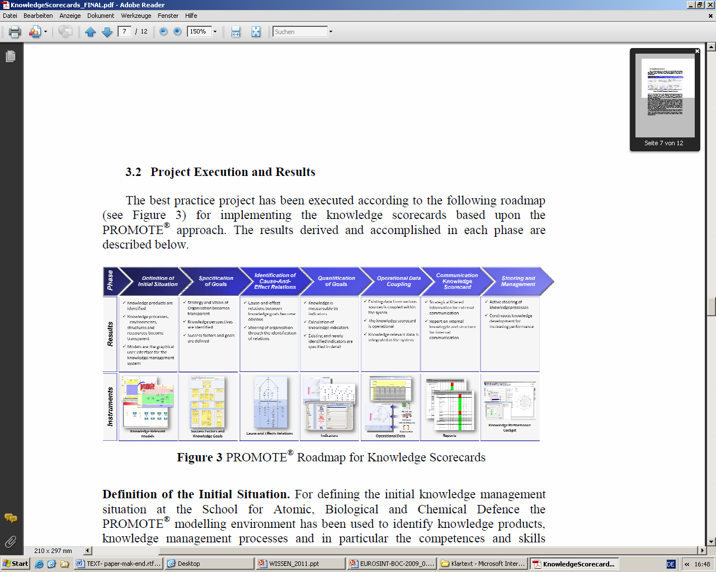
Roadmap to Performance Monitoring
Instruments
Phase
Definition of
Initial Situation
Specification
of Goals
Identification of Cause-And-
Effect Relations
Quantification of Goals
Operational Data Coupling
Communication Knowledge Scorecard
Steering and Management
xls, txt, csv
manuelle
Datenzubringung
Datenbanken
Knowledge Relevant Models
Success Factors and
Knowledge Goals
Cause and Effects Relations
Indicators
Operational Data
Reports
Knowledge Performance Cockpit
Improvement of the evaluation quality?
Notes:
29

Slide 30


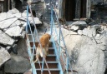
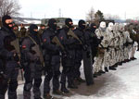

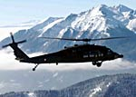
Knowledge Performance System
“Simulation – model”
Reporting
Steering
Performance Monitoring
Needed
Available
Resources
Support
Relations
Skills
HR
Processes
Structure
Product
Use Case
Resources
Support
Relations
Skills
HR
Processes
Structure
Product
Use Case
4
3
2
1
4
3
2
1
Use Case
NBC Defence School
Identifizieren
Environment
Real Organisation
Learning organisation?

Slide 31
Architecture of the KPS + “12 Views”
Performance Monitoring
Product
Knowledge Product
Views
Expression
Use Case and Product
-Perceived Results
-Use Case
-Products
XI
X
XII
What is the impact of the knowledge?
Processes and Structures
Core Processes
Quality Relevant processes
Mgmt and Steering relevant processes
VIII
VII
IX
How to manage the knowledge?
Communication
Transformation
HC relations and Skills
Persons
Skills
Relations
Production
What is available knowledge?
V
IV
VI
Resources and Support
Budget
Infrastructure
Material and Tools
Info and Communication
II
I
III
What is available input?

Slide 32
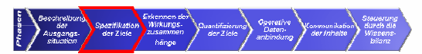
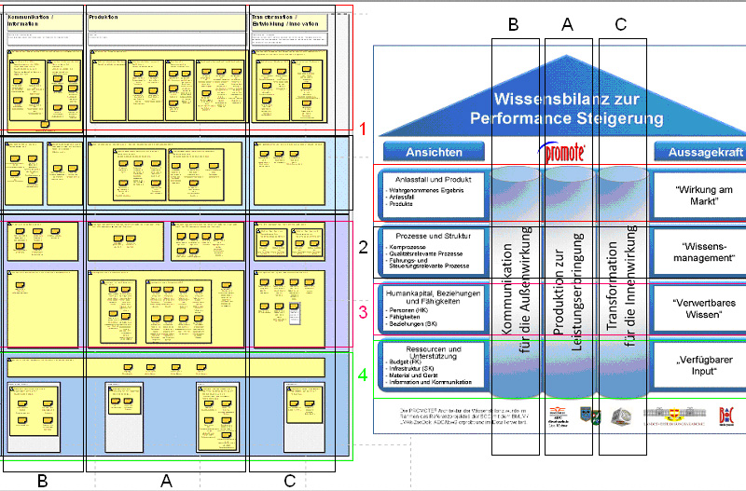

Slide 33
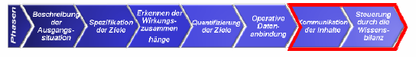
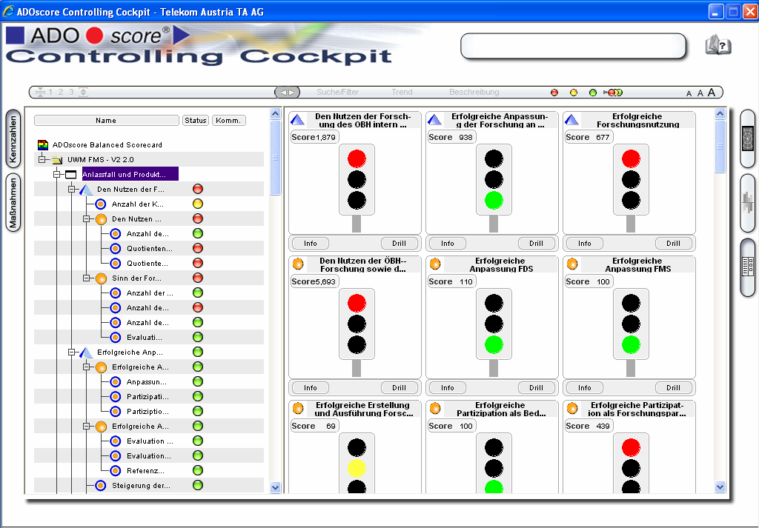

Slide 34
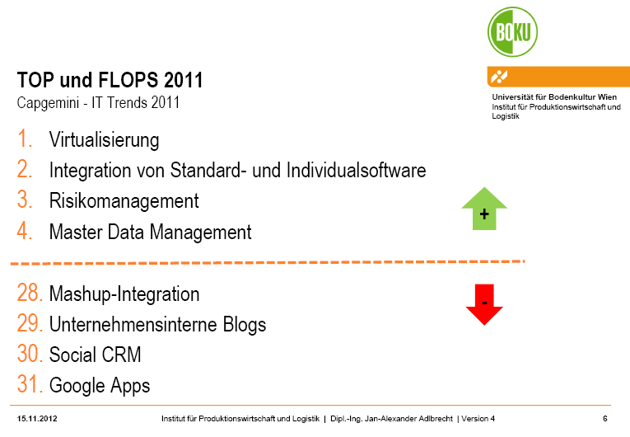
Outlook in Investments:

Slide 35
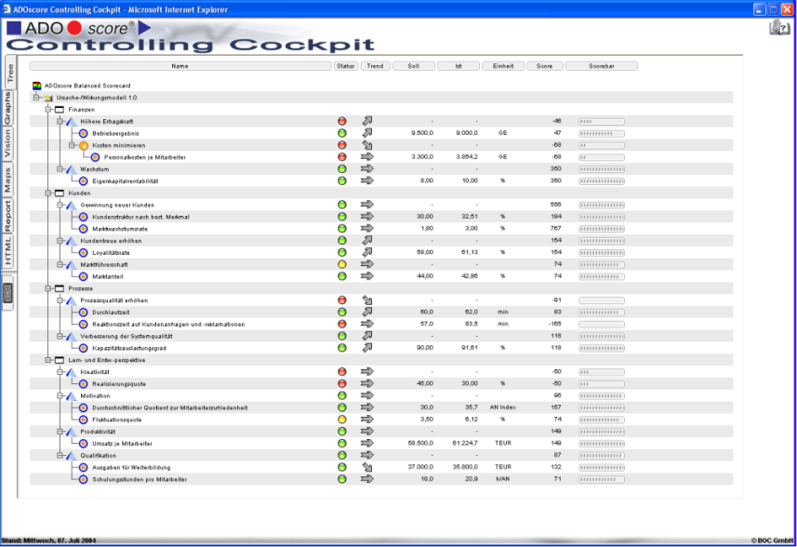
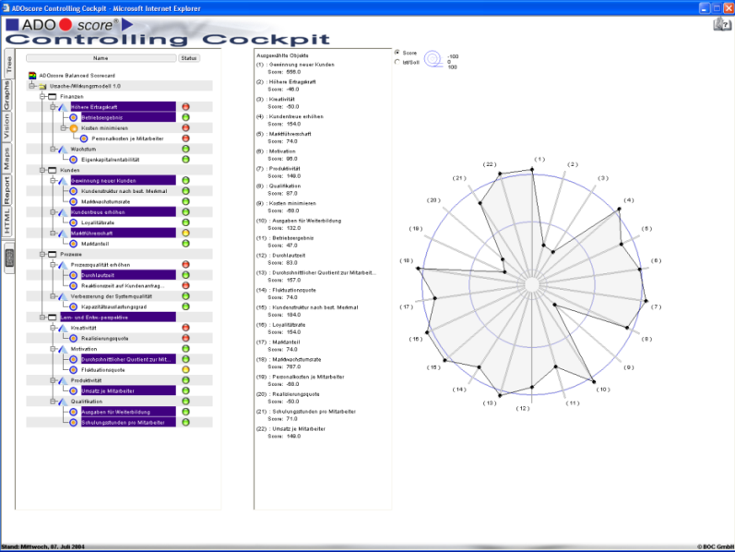
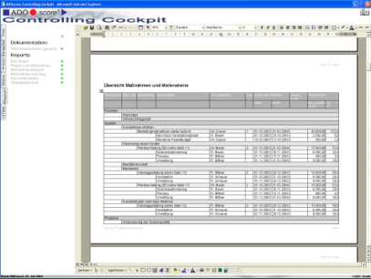
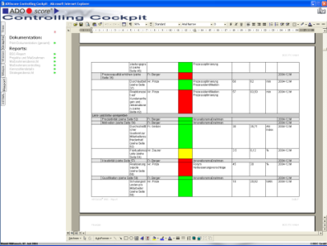
ADOscore® Controlling Cockpit
Steering and Reporting of the Knowledge Balance
ADOscore® Controlling Cockpit is HTML-based steering and management instrument for your Knowledge Balance. It combines Analysis, Management and Reporting functionalities in one application.
Anytime
Anywhere
Tool Independent
Individually customizable
Fast and efficient
Improvement of the evaluation quality?

Slide 36
Knowledge
is the precondition for:
    an action
    or
    a non-action
in an organisation / a system/ a domain,
it must be checked as relevant or irrelevant
(valid or not valid)(sure or not sure) by a
„decision instance“
Knowldge is the ability to interpret data and information correctly,
depending on the environment (system, organisation,...).
Data and information are not sufficient for an interpretation!

Slide 37
Contact:
Dipl.-Ing. Johannes GOELLNER, MSc email: johannes.goellner@meinesteuerberatung.at
1030 Vienna, Marxergasse 13/10, Austria mobil: +43-(0)650-22529991

Slide 38
Thank you for your attention.
Questions ?

