Slide 1
“HRM & Key Indicator System”
Dipl.-Ing. Johannes GÖLLNER, MSc
Masaryk University, Brno, CZ
October, 05th, 2018, 10:00–15:50 following
Lecture 4

Slide 2
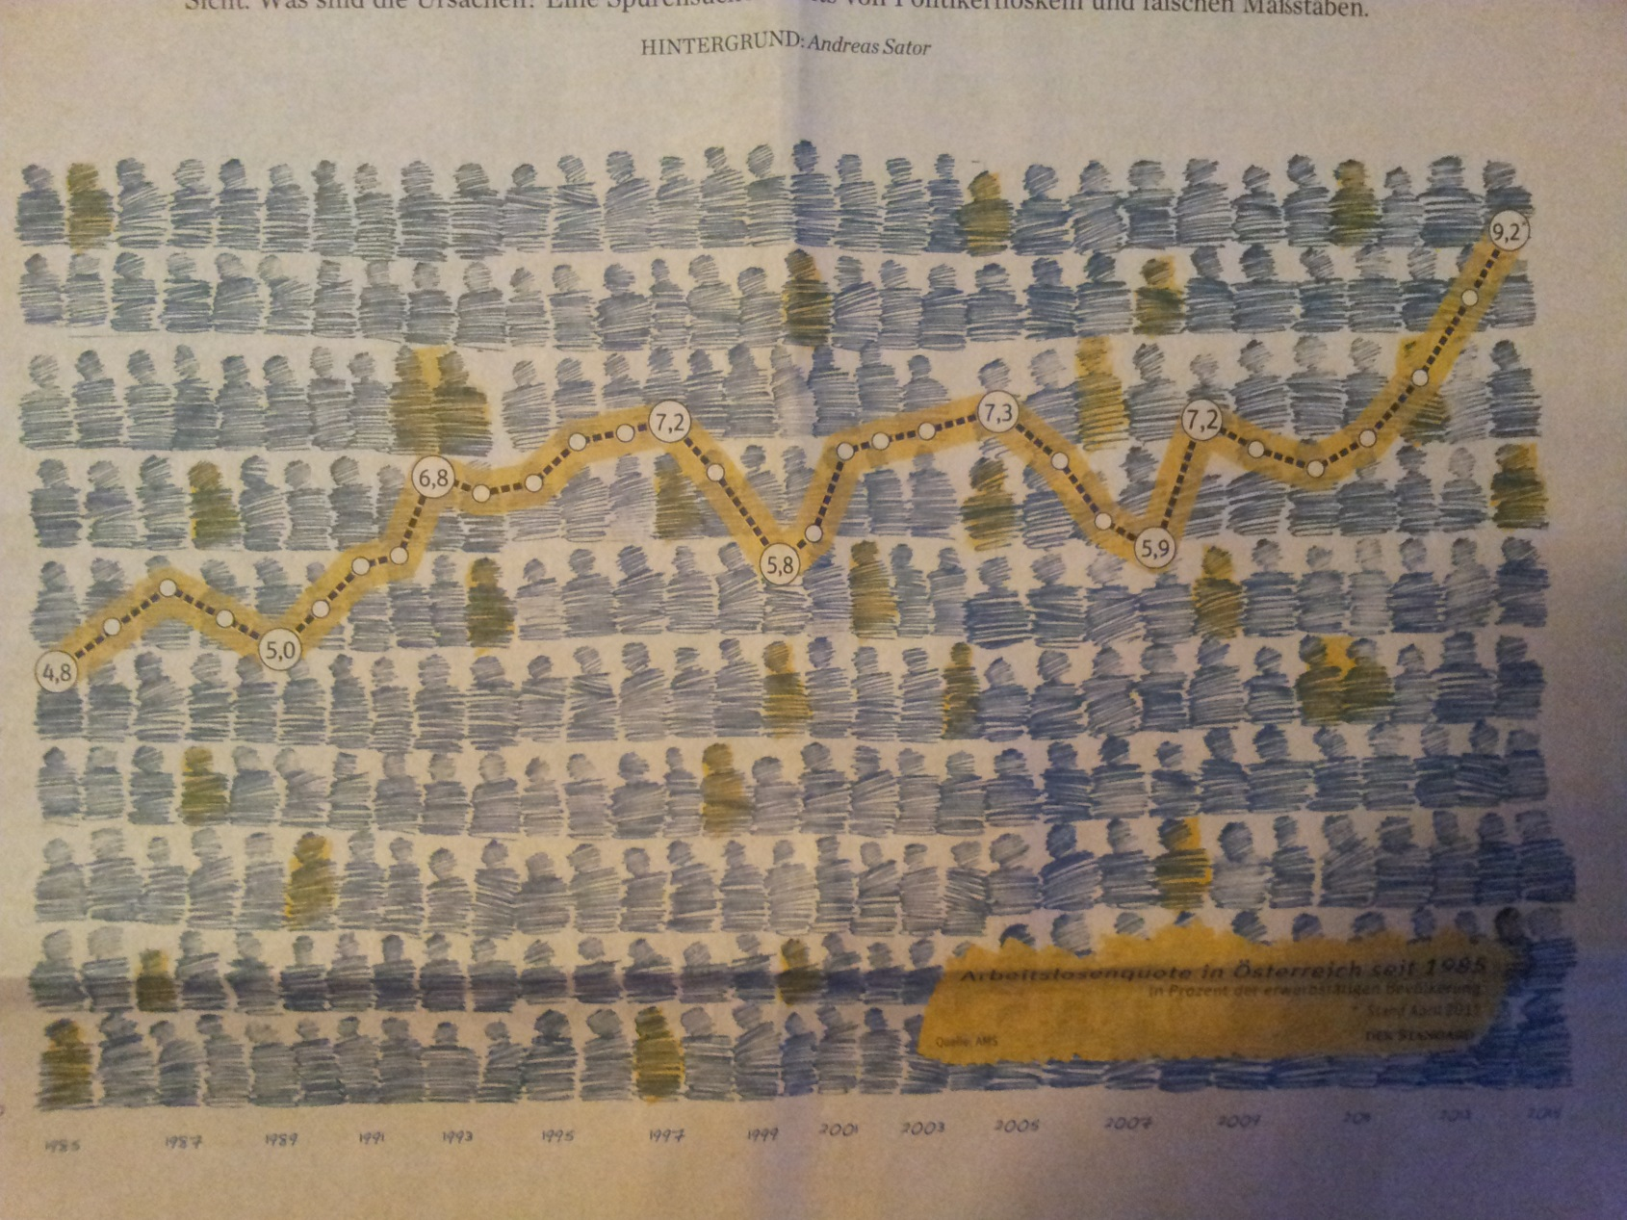
unemployment statistics: (AT: 1985-2015)
Source: Der Standard, 9./10.05.2015, page 6

Slide 3
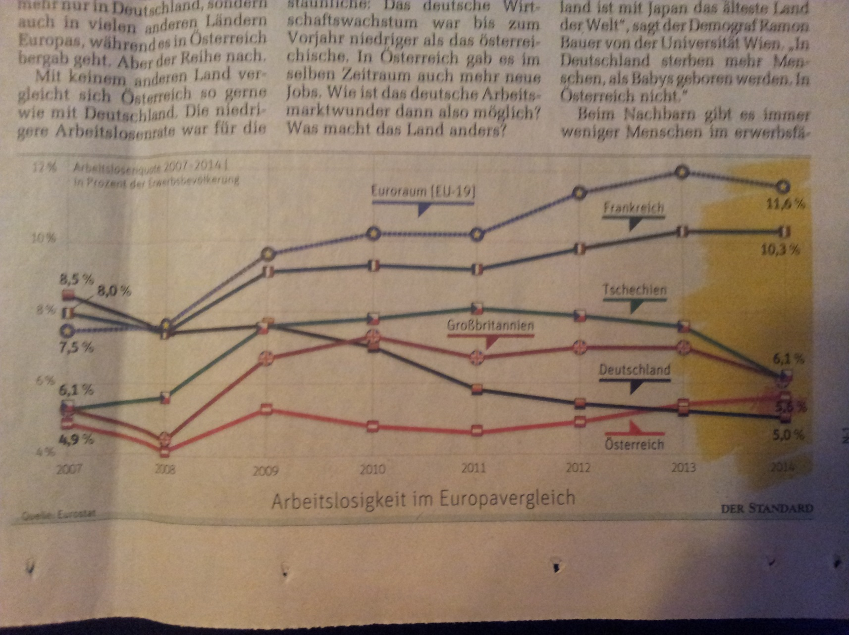
unemployment statistics: EU-Space
Source: Der Standard, 9./10.05.2015, page 6

Slide 4
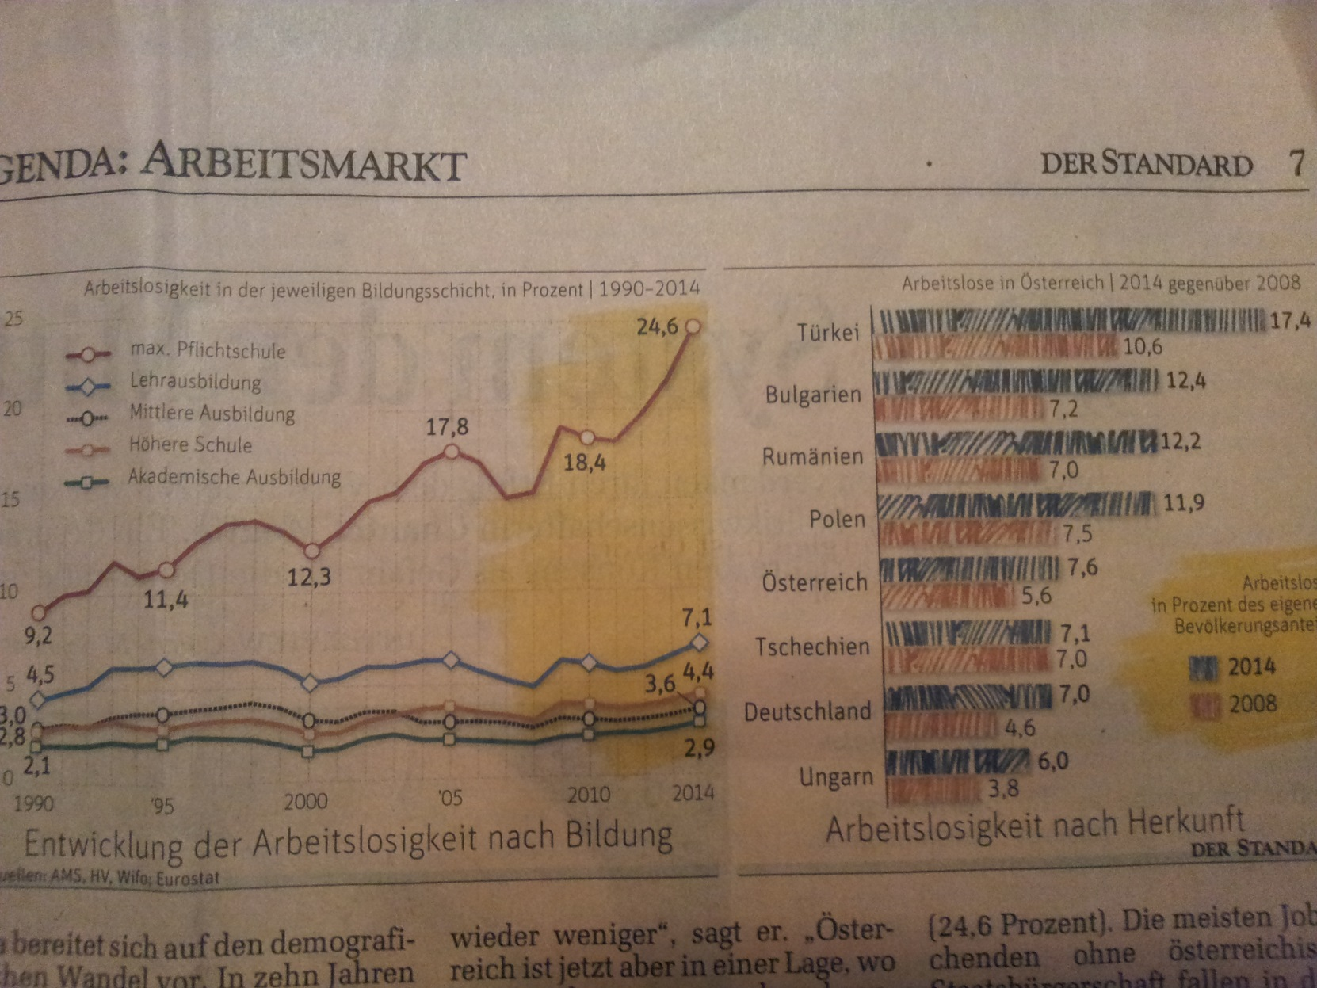
unemployment
statistics:
unemployment: AT
Unemployment ORIGIN
Source: Der Standard, 9./10.05.2015, page 7

Slide 5
Structure of Personnel Costs:
Personnel Costs
remuneration for work done
Additional Personnel Costs
Based on
legal and contract (tarif)
Based on
company agreement
Source: Küpper, H.-U. (2005), page 369

Slide 6
Logic of Indicator Development:
logical derivation
definition logical relationships
empirical-theoretical foundation
mathematical transformation
Development of Indicator Systems
Expert interviews
empirical-inductive generation
plausibility considerations
model-based justification
Data analysis using statistical methods
Source: Küpper, H.-U. (2005), page 369

Slide 7
Selected Indicators relating to Personnel Statistics:
“Personnel Structure” Indicators
“Personnel Movement” Indicators
“Personnel Performance” Indicators
“Working Time” Indicators
“Personnel Development” Indicators
“Job Satisfaction” Indicators
“Personnel Costs” Indicators
“Social Performance” Indicators

Slide 8
“Personnel Structure” Indicators:
under demographic and operational
aspects
Average age of the workforce
Rate of more than 50 years old persons
percentage of women
proportion of skilled workers
Proportion/share handicapped persons
average length of service
average number of employees

Slide 9
“Personnel Structure” Indicators:
2. under workplace-related aspects
income groups structure
span of control
number of IT-workstations
number of accidents
numbers of near misses

Slide 10
“Personnel Movement” Indicators:
“fluctuation” Indicators (4):
BDA-Formula
(BDA: = Confederation of German Employers'
Associations)
SCHLÜTER-Formular
Fluctuation (average target headcount)
ZVEI-Formular (average target headcount)
(Association of german electrical and electronic
industry)

Slide 11
“Personnel Performance” Indicators:
“performance labor productivity”
“performance (increasing
productivity)”

Slide 12
“Working Time” Indicators:
effective working time
Share effective working time
Downtime entire company (per period)
sickness rate (per period or at the time)
Determining the labor reserve (per period)
Overtime rate

Slide 13
“Personnel Development” Indicators:
Education Indicators:
annual training time per employee
Training costs per day and participant
Share employee development costs to total staff costs
Returns to education
Advanced training rate
Structure of training activities

Slide 14
“Personnel Development” Indicators:
2. Education Promotion Indicators:
applicants per training place
applicants ratio (excluding speculative application)
Productivity recruitment in quantity per employee
Efficiency of HR-procurement channels
Number of structured employee interviews
posting quote
rate of return

Slide 15
“Personnel Development” Indicators:
3. Organizational Development
Indicators:
suggestions for improvement rate
Proportion of employees involved in CIP (Continuous Improvement Process) projects

Slide 16
“Job Satisfaction” Indicators:
“fluctuation” Indicators: BDA-Formula
(BDA: = Confederation of German Employers'
Associations)
sickness rate (per period or at the time)
Satisfaction level with working atmosphere in the group

Slide 17
“Personnel Costs” Indicators:
Structure of total labour costs:
Share of salaries
Share of additional labor costs
Share of legal and contract additional labor costs
Proportion of employee development costs
Share of personnel management costs
Proportion of employee costs to total costs

Slide 18
“Personnel Costs” Indicators:
2. Structure of labor costs for different groups of people: (worker, employee, staff, etc.)
Share of personnel expense of workers
Share of remunerations of workers
Share of additional labor costs of workers
Share of legal and contract additional labor costs of workers
Share of corporate labor costs of workers

Slide 19
“Personnel Costs” Indicators:
3. relationship of personnel costs different groups of people:
Share of personnel costs employee to workers
Share of additional labor costs employee to workers

Slide 20
“Personnel Costs” Indicators:
4. relationship of personnel costs to performance data:
share of personnel expenses to corporate turnover
share of personnel costs to production volume
share of personnel expenses to total operating revenue, profit & loss calculation
Personnel costs per employee rendered production hour

Slide 21
“Personnel Costs” Indicators:
5. Key figures per employee:
Personnel costs per company employees
Additional personnel costs per company employees
legal and contract additional labor costs of company employees
operational labor costs per company employees

Slide 22
“Social Performance” Indicators:
Percentage of employees at the site meals
Percentage of employees in company-owned apartments
Proportion of users of company-owned sports facilities
Proportion of users of company-owned kindergarten´s
Proportion of users of voluntary occupational pensions

Slide 23
Contact: Dipl.-Ing. Johannes GOELLNER, MSc email: johannes.goellner@meinesteuerberatung.at 1030 Vienna, Marxergasse 13/10, Austria mobil: +43-(0)650-22529991

Slide 24
Thank you for your attention. Questions ?

