Slide 1
The replacement of human labor through robots
Oral Presentation
Jan Cibulka (489416)
Leonardo Papaveri (489416)
Maximilian Thomaseth (486362)
Carolin Pongratz (486270)
Human Resources Management

Slide 2
Contents:
Overview about robot industry
Job sections affected/not affected
Countries which are most affected by robot replacement
Conclusion: Positive and Negative aspects
References

Slide 3
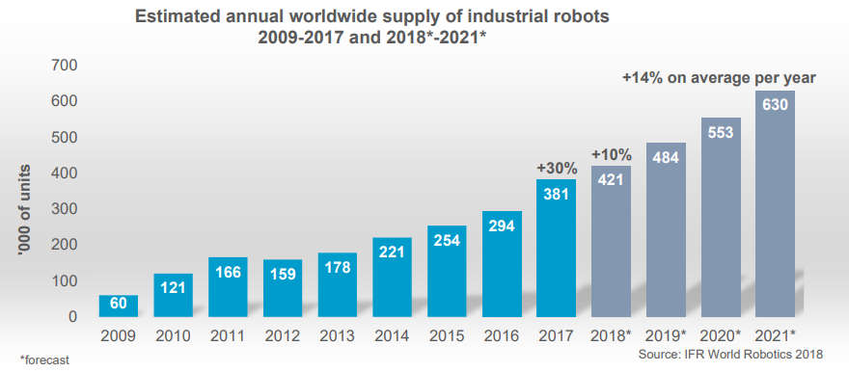
Overview about robot industry
In 2017, the value of global market was around US$16.2 billion
Since 2010, the demand for industrial robots has accelerated considerably due to the ongoing trend toward automation and continued innovative technical improvements in industrial robots
Robot sales increased by 30% to 381,335 units, in 2017; it’s a new peak for the fifth year in a row.
New estimation by IFR World Robotics confirm that this growth is not going to slow down for several years yet, in fact, in 2018 is expected a growth by 10% to 421,000 units and in 2021 the units will be 630,000 with on average per year by +14%

Slide 4
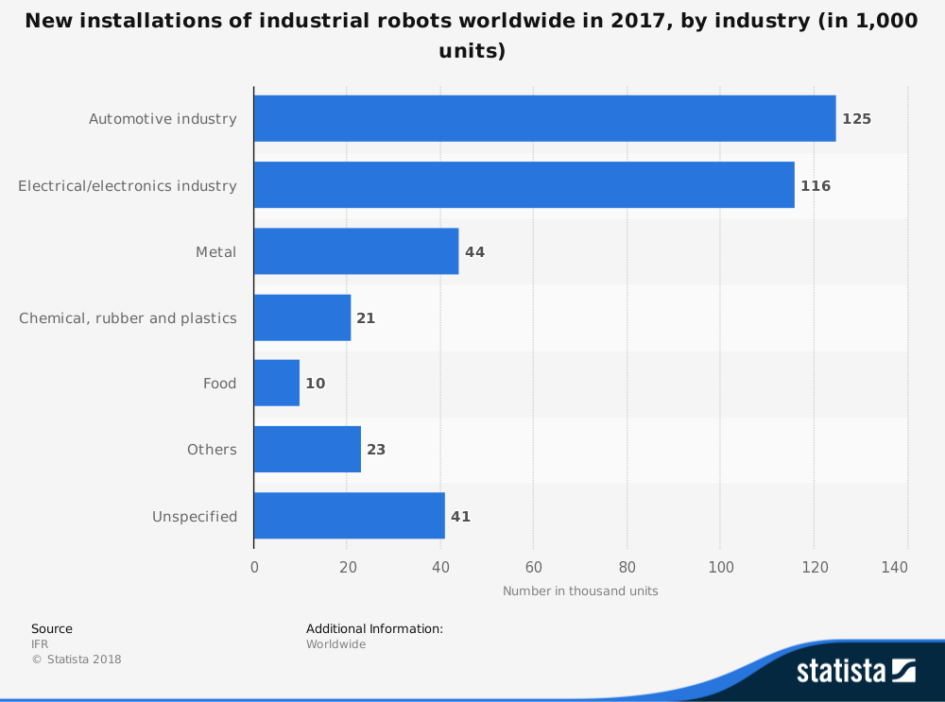
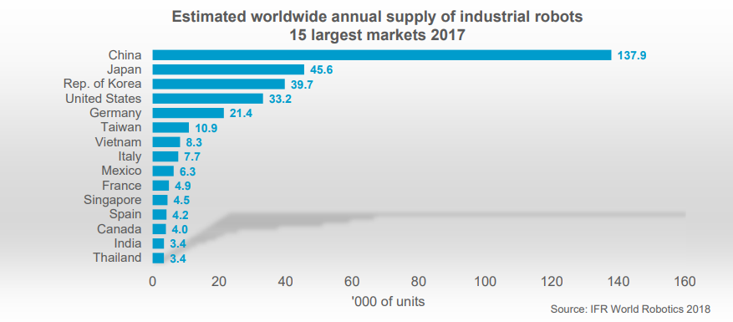
The main drivers of this exceptional growth in 2017 were the metal industry (+55%) and electrical/electronics industry (+33%). Robot sales in the automotive industry increased by 22% and remained still the major customer of industrial robots with a share of 33% of the total supply in 2017.
There are five major markets representing 73% of the total global sales volume in 2017: China, Japan, the Republic of Korea, the United States and Germany. Since 2013 China has been the biggest robot market in the world with a continued dynamic growth.

Slide 5
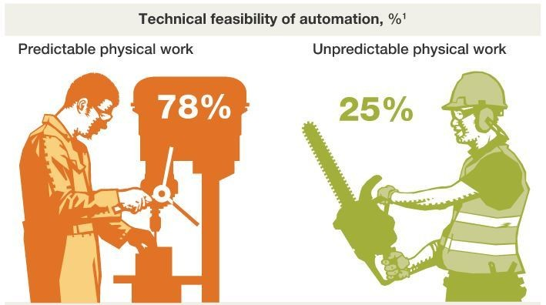
Job sections affected/not affected
Robots may replace 800 million workers by 2030
Automation will more or less affect by type of activity parts of almost all workstations
For some industries, an increase in automation won't mean a decline in employment, but rather a shift in the tasks needed to be done
Factors:
Technical feasibility
Costs for the development and use of both hardware and software
Labour costs and the associated supply and demand dynamics
Advantages over labour substitution including higher production volumes of better quality and fewer errors
Not affected:
Recreational Therapists
First-Line Supervisors of Mechanics, Installers, and Repairers
Emergency Management Directors
Mental Health and Substance Abuse Social Workers
Audiologists
Occupational Therapists

Slide 6
Affected:
Physical activities play a prominent role in sectors such as manufacturing, gastronomy and housing, and retail trade, they are most vulnerable to automation for technical reasons alone
All these occupations share a predictable pattern of repetitive activities, the likes of which are possible to replicate through Machine Learning algorithms
Occupation sector | percent
Professions in agriculture/forestry and horticulture | 44
Social and cultural service professions | 13
Construction and extension occupations | 37
Medical and non-medical health professions | 21
IT and scientific service occupations | 39
Professions in business management and organisation | 57
Occupation sector | percent
Transport and logistics professions | 56
Enterprise-related service occupations | 60
Cleaning jobs | 39
Commercial professions | 50
Manufacturing occupations | 83
Security professions | 20
Food and hospitality professions | 40

Slide 7
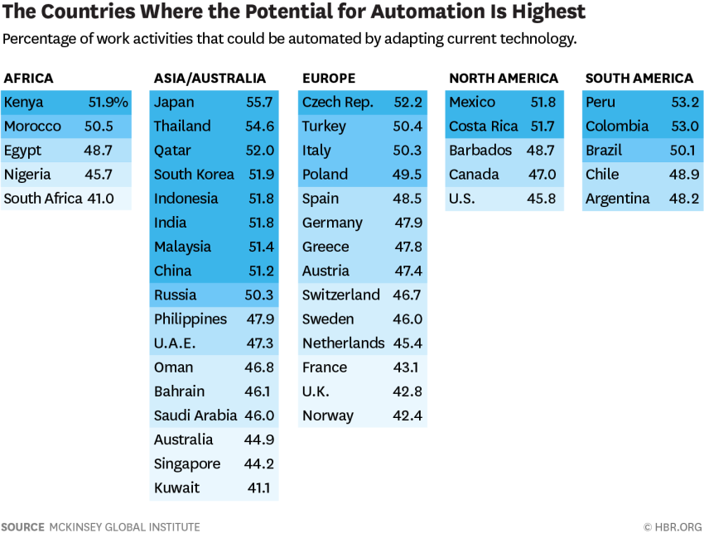
Countries which are most affected by robot replacement
“(…) the share of occupations that could experience significant automation is actually higher in developing countries than in more advanced ones, where many of these jobs have already disappeared“ (Muoio D.)

Slide 8
Decisive factors:
Level of manufacturing processes
Labor costs
Skill shortage
Age of population/ Birth rate
Labor regulations/ bureaucratic obstacles

Slide 9
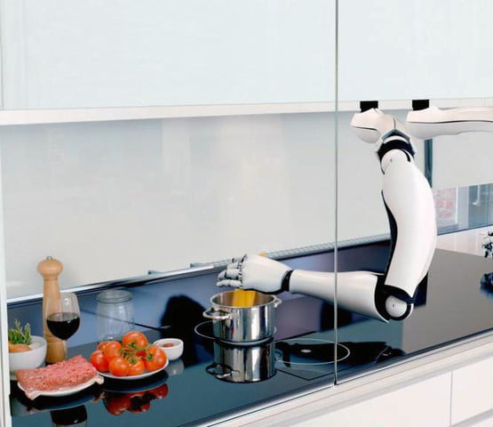
Positive aspects:
Better decision making
Objective feedback
Avoiding conflict
Decreased Production Costs
Shorter Cycle Times
Improved Quality and Reliability
Better Floor Space Utilization
Increased Safety
Improved efficienty and outcome
Looking forward: Utopia

Slide 10
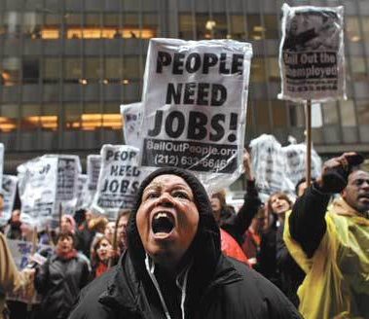
Negative aspects:
Humans need human contact
Lack of creativity
Higher Maintenance and Installation Costs
Enhanced Risk of Data Breach and Other Cybersecurity Issues
Reduced Flexibility
Anxiety and Insecurity Regarding the Future
Looking forward: Dystopia

Slide 11
References
IFR World Robotics (2018). Executive Summary World Robotics 2018 Industrial Robots. Retrieved from https://ifr.org/downloads/press2018/Executive_Summary_WR_2018_Industrial_Robots.pdf
Statista (2018). New installations of industrial robots worldwide in 2017, by industry (in 1,000 units). Retrieved from https://www.statista.com/statistics/257080/new-installations-of-industrial-robots-worldwide-by-industry/?fbclid=IwAR1dttD7D0foIqXhX5uYqlRhW7MnNtsW8d3BJScWz0hDfrCQ9suJQYvatPA
IFR World Robotics (2018). WR 2018 Presentation Industrial and Service Robot. Retrieved from https://ifr.org/downloads/press2018/WR_Presentation_Industry_and_Service_Robots_18_Oct_2018.pdf
Chui M., Manyika J., Miremadi M. (2017). The Countries Most (and Least) Likely to be Affected by Automation. Retrieved from Havard Business Review: https://hbr.org/2017/04/the-countries-most-and-least-likely-to-be-affected-by-automation
Muoio D. (2016). These are the developing countries where robots will take the most jobs. Retrieved from Businessinsider: https://www.businessinsider.com/countries-where-robots-will-take-jobs-2016-3
Sirkin H. (2016). It May Surprise You Which Countries Are Replacing Workers With Robots the Fastest. Retrieved from Huffpost: https://www.huffingtonpost.com/hal-sirkin/robots-workers-countries_b_9992960.html?guccounter=1
Chamorro-Premuzic, Tomas, and Gorkan Ahmetoglu. “The Pros and Cons of Robot Managers.” Harvard Business Review, 23 Mar. 2017. Retrieved from: hbr.org/2016/12/the-pros-and-cons-of-robot-managers.
DelGado, Rick. “The Negative Effects of Robots Entering the Workforce | IT Briefcase.” IT Briefcase, Virtual Star Media, 2 Oct. 2017. Retrieved from: www.itbriefcase.net/the-negative-effects-of-robots-entering-the-workforce.
RobotWorx. “Advantages and Disadvantages of Automating with Industrial Robots.” RobotWorx, SCOTT, 2017, www.robots.com/blogs/advantages-and-disadvantages-of-automating-with-industrial-robots.
RobotWorx. “Advantages and Disadvantages of Automating with Industrial Robots.” RobotWorx, SCOTT, 2017. Retrieved from: www.robots.com/blogs/advantages-and-disadvantages-of-automating-with-industrial-robots.
Make.it; Courtney Connley; 30 Nov 2017; Robots may replace 800 million workers by 2030. These skills will keep you employed. Retrieved from: https://www.cnbc.com/2017/11/30/robots-may-replace-up-to-800-million-workers-by-2030.html
Digital Trends; Luke Dormehl; 11.4.18; Replaced by robots: 10 jobs that could be hit hard by the A.I. revolution. Retrieved from: https://www.digitaltrends.com/cool-tech/examples-of-robots-replacing-jobs/?fbclid=IwAR34SJ0kFwQIiOpn_YVQziyawo7LJ_QFnzayz-pIUdLA26vagfa7unKMRGo
Michael Chui;July 2016; McKinsey & Company; Where machines could replace humans—and where they can’t (yet). Retrieved from: https://www.mckinsey.com/business-functions/digital-mckinsey/our-insights/where-machines-could-replace-humans-and-where-they-cant-yet?fbclid=IwAR1Tp2vbMDyLCmer4vY4uGvS-tQ4nRv9v7httPuqRS1Kx4zmheULPlG69m8
Patrick Scott, 27 SEPTEMBER 2017; The Telegraph; These are the jobs most at risk of automation according to Oxford University: Is yours one of them? Retrieved from: https://www.telegraph.co.uk/news/2017/09/27/jobs-risk-automation-according-oxford-university-one/?fbclid=IwAR3yNdi-kG9g6Mz4EWWUv5X6MXnNqXPwELTQCLPI4OezWw8nnKOetWuxWGI

Slide 12
Thank you!

