Slide 1
Emotional Intelligence
in HRM
Mariia Goroshnikova UČO 483261
Duy Anh Pham UČO 486263
Javier Morán Alcántara UČO 486223
Manas Kadyraliev UČO 480934
Youngeun Kim UČO 483279

Slide 2
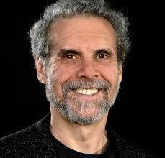
Introduction
Emotional intelligence involves being sensitive to other people’s emotions, facilitating improved performance based on its knowledge.
Main characteristics Emotional intelligence (Goleman):
Self-Awareness
Self-regulation
Internal motivation
Empathy
Social Skills

Slide 3
Measurement of Emotional Intelligence - Models
The performance test approach | Self-report approach | Peer-report approach
Mayer–Salovey–Caruso Emotional Intelligence Test (MSCEIT) | Wong and Law Emotional Intelligence Scale (WLEIS) | WEIP-3
Wong’s Emotional Intelligence Scale (WEIS) | The Bar-On EQ-i
Levels of Emotional Awareness Scale | Emotional Competence Inventory

Slide 4
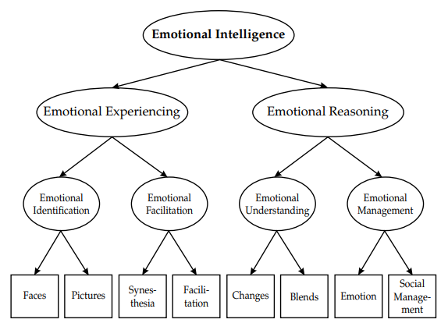
Mayer–Salovey–Caruso Emotional Intelligence Test
Aspects to measure
Where can be used
Limitations

Slide 5
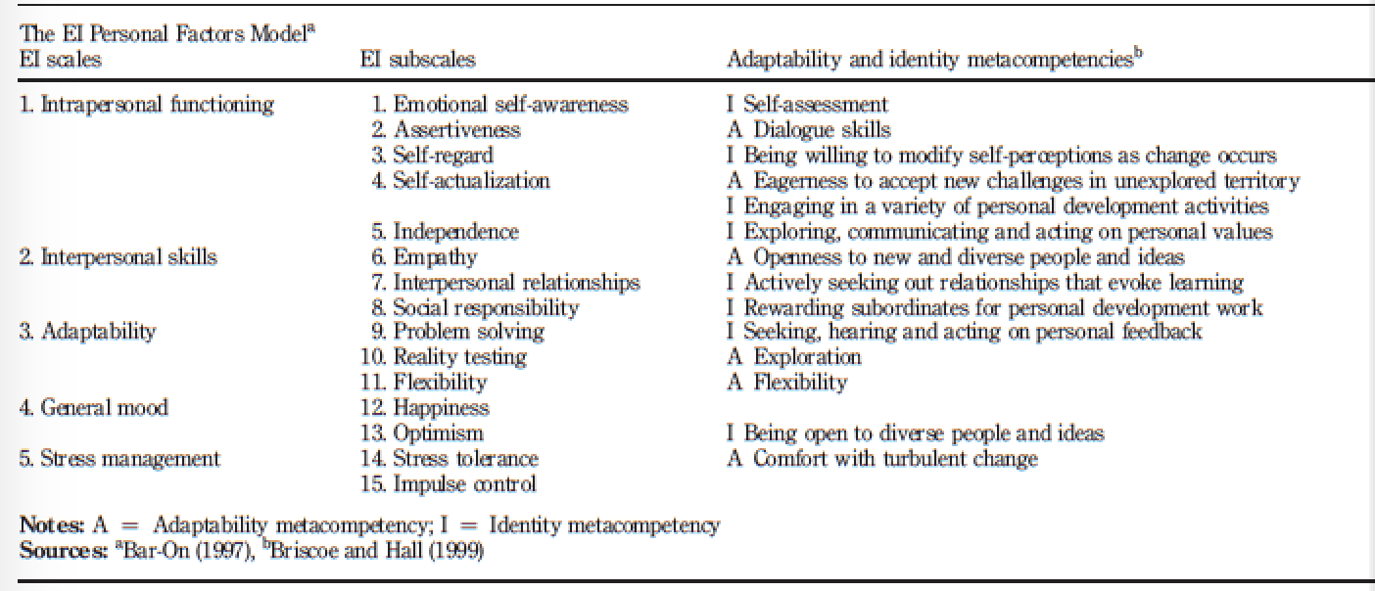
Measurement of Emotional Intelligence - The Bar-on model
How Bar-On model was developed?
Charles Darwin (1892)
Emotional Quotient Inventory (the EQ-i) (1980s)
The EI Personal Factor model (2005) - Bar-on Reuven
The relationship between the Bar-On model and:
physical health;
psychological health;
social interaction;
performance in the workplace;
self-actualization.

Slide 6
Reliability
How to use the Bar-on model in a business environment:
- Using emotional intelligence to identify high potential in managers.
- A synthesis of leadership and emotional intelligence
- The Impact of Emotional Intelligence on Workplace Behaviour
Limitations
Self-evaluate of the respondents.

Slide 7
Practical usage of EI
“emotional intelligence : can companies really feel their way to success?”
-Lauren Garris.
ex) AT&T ; 20 percent more productive.
4/5 large companies ; promote emotional intelligence in their organizations
Can we improve our emotional intelligence? it is possible !!
emotional intelligence levels are firm, but not rigid
ex) Coca-Cola ; exceeded their performance targets by 15 percent.
high emotional intelligence
productivity, engagement levels, turnover and absenteeism rates, market share.

Slide 8
Conclusion
No 100% effective model
Emotional intelligence is being implemented in companies
Future improvements may lead to success

Slide 9
Sources
Emotional Intelligence over IQ, According to CareerBuilder Survey.
Goleman, D. (1995). In Emotional intelligence: why it can matter more than IQ. New York: Bantam Books.
Wilhelm O. (2005) Measures of Emotional Intelligence: Practice and Standards, Human Resource Management Review, 12(2):195-214
Côté S.,C.T.H. Miners,Moon S.(2015) "Chapter 1 Emotional intelligence and wise emotion regulation in the workplace" In Individual and Organizational Perspectives on Emotion Management and Display,1-24
Lauren Garris. (2013). emotional intelligence : can companies really feel their way to success?. UNC Executive Development

Slide 10
THANKS!
Any questions?

