Slide 1
Introduction to MS Dynamics NAV Sales example and impacts (Inventory, Customer Ledger Entries and General Ledger) Assigned to students of courses BPH_EPS1,MPH_AOMA and MPH_AOPR
Ing.J.Skorkovský,CSc.
MASARYK UNIVERSITY BRNO, Czech Republic
Faculty of economics and business administration
Department of corporate economy

Slide 2
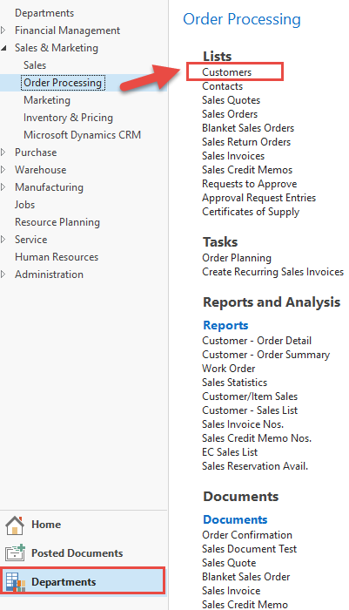
Customer Card
One customer record
Mouse click
List of
customers
See next slide

Slide 3
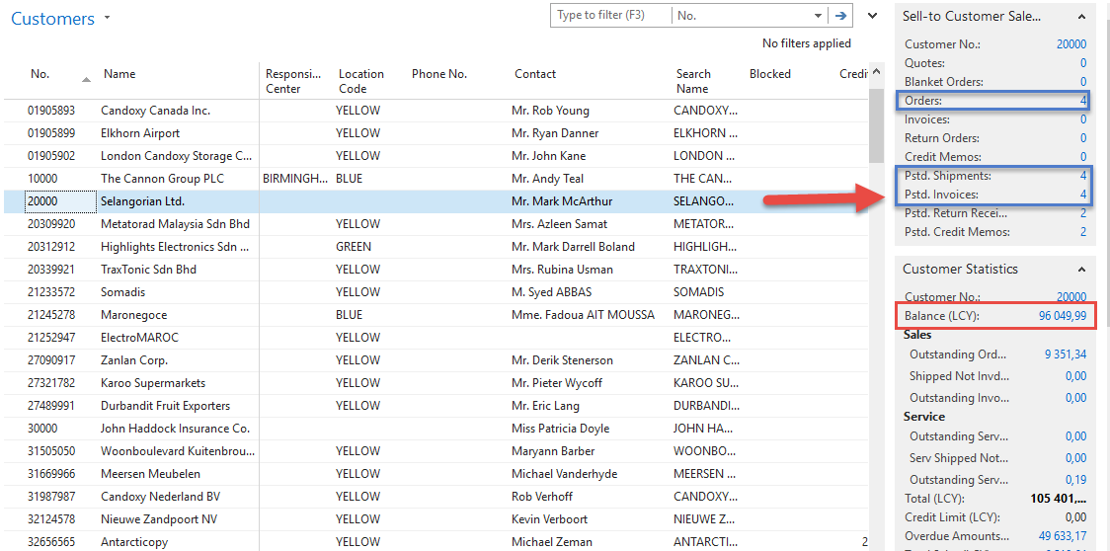
List of Customers
See balance (calculated field ) and explain it! See business history and explain as well!
Use Edit Icon in order to open chosen customer card !
To open one
chosen Customer
Card

Slide 4
Customer Card
See following tabs :
General - basic fields (Country (Region, Salesperson, Balance, Credit limit,...)
Communication – basic fields (e-mail,…)
Invoicing - basic fields (Posting groups- will part of the accounting section of this course)
Payments – basic fields (Payment terms- enter new one by use of formula date)
Receiving – basic fields (Location)
Foreign trade – basic fields (Currency code and Language)
1D, 2W,1M..

Slide 5
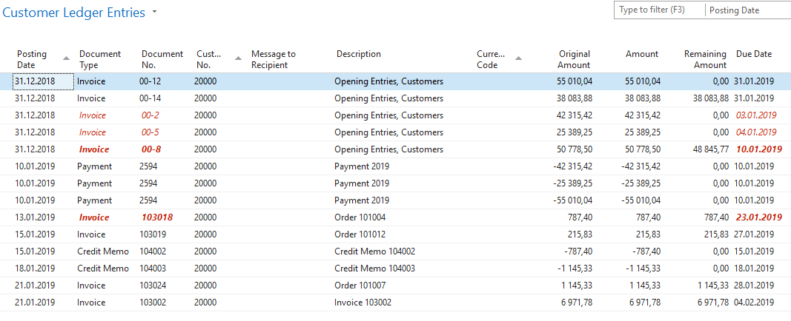
Customer Ledger Entries
Customer
Ledger
Entries
Customer card
Customer Ledger Entries were created due to posted documents
such as invoices, credit memos, and payments

Slide 6
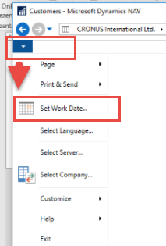
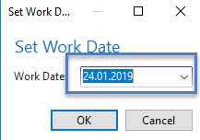
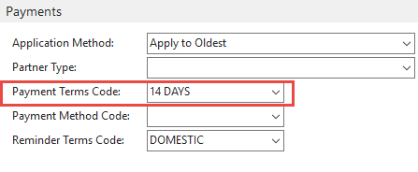
Working date, Payment condition and red marked Customer Ledger Entries
Business
parameters
Customer card
Go to Tab Payments od Customer card

Slide 7
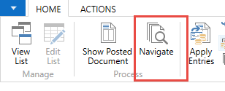
Customer Ledger Entries (filtered to only one red marked invoice entry)
Customer card
By use of Navigate tool you can see document (invoice)
See next slide

Slide 8
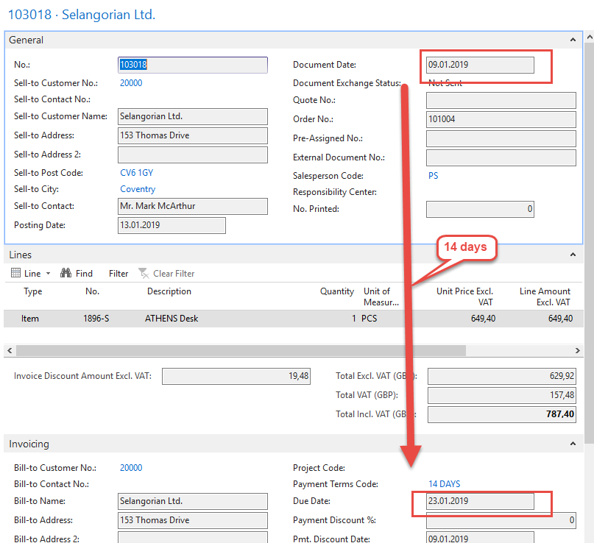
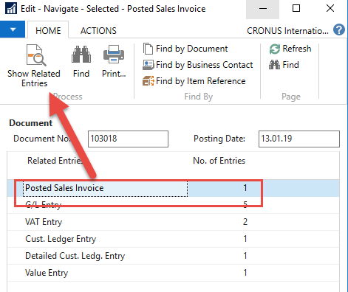
Invoice in question

Slide 9
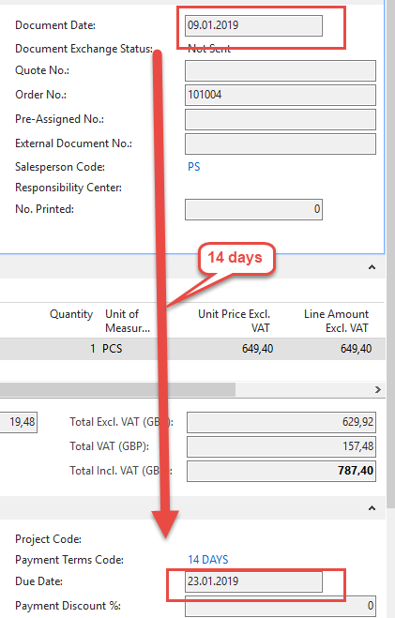
One day after due date

Slide 10
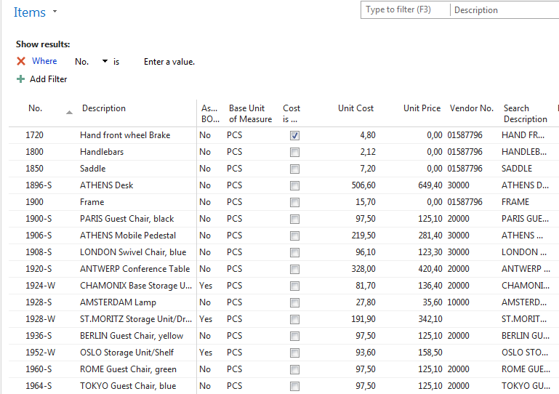
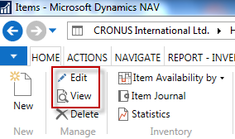
Item list (use search window)

Slide 11
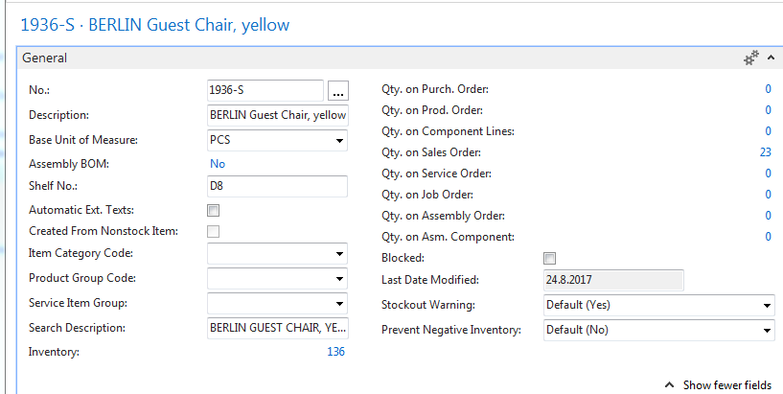
Item Card
See basic fields (Inventory, Quantity on Sales and Purchase orders,…)

Slide 12
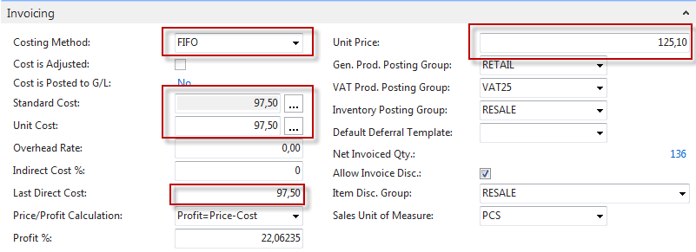
Item Card
Product posting group will be explained later (impact to accounting)

Slide 13
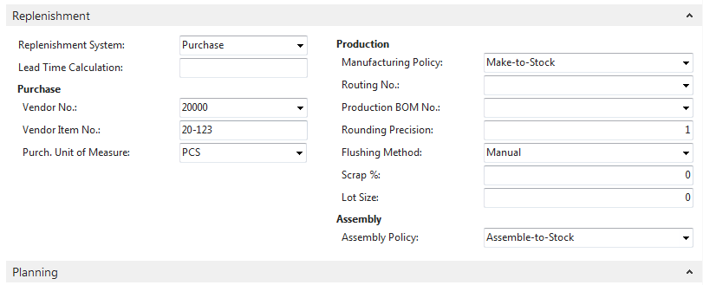
Item Card

Slide 14
Item Ledger Entries
By removing filter value see other entry types (purchases, transfers sales,…) !

Slide 15
Sales Order creation
Customer
Ctrl-N
Sales Order (header and lines)
Insert required quantity !!!
3
Item

Slide 16
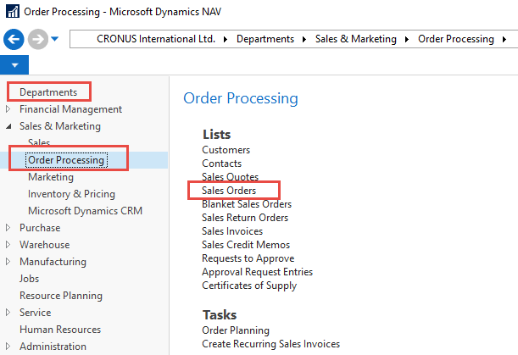
Sales Order creation

Slide 17
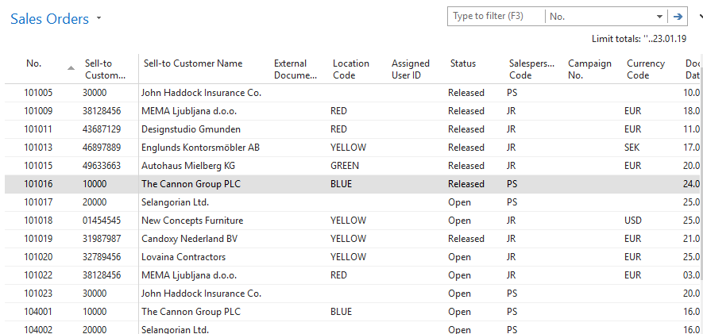
List of already existing Sales Orders

Slide 18
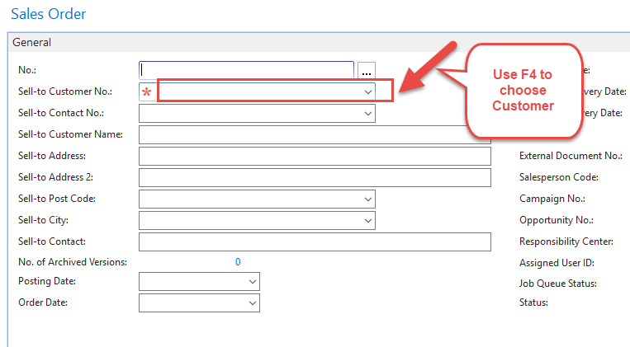
Sales Order (SO) – new one
Double click on icon New
Empty form of SO structure ->Enter and
The new document number is created automatically

Slide 19
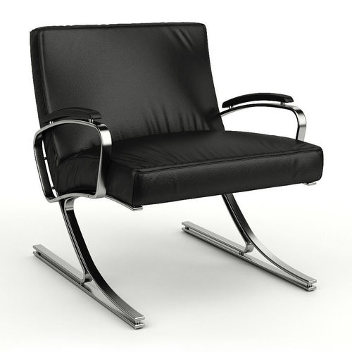
Sales Order (SO) – new (To enter data use F4 or mouse)
Fields with default data are marked by orange *
Enter chosen Customer and confirm by key ENTER !
Enter type of the Sales Order line (by F4 or mouse) = Item !
Enter chosen item (Berlin chair 1936-S) and confirm by key ENTER !
Enter quantity 10 and Stock location= BLUE !!!!
See next slide

Slide 20
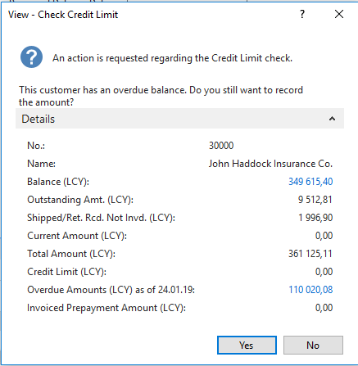
Sales Order (SO)
You will get probably a warning message ! Will be explained by tutor!
To continue push button YES

Slide 21
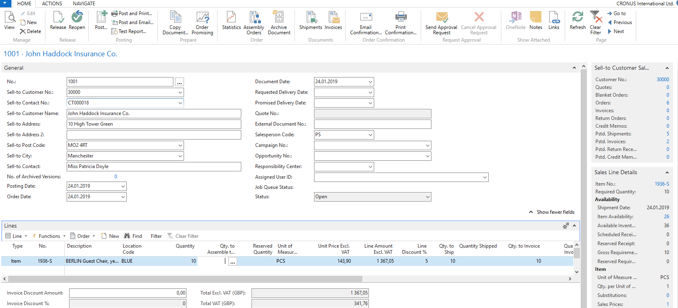
Sales Order (SO)

Slide 22
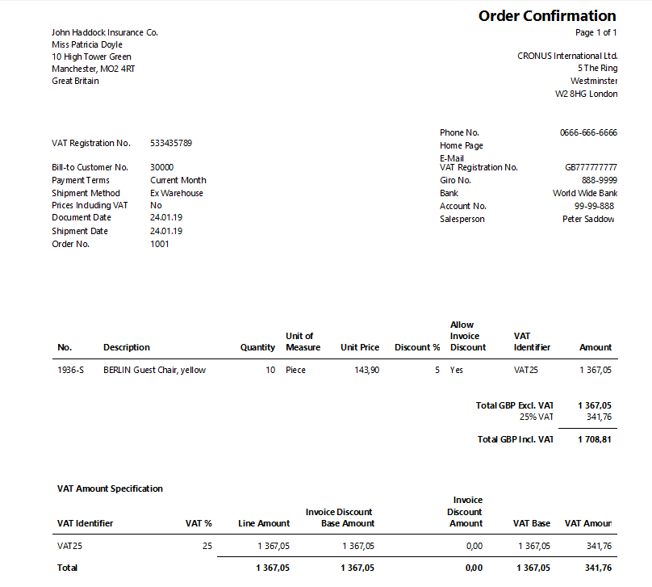
Print (Preview)

Slide 23
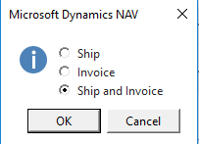
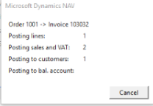
Post SO by use of key F9 (or icon)
See Customer Ledger Entries :
Search window
Customer
Filter to Customer 30000
Icon Ledger Entries –Option Entries or Ctrl-F7

Slide 24
Customer Ledger Entries
See next slide

Slide 25
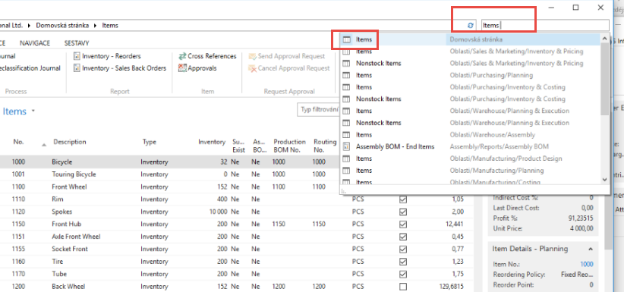
Item Ledger Entries
Inventory decreased by 10 !!

Slide 26
Item Ledger Entries
See Item Ledger Entries :
Search window (See previous slide)
Item
Filter to Item 1936-S
Find icon Entries ->Option=Entries
See next slide

Slide 27
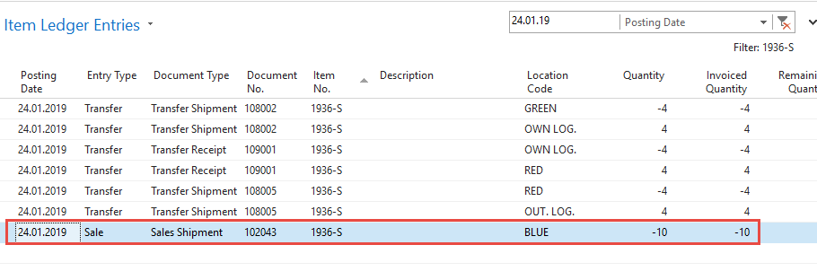
Item Ledger Entries
Ctrl-F7
Inventory was decreased by 10 !!

Slide 28
General Ledger (home study)
What is it ?
A general ledger contains all the accounts for recording transactions relating to a company's assets, liabilities, owners' equities, revenues, and expenses.
In modern accounting software or ERP, the general ledger works as a central repository for accounting data transferred from all sub-ledgers or modules like account payable, account receivable, cash management, fixed assets, purchasing and projects.
The general ledger is the backbone of any accounting system which holds financial and non-financial data for an organization. The collection of all accounts is known as the general ledger

Slide 29
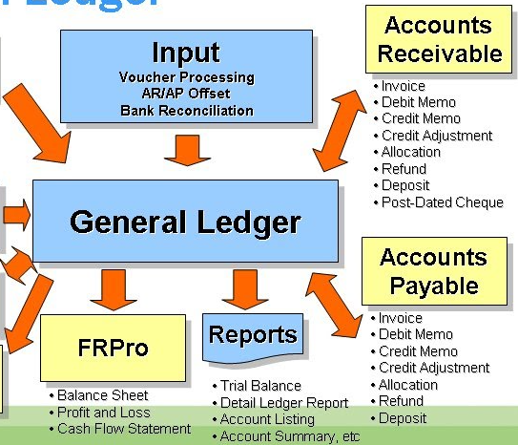
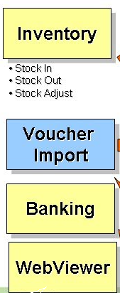
General Ledger (home study)

Slide 30
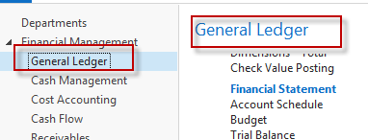
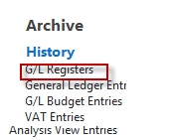
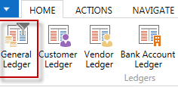
Impacts in General Ledger
Go to last line of G/L register
Go to icon General Ledger

Slide 31
Impacts in General Ledger
Sales Retail Domestic
6110
Sales VAT 25%
5610
Customer Domestic
2310
1439,00
17,99
359,75
1 708,81
Debit | Credit
17,99 | 1439
71,95 | 359,75
1708,81 | 1798,75
1798,75
Discount granted
6910
71,95

Slide 32
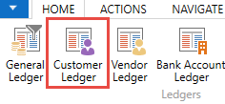
Use of Navigate tool
Go to Icon Customer Ledger Entries (from the same working space (General Ledger)

Slide 33
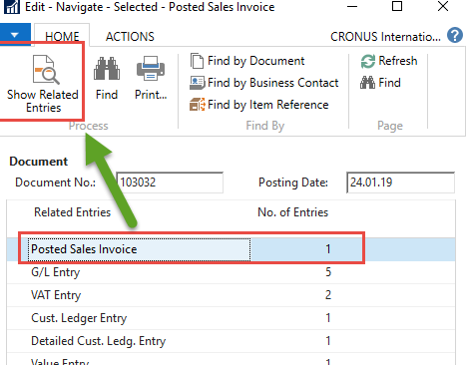
Use of Navigate tool

Slide 34
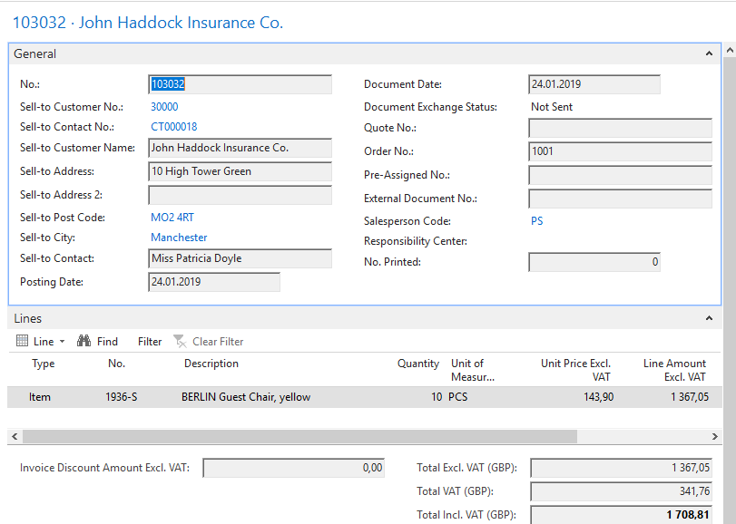
Result of Navigation

Slide 35
End of the section SALES Sales example and impacts (Inventory, Customer Ledger Entries and General Ledge)

