Slide 1

International Trade – A Marketing Perspective
Guest Lecture for Masaryk University
Dr Yang Liu
Queen’s Management School
y.liu@qub.ac.uk

Slide 2
Agenda
The marketing perspective in the international context.
Understanding the marketing environment.
The product standardization-adaptation strategy.
Serving emerging markets.

Slide 3

Marketing Perspective
Marketing is a process by which companies create value for customers and build strong customer relationships to capture value from customers in return (Kotler et al., 2017).
A marketing process:

Slide 4
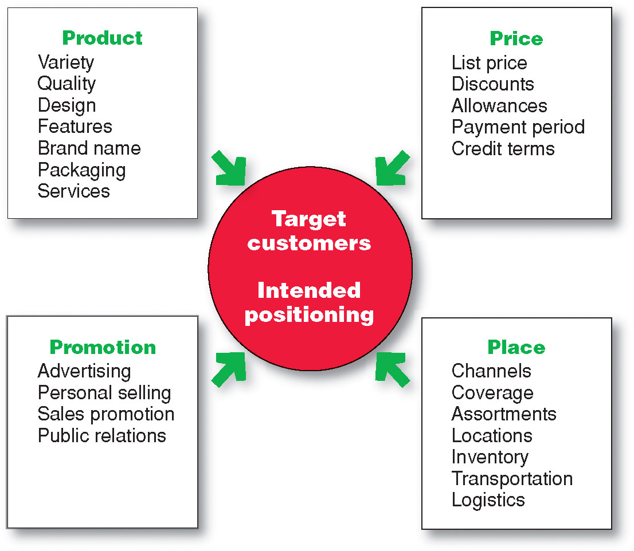
Marketing Perspective
4P marketing mix:
In the international context, a key issue is marketing standardization-adaptation (Katsikeas et al., 2006).

Slide 5
Market Requirements Across Countries
Market requirements can be different across countries, depending on the industry.
There are different aspects:
  Customer taste/habits
  Local environmental conditions
  Regulations
  (Purchasing power)

Slide 6







Market Requirements Across Countries
Customer tastes/habits (e.g. refrigerator types).
  In some industries, they are gradually converging, but differences still remain.
Europe
North America
South America
Asia

Slide 7

Market Requirements Across Countries
Local environmental conditions include local weather (e.g. temperature and humidity) and local infrastructure (e.g. road and energy).
  They are not converging significantly.
Octane Ratings of Petroleum in North America

Slide 8


Market Requirements Across Countries
Regulations/standards are compulsory for firms to meet in a country (e.g. car crashing tests and light configurations).
  They have greatly converged at the regional level, but not so at the global level.
Side Marker: American vs. European Standards

Slide 9
Product Standardization-adaptation
Global standardization: The product design is similar globally. Low costs due to economies of scale.
Local adaptation: Products are customized for different requirements locally. More appealing to local customers.
It is a continuum. MNEs make choices somewhere between the two.
High
standardization
High
adaptation
Notes:
Local adaptation is also called local customization.

Slide 10

Group Discussion
Choose one or two products/services you know. Discuss the following issues:
  Is the product/service globally standardized or locally customized?
  Why?

Slide 11
Product Standardization-adaptation
The strategic fit theory (Katsikeas et al., 2006; Schmid and Kotulla, 2011): MNEs’ strategic choices between product global standardization and local adaptation depend on situational factors including:
  Market demand homogeneity across countries.
  Cost of product modification.
  Price elasticity of demand.
  Potential for economies of scale.
Each factor is positively related to standardization (e.g. high demand homogeneity -> high standardization).
However, one important factor is missing here!

Slide 12

The Effect of Brands on Product S-A
General Motors – The biggest automaker in the U.S.
It has many brands with distinct brand images.

Slide 13


The Effect of Brands on Product S-A
Car bodies are customized in different regions to fit with brand images.
For example, Opel (Vauxhall) Astra in Europe and Chevrolet Cruze in the U.S. have same chassis, but different car bodies.

Slide 14
Managing Dual Pressures in NPD
In new product development, engineers face dual pressures – standardization and adaptation of products. They adopt certain practices to handle the pressures:
  Compromise
  Overdesign
  Modularity

Slide 15


Managing Dual Pressures in NPD
Compromise: A requirement is abandoned or compromised to deliver an “acceptable” rather than “ideal” product.

Slide 16


Managing Dual Pressures in NPD
Overdesign: Product features (required by one country) are offered globally even if they are not required by others.

Slide 17


Managing Dual Pressures in NPD
Modularity: Some components are designed to be modular in order to be shared even if other components are changed.

Slide 18
Brand Standardization-adaptation
Should a company adopt a single-brand strategy or multiple brand strategy for different countries.
  Brand standardization: More advertising needed in foreign countries; easy to be identified when customers are travelling across countries; less complexity.
  Brand adaptation (different brands locally via acquisitions): Easy to be recognized by local customers; difficult to identify when customers are travelling; more complexity.

Slide 19

Brand Standardization-adaptation
Unilever’s laundry detergent business has different brands in different countries due to local acquisitions.
  Acquiring local brands helped Unilever to capture local markets easily and quickly.
  However, it also caused complexity and confusion for customers.
  In around 2002, it conducted unification of brands.

Slide 20








Brand Standardization-adaptation

Slide 21
Emerging Markets
Emerging markets: Developing countries that are more affluent, e.g. BRICs countries.
Characteristics:
  There are a large number of lower class people. Middle class is rising. There are big business opportunities there.
  A lot of people with low purchasing power, calling for special strategies/innovations.
A case study – Microsoft in India (Hill, 2012)
Notes:
Here the content is more general, not specific to the case study.
There is a related concept, base of the pyramid.

Slide 22

Case Study – Microsoft in India
How is the Indian market different from western countries like the US?
  More people with low income. They cannot afford Microsoft software.
  Pirated software and free software (Linux) used by many people.
  Some small companies use mobile phones instead of computers.

Slide 23
Case Study – Microsoft in India
What steps did Microsoft take for the Indian market?
  It developed Windows XP Starter (a simplified version) which is sold at less than half of the original price.
  It offered online monthly subscription of Office software at low price.
  It developed Multipoint computers (with multiple mice), allowing multiple people to use one computer simultaneously.
  It offered text-messaging services for firms using mobile phones. With the services, firms can check order status and inventories.

Slide 24


Serving Emerging Markets
Product simplification: Complex functions of products sold in developed countries are removed for lower costs in developing countries.
  High-cost premium products are still sold in developing countries. Thus developing countries can have more products variants.

Slide 25


Serving Emerging Markets
Product retaining: Products phased-out in developed countries can still be sold in developing countries with lower prices.
  It means longer product life cycles in developing countries, but new products can also be sold.

Slide 26


Serving Emerging Markets
Reverse innovation (Immelt et al., 2009): Low cost innovations are made specifically for developing countries (designed from scratch).
  It can be popular in developed countries as well. The (low-cost) environment of developing countries facilitates such innovations.
Traditional Ultrasound Device
$ 100K
Portable Ultrasound Device
$ 15K
Notes:
The Portable Ultrasound Device need to be connected to a computer. It uses the computing capability of a computer, so the price can be significantly reduced.

Slide 27
Learning Points
Marketing is about serving customers.
In the international context, market requirements are different in four aspects.
There are situational factors affecting product standardization-adaptation in a firm.
Emerging market requirements need to be handled through special strategies.

Slide 28
References
Katsikeas, C. S., Samiee, S. & Theodosiou, M. (2006). Strategy fit and performance consequences of international marketing standardization. Strategic Management Journal, 27(9): pp. 867-890.
Kotler, P., Armstrong, G., Harris, L. and Piercy, N. (2017). Principles of marketing. 7th European edition. Harlow: Pearson.
Hill, C. W. L. (2012). International business: Competing in the global marketplace. 9th Global edition. NY: McGraw-Hill.
Immelt, J. R., Govindarajan, V., & Trimble, C. (2009). How GE is disrupting itself. Harvard Business Review, 87(10): pp. 56-65.
Schmid, S. & Kotulla, T. (2011). 50 years of research on international standardization and adaptation—From a systematic literature analysis to a theoretical framework”. International Business Review, 20(5): pp. 491-507.

