Slide 1
Economic Policy #01
The Concept of Economic Policy
Aleš Franc

Slide 2
Course contents (subject to change)
Concepts of Economic Policy (L#01)
Limits of Economic Policy (L#02)
Fiscal Policy (L#03,04)
Monetary Policy (L#05,06)
Foreign Economic Policy (L#07)
Growth Policies (L#08)
Labor Market Policy (L#09)
Social Policy (L#10)
Policy seminars (L#11-13)

Slide 3
Assessment methods
Policy presentation (1/2)
  during the last 3 classes
  topic list will be published, students will enroll
  each presentation should last around 15’ and be based on ppt or equivalent handout
Final written exam (1/2)

Slide 4
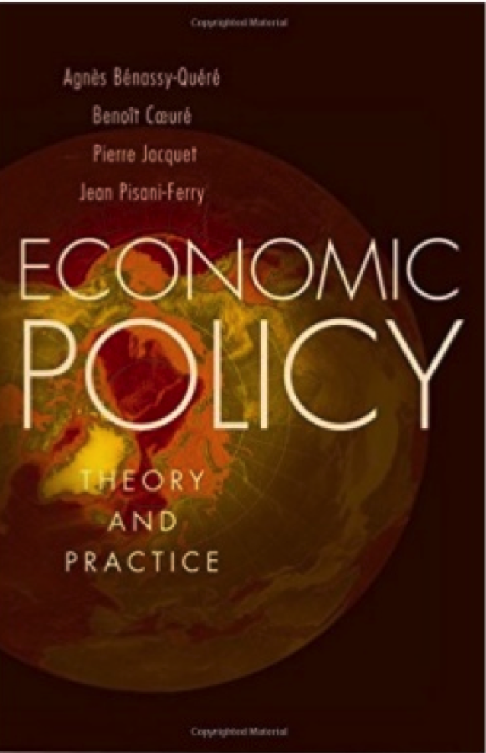

Slide 5
The Concept of Economic Policy
Approaches to economic policy
Objectives of economic policy
The whys and hows of public intervention

Slide 6
Three approaches #1
Positive economics:
  studying the effects of economy policy (EP) choices on the economy => EP is regarded as exogenous
  determining transmission channels (e.g. impact of an interest rate cut)
Normative economics:
  making recommendations to the Prince
  based on positive-economics results on the Prince’s utility function
  political and social constraints (second best problem)
  information contraints (asymmetric information, communication failures)

Slide 7
Three approaches #2
Political economics
  Agents ‘ behaviour is endogenous
  Government is a machine directed by rational players with specific objectives and facing specific constraints
  EP is determined by policy regime

Slide 8
The main tasks of policymakers
set and enforce the rules of the economic game
tax and spend
issue and manage the currency
produce goods and services
negotiate with other countries

Slide 9
A general framework of EP making

Slide 10
Role of institutions
Douglass North (1993): “Institutions are the humanly devised constraints that structure human interaction. They are made up of formal constraints (rules, laws, constitutions), informal constraints (norms of behavior, conventions, and self imposed codes of conduct), and their enforcement characteristics.”
Institutional framework affects directly market equilibriums and effectiveness of EP instruments.

Slide 11
Objectives of EP (examples)
Humphrey-Hawkins Act (USA):
  “promote full employment and production, increased real income, balanced growth, a balanced Federal budget, adequate productivity growth, proper attention to national priorities, achievement of an improved trade balance..”
Article 3 of the treaty on the EU:
  “work for the sustainable development of Europe based on balanced economic growth and price stability, a highly competitive social market economy, aiming at full employment and social progress, and a high level of protection and improvement the quality of the environment.”
=> Objectives of EP are numerous and sometimes contradictory.

Slide 12
EP as a succession of trade-offs
Tinbergen rule: to reach an indepedent
  objectives governents needs at least
  an equal number of EP instruments.
In reality, number of instruments < number of objectives
=> there are inevitable trade-offs

Slide 13
Economic management vs. structural reform #1

Slide 14
Economic management vs. structural reform #2
Economic management contains various levers such as tax rates, interest rates and public spending.
Structural reforms aim to modify EP trade-offs by changing the institutions (CB independence, choosing a currency regime, adopting framework for budgetary policy etc.)

Slide 15
The employment-productivity trade-off

Slide 16
Structural reforms in post-communist countries
Structural reforms often have negative short-term,
but positive long-term effects.

Slide 17
The Whys and Hows of Public Intervention
Three functions of economic policy (Musgrave&Musgrave, 1989):
Allocation ⬄ market inefficiency (ex. competition, education, climate)
Macroeconomic stabilization ⬄ nominal rigidities (ex. monetary and fiscal policies)
Income redistribution ⬄ corrects the primary distribution of income (eg. taxation, social transfers, housing)

Slide 18
Stabilization vs. allocation policies
=> Allocation policies impact potential output
=> Stabilization policies impact the output gap

Slide 19
More on allocation
Imperfect competition: fight market power, regulate innovation rents and natural monopolies
  Instruments: antitrust, intellectual property, regulation etc.
Externalities
  Instruments: regulation, taxes
Imperfect information: innovation rents, consumer illiteracy, moral hazard, conflicts of interest
  Instruments: mandatory disclosure, financial regulation, etc.
Incomplete markets
  Instruments: public education, credit enhancement

Slide 20
More on stabilization #1
J. M. Keynes (1883-1946):
private instability (‘animal spirit‘) + ineffective self-correcting mechanisms (nominal rigidities)
=> need for counter-cyclical policies to smooth out economic fluctuations and prevent economic depressions.

Slide 21
More on stabilization #2

Slide 22
More on redistribution
Two arguments:
  Pareto optimality (resulting from first welfare theorem) does not amount to social justice
  Efficiency-enhancing policies (e.g. trade) make winners and losers
Income distribution can be corrected in a non-distortionary way through lump-sum transfers
Difficult to implement in practice => frequent equity-efficiency trade-offs

Slide 23
Reference textbook
Bénassy-Quéré, A. et al. Economic Policy : Theory and practise. Oxford University Press, 2010. Chap. 1.1. -1.2

