Slide 1
FINAL ASSIGNMENT: RESEARCH PROPOSAL
Stanislav Ježek

Slide 2
FINAL ASSIGNMENT FOR THIS SEMESTER
Submit a research proposal for one study that could be a part of your dissertation
The document should be structured according to the structure described by Sekaran, Bougie, p. 45 – 46 with added ethical considerations (see next slide)
You can use the following sources as tips concerning content an style Robson, McCartan (2016, in study materials) or this guide
Methods and materials (questionnaires, interview schedules, observations schedules, stimulus materials etc.) should be included in full and placed in appendices.
For the purpose of the assignment you may simplify your planning by disregarding the discrepancy between English as the official language of the course and the fact you might be doing the study in a population of non-native speakers
Deadline is in course description in the IS.
There are no strict limits on the length but usually around 8-10 normed pages (roughly 2500 words) without references and appendices.

Slide 3
Structure of proposal from S-B (p. 45 – 46)
A working title.
Background of the study.
The problem statement:
The purpose of the study
Research questions.
The scope of the study.
The relevance of the study.
The research design, offering details on:
Type of study – exploratory and descriptive
Data collection methods
The sampling design
Data analysis.
Time frame of the study, including information on when the written report will be handed over to the sponsors.
The budget, detailing the costs with reference to specific items of expenditure.
Ethical consideration
References

Slide 4
Notes
Sections 2-3: Please assume the reader has only general knowledge of your area of interest. Make sure your backgound is written clearly and includes all important theory to make the research statement understandable to a non-specialist.
Sections 4-5: Please, be realistic. There is no need to exaggerate. Even small findings on limited populations can be useful.
Section 6 should be very detailed, concrete. Think it through all the way – almost a like a script of your interactions with participants from recruiting them to thanking them good bye.
Section 9 is an addition to S-B structure. Please argue why you believe all ethical requirements are met.

Slide 5
The following are just resources that could be useful.

Slide 6
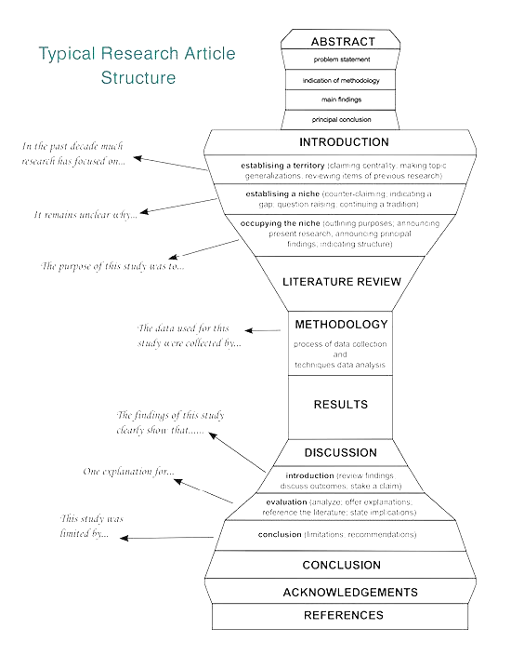
Writing up - IMRaD
INTRODUCTION
Topic – literature review – RQs/Hs
METHODS
Sample – Measures – Design - Analyses
RESULTS
Data description – models – tests of hypotheses – exploratory analyses
DISCUSSION
Findings – implications – limitations – further research

Slide 7
INTRODUCTION
From the topic to RQ/H
The topic – what is the problem area and why it is important
The problem – what is the problem and and what are solutions in literature → what is unknown, uncertain, missing, controversial….
My contribution – what my research should bring – RQs/Hs that logically follow from the previous paragraphs

Slide 8
METHOD
How do I (plan to ) achieve the aims of my research.
In detail allowing the reader to assess
feasibility
validity – interenal and external – and threats to it
researcher competence
Design
Sample
Methods (measures, protocol)
Analyses
Order of the first three varies.
In lab experiments the placement of detailed description of the experimental procedure varies.

Slide 9
METHOD - DESIGN
The overall strategy of creating new knowledge
Identification of standard type of design + details, deviations
Observational, Survey, Longitudinal, panel, (Quasi-)Experimental, Case study, Evaluation, Ethnography, GT, Simulation ….

Slide 10
METHOD - METHODS
Measures (to be) used
Experimental procedures.
Short descriptions with arguments for sufficient validity and reliability
In QUAL studies often merged with Design.
Procedures ensuring validity are explicitely proposed as a part od method
What choices will be made during the study and how wil the be made?

Slide 11
METHOD - SAMPLE
Description of sampling procedure
Argument for sample size
Description of sample (not in a proposal)
Ethics statement (unless in a special section)

Slide 12
METHOD - ANALYSIS
Plan (or description) of the analysis
Data processing
Analytical approach
Tools used (software)
Relevant level of detail – often short unless the analysis is unusual or complex

Slide 14
ETHICS OF RESEARCH WITH HUMAN SUBJECTS – AN OVERVIEW

Slide 15
Research ethics (Ruane, 2016)
Doing no harm
Obtaining informed consent
Competence
participants need to have the ability to know what is in their best interest
Voluntarism
participants must have freedom of choice about study involvement
Full information
participants should receive all relevant information about study
Comprehension
participants must understand information presented
Protecting privacy
More complicated in our technology saturated world
Many public settings still have privacy expectations
Avoiding conflict of interest
a challenge given prevalence of corporate funding of research
Ethics review boards
(https://vyzkum.rect.muni.cz/cs/zazemi/etika-vyzkumu)

