Slide 1
“HRM
&
OrgDev”
Introduction
Dipl.-Ing. Johannes GÖLLNER, MSc
Masaryk University, Brno, CZ
September, ^{20th}, 2019, 10:00–15:30
Lecture 1

Slide 2
Relevant CONTENT of HRM & OrgDev:
Which problems should have been solved by Human Resource Management in organizations, and in further consequence in economy and society?
Relation between organizational and individual capabilities and skills for strategic and operational organizational development
Relevance of Knowledge Management for Human Capital Leadership?
Models and methods for skill analysis and development (input, output and comparison models and methods with a special focus on assessment centres)
A practical example for the application of the assessment centre method in context of HRM
Relation between HRM, Knowledge Management and Risk Management for organizational development, controlling and leadership

Slide 3
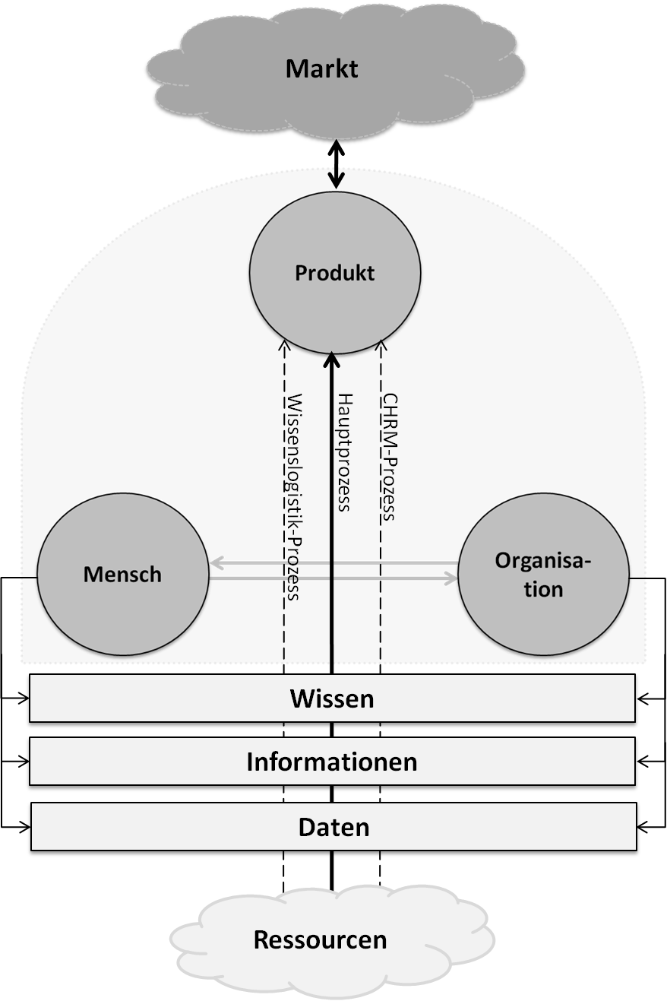
/market
Generic description
of the system ORGANISATION
/product
/human being
/main process
/knowledge
/data
Quelle: Copyright by GÖLLNER,
publiziert iRd MT-Hartinger, Donau Universität Krems, 05/2012, S.71
/resources

Slide 4
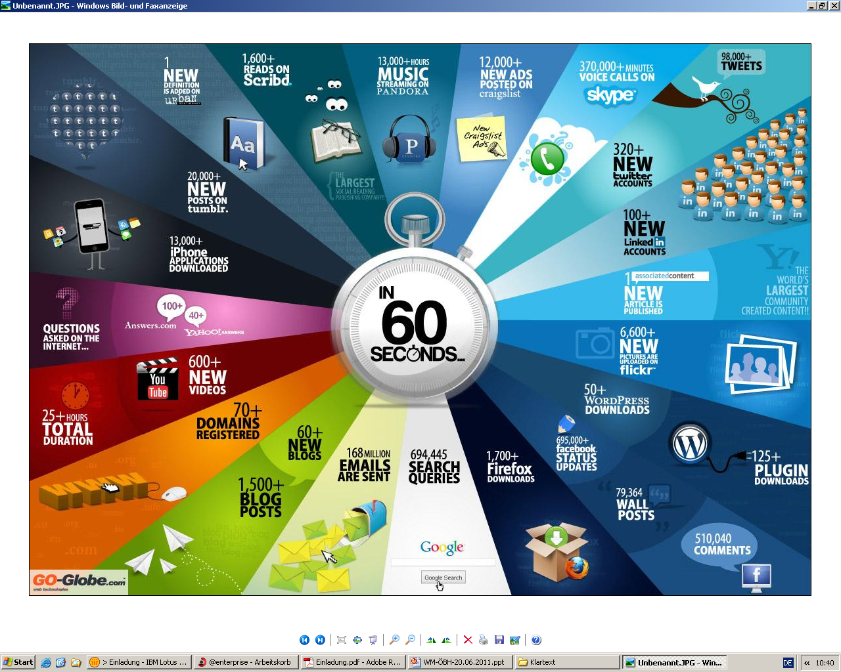

Slide 5
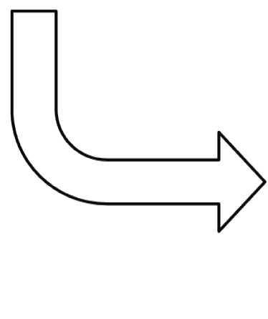
Organisation-Development
EVALUATION
(Controlling)
SCENARIO
Knowledge
(FC, SC, HC, RC)
ORGANISATIONAL
OPERATION

Slide 6
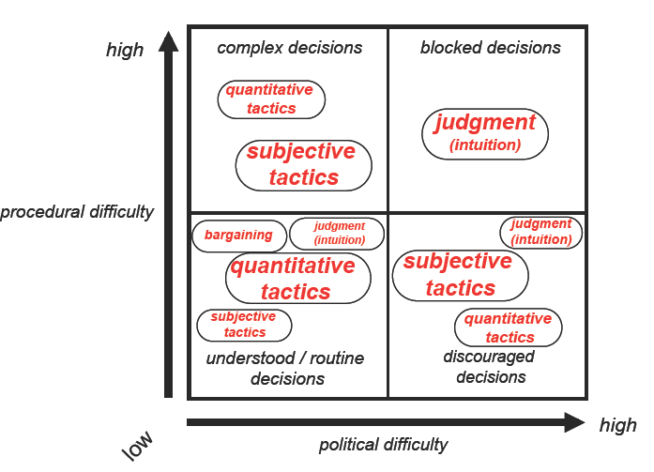
Entscheidungsfindung
30%
4%
49%
17%
Quelle: Paul C. Nutt, 1998
Notes:
References Paul C. Nutt
How Decision Makers Evaluate Alternatives and the Influence of Complexity Management Science 1998 44:1148-1166;

Slide 7

Building
the Knowledge Performance System
with a Model Based
Approach
No engineer, designer or architect works without a
plan / planning / BPM - tool!
Do we have a KM - System, a Knowledge planning/
modelling tool and a KM/Evaluation tool in our
organisation?

Slide 8
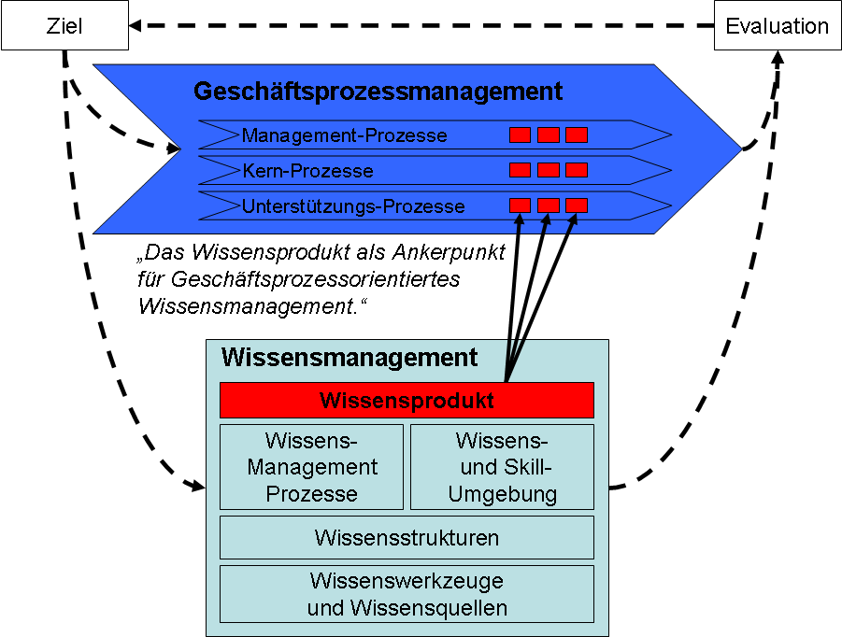
  IF YOU CAN`T MEASURE -
  YOU CAN`T MANAGE IT!
„idea“
Goal/Task
Evaluation
Business-Process
Management-Process
Core-Process
Support-Process
„The Knowledge-Product – anchor point
of business process oriented
Knowledge Management“
Knowledge Management System
Knowledge Management System
Knowledge Product
Use case and product
Knowledge-
Management
Process
Knowledge-
and Skill
Environment
HC relations and skills
Processes and structures
Knowledge Structures
Ressources and support
Knowledge Tools & Knowledge Sources

Slide 9
Relation HC and Risk Management (RM) for organisational development
risk-identification, -analysis, -assessment
Risk Management
design procedures
Shareholder value
guarantees
purchasing price

Slide 10
All measures designed to ensure the correct conduct of a company, its management and supervisory bodies and its employees.
CORPORATE COMPLIANCE
The main task of the Board / CEO is to ensure that:
- organizational measures, training and controls and
- the correct conduct of the company and its employees
is ensured.
The company should be protected from claims for damages and judicial and administrative authorities penalties.
Source: Copyright by GÖLLNER,
LV Risikomanagement I, BOKU Wien, 2012
Notes:
Text ergänzen aus Folienvortrag RM Vortrag BOKU: HANNES

Slide 11
Process-Chart: Organisation „X“:
Strat.Plg.
Lead.Pr.
Oper.-Plg.
QM
Controlling
RM
WM
Mgmt.-prozesse
Contr.Pr.
Orders
Knowledge Logistics
Core-
processes
PL
Support-processes
Accounting
LOGISTIC
SALES
LAW
PRODUCTION
R & D
HRM
PR
etc.

Slide 12
General Process-Logic of an Organisation
SCENARIO
Development
MONITORING
(Controlling)
KNOWLEDGE/RISK-PRODUCT Relation
(FC, SC, HC, RC)
ORGANISATIONAL
OPERATION
Source: Goellner

Slide 13

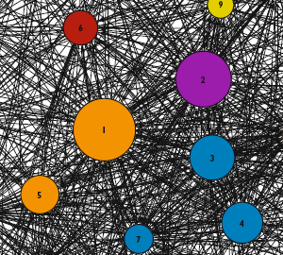
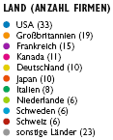
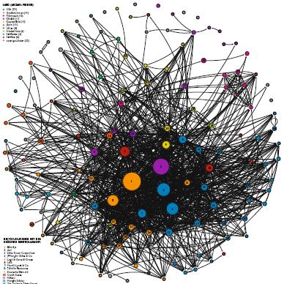
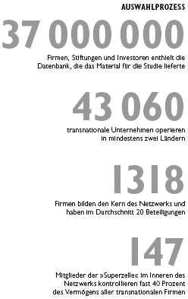
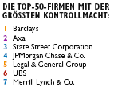

Network Analysis of Banking & Finance Organisations
Source:

Slide 14
Practical example
competence profiling:
  social competences
  personal competences
  professional competences
  technique competences
  Leadership competences

Slide 15
Human Capital - Ideas
for instance:
Prof. Eduard E. Lawler III, USA, Development: Human-Capital-Measurement 1970-1980 as well as political implications for enterprises, shareholder and state,
Prof. David P. Norton, USA, developed Balanced Scorcard under the criteria of measurement of Intangible Assets,
The book: „Humanvermögensrechnung“ von Dr. Herbert Schmidt im Jahr 1974 and
Flamholt´s Buch: Human Resource Accounting, published 1974,
Introduction of Human Resource Accounting (HRA) at Barry Corporation, USA,1972,
HC-Measurements at the enterprise SKANDIA (Skandia Navigator)
HYPO-BANK, Germany, Realisation of the Human-Capital-Measurements via Employee-Value-Index (EVI) 1990,
Buck Consultants of Mellon Financial: Development of a EVi-Expected Value of the individual (EVi represents the value of a individual for the organisation as minimum of the expected partitional contribution to the profit of the organisation)
Intellectual Capital Report (Wissensbilanz) of the Austrian Research Centers ARC (2003)
Intellectual Capital Report-Act (Wissensbilanz) for Austrian Public Universities (2004)

Slide 16
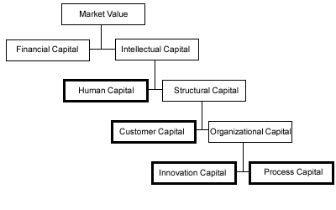
Scandia Navigator:

Slide 17
Human Capital - Models
Input Models: value of the HC = in employee invested sum of money
  Output Models: value of the HC = from employee earned profits
  Comparison Value Models: value of the HC = difference between at the employment market potentially achievable value and the transacted investments
    Indicator Models:
  often only listings of indices
  mostly approximations

Slide 18
scheme of HC-models
Input Models:
  HumanAssetWorth (Mayos 2001)
  Value Added Intellectual Coefficient (Public 1998/2000)
  Output Models:
  Accounting for the Future (Nash 2003)
  Calculated intangible Value (NCI Research, Stewart 1997)
  Human Capital Pricing Model (Bender/Röhling 2001)
  ROI on Human Capital (Fitzenz 200)
  Knowledge Capital Scoreboard (Lev/Bothwell 2001)
  EVi - (expected value of the individual) (Buck Consultants)

Slide 19
scheme of HC-models
  Comparison Value Models:
  Excellence Modell (EFQM) (European Foundation for Quality Management, Brüssel)
  Global Human Resources Survey Report (PriceWaterhouseCooper, 2003)
  TRI*M Index (NFO Infratest)
  Overall Human Capital Index (Watson Wyatt)
  Ranking: Attractive Employer (Hewitt 2001)
  Value Creation Index (Cap Gemini Ernst & Young,
  1997/2000)
  CIPD Framework (Scarborough/Chartered Institute of Personnel& Development 2003)
  Intellectual Capital Ranking (Edvinsson2000)
  Human Capital Value (Human-Capital-Club e.V. Munich, Ge, 2003)
  Intellectual Capital Audit (Brooking 2000)

Slide 20
scheme of HC-models
      Indicator Models:
    Intangible Assets Monitor (Sveiby 1986/87)
    Skandia Navigator (Edvinsson 1991)
    Intellectual Capital Navigator (Stewart 1995)
    Human Resource Scorecard (Becker/Huselid/Ulrich 2001)
    Human Capital Indicator (Mercer 2001)
    Werttreiber-Modell (Wucknitz 2002)
    (value driver-Model)

Slide 21
scheme of HC-models
      Saarbrücker Formel (formula):
Value Basis
Value Loss
Value Compensation
Value Change

Slide 22
Practical example
competence profiling:
  social competences
  personal competences
  professional competences
  technique competences
  Leadership competences

Slide 24
Dr Gerhard Hanggi’s Model

Slide 25
Individual skill profiling
Defining skill profile for position “Production Controller”
Tasks | Skill profile | Description
Task 1-Control production costs | Personal competences | load-bearing capacity,credibility,goal oriented
 | Technique competences | critical thinker,conceptual skills,negoiation skills
 | Professional competences | strategy formulator,decion maker,problem solver
 | Social competences | conflict resolution ability,persuasive
Task 2-Processing customer orders | Personal competences | crediblity, assertiveness,goal oriented
 | Technique competences | negotiation skills, language skills
 | Professional competences | delegation capabilites, problem solver
 | Social competences | social intelligence, conflict resolution
Task 3-Investigate production problems | Personal competences | willingness to change, assertiveness, load bearing capacity
 | Technique competences | negotiator,structured thinking
 | Professional competences | decision maker, problem solver
 | Social competences | conflict resolution, flexibility

Slide 26


Users of Dr Hanggi’s model:

Slide 27
Practical example
Kompetence Radar

Slide 28
Practical example
Assessment Center:
development of arrangements
potential assessment
strengths-weakness-profil
Simulations
(exercises)
observation/
rating system
Profil of qualification
structure of a assessment center

Slide 29
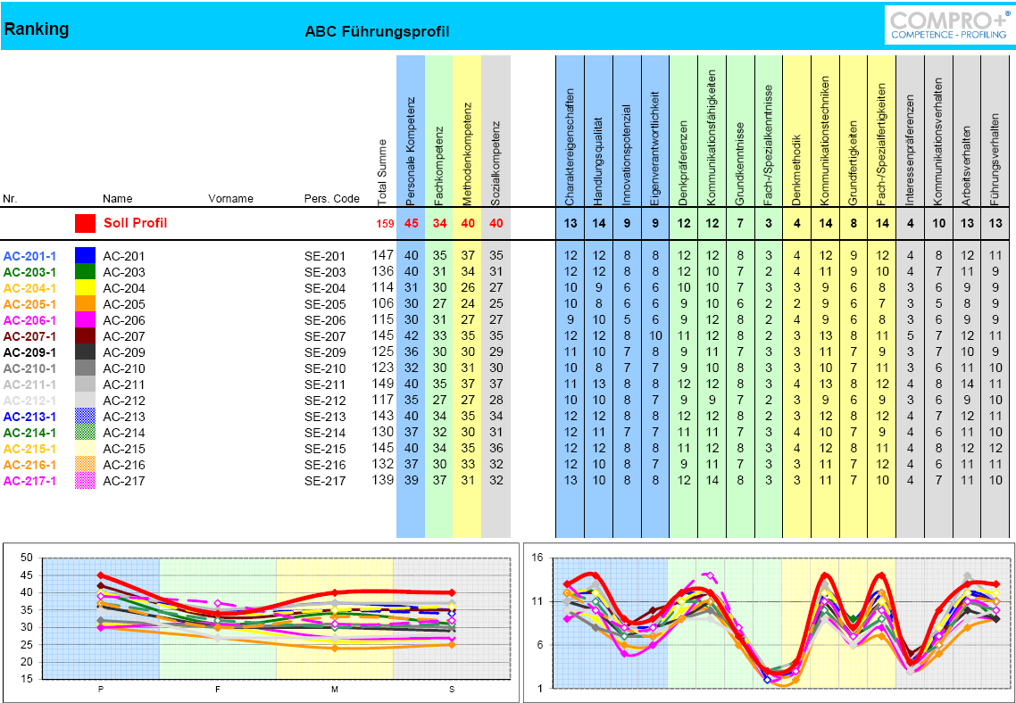

Slide 30
Contact:
Dipl.-Ing. Johannes GOELLNER, MSc email: johannes.goellner@meinesteuerberatung.at
1030 Vienna, Marxergasse 13/10, Austria mobil: +43-(0)650-22529991

Slide 31
Thank you for your attention.
Questions ?

