Slide 1
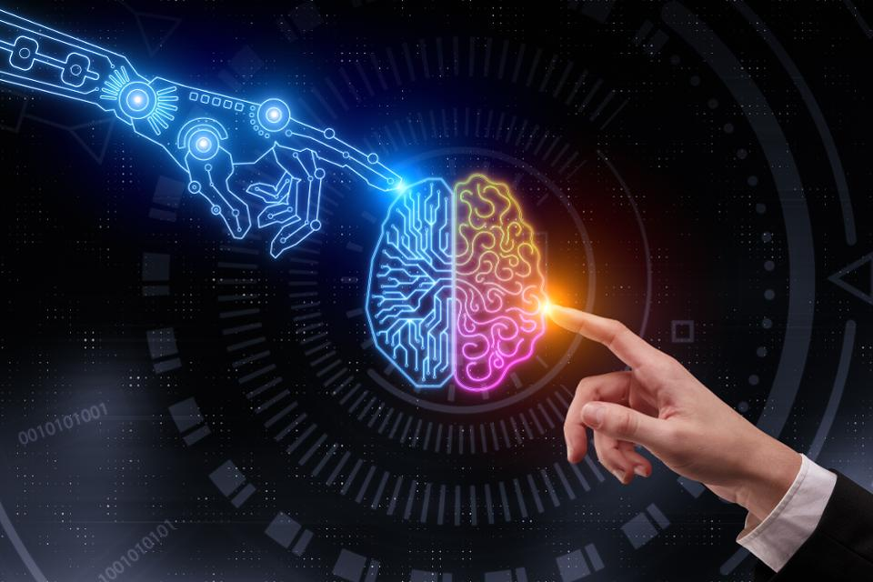

Slide 2
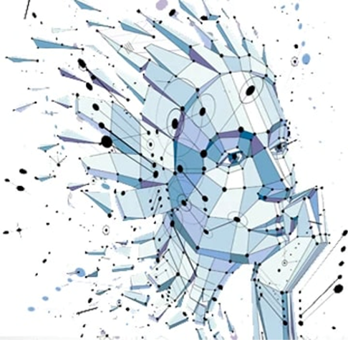
Artificial intelligence in human resource management
Adelia Gafurova | Noelia Medina Jurado | Taher Al-ahwal

Slide 3
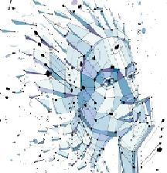
What is artificial intelligence (AI)?
Development of “thinking” computer systems
Deep Learning
Natural Language Processing
Machine Learning
Robotics
Predictive Analytics
Expert Systems
Image Recognition
Knowledge Engineering
Neural network(s)
Process Automation
AI in HR

Slide 4
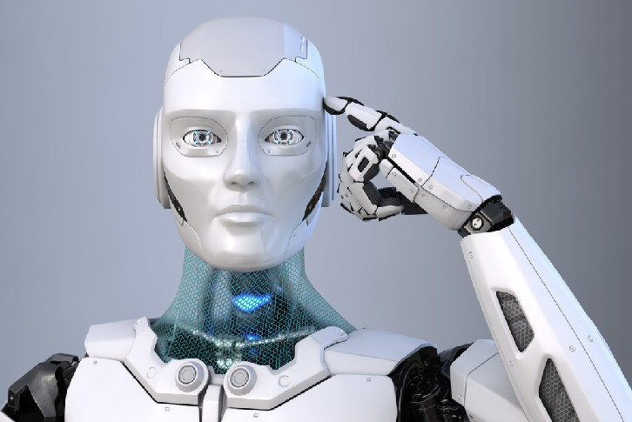
What is artificial intelligence (AI)?
Definition:
AI the ability of a machine to perform cognitive functions associated with human minds (such as perceiving, reasoning, learning, and problem solving), includes a range of capabilities that enable AI to solve business problems – by the use of algorithms.
AI is pushing humans and machines closer together.
Is it?!
AI in HR

Slide 5
Where is ai used?
Wherever tasks call for intelligent, analysis-based behavior.
Main uses in:
Telecom
High-tech
Financial services
2017 : 20% used AI
2018 : 47% used AI
Popularity of AI is increasing.
AI in HR

Slide 6
does ai have added-value?
1%
McKinsey & Company
Global Survey:
41%
AI in HR

Slide 7
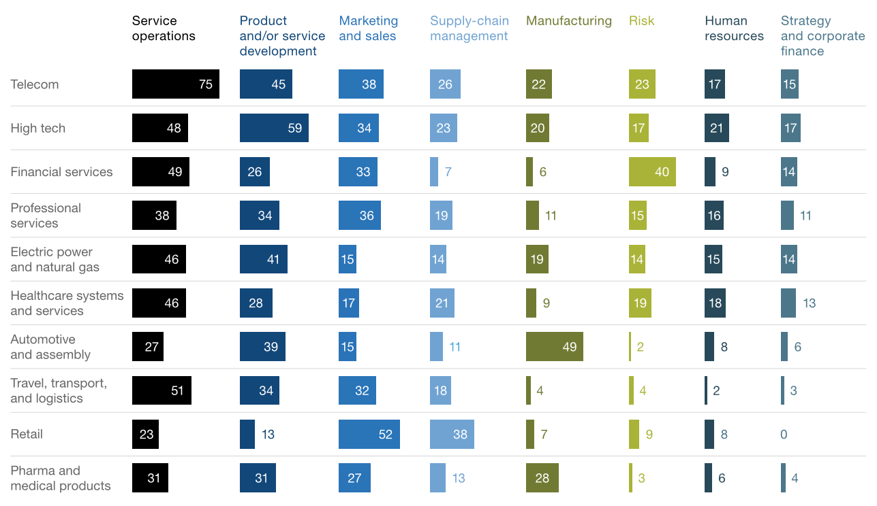
ai in different business functions?
AI in HR

Slide 8
Ai in hr
Exploring
AI-supporting applications designed to improve operations
Recruitment (Talent Acquisition)
Automation of Administrative Tasks
Onboarding
Employee Training
Retention
Knowledge Sharing
AI in HR

Slide 9
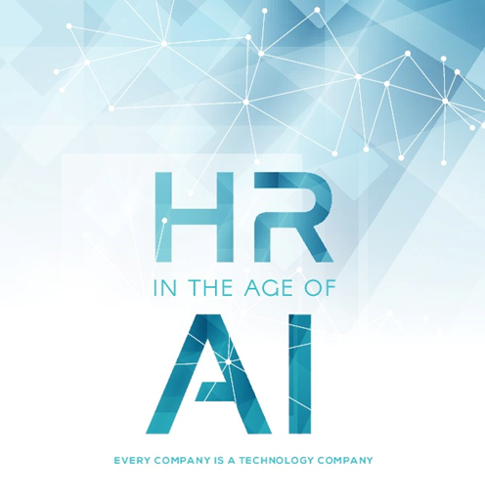
What does that mean??
AI in HR

Slide 10
1. Recruitment (Talent Acquisition)
The ability to identify suitable candidates accordingly to Job Descriptions.
Speeding up the preliminary screening processes (100’s of applications in fraction of time). Is there a problem ??!
YES. Possible Loss of Creativity would go unrecognized
AI helps eliminate human bias.
Managers use AI to search database of past applications of new positions.
According to Forbes, by using AI 16% increase in competitive advantage in talent acquisition.
AI in HR

Slide 11
2. Automation of Administrative Tasks
Pre-screening questions and interview scheduling to speed up recruitment process.
Allocating office space and providing certain equipment saves HR staff time.
Study shows 19% increase in effectiveness in administrative tasks done by HR using AI-supported software.
What is a smart chatbot?
Use of smart chatbots give instant access to loads of company-related information.
Chatbots give HR staff good knowledge and holistic view of the organization.
AI in HR

Slide 12
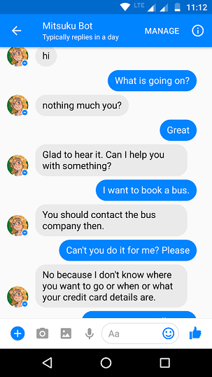
2. Automation of Administrative Tasks
It is a bot made to chat about anything, which is one of the main reasons that make it so human-like
Talk to Mitsuku for hours without getting bored.
It replies to your question in the most humane way and understands your mood with the language you’re using
AI annual competition prize (Loebner) awared to Mitsuku chatbot.
AI in HR

Slide 13
2. Automation of Administrative Tasks
Employee doubts about policies and procedures can be resolved by way of simple queries with prompt answers.
Submission and processing of leave forms.
Decreasing ‘low-value’ tasks helps HR focus/improve workplace bonds and relationships.
AI in HR

Slide 14
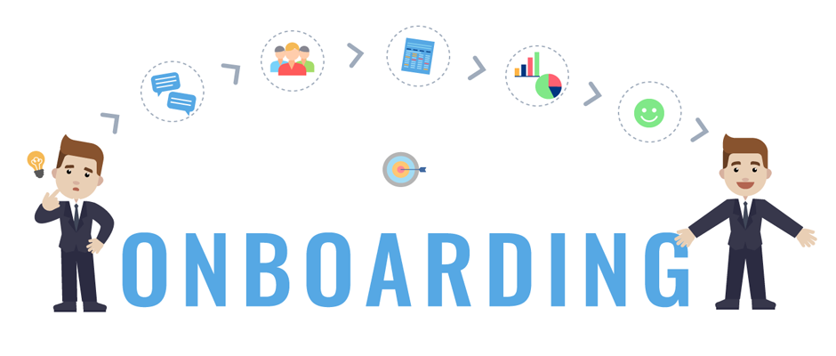
3. Onboarding
With the use of artificial intelligence, onboarding can be customized to individual employees, their position and tasks.
AI algorithms can be used for:
briefing about job profile, tasks, benefits
informing employees about important company contacts
identifying and answering repetitive employee questions
verifying documents
AI in HR

Slide 15
3. Onboarding
A crucial part of successful employment.
Glassdor: strong onboarding improves new hire retention by 82% and increases productivity by 70%
Click Onboarding: ~ 75% of employees “are more likely to stay with a company for three years if they experienced great onboarding.”
AI in HR

Slide 16
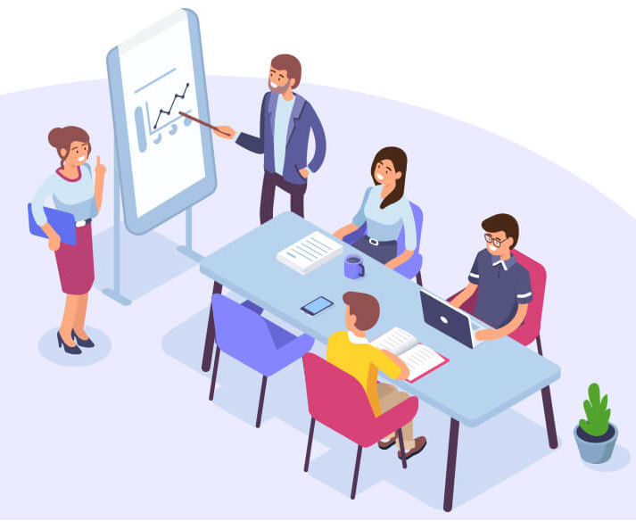
4. Employee Training
Use of large databases of job profiles and skills to tailor training programs.
Personalized training to fill skill gaps and polish existing ones.
Career pathing: draw possible career directions.
AI in HR

Slide 17
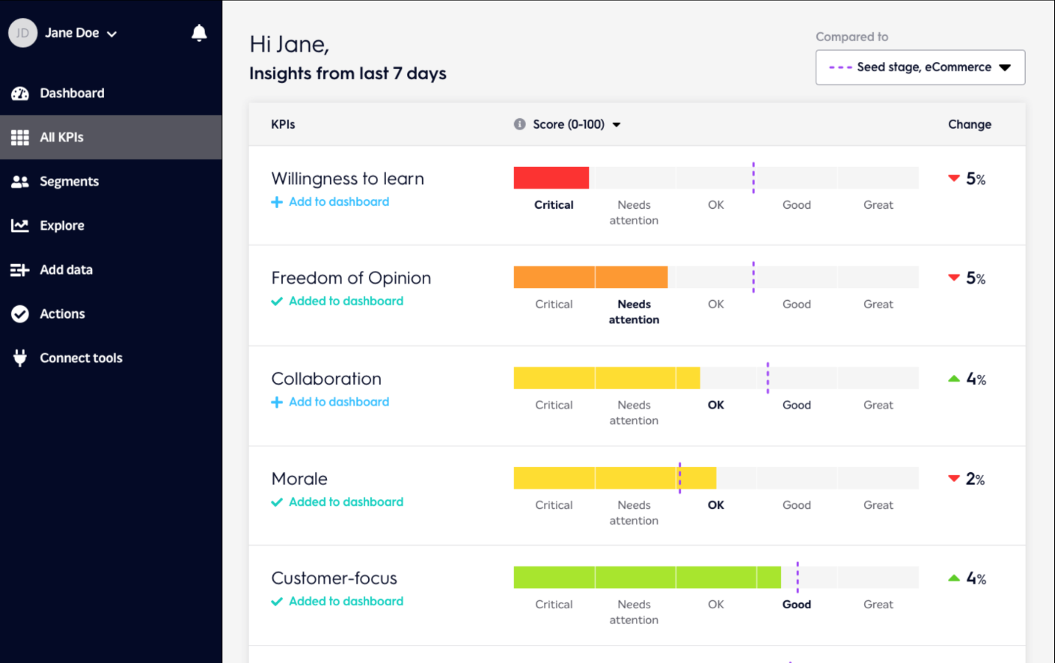
5. retention
AI-based analysis of individual preferences and employee performance helps HR Dept. identify who should get a raise and who is likely to resign.
AI applications predict which employee plans to quit, with 95% accuracy, e.g, IBM AI Tech.
Identifying who might quit helps HR Dept. decrease talent lose.
Retention-oriented AI technologies prepare surveys and reward systems.
Bunch.ai app - real-time culture and employee
engagement insights
AI in HR

Slide 18
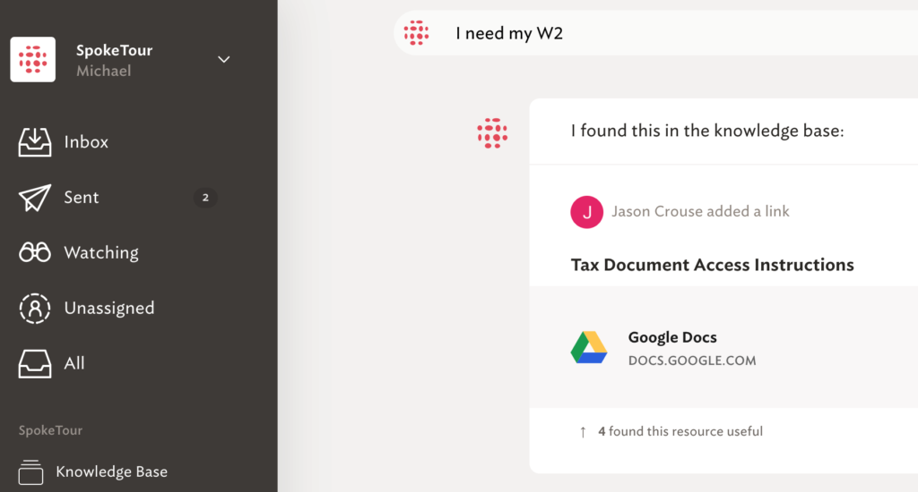
6. Knowledge sharing
Use of new technologies—semantic search, natural language processing, and machine learning—to make it easier for employees to find the knowledge they’re looking for quickly and easily.
AI-powered tools help you connect and combine knowledge across multiple systems, giving all employees access to knowledge regardless of where it lives.
AI in HR

Slide 19
popular ai applications for hr
TextRecruit – recruiting automation
GoHire – recruiting automation
Workday – focuses on leveraging employees potential (retention and training).
Ascendify - focuses on leveraging employees potential (retention and training).
Everwise - focuses on leveraging employees potential (retention and training).
Spoke – allows knowledge sharing across functions; helps HR keep employees’ knowledge up to date.
AI in HR

Slide 20
To ai or not to ai?
Advantage: AI improves HR processes; thus, increases productivity.
Challenges:
lots of data has to be properly stored and managed
additional talent required to operate and maintain AI software
the dilemma of how to balance between human-centric management on one hand, and automated scalability on the other.
AI in HR

Slide 21
discussion
Chris Taylor (Chief Human Resource Officer at Buy Canada) says AI helps Human Resource Management become more human because it allows them to FOCUS on the “critical thinking, creativity and empathy”, while AI does the rest of the tedious and time consuming tasks.
Because HR is everything that has to do with humans, do you think having AI software dictate HR processes and decisions will turn us eventually into robots? Remember, AI increases company’s productivity , reduce bias, and decreases operational costs!
AI in HR

Slide 22
References
https://chatbotsmagazine.com/which-are-the-best-intelligent-chatbots-or-ai-chatbots-available-online-cc49c0f3569d
https://www.monterail.com/blog/ai-transforming-hr
https://www.thesaurus.com/browse/artificial%20intelligence
https://www.hrexchangenetwork.com/hr-tech/articles/ai-in-hr
https://www.mckinsey.com/featured-insights/artificial-intelligence/ai-adoption-advances-but-foundational-barriers-remain
https://www.monterail.com/blog/digital-transformation-with-hr-tech
https://www.google.com/search?q=ai+in+hr&rlz=1C1FGUR_enCZ839CZ839&sxsrf=ACYBGNQBGZENQBr_nawWCugWlC530AVhew:1574531817323&source=lnms&tbm=isch&sa=X&ved=2ahUKEwjcxaKN9IDmAhVDJFAKHd0cDGgQ_AUoAXoECBAQAw#imgrc=I_MmKmPtSCYvEM:
https://www.forbes.com/sites/louiscolumbus/2018/09/23/5-ways-ai-can-help-solve-todays-talent-crisis/#532d9e1ba386
https://www.cnbc.com/2019/04/03/ibm-ai-can-predict-with-95-percent-accuracy-which-employees-will-quit.html
https://www.askspoke.com/blog/knowledge-management/ai-helps-knowledge-management/
AI in HR

Slide 23
Thank You
AI in HR

