Slide 1
EMPLOYEE ONBOARDING Issues and Recommendations
Human Resources Management
Ngoc H. Vu, UČO: 495670 | Enrique T. Palazuelos, UČO: 497742
Nara C. S. Silva, UČO: 497471 | María L. Barberá, UČO: 497585
Davit Hovhannisyan, UČO: 495675

Slide 2
Table of Contents
Introduction
Definition of employee onboarding
Importance of employee onboarding
Onboarding Issues
Lack of preparation on first day
Lack of role clarity
Informative isolation
Difficulty in navigating the culture
Unfriendly environment at work
Inefficient training program
Conclusion

Slide 3
What is employee onboarding?
Onboarding is
the process of introducing a new employee into his or her new job;
acquainting that employee with the organization’s goals, values, rules and policies, and processes;
socializing the employee into an organizational culture (Watkins, 2016)
Timeframe
From accepted offer to end of first year
Notes:
Effectively incorporating new employees can be a challenging task for HR and managers alike. With the expectation that the majority of new hires were there to stay for the long haul, traditional orientation programs consisted of a brief introduction to the company and a lot of paperwork. However, this task has become even more difficult with the entrance of a new generation of workers. Today’s top talent are looking for more than just a job and are not afraid to job hop until they find the right fit. In a recent survey by Korn Ferry, 90% of executives said retaining new hires was an issue in their company with turnover rates of 10-25% within the first 6 months alone.
Shockingly, a survey by Bamboo HR found that only 9% of HR managers don’t think their onboarding processes need to be improved. In fact, 43% went so far as to agree that “time and money are wasted because of ineffective onboarding processes.” A further 45% believe this could add up to over $10,000 per year.
https://blog.impraise.com/360-feedback/top-3-new-employee-onboarding-challenges
TinyPulse reports that:
91% of employees stick around for at least a year when organizations have efficient onboarding processes
69% of them stick around for at least three years when companies have well-structured onboarding programs
https://www.edgepointlearning.com/blog/how-to-train-new-employees/

Slide 4
Why onboarding is important?
Up to 20% of staff turnover occurring within the first 45 days of employment (Llarena, 2013)
CEOs are concerned about the retention rate, yet spent very little time on onboarding
The most effective organizations onboard new hires for the duration of their first year — their most vulnerable period (Carucci, 2018)
One research suggested that onboarding maybe the most critical process that has long-lasting influence on engagement, performance, and retention (Cable et al, 2013 and Cadwell, 2016)

Slide 5
Issues
Lack of preparation on first days
Lack of role clarity
Informative isolation
Difficulty in navigating the culture
Unfriendly enviroment at work
Inefficient training program

Slide 6
Lack of preparation on first days
Problem
Solution
New employees could feel totally disoriented or not being trained to do certain tasks in their first days
New hires know how important it is to make a good first impression early in their tenure, but it’s also important for companies to put their best foot forward for their newest team members. (Lavoie, A. 2014)
Consequences
Blocked interaction within the company
Mistrust towards the new worker
Companies should generate motivation to the new employee.
For example: a welcome card signed by the Human Resources Manager or deliver a welcome pack with the company policies, code of behavior, and so on
The new employee must have quick access to work documents, thus facilitating his task
Notes:
Problem
Sometimes new employees could feel totally disoriented or not being trained to do certain tasks in their first days
New hires know how important it is to make a good first impression early in their tenure, but it’s also important for companies to put their best foot forward for their newest team members. (Lavoie, A. 2014)
Consequences
Blocked interaction within the company
Mistrust towards the new worker
Solution
Companies should generate motivation to the new employee. For example, a welcome card signed by the Human Resources Manager or deliver a welcome pack with the company policies, code of behavior, and so on
The new employee must have quick access to work documents, thus facilitating his task

Slide 7
Lack of role clarity
Problem
Solution
Expectations and objectives are not clear to new employees
60% of companies report that they do not set short-term goals for new hires (Rollag et al, 2005)
Consequences:
low productivity
absenteeism
poor performance
Set up early wins
Assign tasks with an expectation that new hires to complete at the three, six, and nine-month milestones (Carucci, 2018)
Gradually increase the level of responsibility associated with each task
Discuss about the gap between the expectation and reality

Slide 8
Informative isolation
Problem
Solution
When an employee feels like a stranger in the team, because of unfriendly staff, no confidence in newcomer, lack of communication.
Consequence: decreased productivity and negative morale.
Difference between Informative isolation and workplace bullying: Just because someone feels informative isolated doesn’t necessarily mean that bullying is taking place
Employees aren’t getting what they need, their work suffers.
Engage in face-to-face conversations with your team members throughout the office.
Create a common database.
Make a welcoming events for the whole team.
Keep in touch with remote workers (employees who work offsite).
Redesign office, make boards with daily or monthly activities.
Notes:
We often are facing this problem, when an employee feels him like a stranger in the team, because of unfriendly staff, no confidence in newcomer, lack of communication. All these problems can lead to decreased productivity and negative morale.
It’s important to recognize the difference between Informative isolation and workplace bullying. Just because someone feels informative isolated doesn’t necessarily mean that bullying is taking place.
Employees aren’t getting what they need, their work suffers.

Slide 9
Difficulty in navigating the culture
Problem
Solution
New employees likely fail at their new jobs because of a poor culture fit.
"Creating a cultural onboarding experience helps new employees understand the unique culture they have become a part of and the challenges they will face" (Hillebregt, 2019).
Consequences
Not fitting into the company culture
Offer assistance to integrate them as quickly as possible - Assign a buddy (Klinghoffer et al, 2019)
Intensive multiple day program
Engage them into activities that captures your company’s culture (team lunches, happy hour, etc) (Llarena 2013)

Slide 10
Unfriendly/hostile environment at work
Problem
Solution
"A hostile work environment is created by a boss or coworker whose actions, communication or behavior make doing your job impossible." (Susan M. Heathfield, 2019)
Can discourage, chase away and depress your new employee
Make new employees feel comfortable and part of the project by:
Welcome the new employee to your team
Offer flexible schedules
Perform activities outside the office
Notes:
Microsoft has been working to improve its onboarding process. At the outset, we learned that a seemingly simple action — managers having one-on-one meetings with their new hires during their first week on the job — has outsized benefits. Through our continued research, we’ve also come to another conclusion: Onboarding buddies play an important role in ensuring a successful onboarding experience. While this may seem obvious, much like our findings on one-on-ones, it’s often missing in a new employee’s introduction to a brand new company. After piloting a buddy program involving 600 employees across the organization, we found that onboarding buddies help our hires in three key ways:
Bringing a new employee onboard is both an exciting and stressful time. And while managers play a critical role in shaping a new employees’ first weeks and months, a broader team effort can ensure the experience is both positive and productive.
Over the last few years, Microsoft has been working to improve its onboarding process. At the outset, we learned that a seemingly simple action — managers having one-on-one meetings with their new hires during their first week on the job — has outsized benefits. Through our continued research, we’ve also come to another conclusion: Onboarding buddies play an important role in ensuring a successful onboarding experience. While this may seem obvious, much like our findings on one-on-ones, it’s often missing in a new employee’s introduction to a brand new company. After piloting a buddy program involving 600 employees across the organization, we found that onboarding buddies help our hires in three key ways:
Onboarding buddies provide context. For tenured employees, the context surrounding most of their work has been so well established, it’s in the folds of every email written, every meeting attended, and every PowerPoint presented. For new hires, context is a precious commodity. Without it, a new hire will likely struggle to fully understand their role or how to contribute to their team’s success. Onboarding buddies can give the type of context you won’t find in the employee handbook. For instance, knowledgeable onboarding buddies can help new hires determine who relevant stakeholders are, how to navigate the matrix of different organizations, and think strategically when problem solving. They can also shed light on cultural norms and any unspoken rules that exist, which could lead to a much smoother transition into the organization.
Onboarding buddies boost productivity. Speed to productivity is often a concern for both the company and the new hire. By filling the position, the company satisfied the need for a certain skillset and now wants to see a quick return on its investment. Meanwhile, the new hire is likely experiencing the tension between wanting to ramp up quickly but also needing to take time to learn the job. At Microsoft, we found the more the onboarding buddy met with the new hire, the greater the new hire’s perception of their own speed to productivity: 56% of new hires who met with their onboarding buddy at least once in their first 90 days indicated that their buddy helped them to quickly become productive in their role. That percentage increased to 73% for those who met two to three times with their buddy, 86% for those who met four to eight times, and 97% for those who met more than eight times in their first 90 days. Clearly, that additional layer of support is critical to a new hire’s success.
Onboarding buddies improve new employee satisfaction. With over 120,000 employees, it’s not hard to imagine the overwhelming challenges one might face entering such a large and complex organization. In order to truly understand the value of onboarding buddies, we looked at the difference in hires who were assigned onboarding buddies versus those who were not. Our research found that after their first week on the job, new hires with buddies were 23% more satisfied with their overall onboarding experience compared to those without buddies. This trend continued at 90 days with a 36% increase in satisfaction. Those with buddies also reported receiving more active support from both their manager and the broader team.

Slide 11
Inefficient training programs
Problem
Solution
Boring orientation program with overload of paperwork and information (Brown, 2019)
New hires have to go sit through lectures about health insurance, paid time-off, and company policy.
Lengthy presentations and instructions
Time consuming for both trainers and trainees
Review training materials, make sure to keep only essential information and remove unnecessary one
Make your training interactive (Nornberg, 2013)
Quizzes
Hand—on experiences
Video interaction
Involve robots (Davis, 2017)
Notes:
Developing a solid new hire training program is an important management skill. More than just showing new employees where the coffee maker is and how to get their parking permit, training new employees procedures helps employees settle into the rhythm of the company to focus on the most important thing: their job.
How to train new employees effectively
Developing a solid new hire training program is an important management skill. More than just showing new employees where the coffee maker is and how to get their parking permit, training new employees procedures helps employees settle into the rhythm of the company to focus on the most important thing: their job.
While your exact onboarding tasks may differ, these best practices for employee onboarding help you get your employees up-to-speed, whether they’re hourly, C-suite, or anywhere in between. And, they’re just as useful for in-office and remote employees. This is how to put together your new hire training program:
Establish your new employee procedures, beforehand
Ensure that all managers use a new hire training checklist
Start onboarding before day one
Include onboarding best practices into your procedures
Train for culture, not just topics
Build in regular reviews and adjustments to your training program
Let’s look at each of these in more detail.
http://www.yourtrainingprovider.com/blog_main/training-new-employees-the-challenges-and-solutions

Slide 12
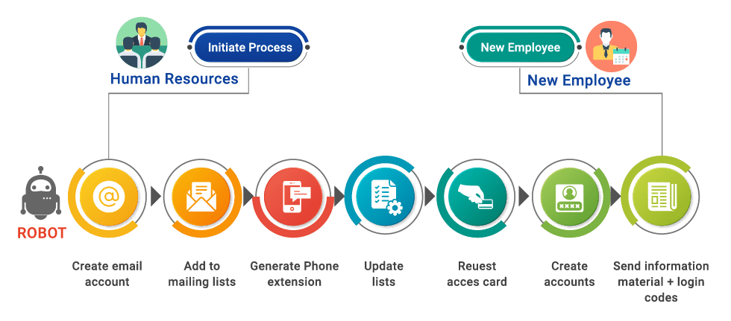
Example of involvement of robots
Diagram: Involvement of robot in onboarding process
Source: Automation Edge

Slide 13
Inefficient training programs
Problem
Solution
Inconsistent training materials and styles (Lightfoot, 2019)
Different trainers are involved
Difficult to ensures these trainers follow the same teaching styles and agenda
Follow an agenda and mandate use of the same materials
Create online training where possible. This will minimalize the inconsistency
Create trainer guidelines, briefing ground rules and desire styles, mandate the same lengths, templates
Create trainer checklist
Implement outcome tests on trainees to identify knowledge gap

Slide 14
Conclusion
Onboarding is an important process, yet underestimated in many enterprises
Effective onboarding program helps increase retention rate, productivity, and cultural integration
Currently, there are certain weaknesses in onboarding program that hinder employees from committing to the organization
HR should be aware of these problems and be creative when designing onboarding program, engaging technology such as HR software, robot, or AI to reduce burden

Slide 15
THANK YOU!

